Slide 1
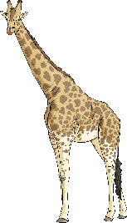
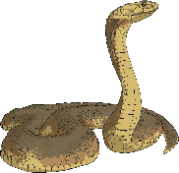
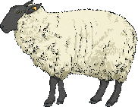
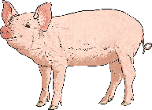
Nutrients for Animals
Although the Eatwell Guide provides human beings with guidance to know how much of different kinds of foods to eat, the guide does not apply to other animals.
Some animals need to eat more of certain nutrients than others. There are special terms for animals that eat particular types of foods.
Carnivores: These animals feed on other animals.
Herbivores: These animals only eat plants.
Omnivores: These animals eat both meat and plants.
Carnivores | Herbivores | Omnivores

Slide 2
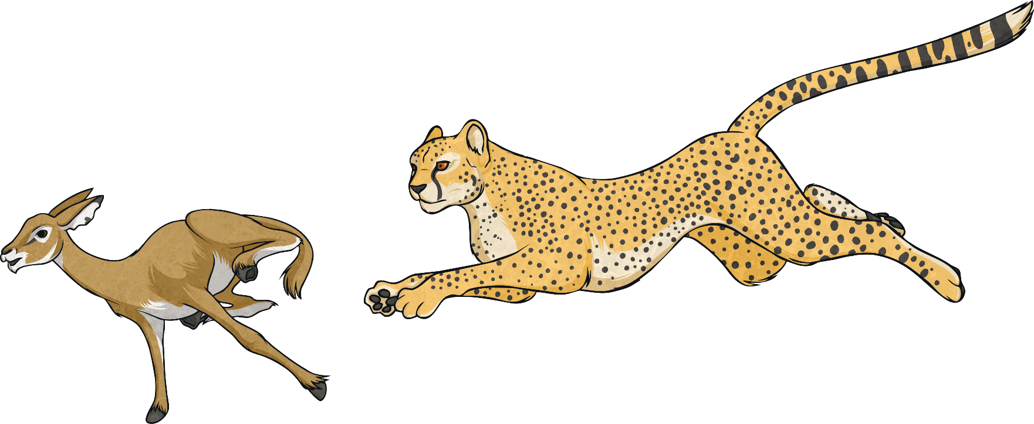
Nutrients for Animals
Carnivores eat lots of meat so they get lots of their energy from protein rather than from carbohydrates. Their bodies are designed for this.
A carnivore’s diet is mostly made up of protein but meat also provides vitamins, minerals and fats.
Although carnivores have a diet which is high in protein, not all carnivores require the same balance of nutrients.

Slide 3
Herbivores
Herbivores get their energy from eating plants. As plants are often not high in carbohydrates, protein and fats, herbivores have to eat large amounts of plant-based foods to get the energy they need. Some herbivores spend a lot of their day eating.
While some herbivores eat a wide variety of plants, others will only eat a limited number of types, meaning that they consume a smaller range of vitamins and minerals.
Koalas, on the other hand, only eat eucalyptus tree leaves. These leaves do not provide high levels of energy for these animals but as koalas sleep for twenty hours a day, they need less energy than other animals.
Elephants eat a wide variety of plant foods such as branches, fruit, grasses and leaves.

Slide 4
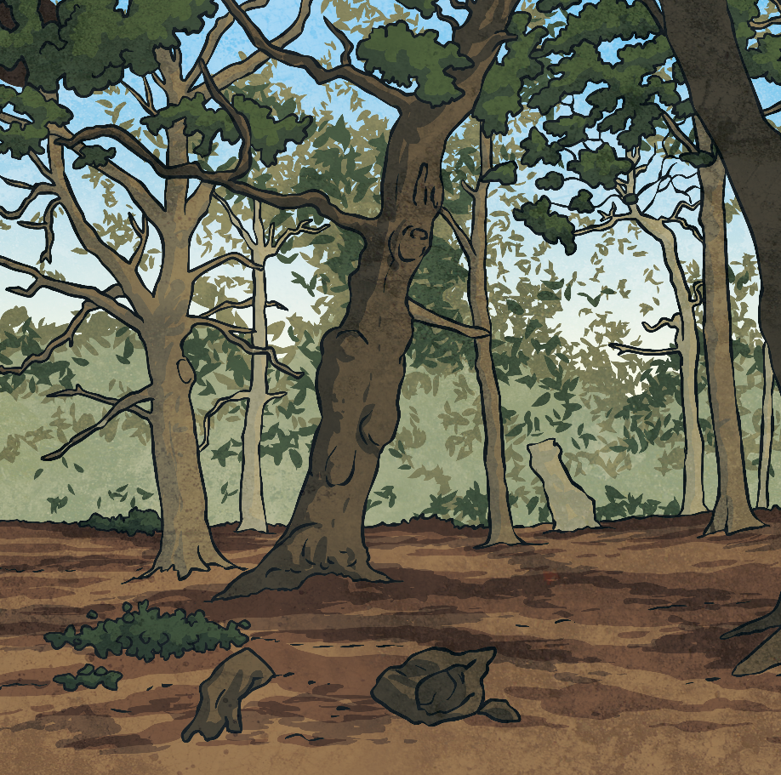
Omnivores
Omnivores get their nutrients from both meat and plants. Omnivores can therefore be more flexible in what they eat, often only eating what is available to them.
For example, a brown bear will eat fish when it can catch them in a river, but it will also pick berries to eat if they are available.
Different omnivores vary in the balance of nutrients they require.
Even pandas, who are famous for eating bamboo for most of their day, occasionally eat rats or birds they catch or find.

