Slide 1
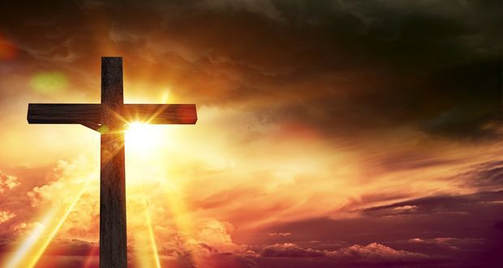
Was Jesus the Messiah?
Lesson 3

Slide 2
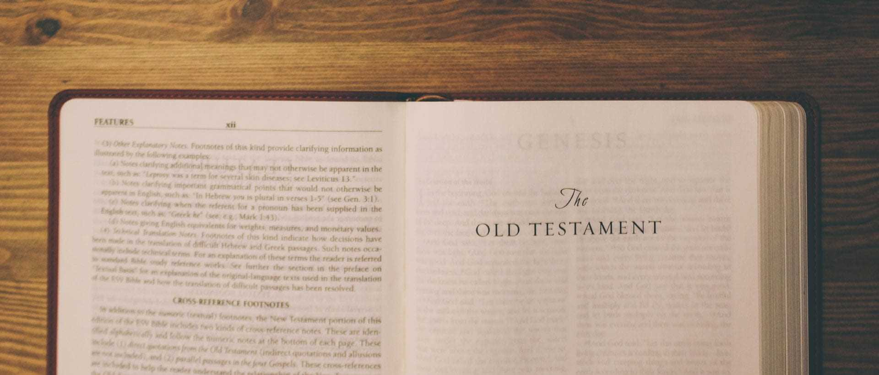
LI: To show how Christians put their beliefs about Jesus's incarnation into practice in different ways in celebrating Christmas.

Slide 3
I would like you to write down as many words as you can think of to do with Christmas.

Slide 4
Have a look at the words you have written down.
How many are to do with Christianity and Jesus?
Are there a lot? Are there none?
Why do you think this is?

Slide 5
For Christians, Christmas is a time of celebration of the arrival of the Messiah.
Many Christians argue that Christmas has lost its real meaning.
The Christian Church uses Advent as a time of preparation for the arrival of Jesus.

Slide 6
Can you think of three good reasons why Christians want to make Christmas about Jesus Christ?
‘Christ’ is the Greek word for ‘anointed one’, or ‘Messiah’.

Slide 7
It is important to recognise that Christians do not just believe that Jesus was an Old Testament prophet, or a messenger — they are convinced that Jesus was God in the flesh.
Jesus has an important place in the ‘big story’ of the Bible — he was the central part of God’s rescue mission to bring people back to him, healing the effect of sin and to create peace again.

Slide 8
What do Christians do at Christmas?
Have a think, and note down some ideas.
How do some Christians bring peace, good news, and show Jesus’s love to others at Christmas?
You might want to look at the work of www.presentaid.org or Christmas dinner on Jesus www.urbanoutreach.co.uk
These will give you some extra ideas.

Slide 9
I would like you to create a poster with 2 halves.
One side which shows how atheists (people who don't believe in any God) celebrate Christmas and then the other half which shows how Christians celebrate Christmas.
You should show the comparison between the real meaning of Christmas and what has developed over time.
You may need to research before you start your poster.
Atheist
Christian
Example

