Slide 1
Thursday 4th February

Slide 2
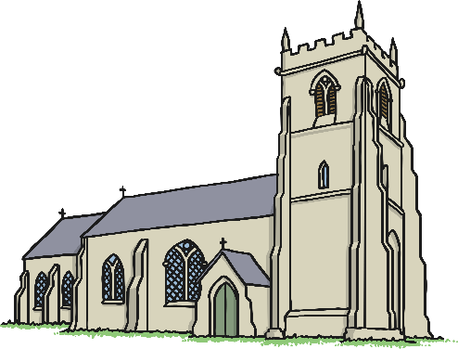
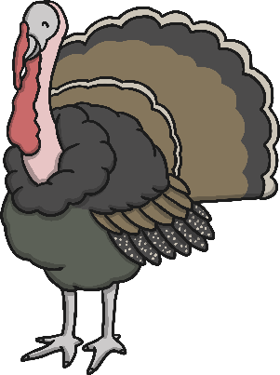
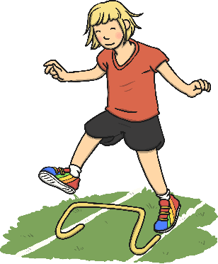
Phonics - Phase 3
Can you guess our phoneme today. Say each word and listen for the common phoneme.

Slide 3
Our phoneme today is…
hurt
curl
ur
fur
turn
Can you say these words with our phoneme in? See if you can sound out the words then blend to read

Slide 4
I Spy
I spy with my little eye, something with the phoneme…
Look around your house and make a list of all the things you can see which
have the ‘ur’ sound.

Slide 5
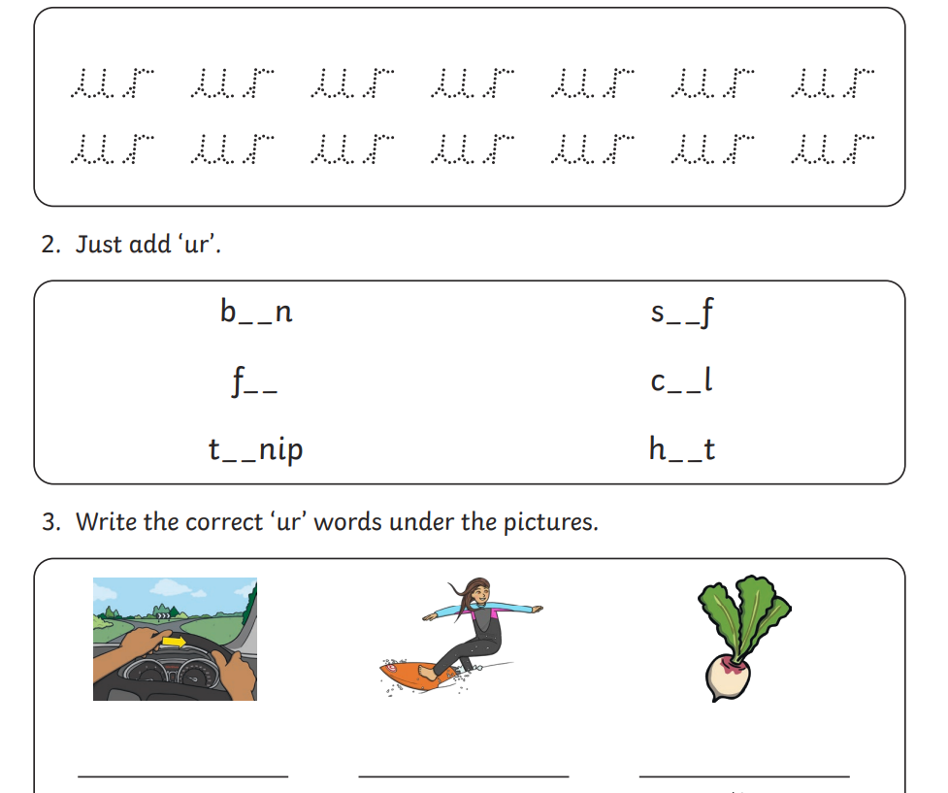
Turnip
Journey
surf

