Slide 1
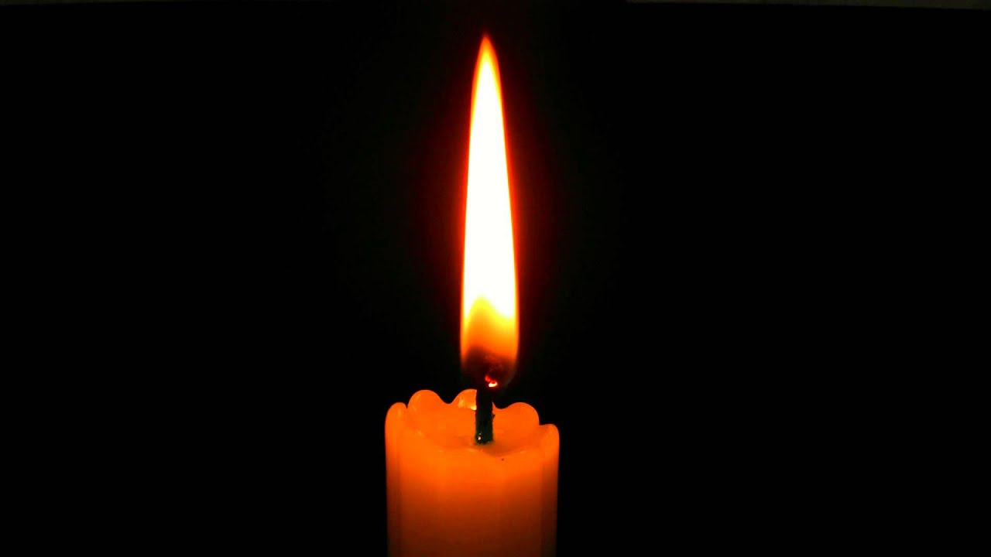
We come together in the name of God the Father, Son and Holy Spirit

Slide 2
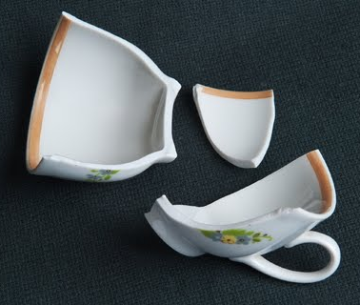
Have you broken anything recently?

Slide 3
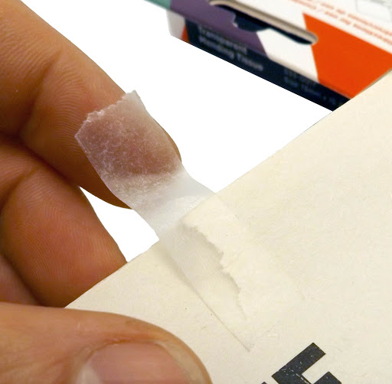
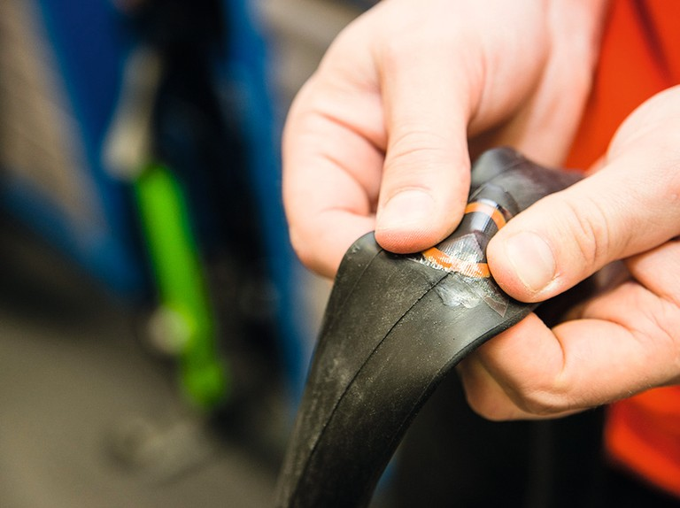
Some things which get broken can’t be mended. However if we care for our environment, it is a very good idea to try and mend things which have been damaged.
For example, a puncture in my bike tyre or a ripped page in a book.

Slide 4
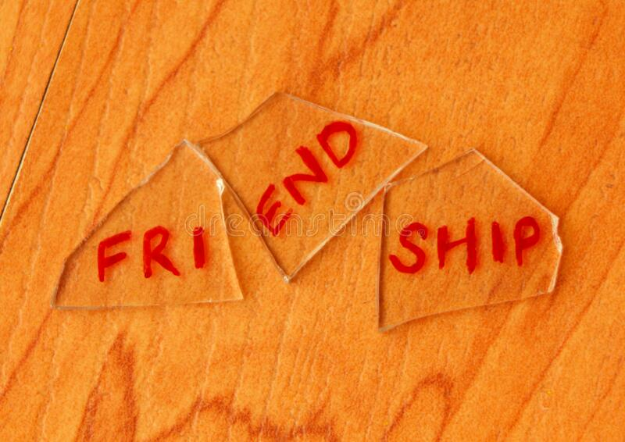
How do you mend a broken friendship?

Slide 5
The Parable of the Unforgiving Servant

Slide 6
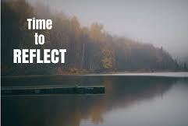
What do you think the theme of our worship is today?

Slide 7
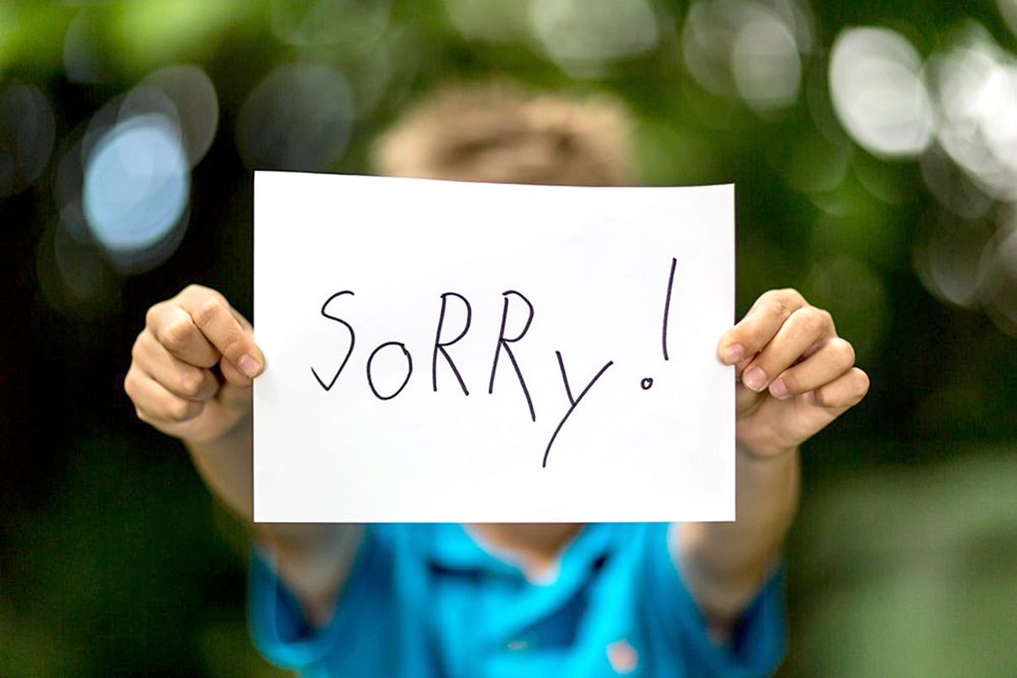
What kind of things do you need to say sorry for?

Slide 8
What might I use to mend a broken friendship?
FORGIVENESS

Slide 9
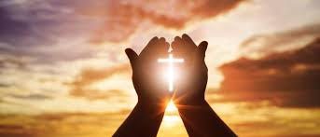
Dear Lord,
Thank you for today’s Bible story about forgiveness.
Thank you that if we say sorry to you, you give us a fresh start.
Please help us to be forgiving people here in this school.
Amen

