Slide 1
Thursday 21st January

Slide 2
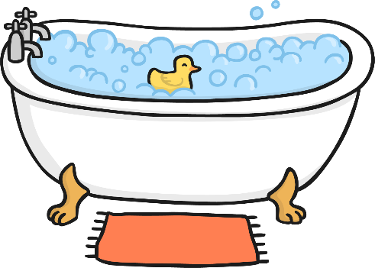
Phonics - Phase 3
Can you guess what our phoneme is today?
13

Slide 3
Our phoneme today is…
Can you read the ‘th’ words?
them this
that then
with thin
Can you find some parts of your body that have our phoneme in?
th

Slide 4
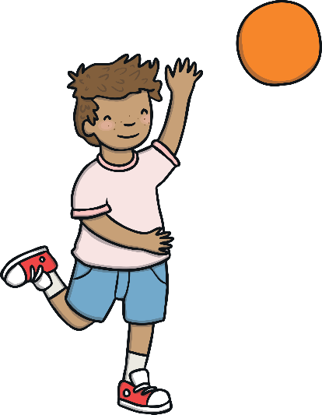
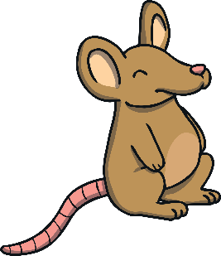
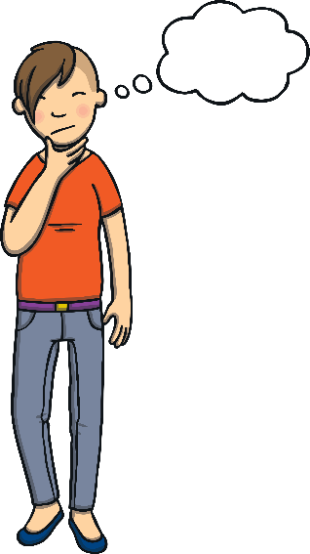
Click the pictures that begin with ‘th’ to move them into the middle.
th
3
13
x
x

Slide 6
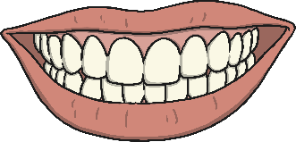
Words with the ‘th’ Sound
Write the word that goes with each picture. When you are sure you have spelt the word correctly, click on the picture and the word will appear. Check your spelling!
mouth
thumb
bath
thistle
cloth
path
moth
three

