Slide 1
Friday 22nd January

Slide 2
Phonics - Phase 3
Can you remember the phonemes that we have learned?
See how quickly you can move through the slides saying each phoneme out loud.

Slide 3
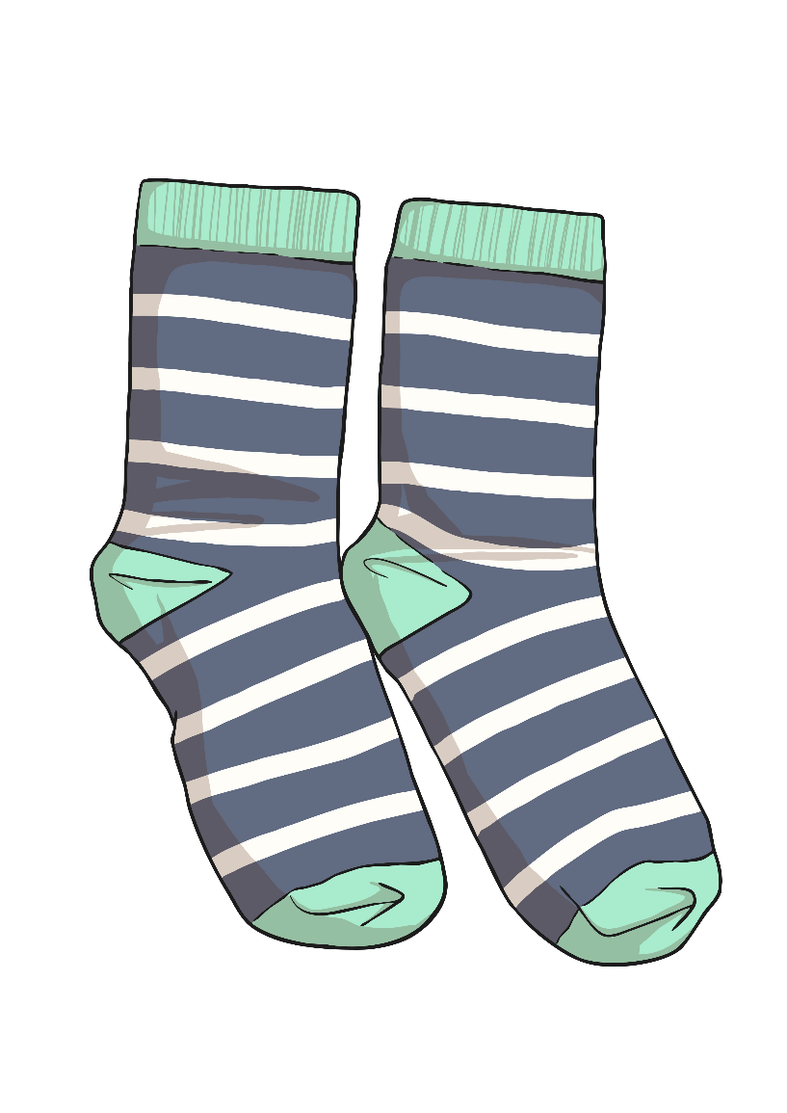
s

Slide 4
t

Slide 5
a

Slide 6
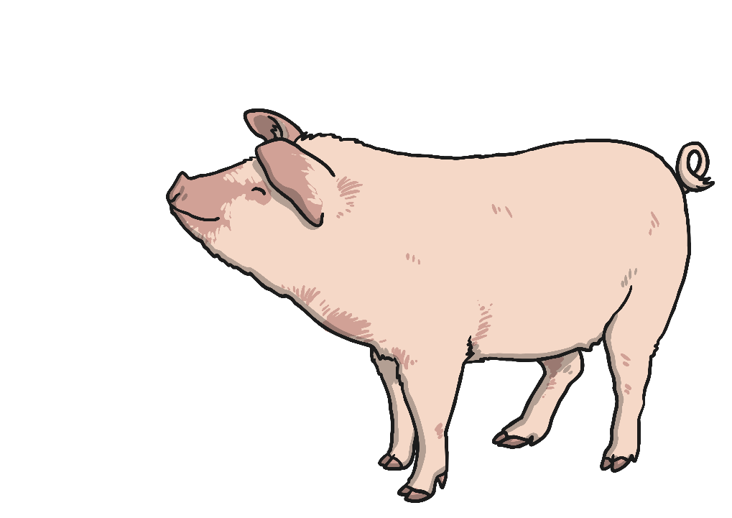
p

Slide 7
i

Slide 8
n

Slide 9
m

Slide 10
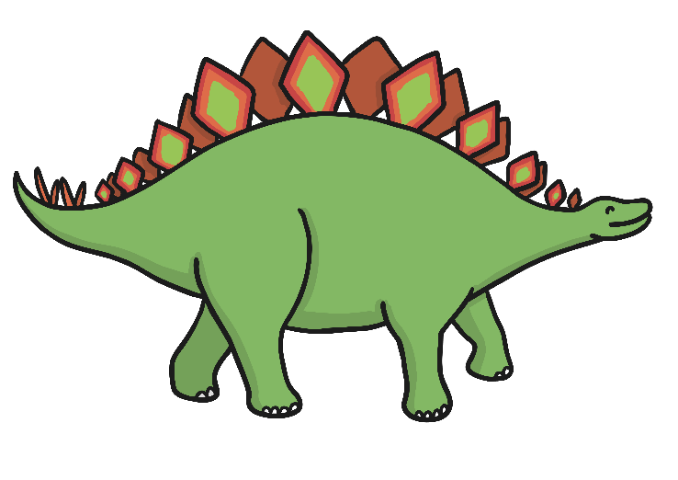
d

Slide 11
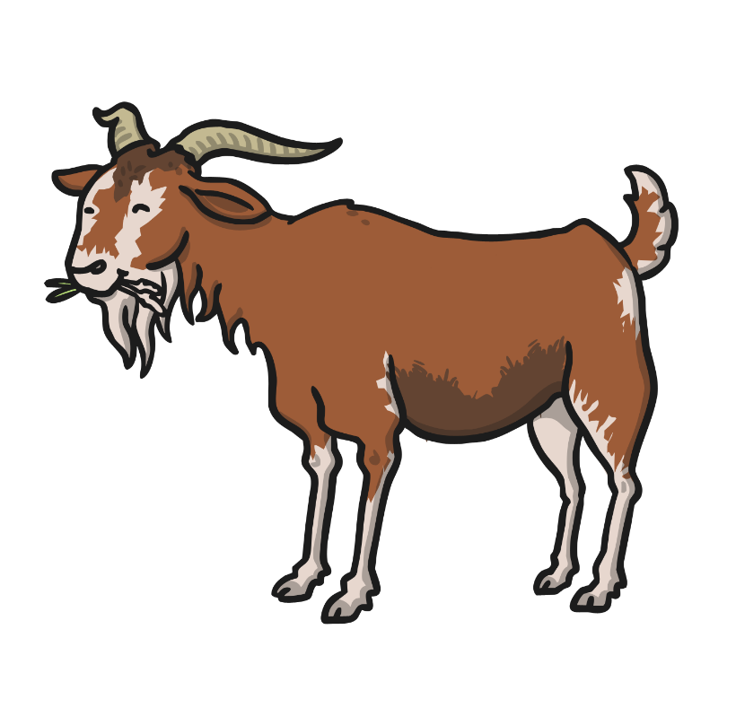
g

Slide 12
o

Slide 13
c

Slide 14
k

Slide 15
ck

Slide 16
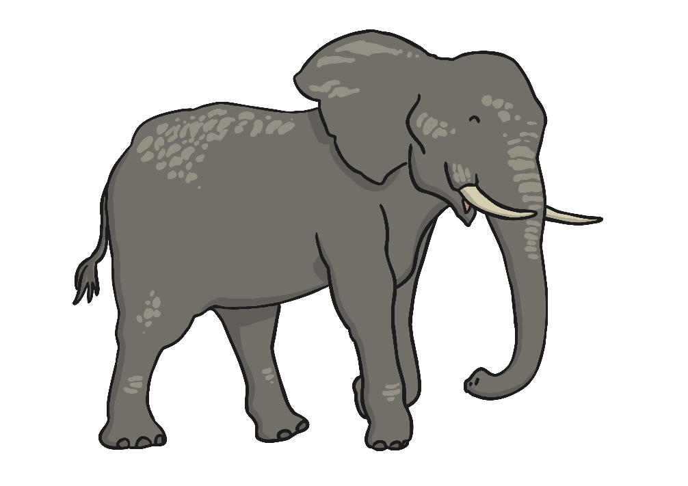
e

Slide 17
u

Slide 18
r

Slide 19
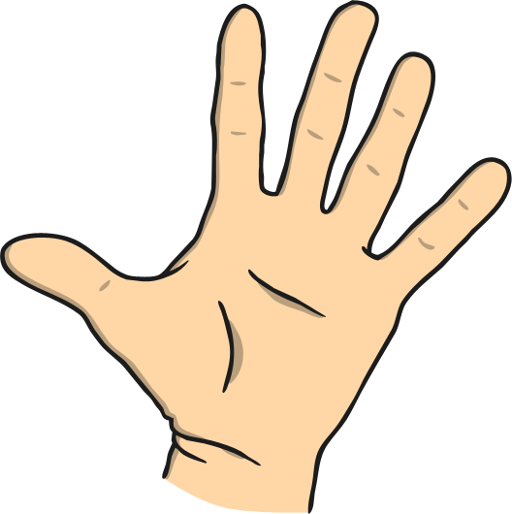
h

Slide 20
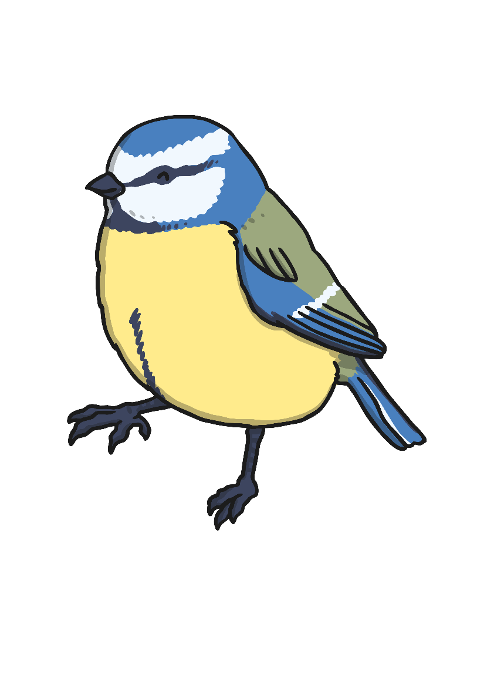
b

Slide 21
f

Slide 22
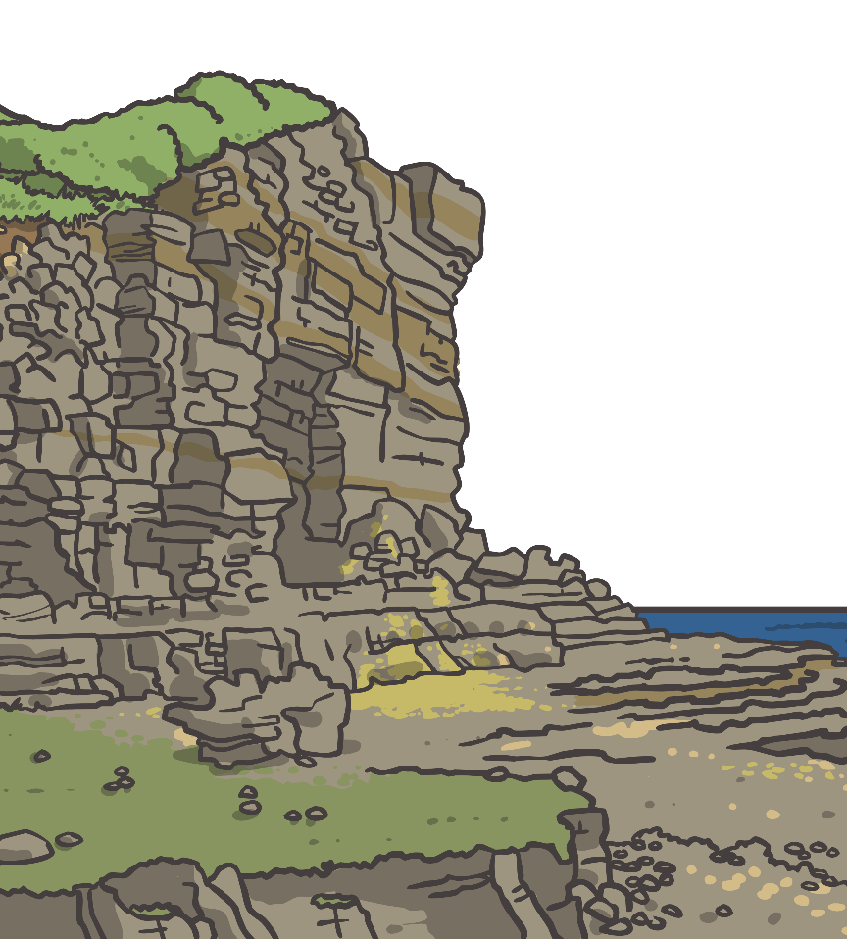
ff

Slide 23
l

Slide 24
ll

Slide 25
ss

Slide 26
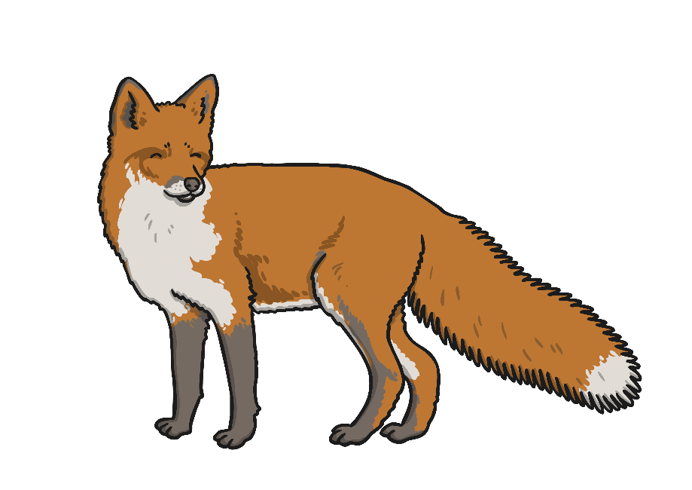
x

Slide 27
j

Slide 28
v

Slide 29
w

Slide 30
y

Slide 31
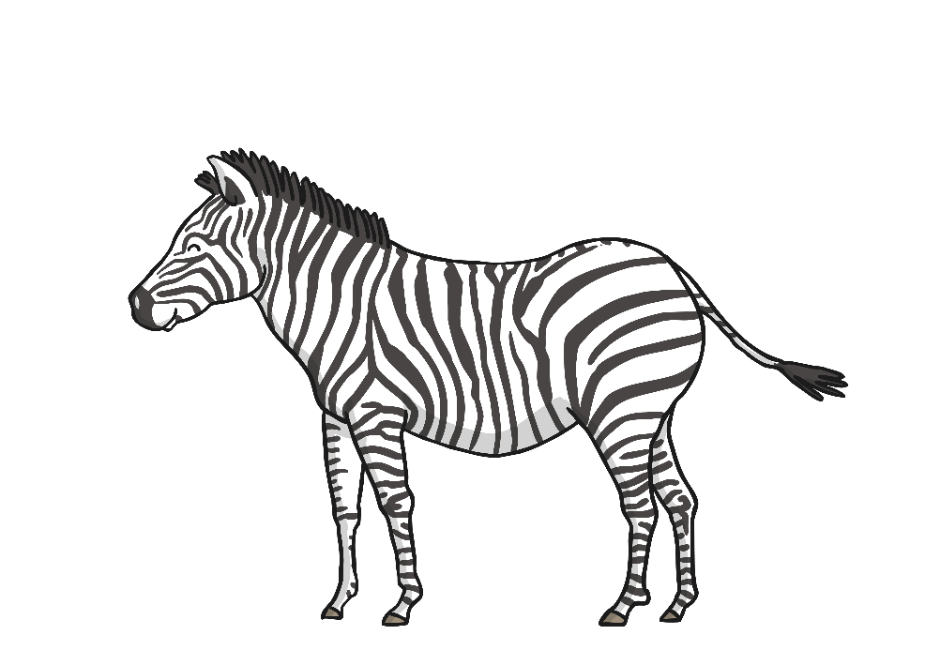
z

Slide 32
zz

Slide 33
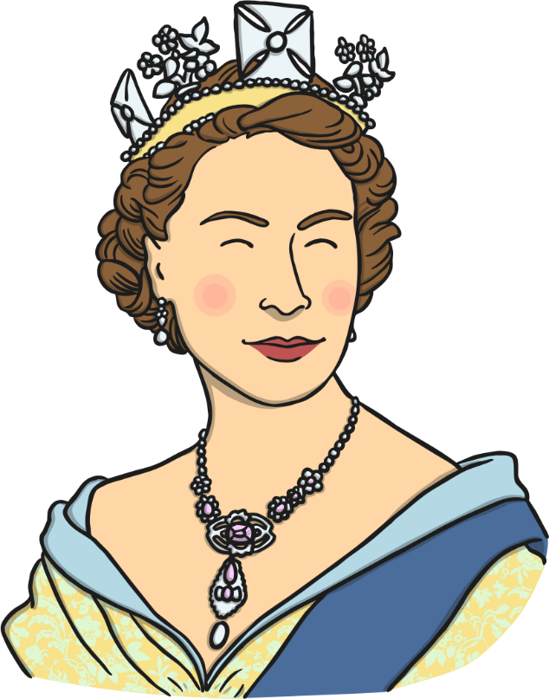
qu

Slide 34
sh

Slide 35
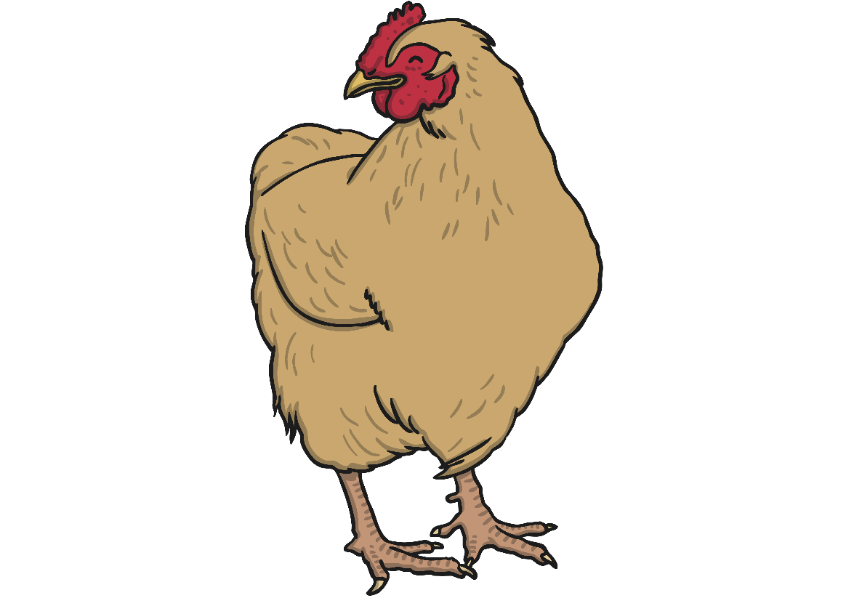
ch

Slide 36
th

