Slide 1
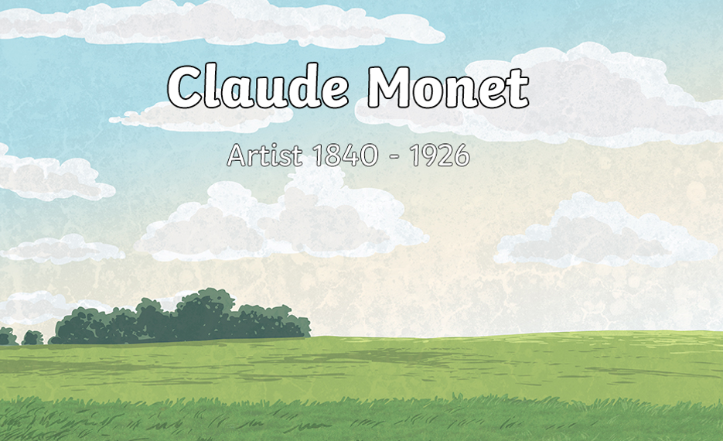

Slide 2
What do we know about Claude Monet already?
Where was he born?
Where did he like to paint?

Slide 3
Let's find out more about Monet...

Slide 5
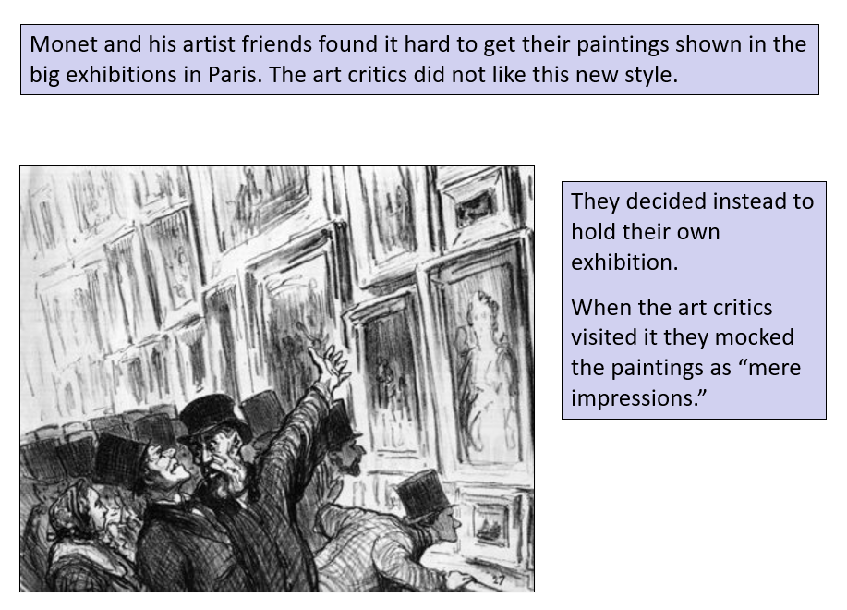

Slide 7
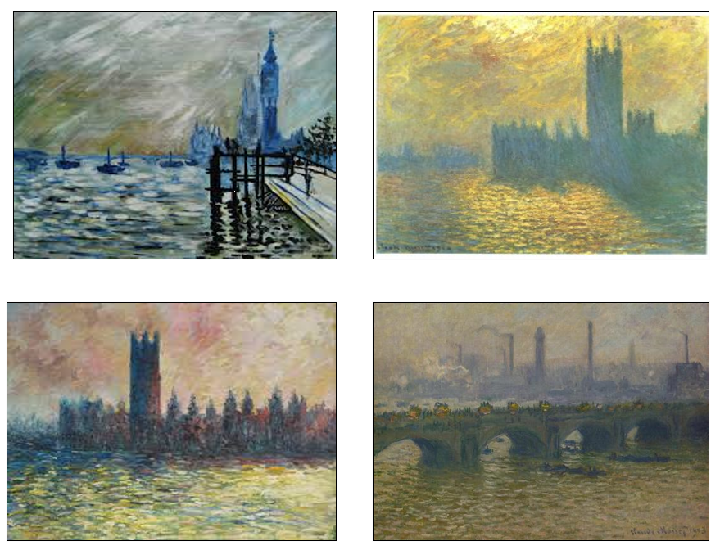
Look carefully at how Monet has painted the water here. What do you notice?

Slide 8
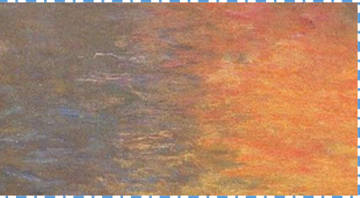
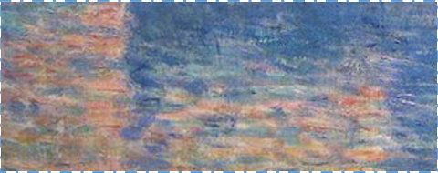
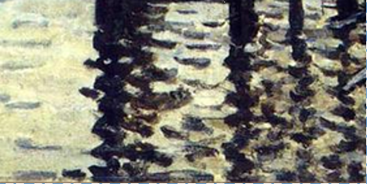
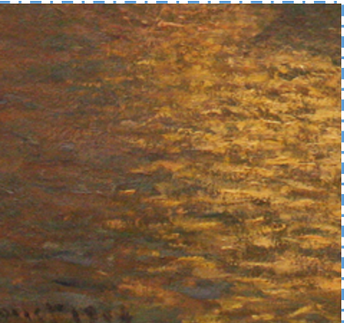
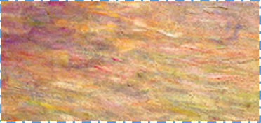
Look at these sections of water painted by Monet.

Slide 9
I would like you to choose one of the water sections from slide 8.
I want you to paint that section using (acrylic) paint ideally, but you can use whatever you have at home.
Firstly, I would like you to mix the colours that you can see in the ‘water’. You should try out each colour on your page using loose brush strokes similar in size and direction to those used by Monet.
You should investigate how to best recreate the effect you can see in your rectangle of water. You could try different brushes or different size of strokes to see which works best.

Slide 10
Secondly, once you have mixed each of the colours and investigated how to best recreate the effect of the water, you should begin to paint your rectangle.
Paint a patch of water that resembles your rectangle.
Try to make the strokes horizontal and longer at the bottom of the rectangle (closer to the viewer) becoming shorter as they progress up the page.

Slide 11
When you have finished, look at your piece of artwork.
What effect have you created?
Does your painting look like water close up?
What about from a distance?
Have you successfully created an impression of water on sunlight?
It would be great if you would send me your artwork today.

