Slide 2
Aim
I can state why animals, including humans, need the right type of nutrients.
Success Criteria
I can explain the difference between food groups and types of nutrients.
I can explain what types of nutrients humans need.

Slide 3
Types of Nutrients
Nutrients are substances that animals need to stay alive and stay healthy. These nutrients are found in the foods we eat.
There are seven nutrients.

Slide 4
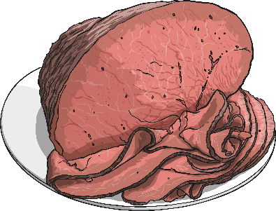
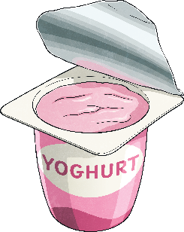
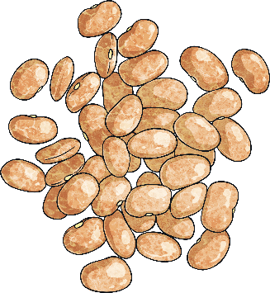
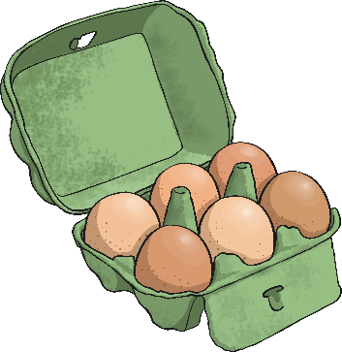
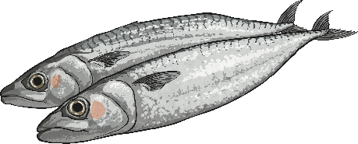
Types of Nutrients - Proteins
Proteins help your body to grow and repair itself.
Foods high in protein include:
Red Meat
Fish
Beans
Yoghurt

Slide 5
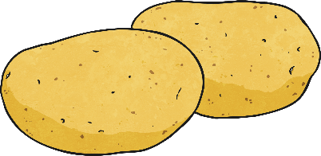
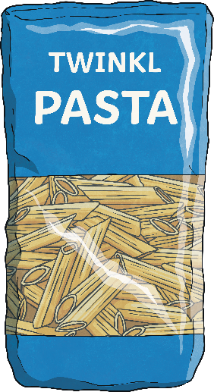
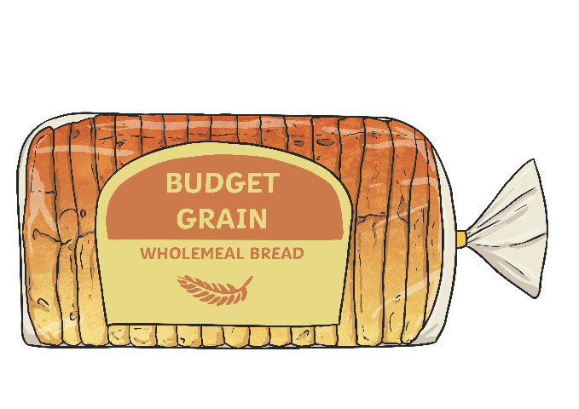
Types of Nutrients - Carbohydrates
Carbohydrates give you energy.
Foods high in carbohydrates include:
Bread
Pasta
Fruit
Potatoes

Slide 6
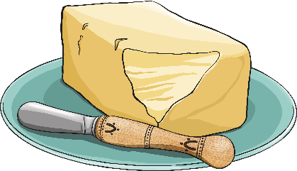
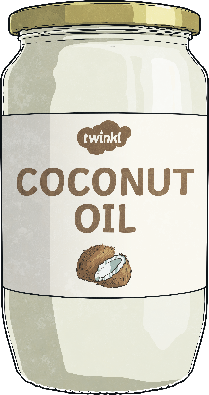
Types of Nutrients - Fats
Fats give you energy.
Foods high in fats include:
Nuts
Oils
Avocados
Butter

Slide 7
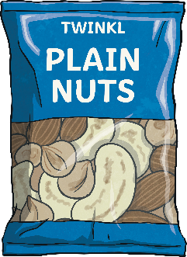
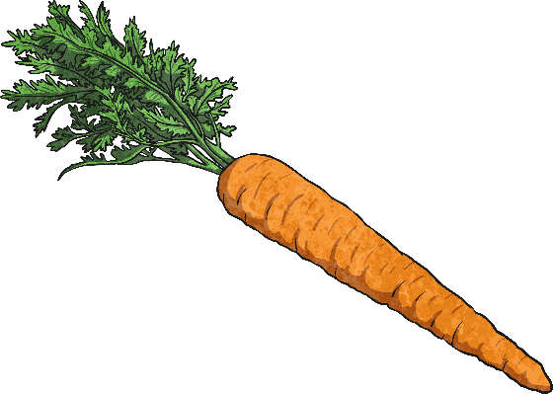
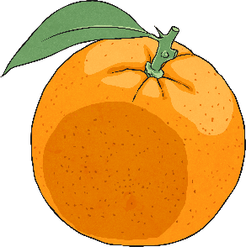
Types of Nutrients - Vitamins
Vitamins keep your body healthy.
Foods high in vitamins include:
Oranges
Carrots
Beef
Nuts

Slide 8
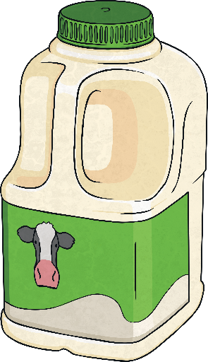
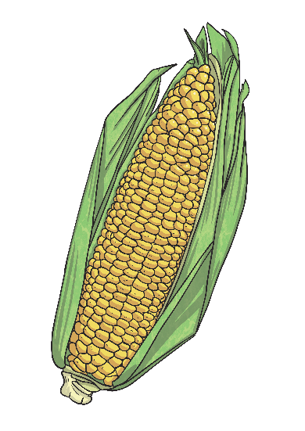
Types of Nutrients - Minerals
Minerals keep your body healthy.
Foods high in minerals include:
Milk
Spinach
Salt
Sweetcorn

Slide 9
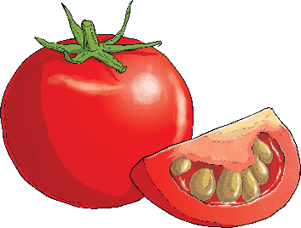
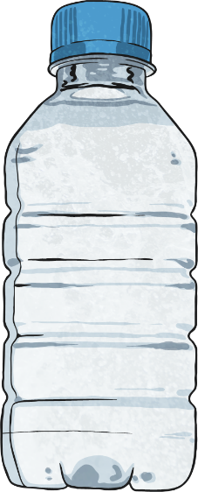
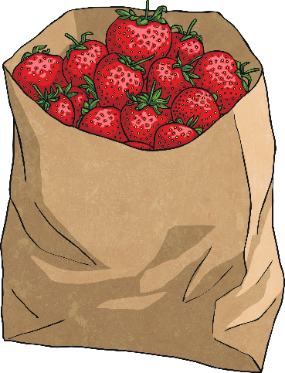
Types of Nutrients - Water
Water helps to move nutrients in your body and get rid of waste that you don’t need. It is an essential nutrient for our survival. While it is really important to drink plenty of water, it is also important to remember that many foods contain water also.
Foods high in water include:
Tomatoes
Cucumbers
Lettuce
Strawberries

Slide 10
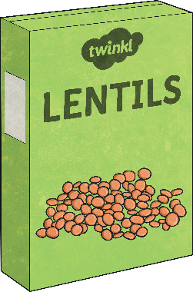
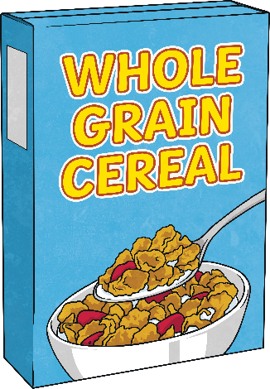
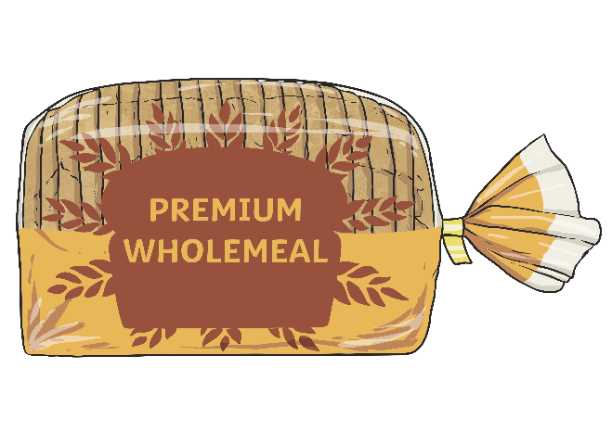
Types of Nutrients - Fibre
Fibre helps you to digest the food that you have eaten.
Foods high in fibre include:
Cereal
Apples
Wholegrain bread
Lentils

Slide 11
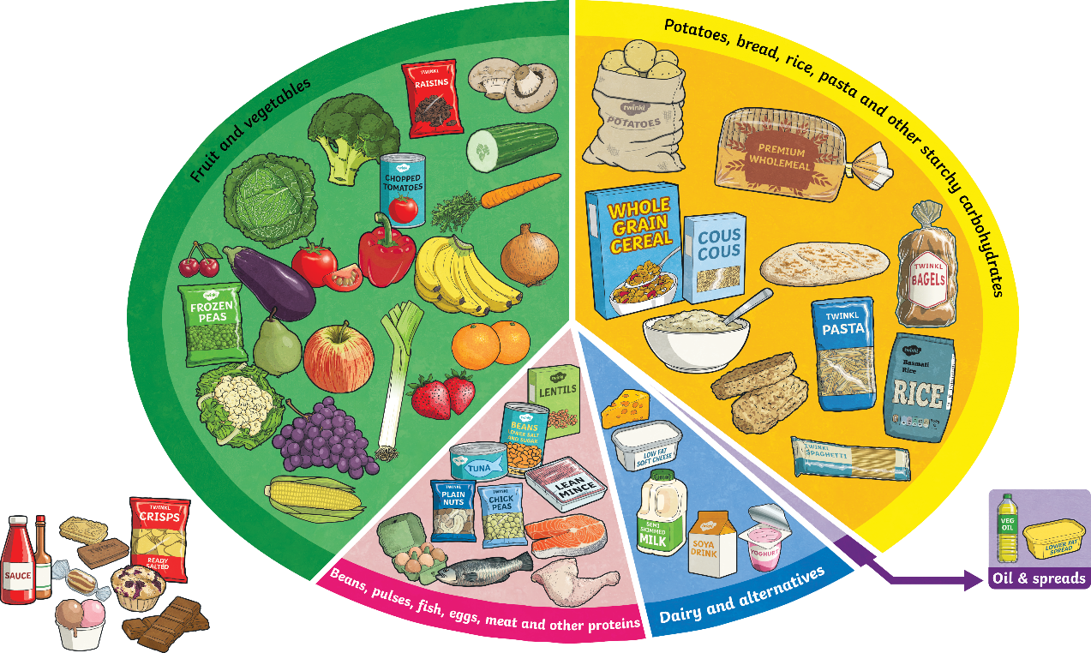
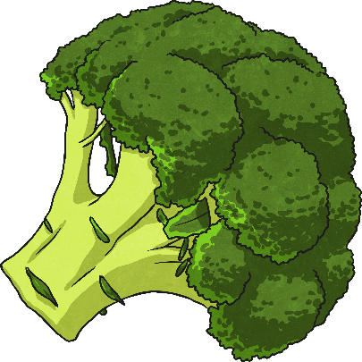
Food Groups and Nutrients
Within each food group, there are many foods which contain more than one type of nutrient.
For example, eating broccoli from the fruit and vegetables section would provide with various different nutrients. This food is a great source of minerals (especially a mineral called potassium), a really good source of vitamins and it provides the body with fibre.

Slide 12
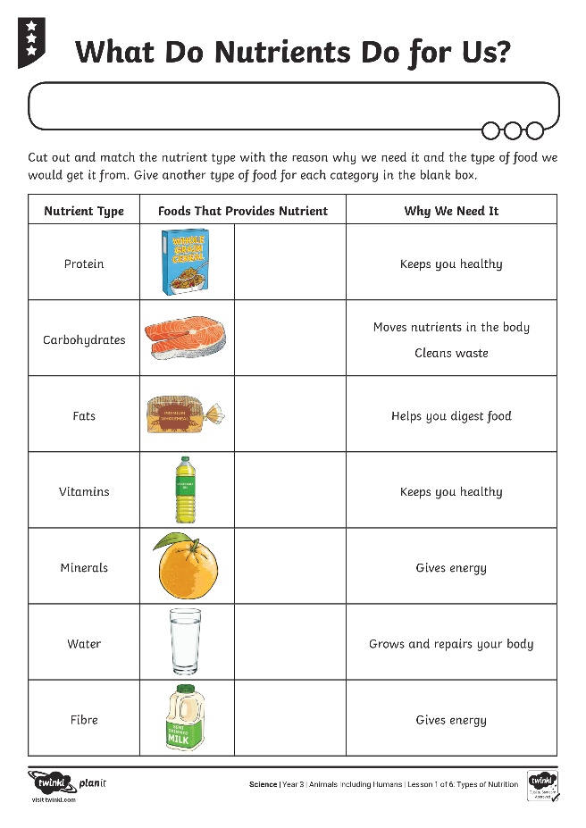
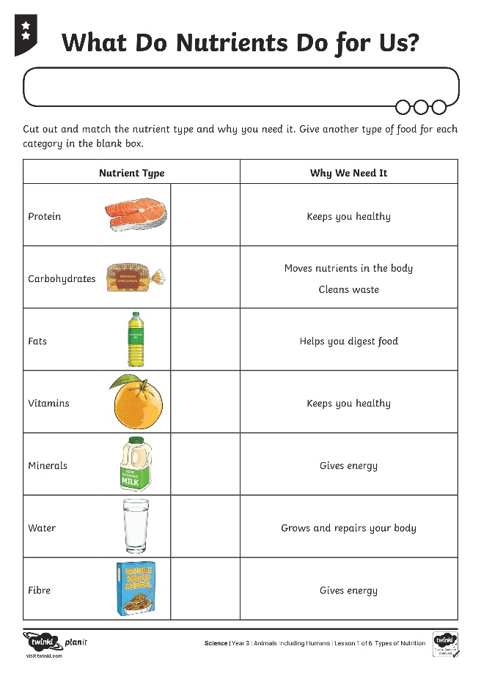
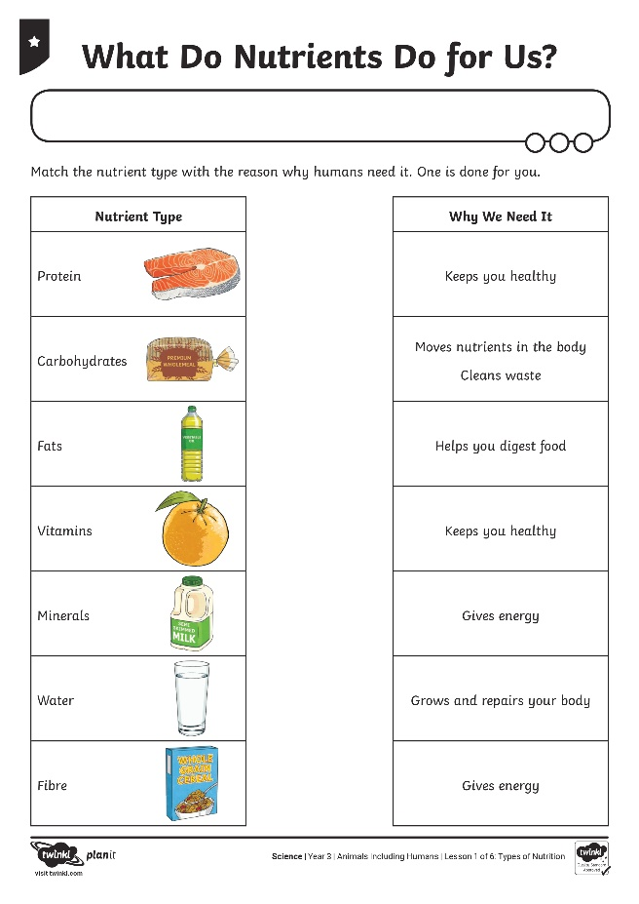
What do Nutrients do For us?

Slide 13
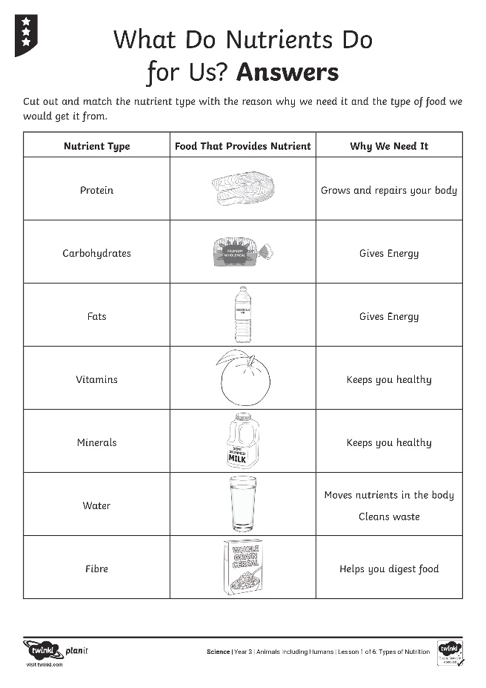
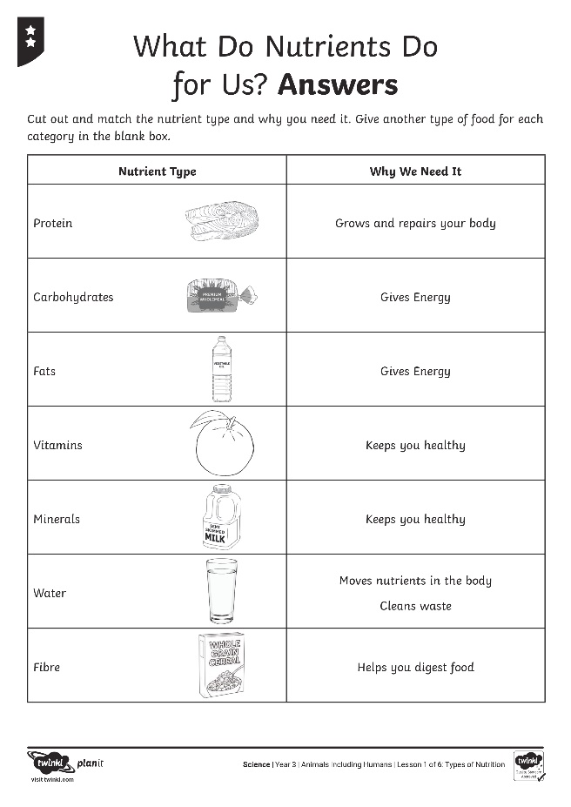
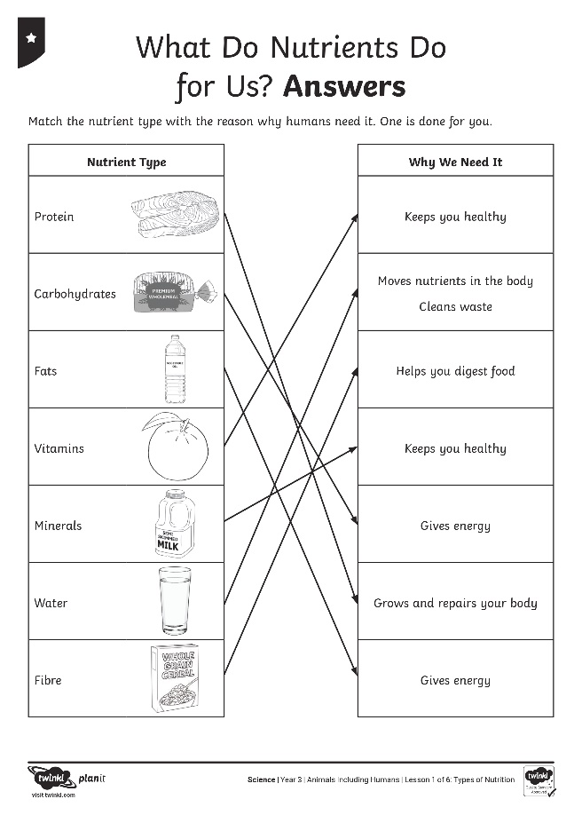
What do Nutrients do For us?

