Slide 1
Fountains C E School 2021
A Day in Class 1
Information for children and parents about Fountains CE School.

Slide 2
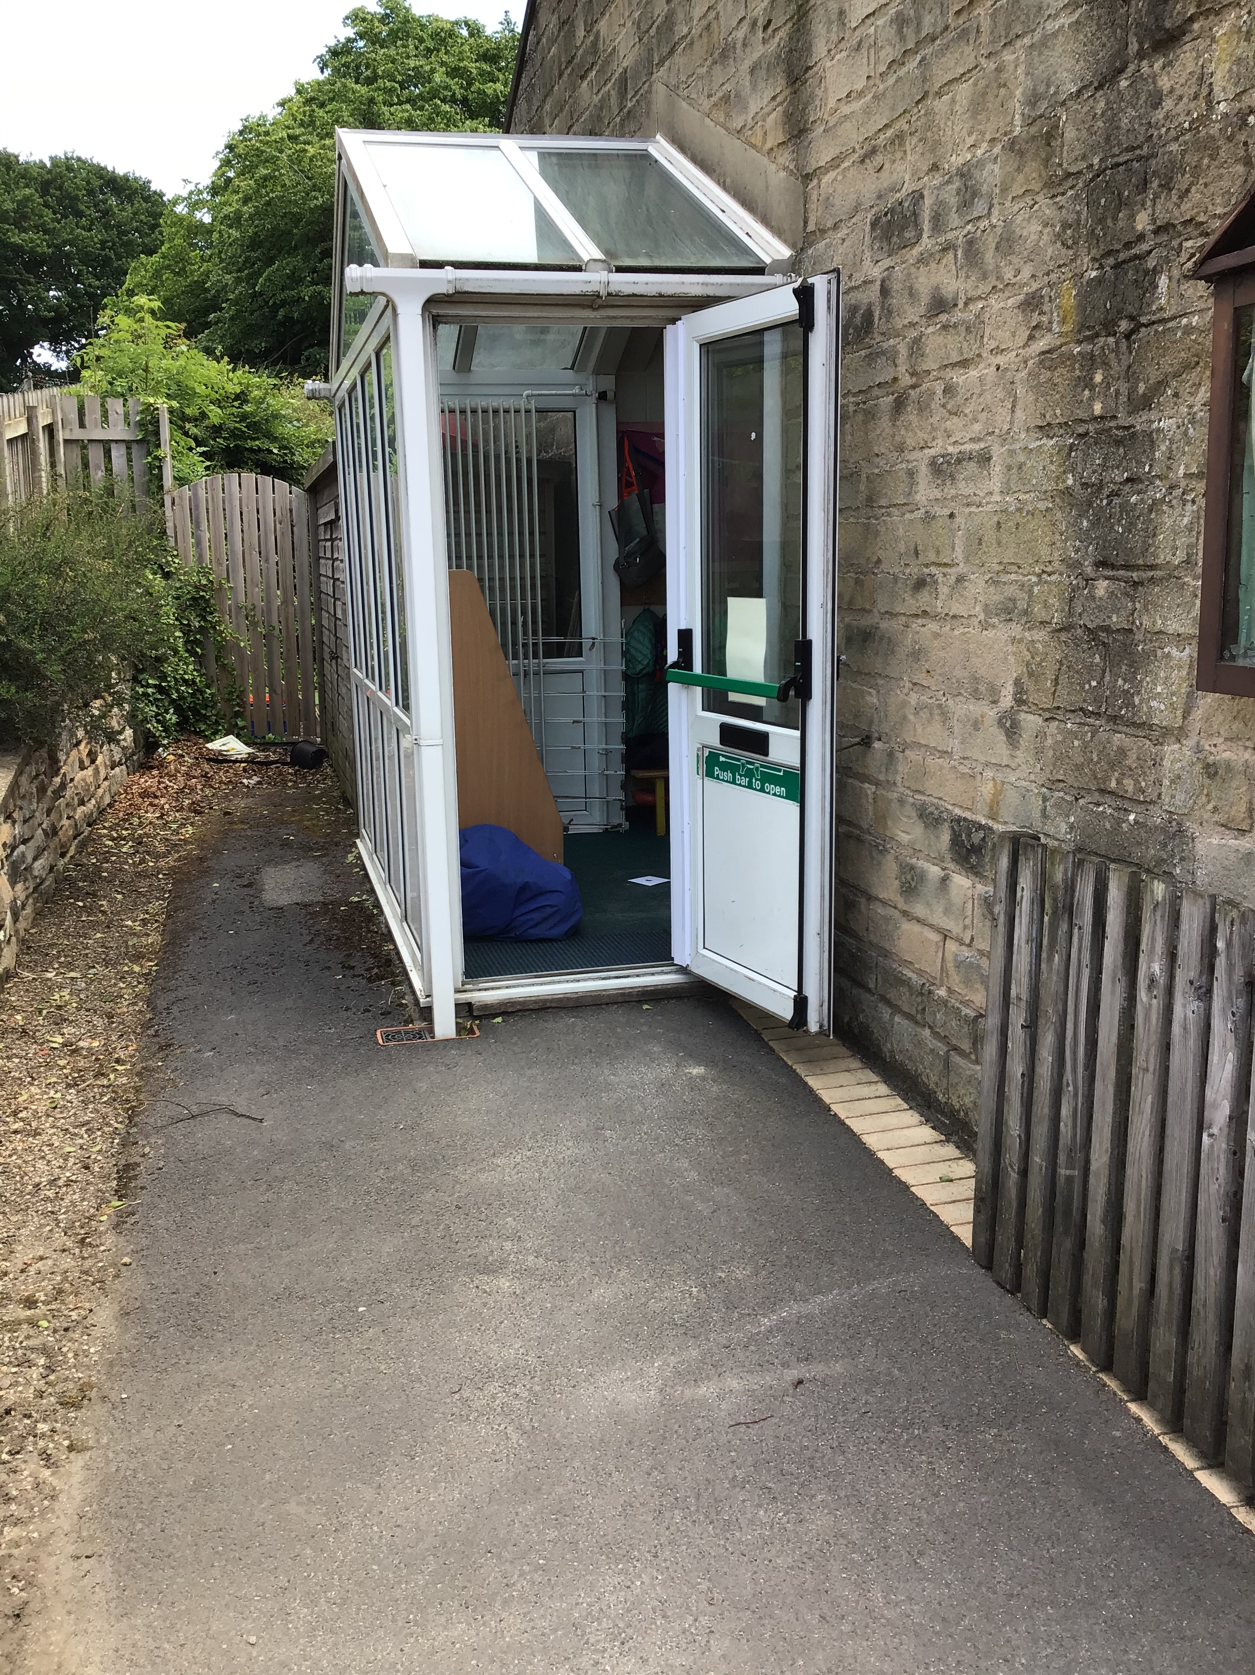
Daily routines…
On a morning, the door opens at 8.45am. The children come in and choose their learning.
At 9am, the door closes and we gather on the carpet for the register.
If you arrive after 9am, you will need to come to the school office.
If your child is poorly, please telephone the office.

Slide 3
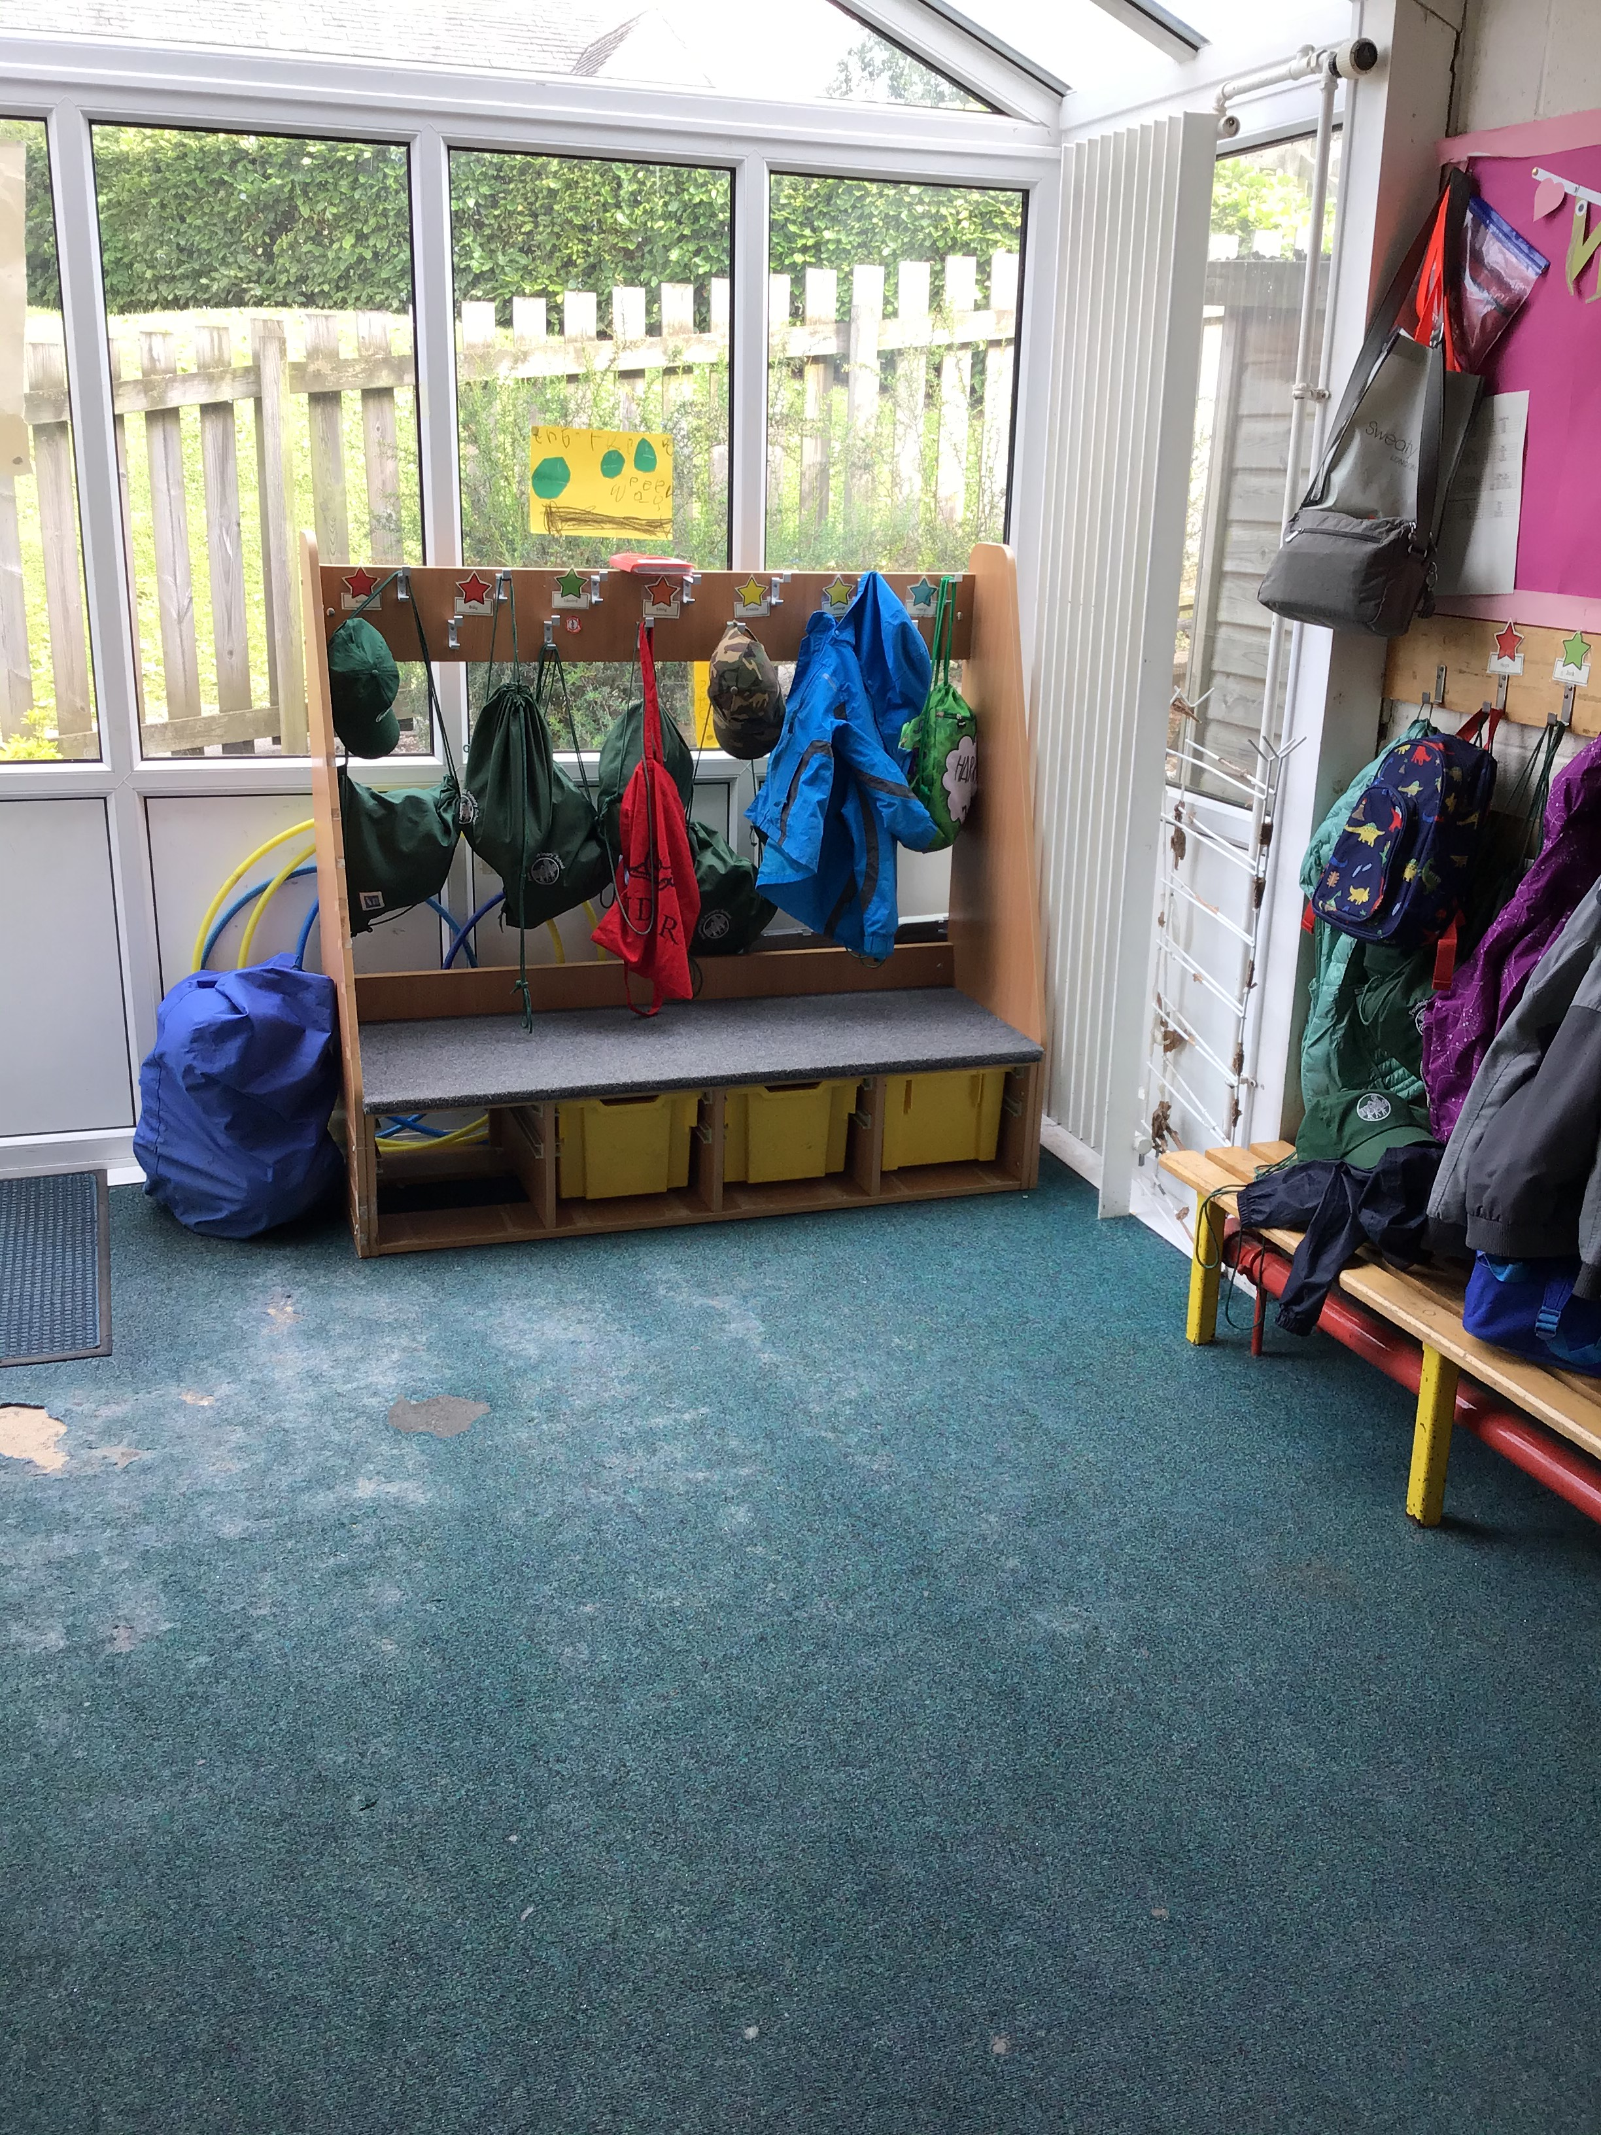
Our cloakroom..
When you arrive at school, you will come into the cloakroom. You will have your own peg to hang your coat, book bag and PE bag.
Miss Wray will encourage you to find your name label on your peg so that you know where your things belong.
Sometimes we forget where our peg is so please make sure that all items of clothing are clearly labelled so that they can be returned to where they belong – *TOP TIP add a unique keyring to book bags to help identify them*
We encourage all children to be independent learners and being able to dress and
undress themselves – putting on and taking off jumpers, coats and shoes - helps
them to access all areas of our classroom when they choose.

Slide 4
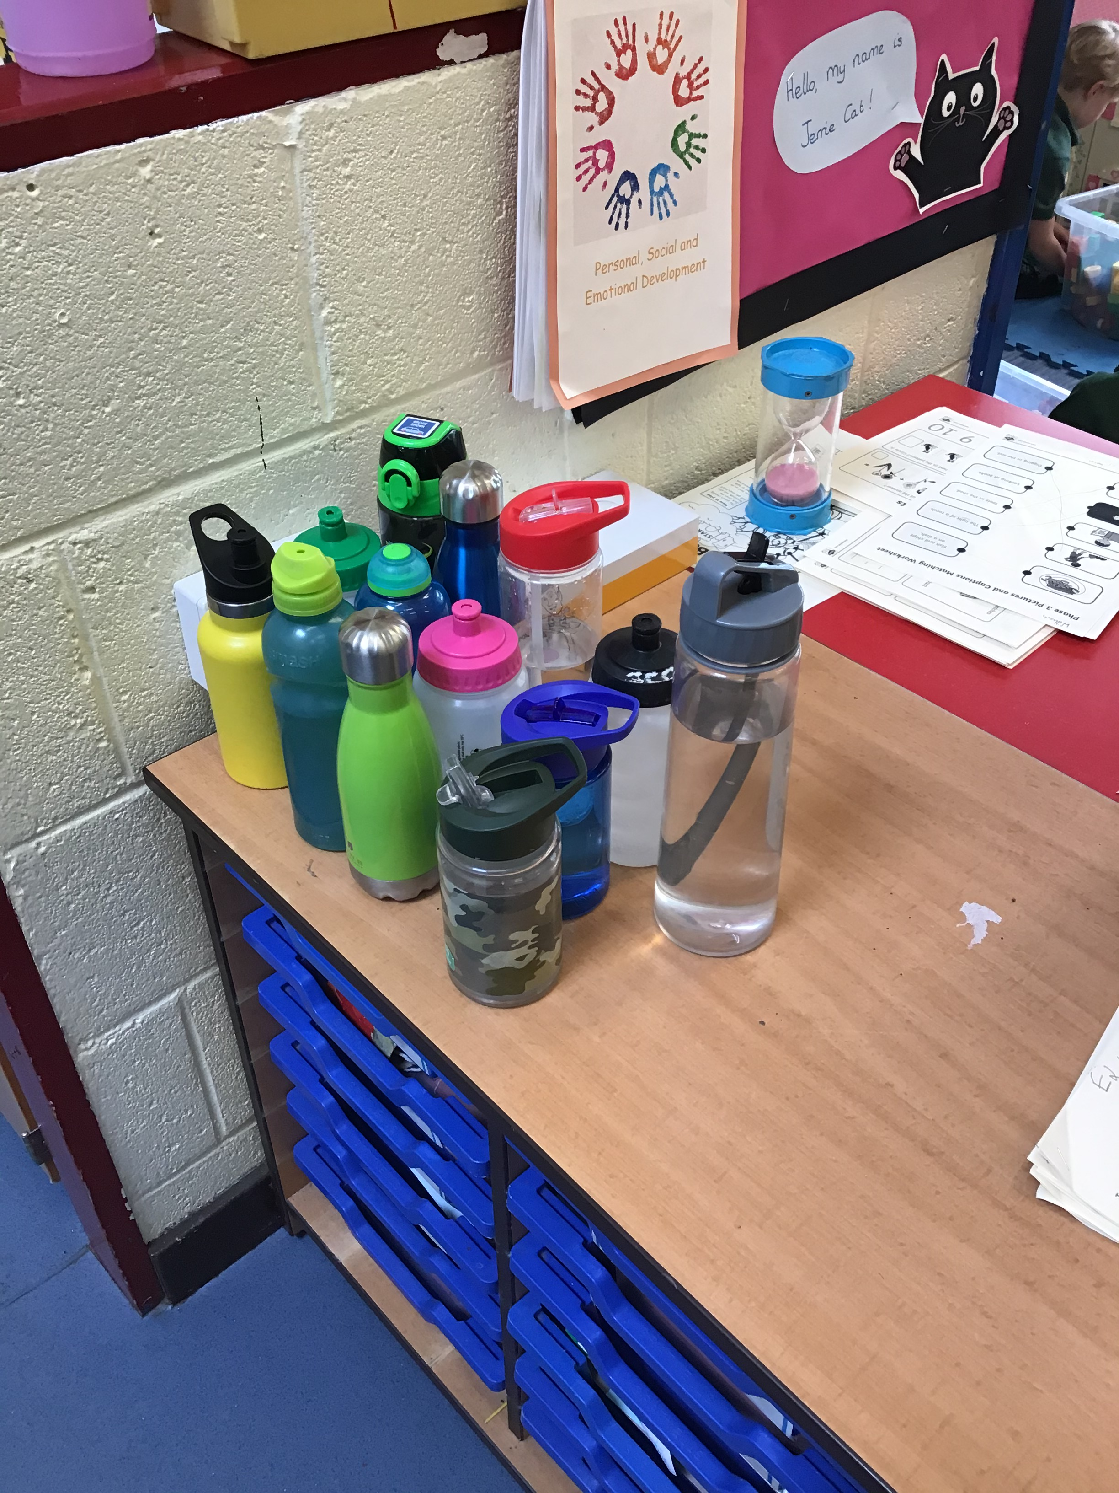
Water bottles…
Children should have a labelled water bottle in school at all times.
We have a space in our classroom where our water bottles are stored and they can be accessed at any time throughout the day.

Slide 5
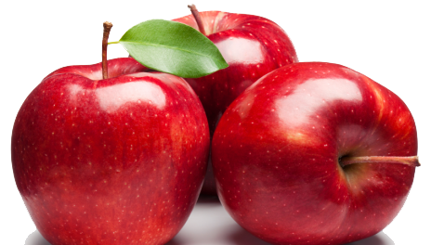
Snack…
We have a snack stop mid morning every day and there is also fruit available in the afternoons for those who would like it as part of the government ‘School Fruit and Vegetable Scheme’.
Milk is available from our provider, Cool Milk. Milk is free for all children under the age of 5. They will be added to the list and offered milk at snack time. After your child’s 5th birthday they will no longer receive the offer of milk but if you would like them to continue to access milk as part of their morning snack you can purchase milk via the Cool Milk website.

Slide 6
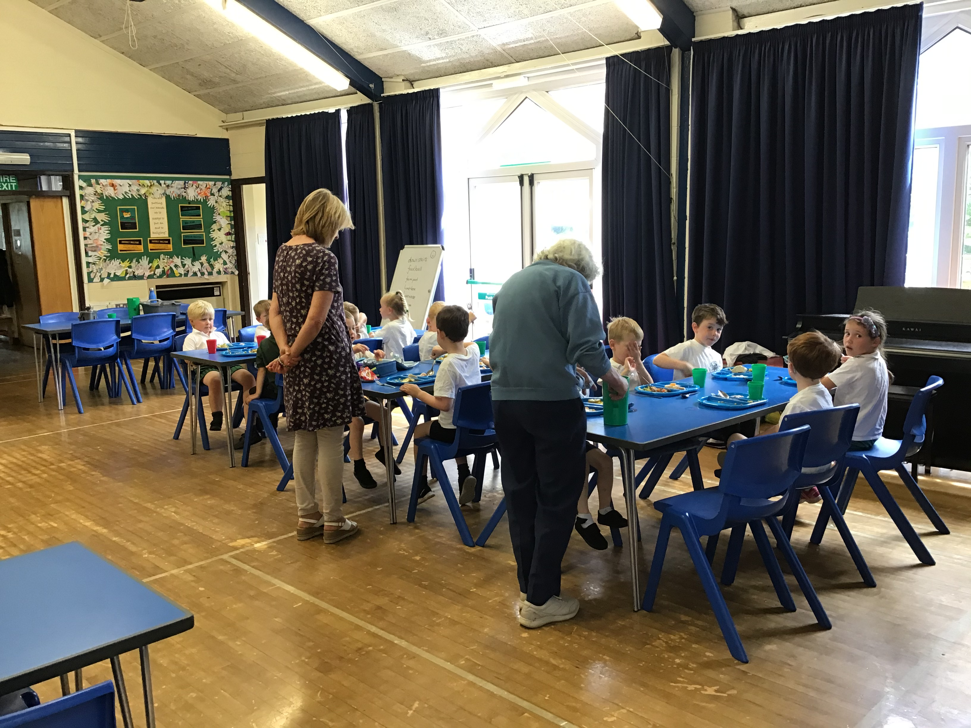
Our lunch time is 12 noon until 1pm.
We eat in the school hall between 12 and 12.30pm and then go onto the big playground for a playtime after we have eaten.
There are midday supervisors who are there to help us with cutting up food and opening packets.
All children in Reception class and Class 2 can have a free school meal which is prepared on site by our school cook, Mrs Kitching, and they are delicious!
If you choose to send a packed lunch, these will be stored in the cloakroom next to their peg.
As we are a healthy school, we encourage all children
to have a healthy balanced diet, please cut up grapes
and cherry tomatoes and avoid sending food which
contain nuts.
Lunch…

Slide 7
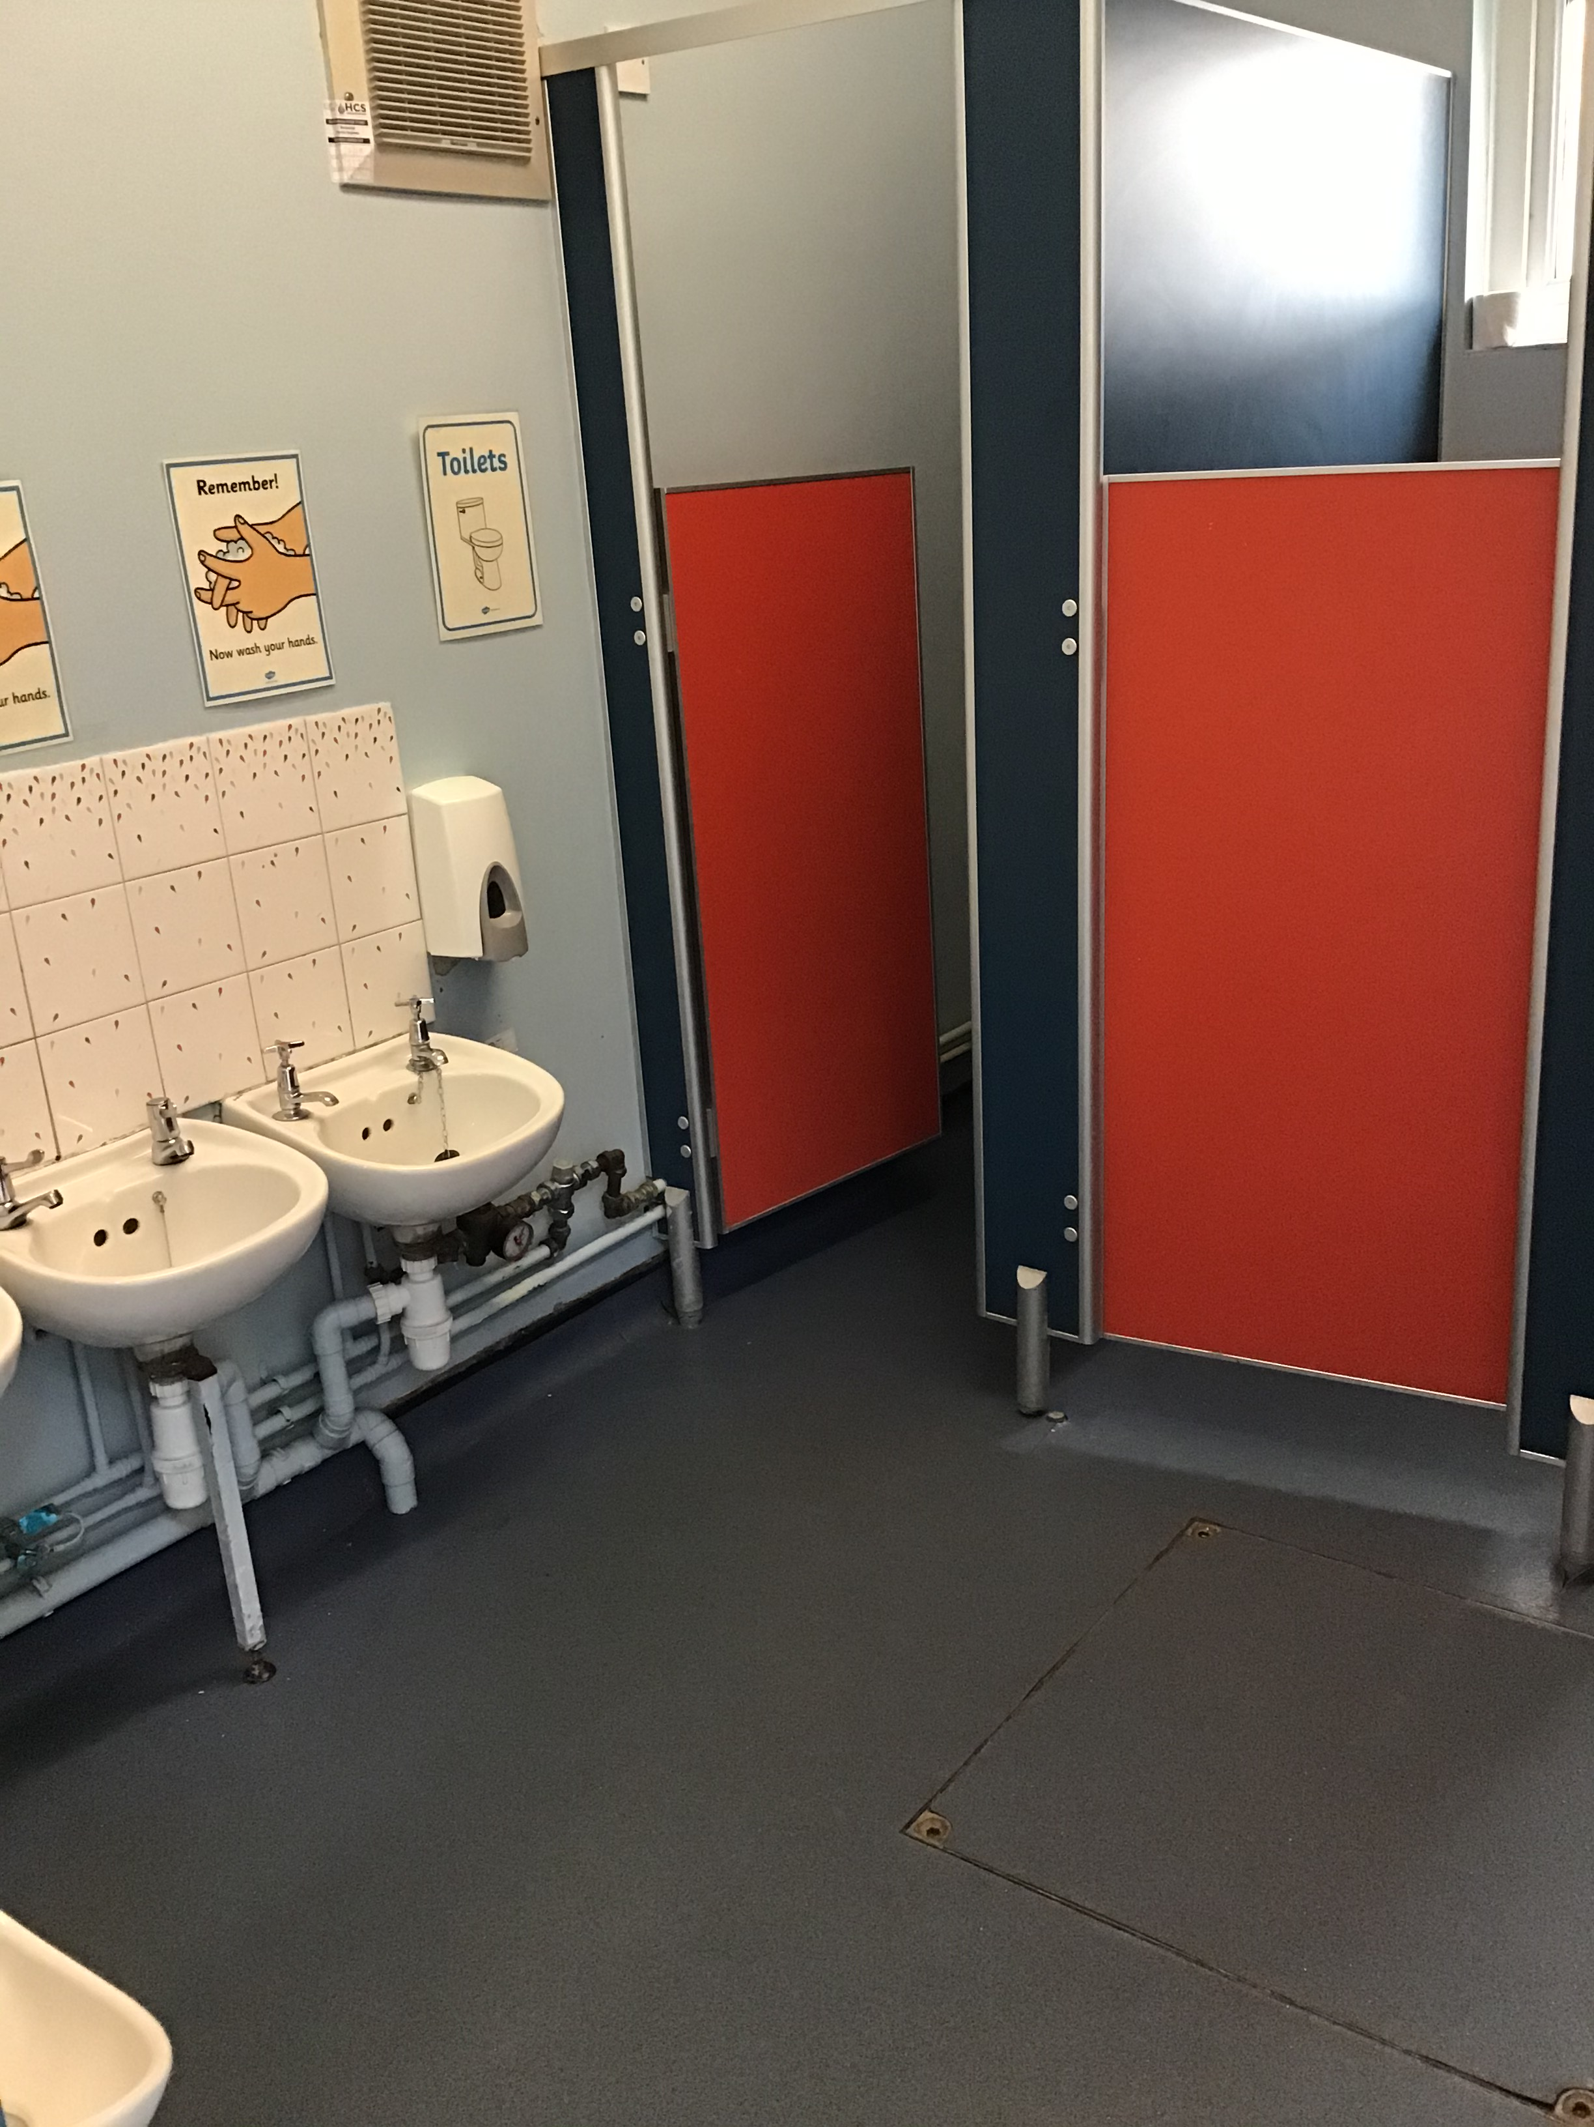
Toilets…
Class 1 have their own toilets which are located in our cloakroom.
The children are encouraged to ask to go
to the toilet but can access these at any
time during the day.
They are also encouraged to wash their
hands regularly throughout the day.

Slide 8
End of day…
We always finish the day with some calm time. This can be a story, carpet game, yoga or singing.
Our day ends at 3.30pm.
The children will use the same door that they come in through on a morning to leave the classroom at the end of the day.
The adult in class will make sure that they see the child’s grown up before being let out of the cloakroom.

