Slide 1
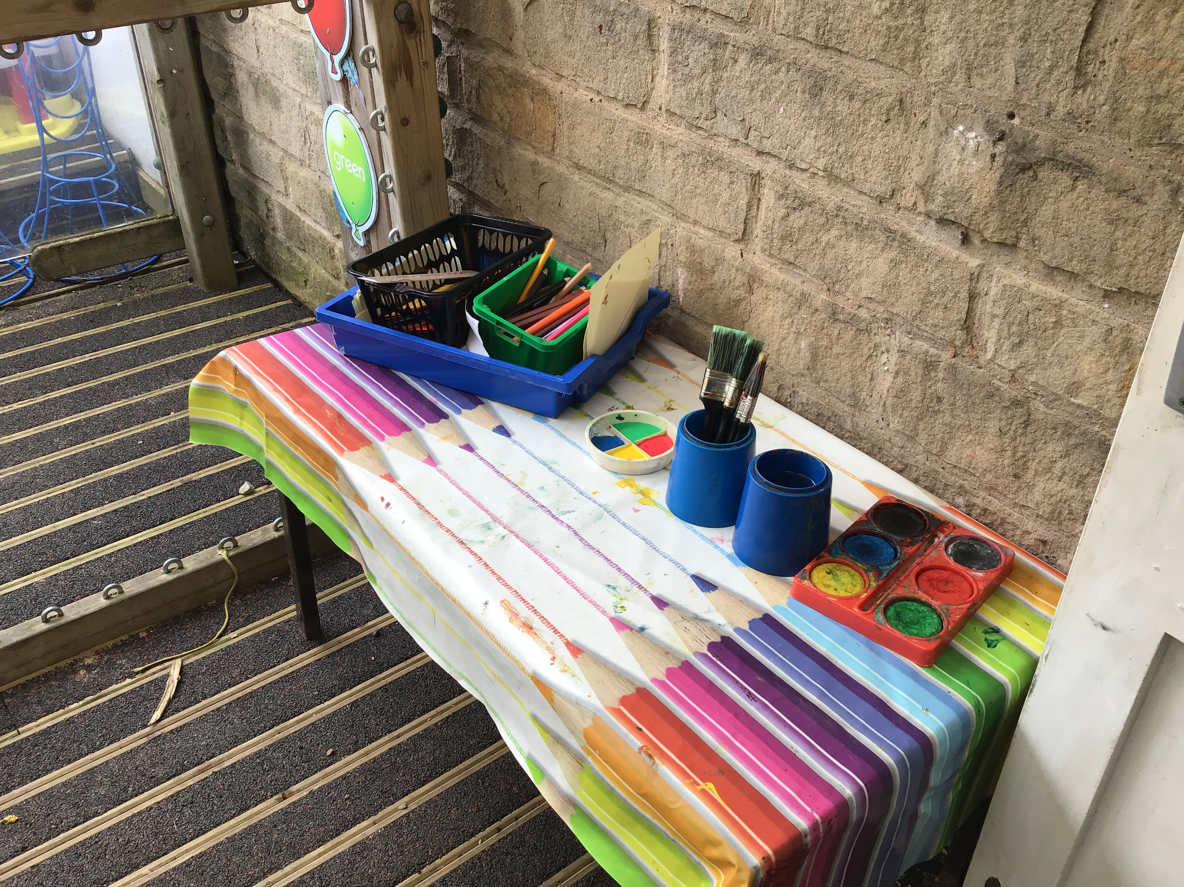
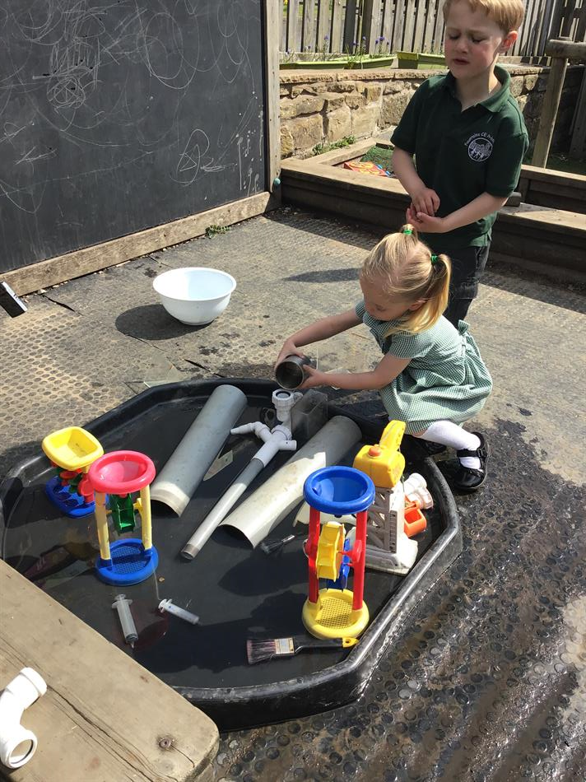
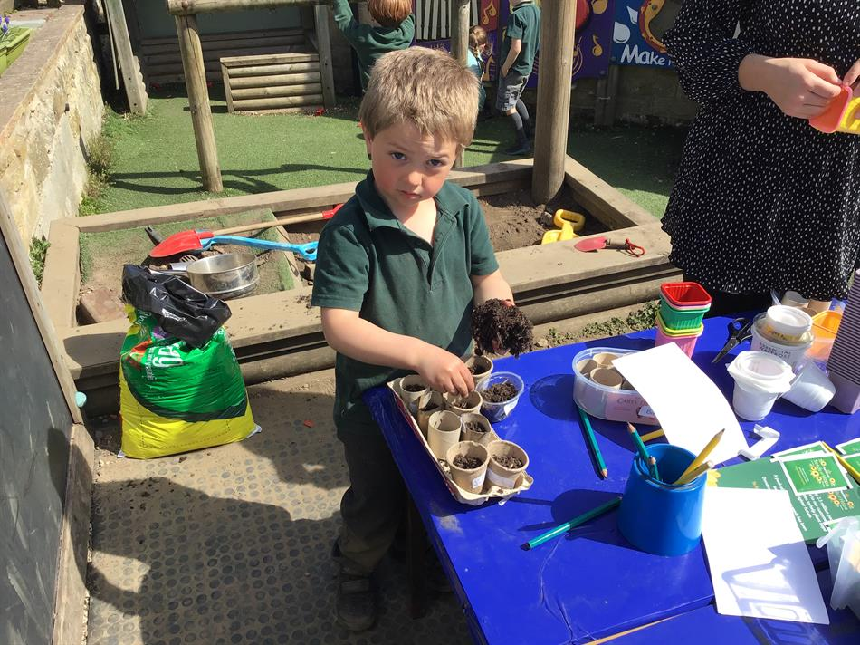
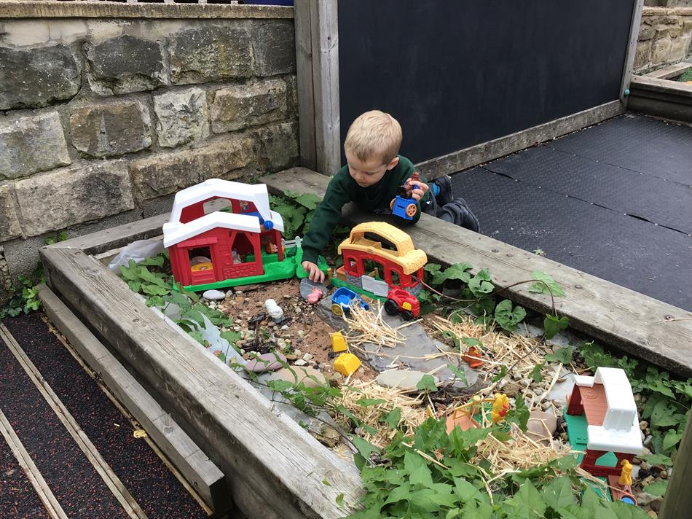
Our outdoor classroom…
We use our outdoor area every day. We love being outside in any weather!

Slide 2
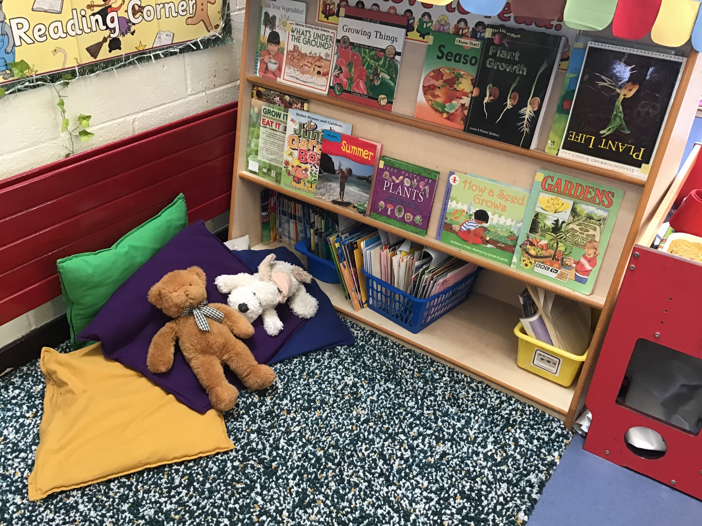
Our class library…
Our reading corner is a place where we can enjoy sharing books with our friends and teachers or if we want some quiet time by ourselves.
We read books and listen to stories every day.

Slide 3
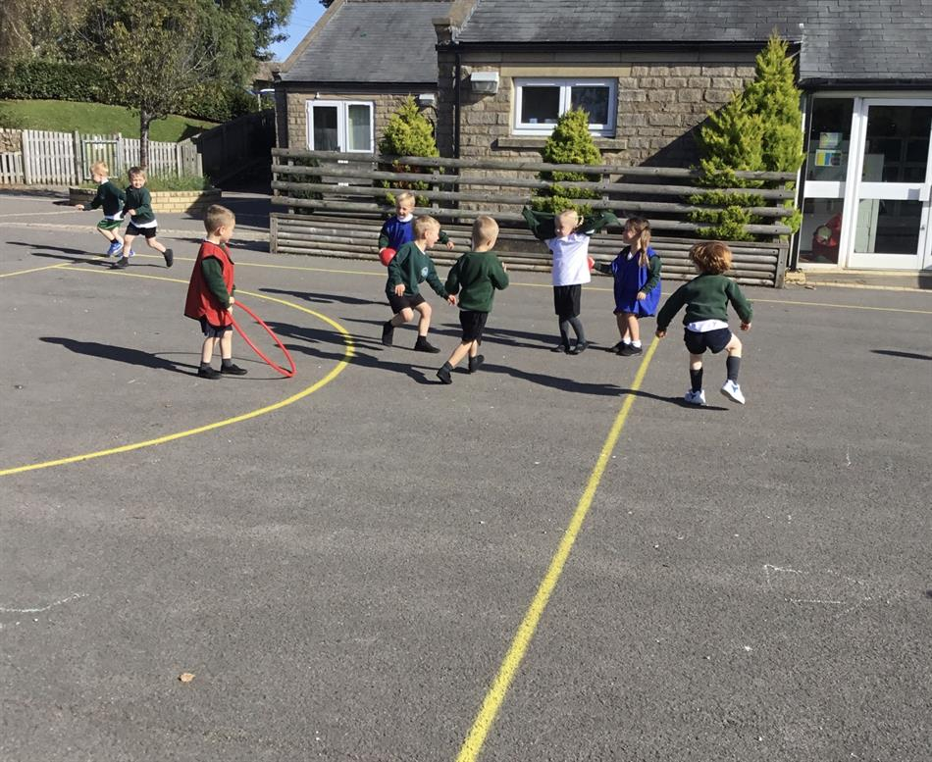
Playtime…
We go onto the big playground and field after our lunch for a play everyday. We share this playtime with Class 2.
Later in the year we will also join with the rest of the school for playtime in a morning on the big playground too.

Slide 4
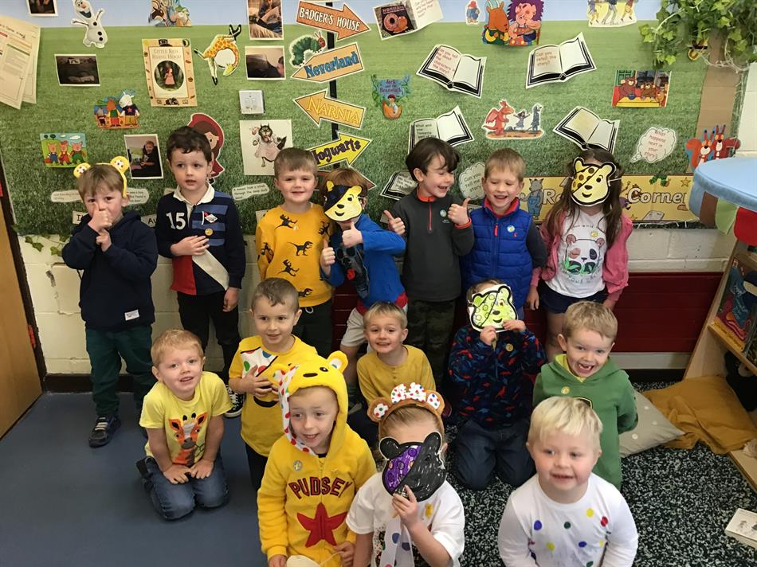
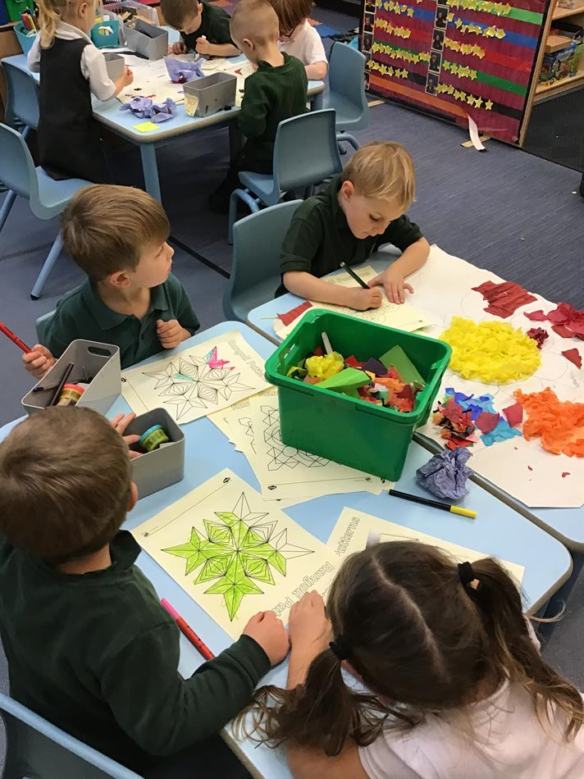
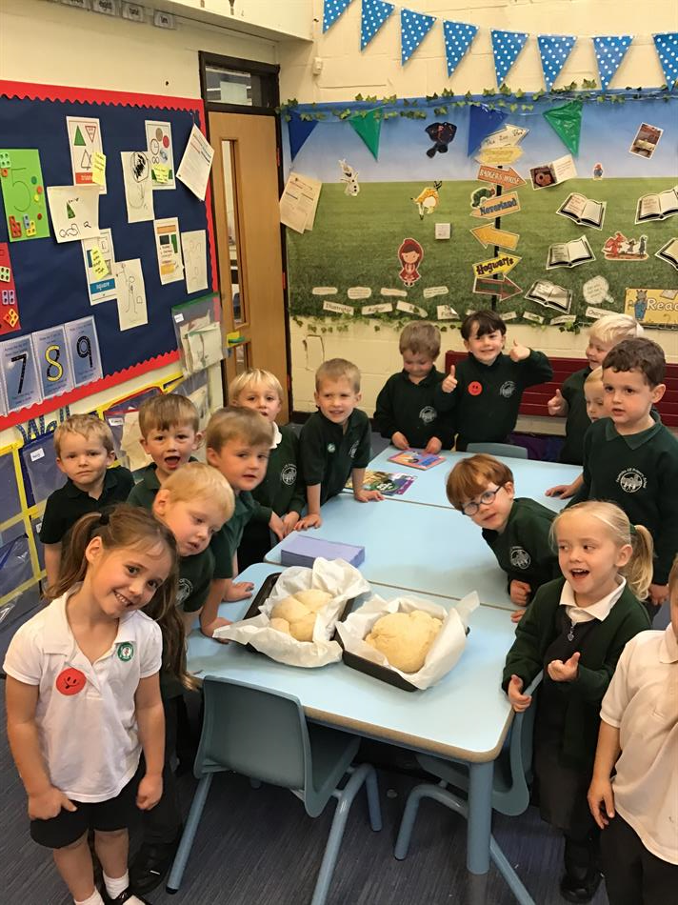
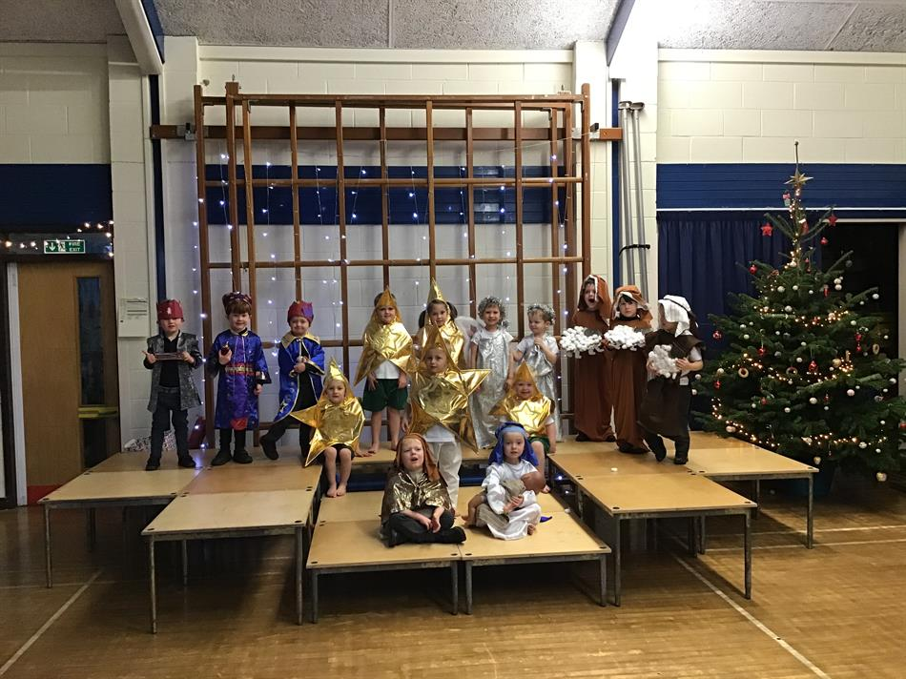
More learning…
We like to have special theme days throughout the year where we learn about different cultures. We also enjoy supporting different charities by having dress up days and doing sponsored events.
At our school, we also want to provide opportunities for the children to learn away from the classroom by going on visits or by having visitors come in to school.

