Slide 1
Tuesday 2nd February

Slide 2
Phonics - Phase 3
Our phoneme today makes two different sounds. Listen to each word. Can you hear the difference?

Slide 3
Our phoneme today is…
Short ‘oo’
book
Long ‘oo’
broom
oo
foot
zoom
Can you say these words with our phoneme in? See if you can sound out the words then blend to read

Slide 4
Click the pictures that contain the long or short ‘oo’ sound to move them into the middle.
oo

Slide 5
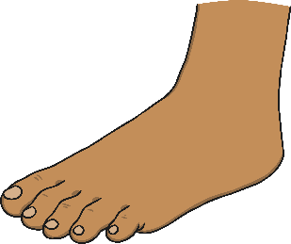
Can you sort the words into short and long ‘oo’? Can you think of anymore ‘oo’ words?

