Slide 1
A life well lived

Slide 2
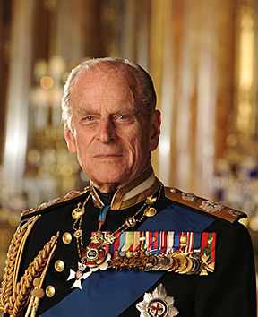
HRH Prince Philip, Duke of Edinburgh
1921-2021
All photos © www.royal.uk, unless otherwise listed

Slide 3
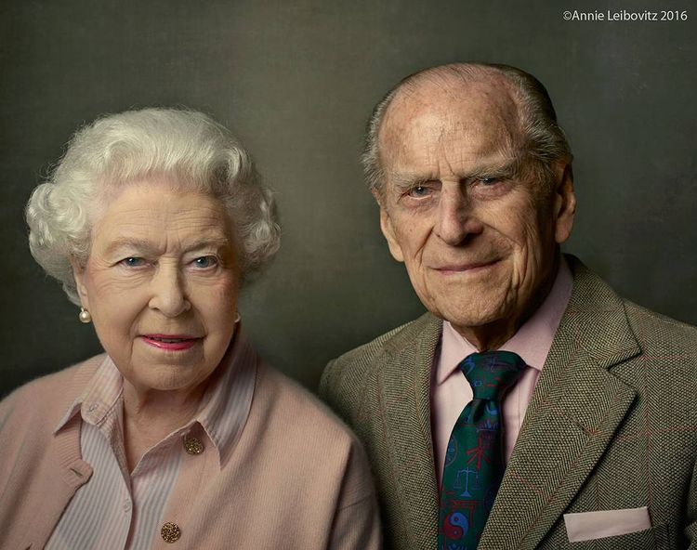
“My strength and stay”
Her Majesty the Queen, Elizabeth II

Slide 4
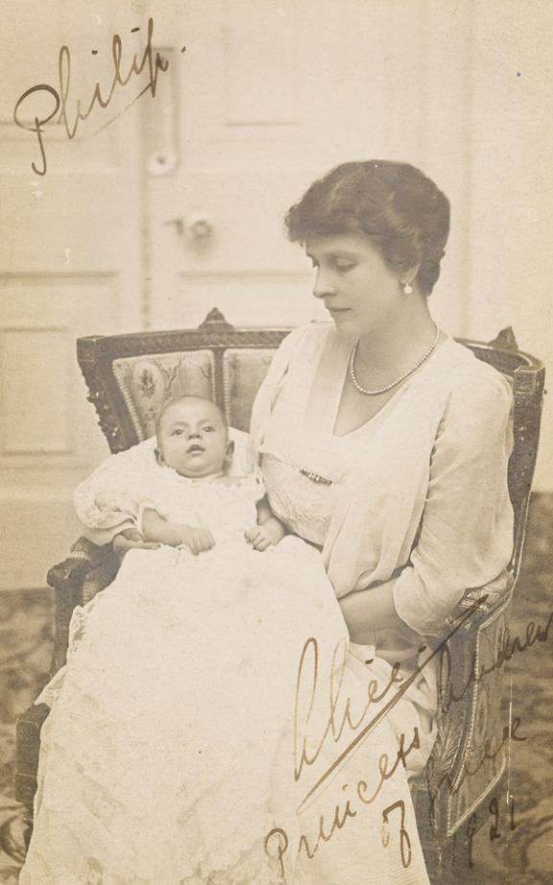
Philip, Prince of Greece and Denmark
10th June 1921
© www.royal.uk

Slide 5
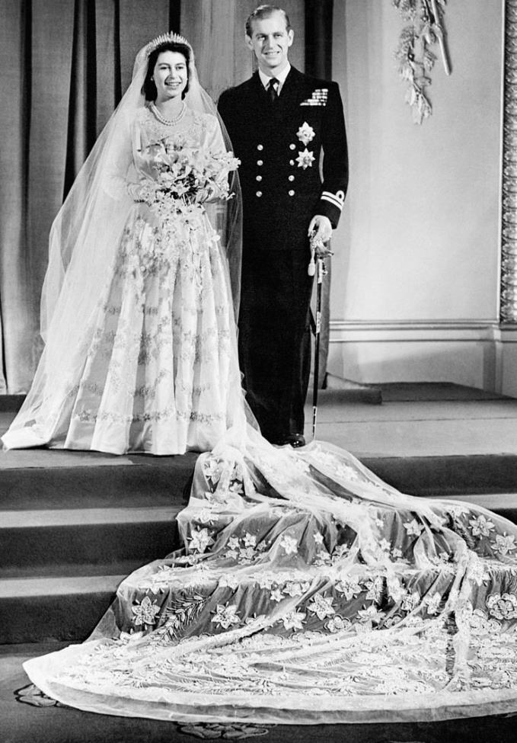
Wedding of HM Queen and Prince Phillip
27th November 1947
© www.royal.uk

Slide 6
A career in the Royal Navy
© www.royal.uk

Slide 7
Platinum Wedding Anniversary
20th November 2017
© www.royal.uk

Slide 8
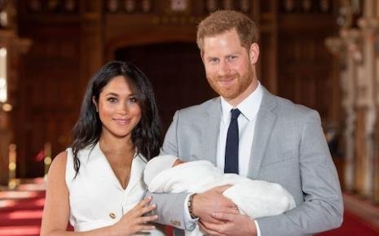
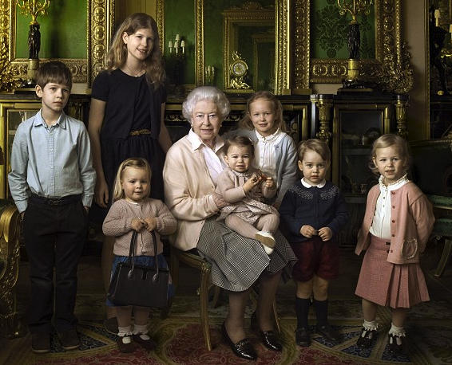
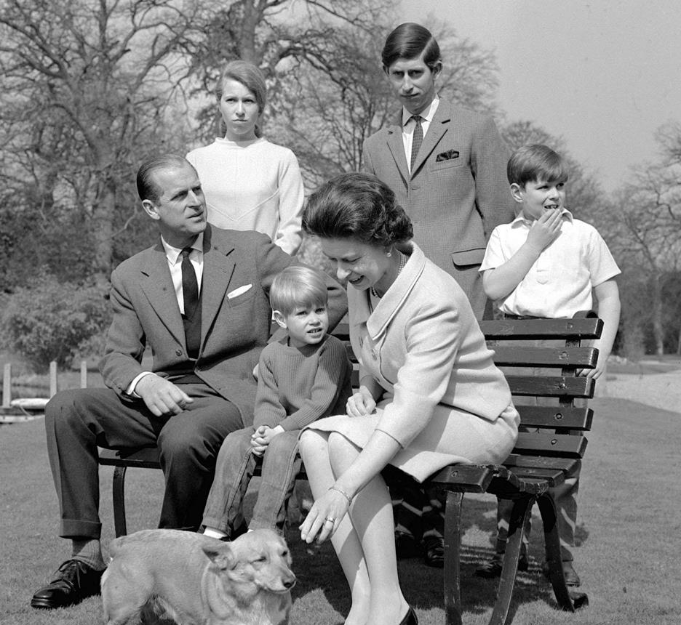
A family man
2016
James
Archie, 2019
Louise
Savannah
Isla
George
Charlotte
Mia
© www.royal.uk

Slide 9
Duke of Edinburgh Awards for 14-16 year olds
1956 – to present day

Slide 10
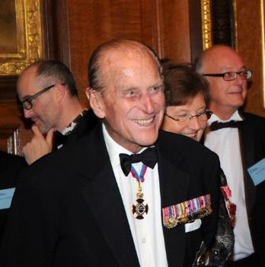
Patron and ambassador
© www.raeng.org.uk
Pixabay.com

Slide 11
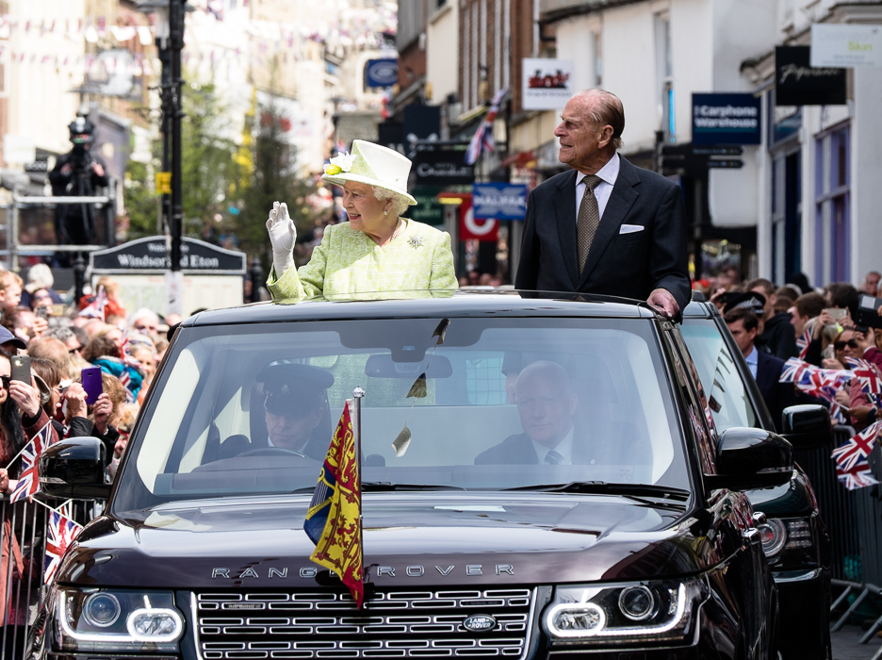
Celebrating with the Queen

Slide 12
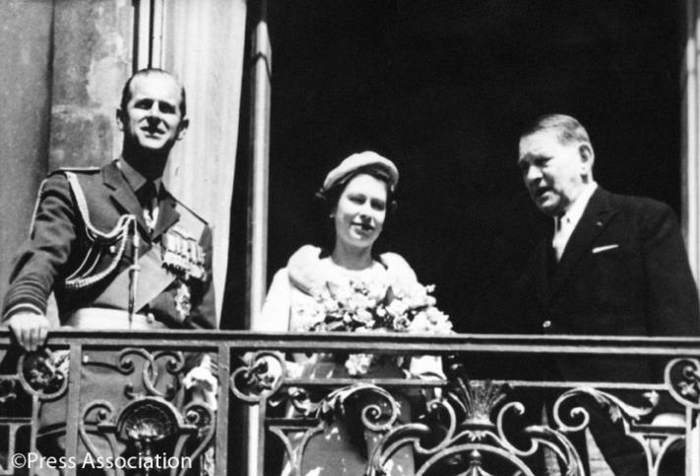
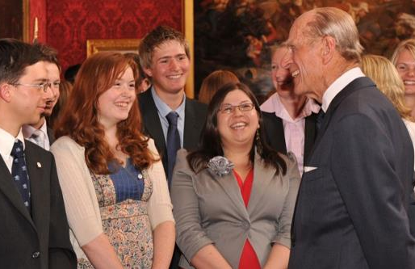
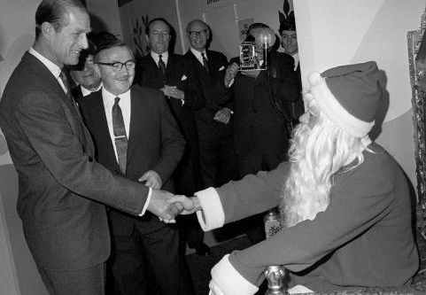
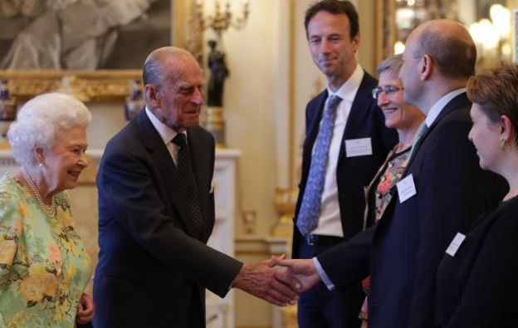
Royal engagements

Slide 13
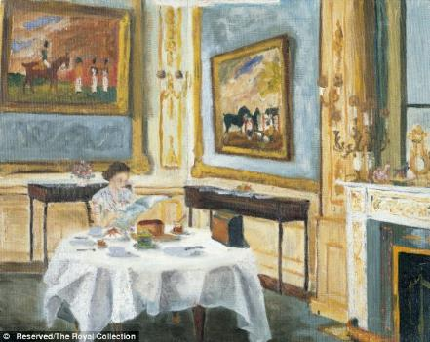
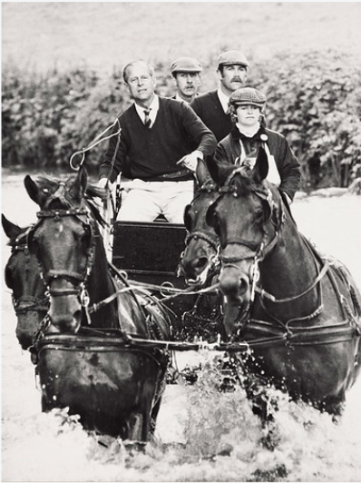
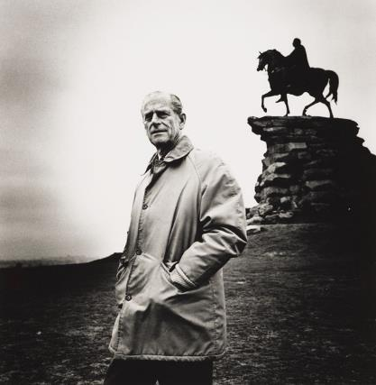
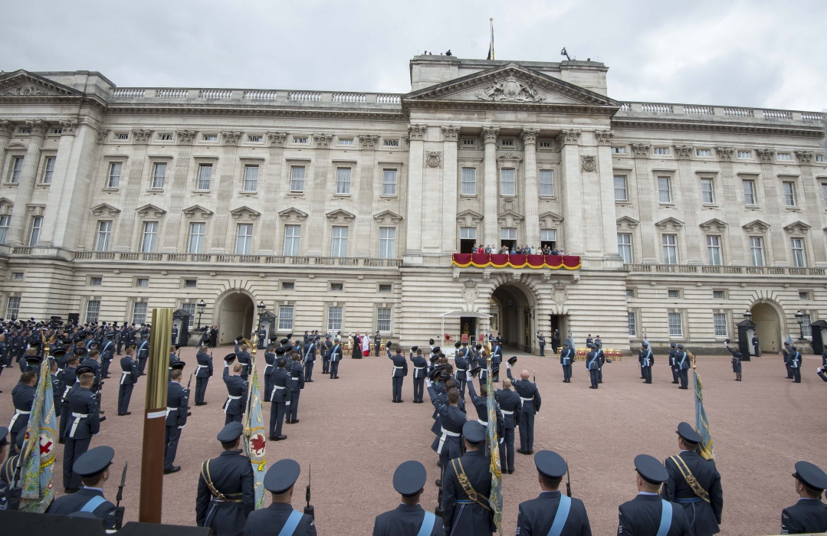
Less well known facts

Slide 14
Announcing his retirement
4th May 2017
On his retirement, aged 96, a guest at St. James’ Palace said ‘I’m sorry to hear that you’re standing down.’ to which the Duke replied ‘Well, I can’t stand up much longer!’

Slide 15
HRH Prince Philip, Duke of Edinburgh
1921-2021
All photos © www.royal.uk, unless otherwise listed

Slide 16
‘I will be with you always – until the very end of time’
Matthew 28:20

Slide 17
Let us pray…

Slide 18
The Lord's my shepherd, I'll not want; He makes me down to lie In pastures green; he leadeth me The quiet waters by. My soul he doth restore again, And me to walk doth make Within the paths of righteousness, E'en for his own name's sake. Yea, though I walk in death's dark vale, Yet will I fear no ill: For thou art with me, and thy rod And staff me comfort still. My table thou hast furnished In presence of my foes; My head thou dost with oil anoint And my cup overflows. Goodness and mercy all my life Shall surely follow me; And in God's house for evermore My dwelling-place shall be

