Slide 1
Encouraging

Slide 2
Today, we are looking at encouraging, as we continue to think about the Baptism of Jesus.
Before we start, consider these questions…
How do people let you know that they think you’re special?
Have you ever seen something happen that you couldn’t explain?
You can listen by clicking here

Slide 3
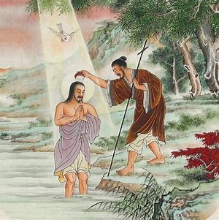
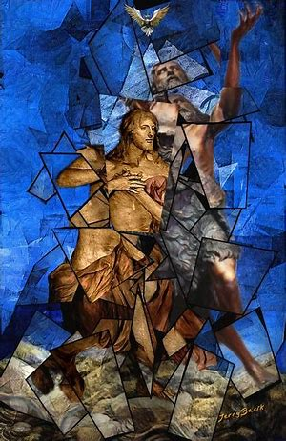
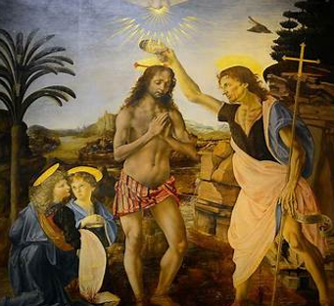
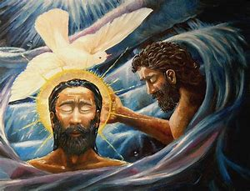
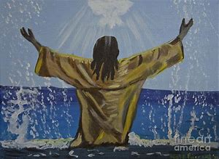
Look at these paintings based on the story.
What is the same or different about them?
How was God letting Jesus know that he was very special to him?

Slide 4
⁹ At that time Jesus came from the town of Nazareth in Galilee to the place where John was. John baptized Jesus in the Jordan River. ¹⁰ When Jesus was coming up out of the water, he saw heaven open. The Holy Spirit came down on him like a dove.
Mark’s gospel tells us this part of the story.
You can listen by clicking here
Mark - Chapter 1

Slide 5
Choose your favourite picture to think about:
Why do you think God sent a dove? Could he have used something else?
How might Jesus have felt?
What other ways might God use to communicate with people?

Slide 6
You can listen by clicking here
A thought for today…
Christians believe that they are never alone, that God is always with them. When Christians are baptised, they become a member of the Church throughout the whole world and there are always others to believe with them – and maybe even for them when they’re finding things really difficult.
By sending the dove, Jesus was reminded that whatever he faced in life, he was not alone. In the same way, God promises to be with each and every person throughout their life, loving and encouraging them, to be the very best they can be.

Slide 7
Putting encouraging into action!
You might want to try:
Find a new way to encourage someone today so that they know they are not on their own
or
Find some recycled materials and make a dove to remind you of God’s spirit with you today

Slide 8
Heavenly Father, just as you reminded Jesus how special he was to you, help me to remember you feel the same way about me. Amen

Slide 9
This resource was produced by the Diocese of Leeds Education Team. For more information about this or future resources,
please contact your named adviser:
simone.bennett@leeds.anglican.org
simon.sloan@leeds.anglican.org
darren.dudman@leeds.anglican.org
janet.tringham@leeds.anglican.org
lee.talbot@leeds.anglican.org
rupert.madeley@leeds.anglican.org

