Slide 2
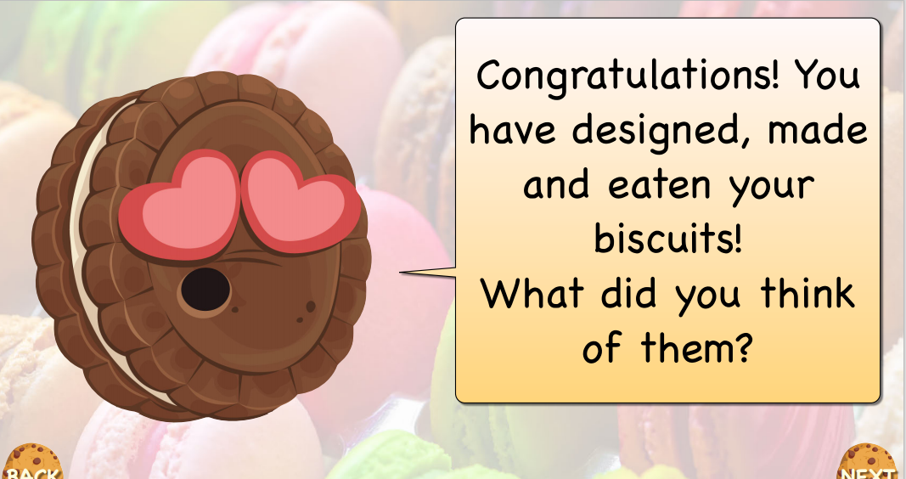

Slide 3
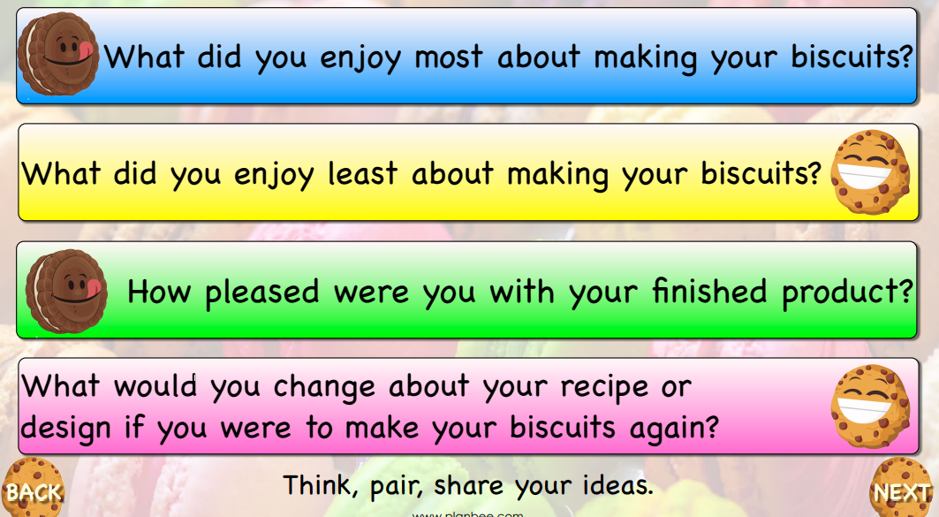

Slide 4
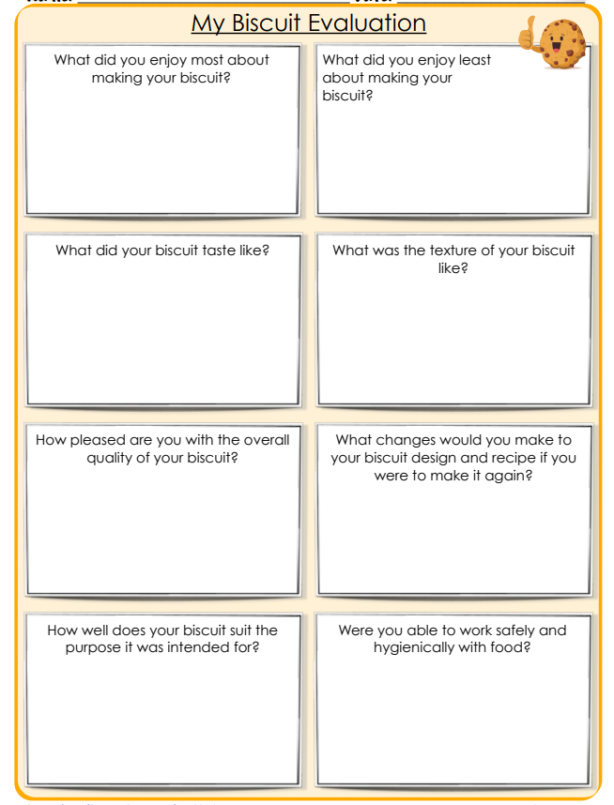

Slide 5
Now I would like you to go back to your original design and annotate any changes or improvements you would make if you were to make your biscuits again.
Well done, that’s the end of the unit!

