Slide 1
Monday 1st February

Slide 2
Phonics - Phase 3
Can you remember the phonemes that we have learned?
See how quickly you can move through the slides saying each phoneme out loud.

Slide 3
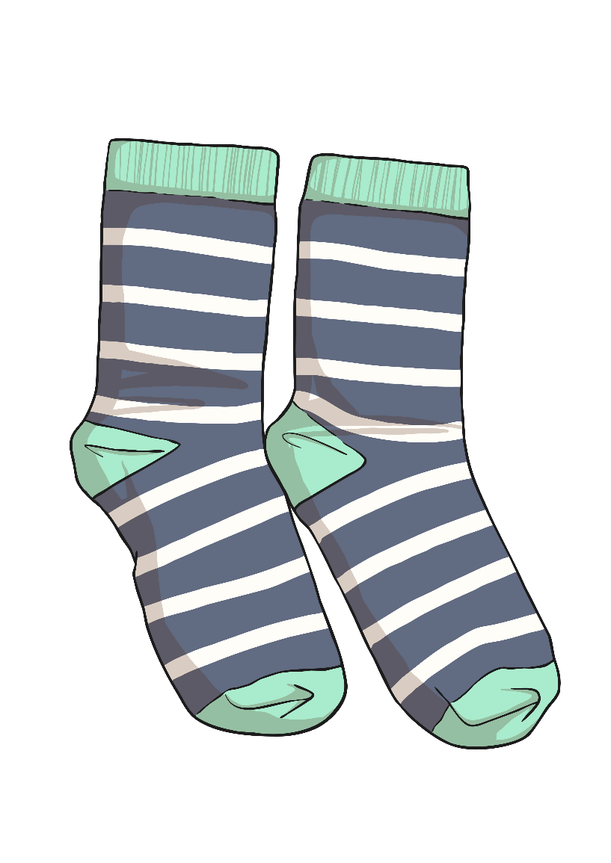
s

Slide 4
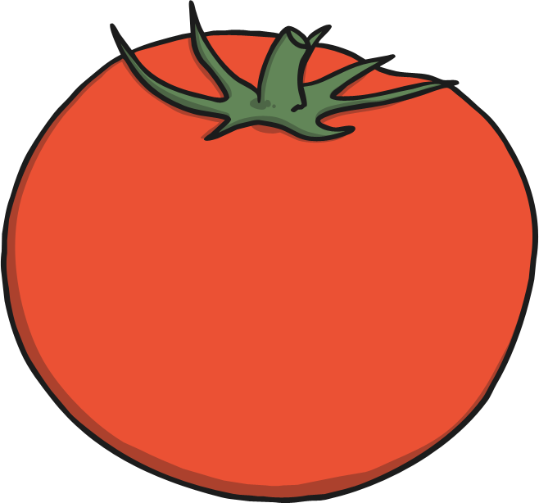
t

Slide 5
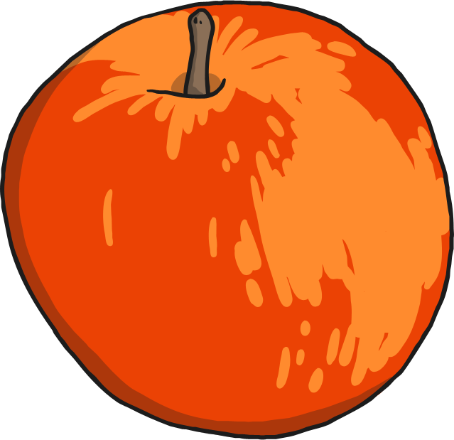
a

Slide 6
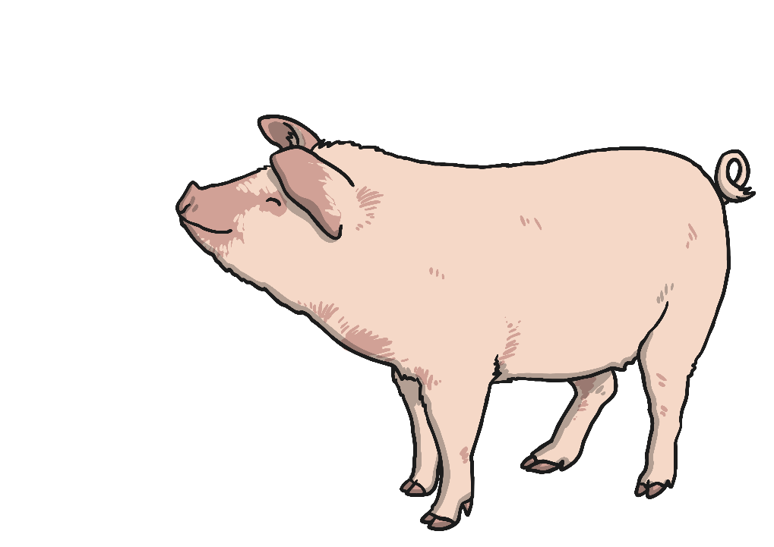
p

Slide 7
i

Slide 8
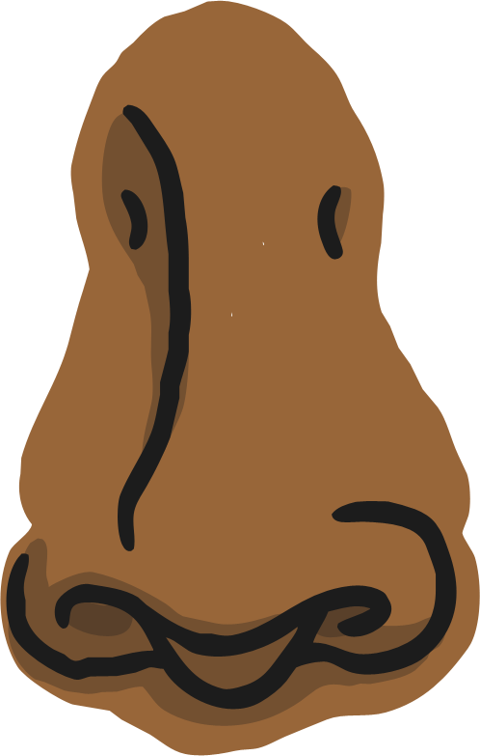
n

Slide 9
m

Slide 10
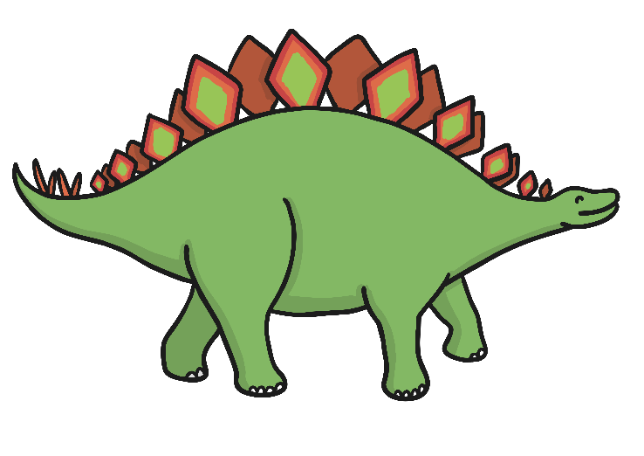
d

Slide 11
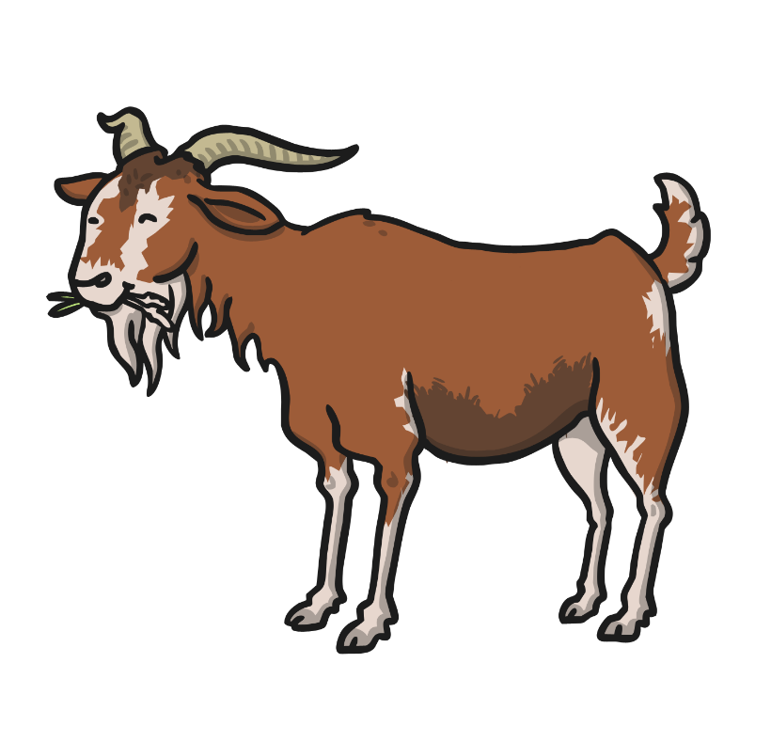
g

Slide 12
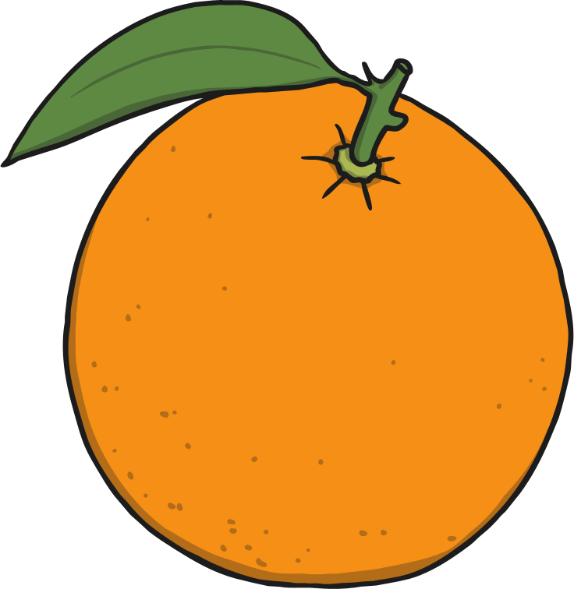
o

Slide 13
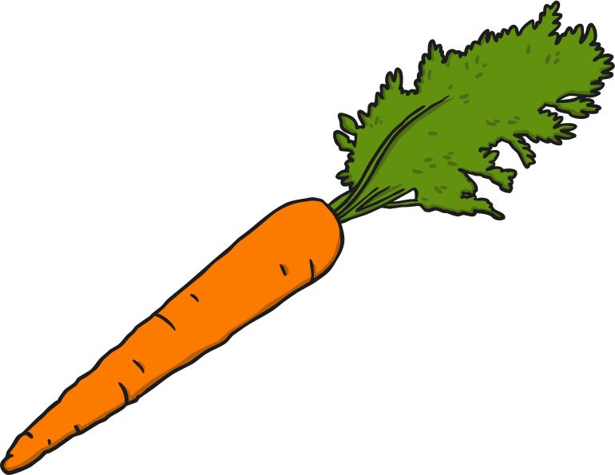
c

Slide 14
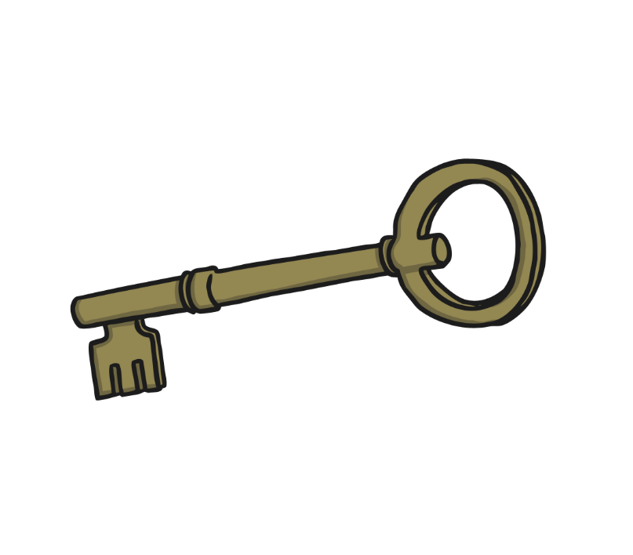
k

Slide 15
ck

Slide 16
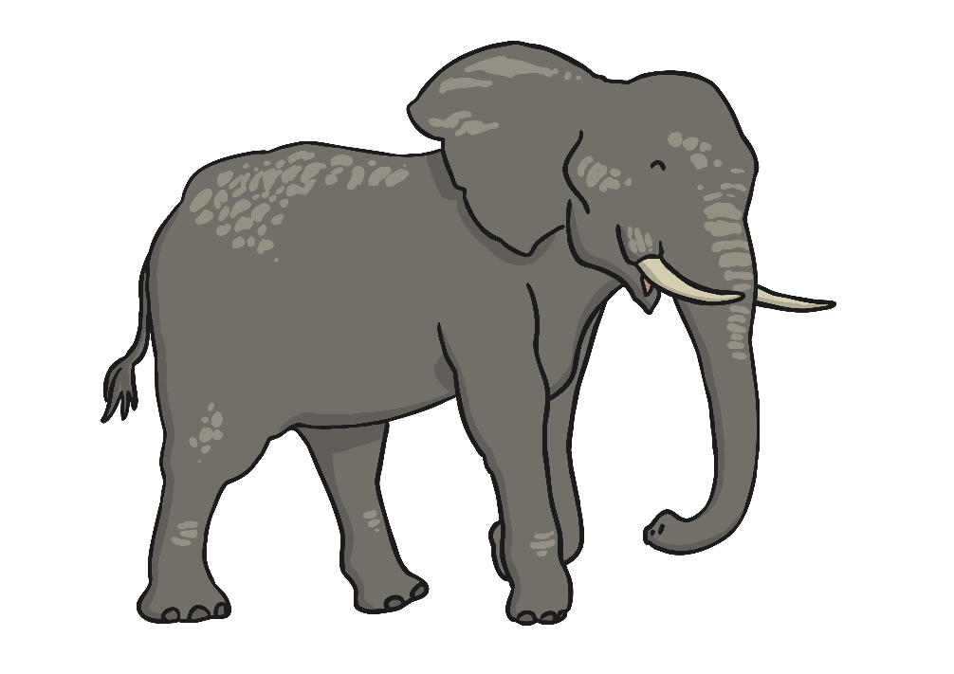
e

Slide 17
u

Slide 18
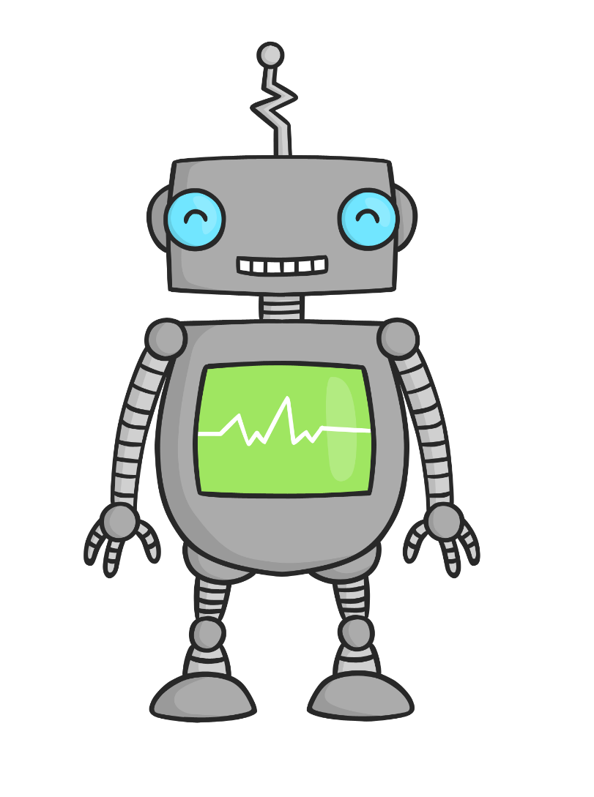
r

Slide 19
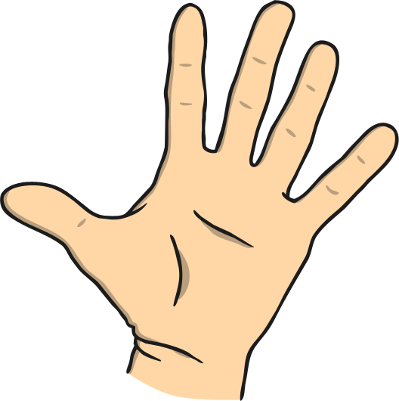
h

Slide 20
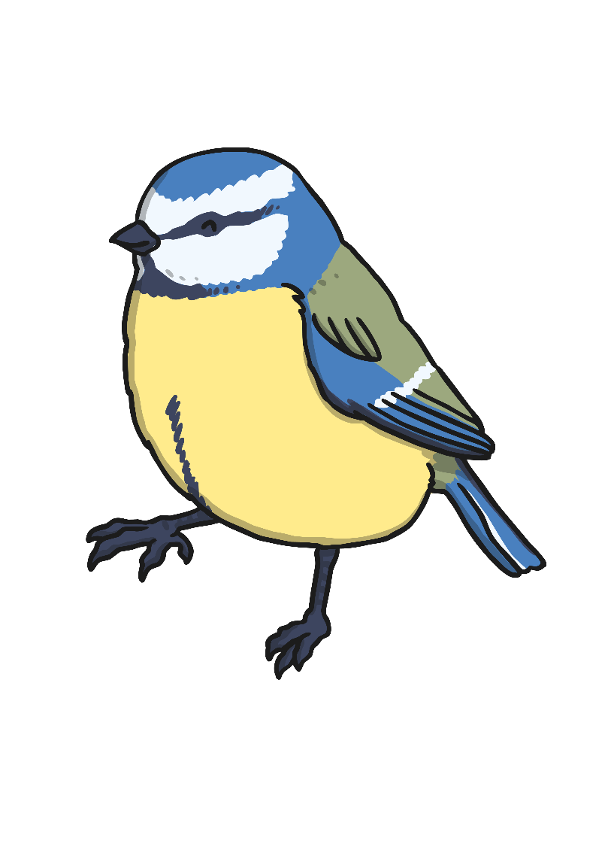
b

Slide 21
f

Slide 22
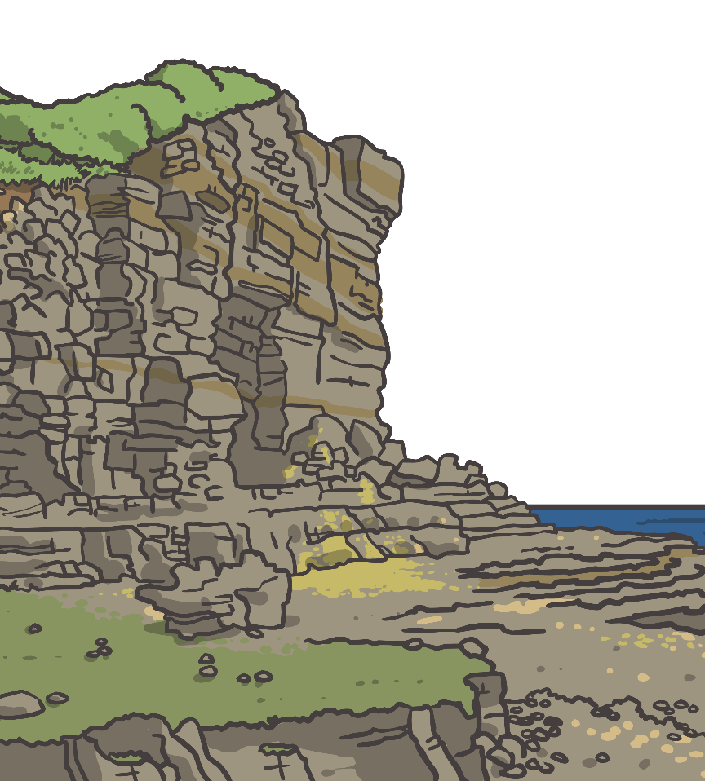
ff

Slide 23
l

Slide 24
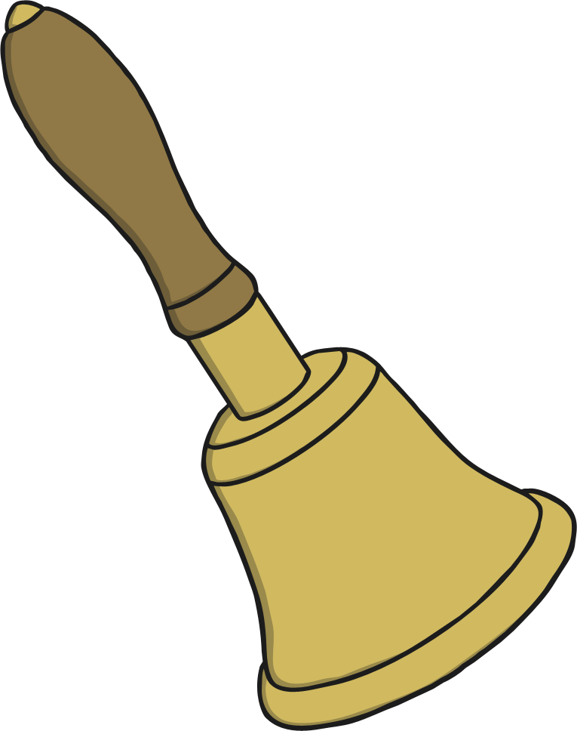
ll

Slide 25
ss

Slide 26
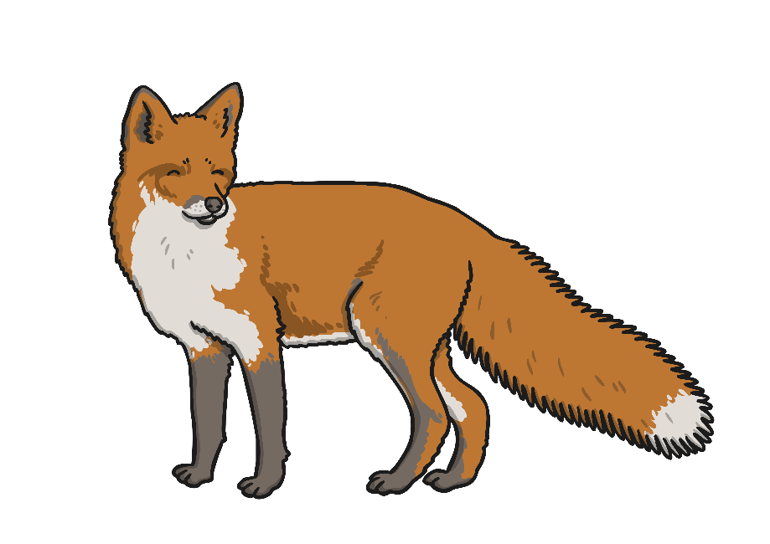
x

Slide 27
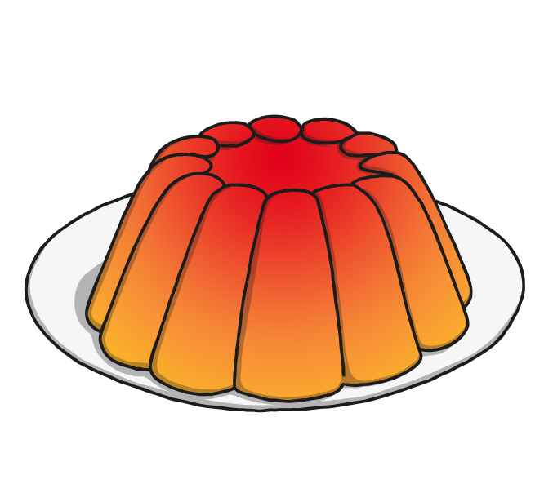
j

Slide 28
v

Slide 29
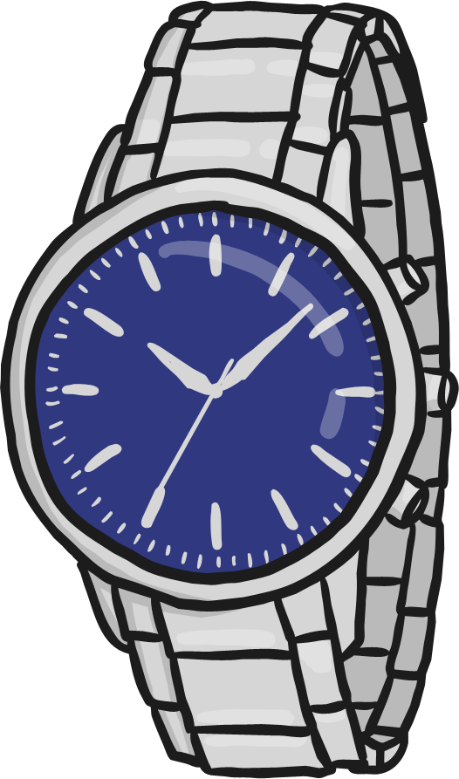
w

Slide 30
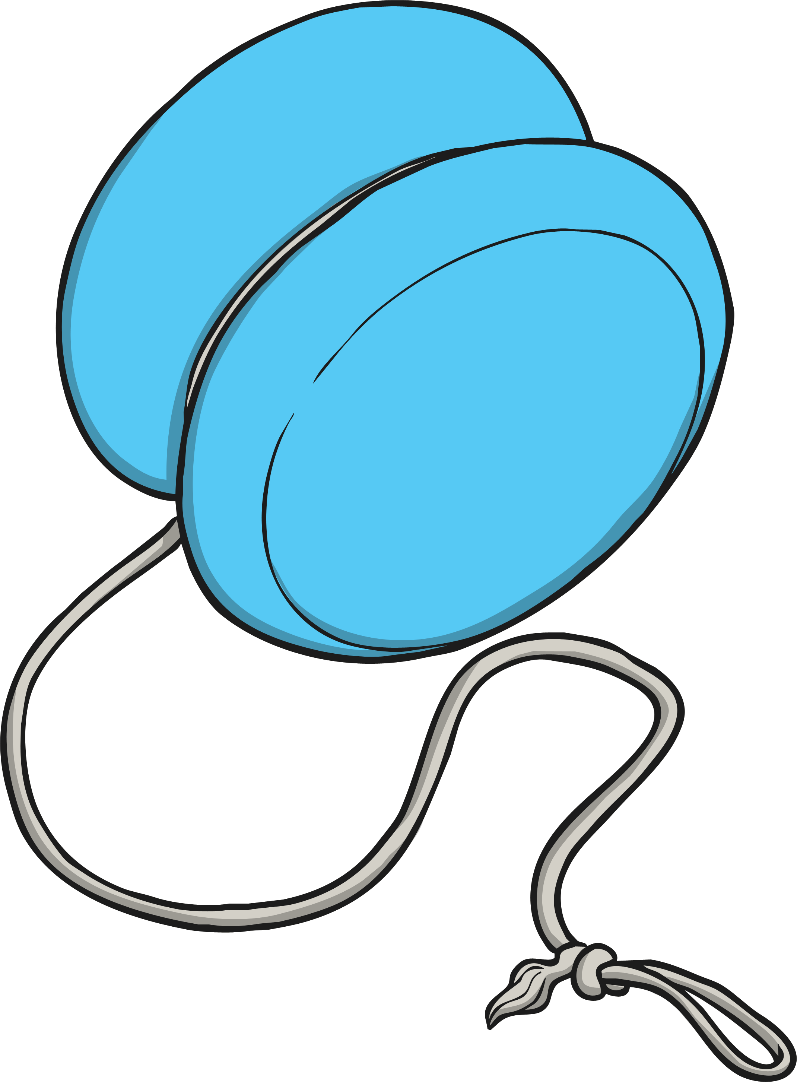
y

Slide 31
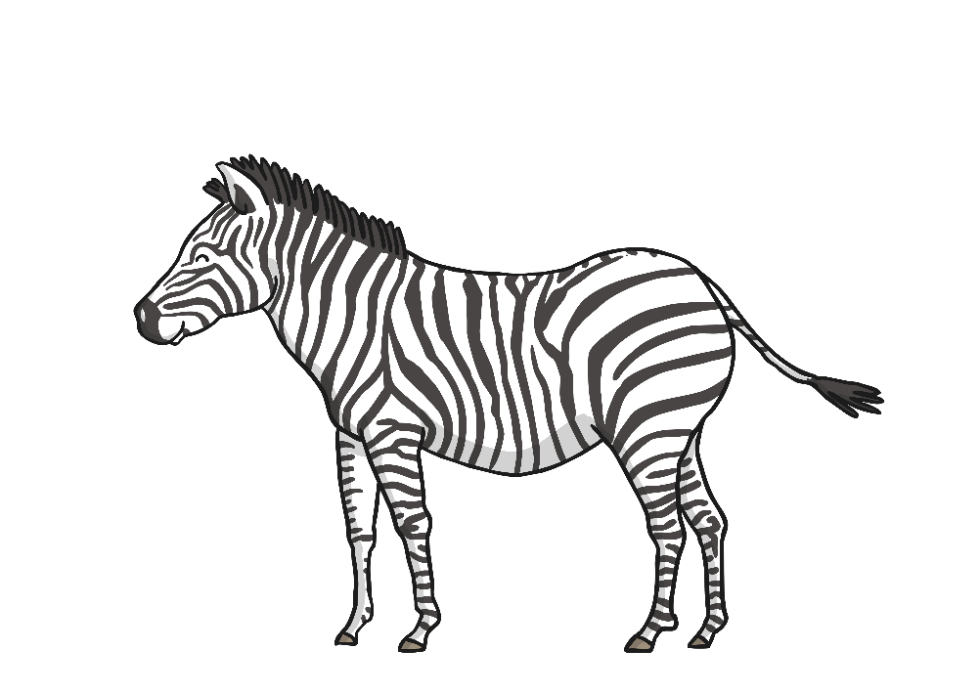
z

Slide 32
zz

Slide 33
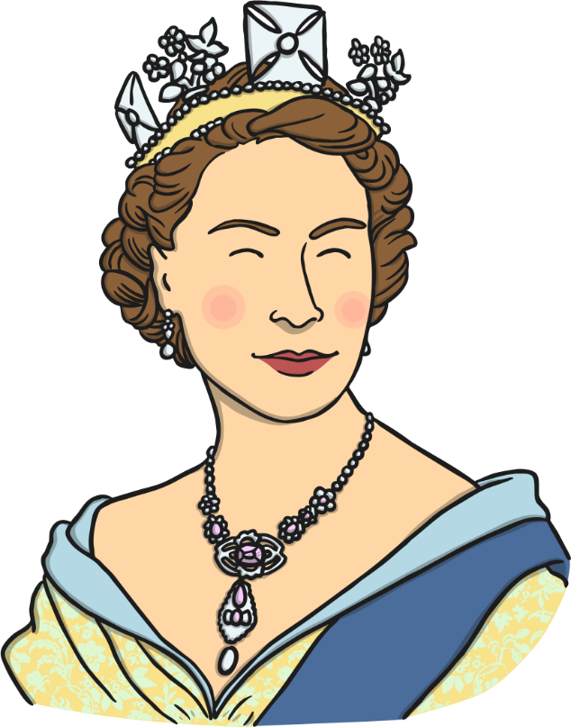
qu

Slide 34
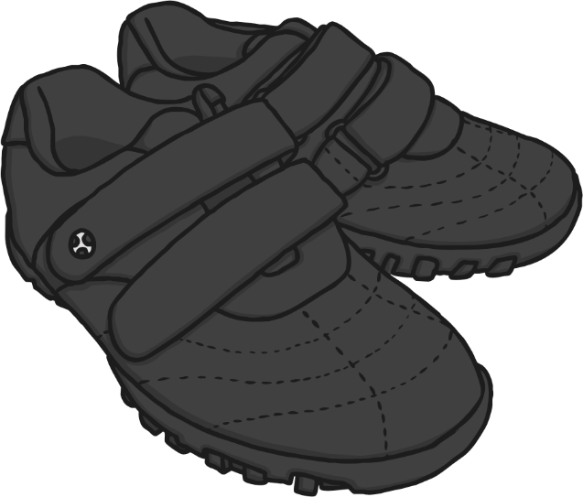
sh

Slide 35
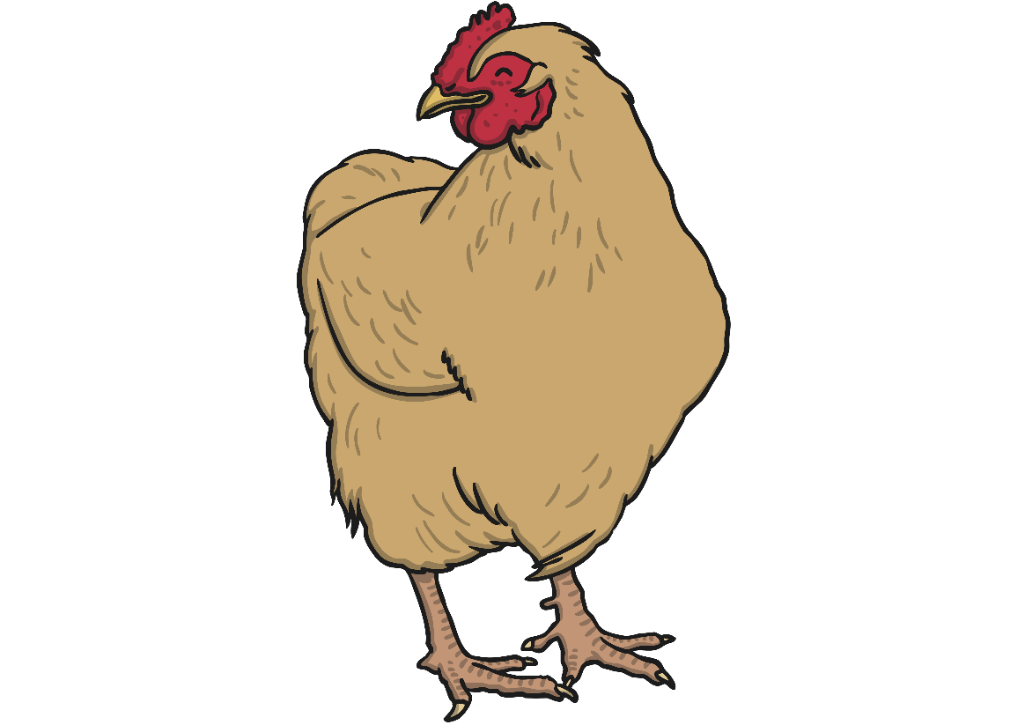
ch

Slide 36
th

Slide 37
ng

Slide 38
ai

Slide 39
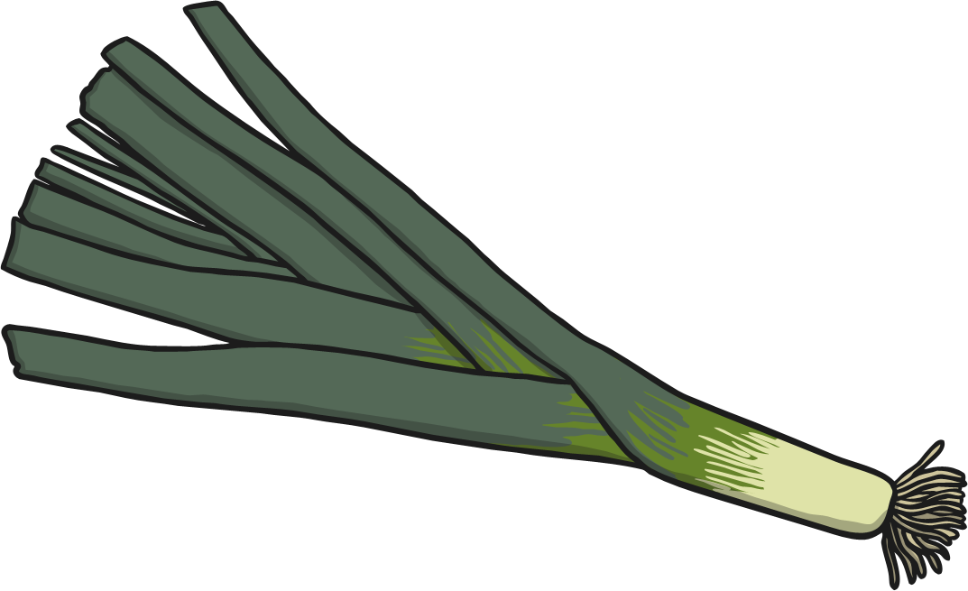
ee

Slide 40
igh

Slide 41
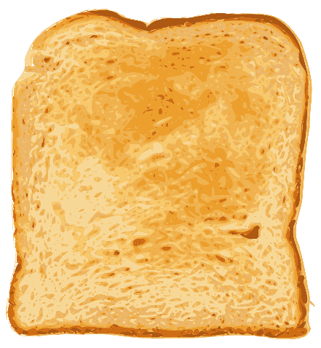
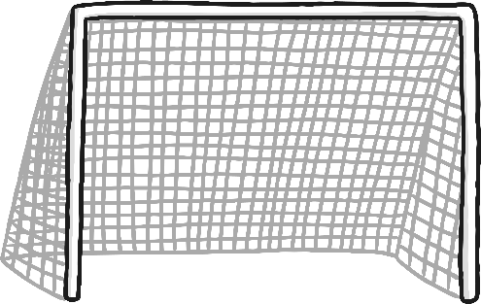
Phonics - Phase 3
Can you guess what our phoneme is today?

Slide 42
Our phoneme today is…
Can you read the ‘oa’ words?
loaf
float
oa
load
moan

Slide 43
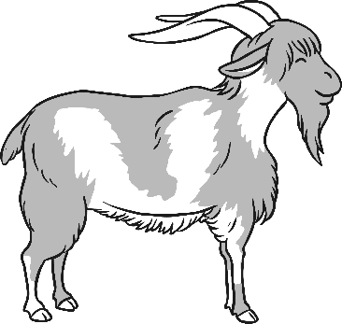
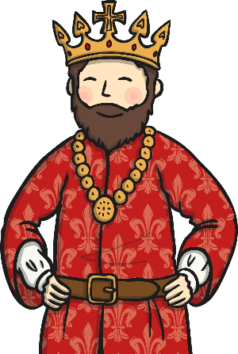
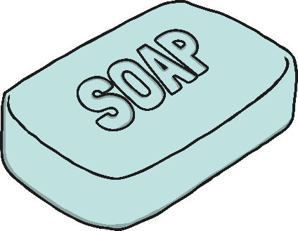
Click the pictures that contain the ‘oa’ sound to move them into the middle.
oa

Slide 44
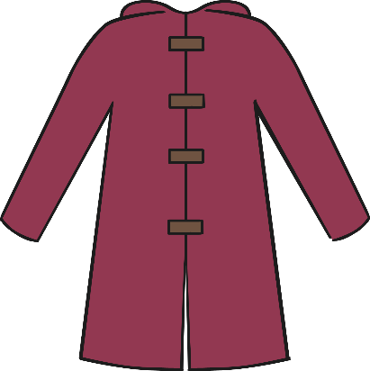
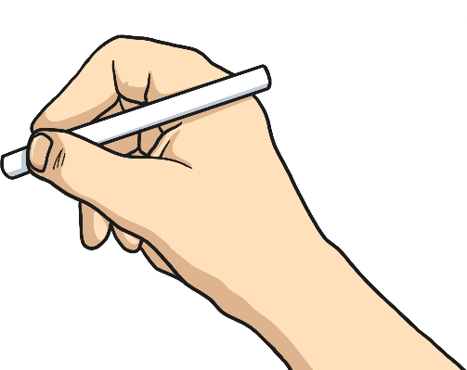
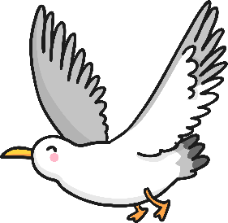
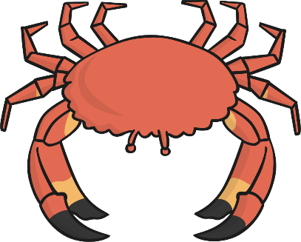
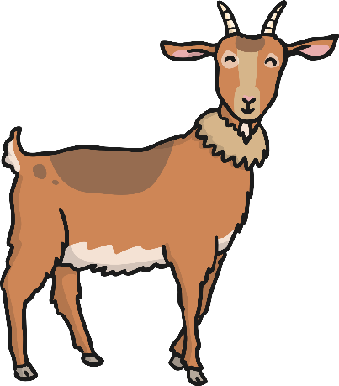
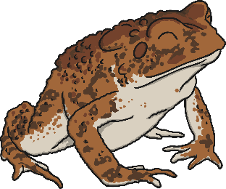
Digraphs
A digraph is a sound which has two letters.
Write the name of each object that has the ‘oa’ sound.

