Slide 1
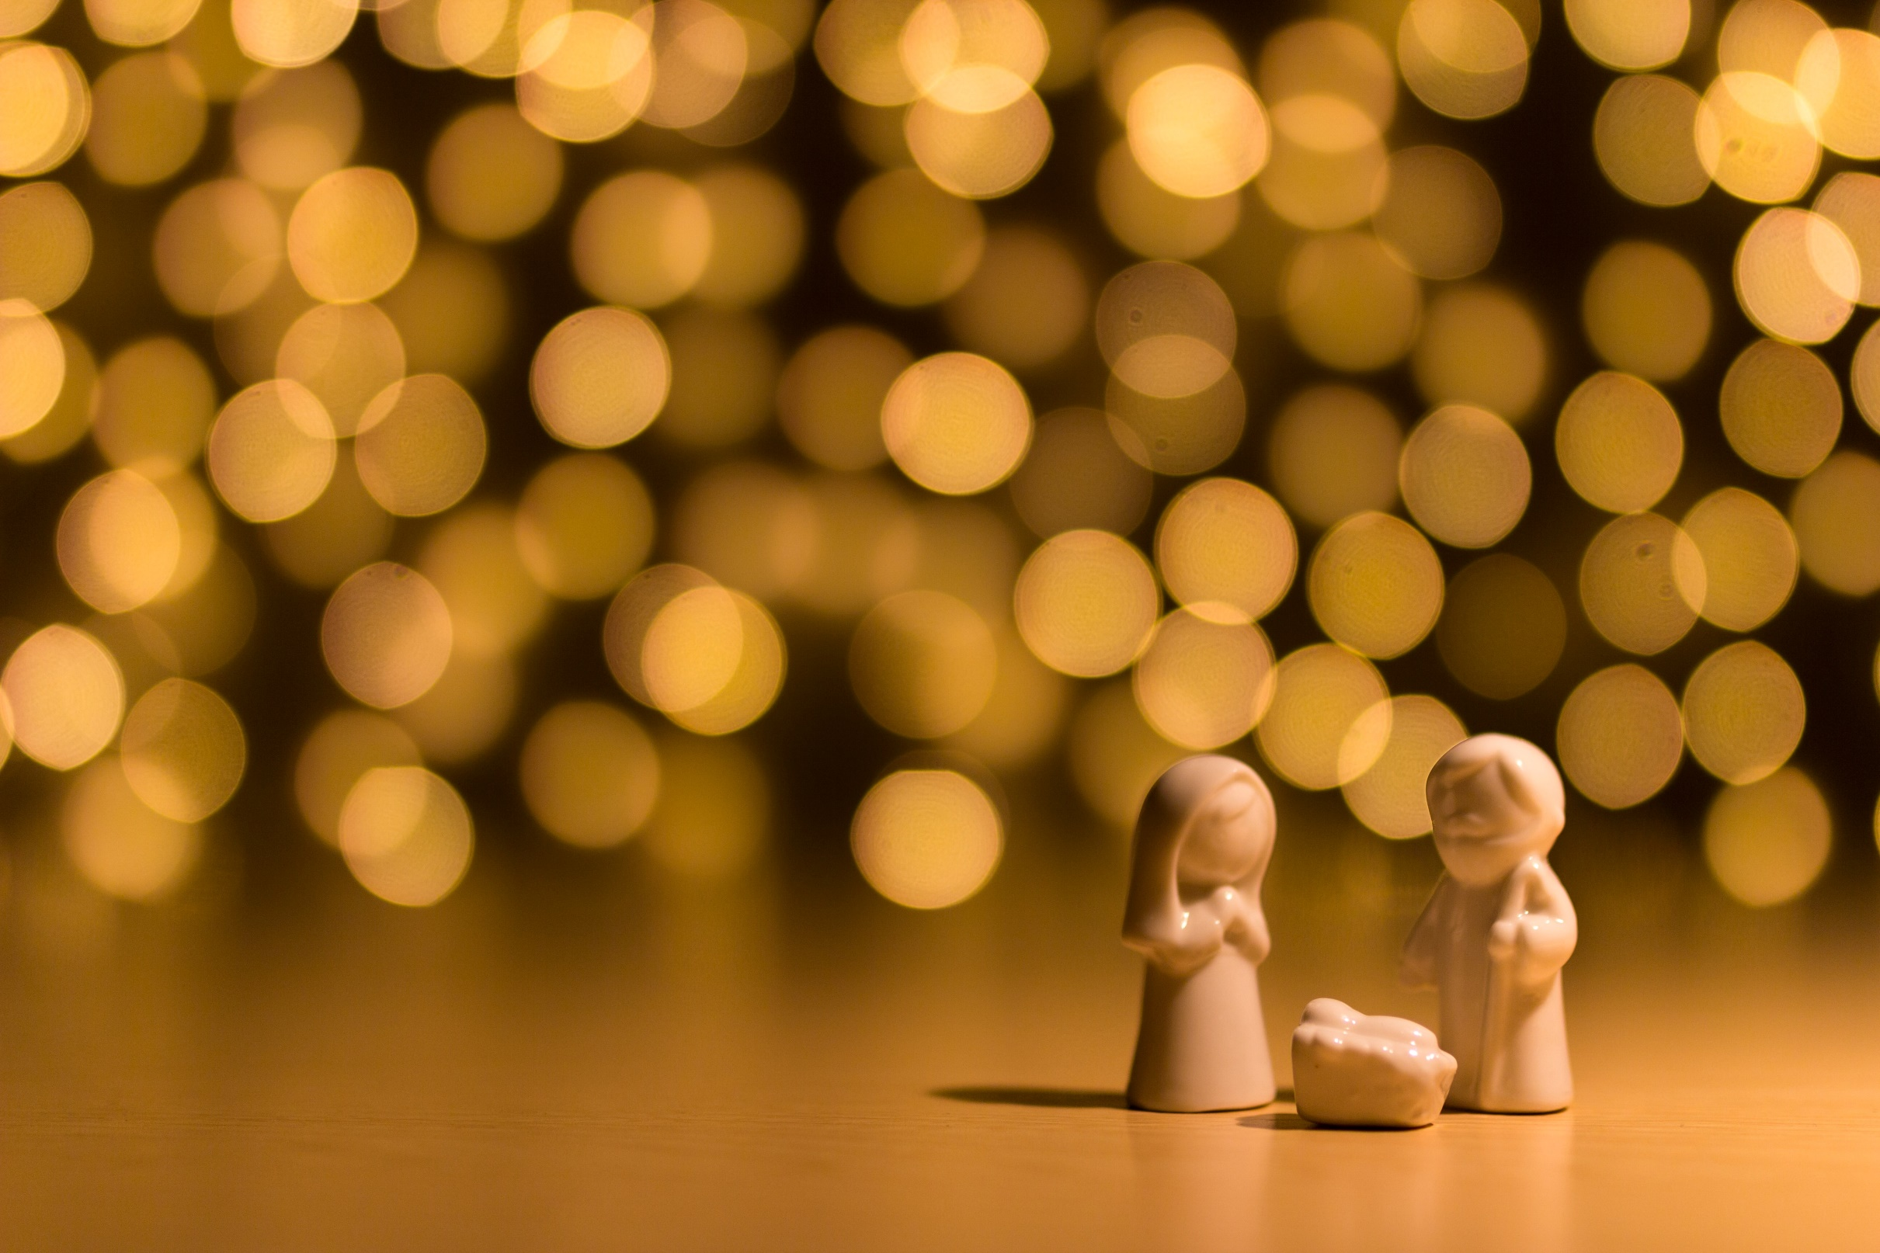
The Rhythm of Life Advent Journey
Creating

Slide 2
Celebration 1
Have a thoughtful look at these images.
Think about what was created,
how they were created
and who created them…

Slide 3
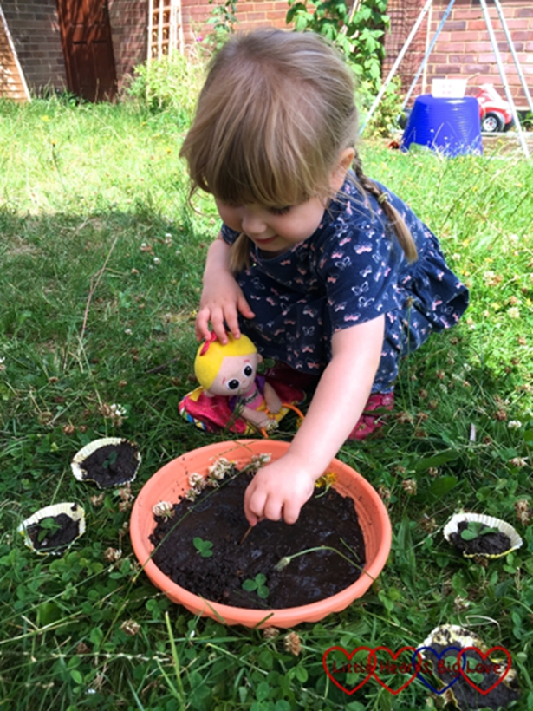
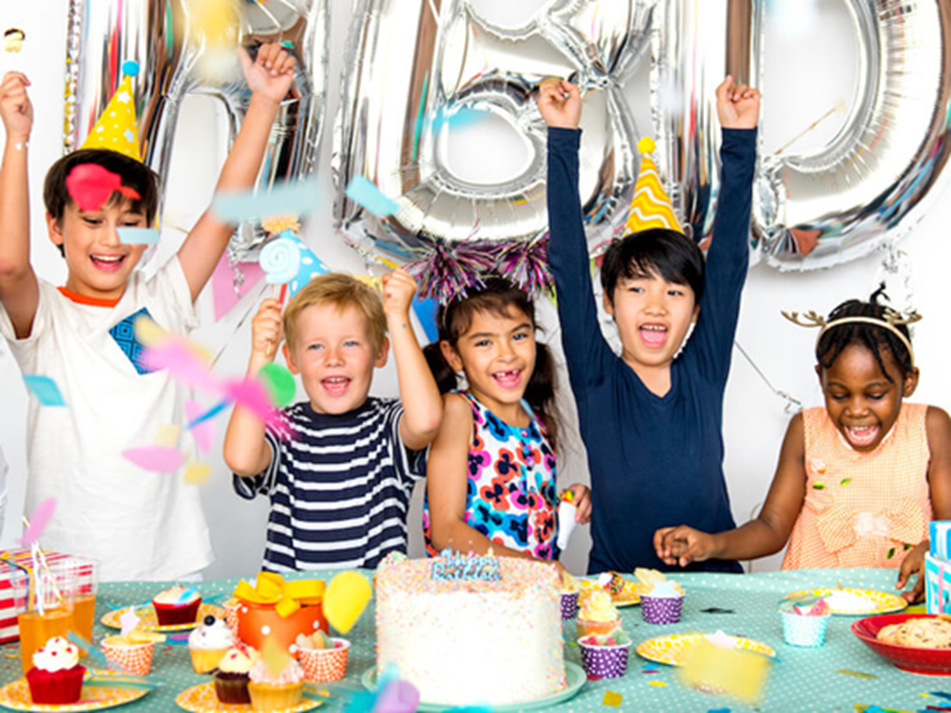
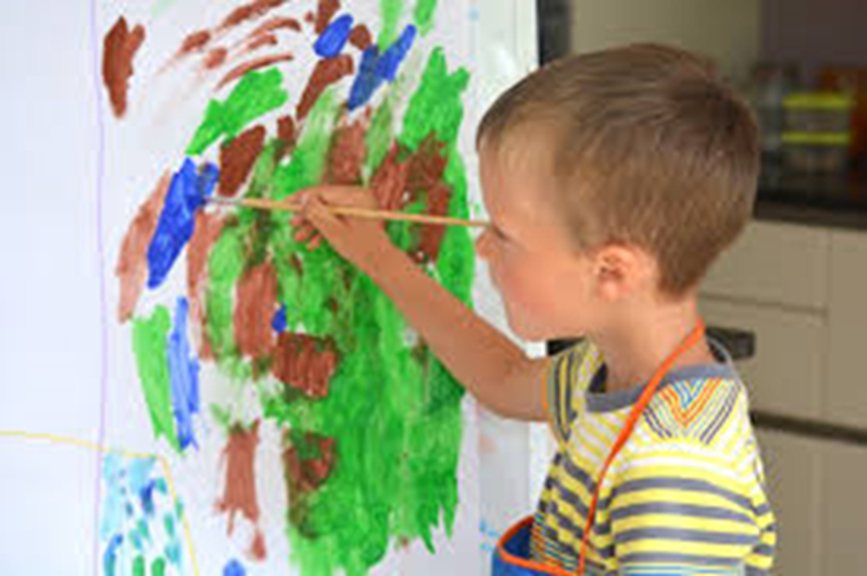
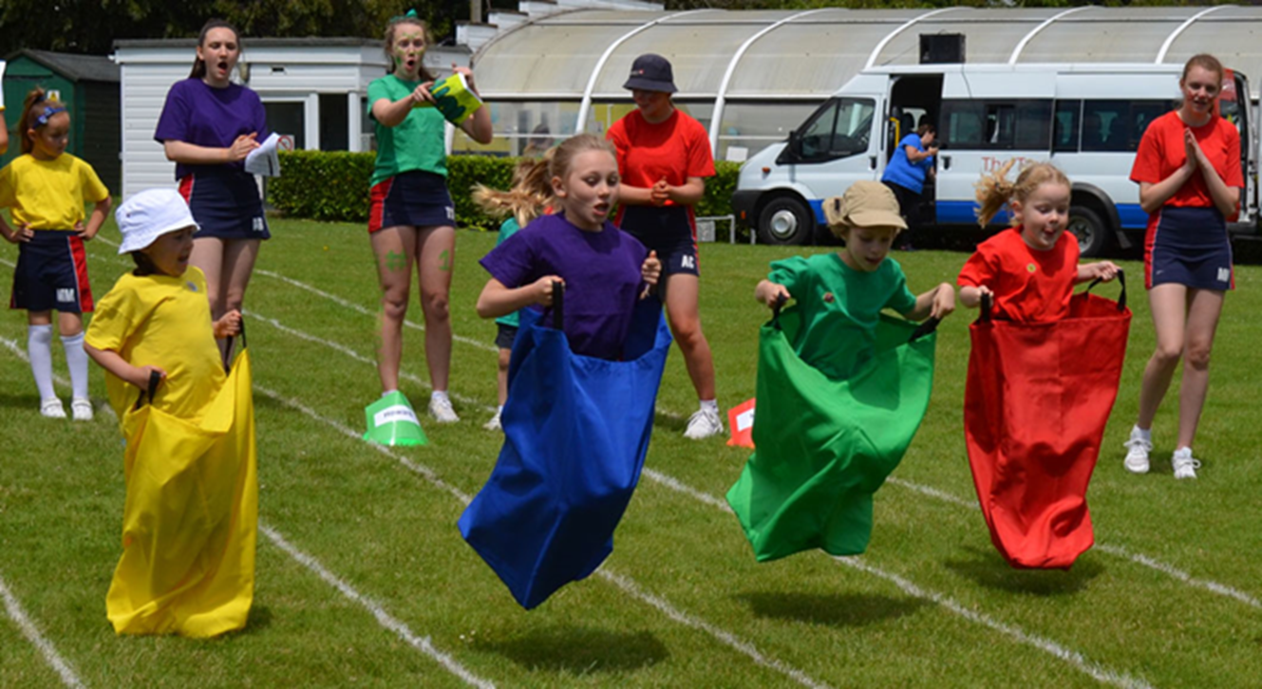
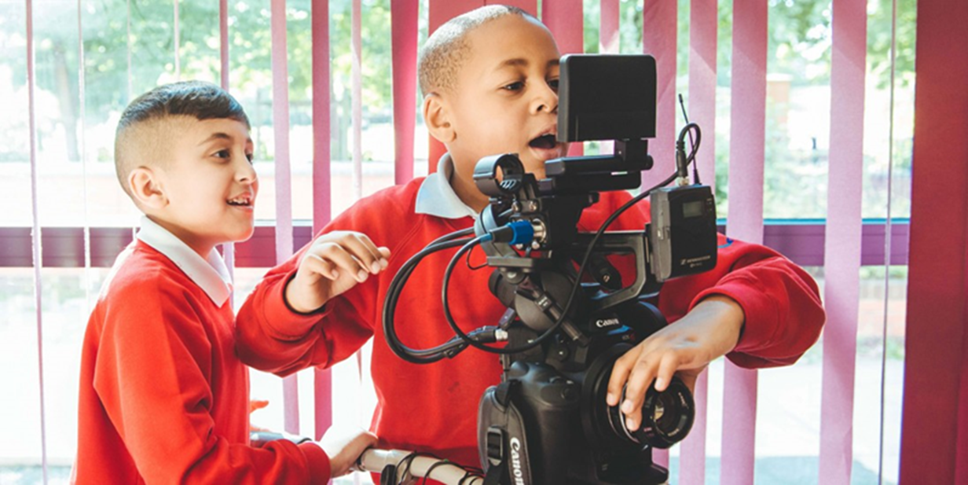
Someone created the sacks, but who created the event?
These boys are creating a film, but who created the camera?
Someone created the cake, but who created the happy party atmosphere?
What was created, how were they created and who created them?

Slide 4
Celebration 1
Creativity starts with imagination, with an idea.
Then you need the patience, hard work and skill to bring that idea into being.
What would you like to create?
Would you create a ‘thing’ or an event,
an occasion, or an atmosphere?
What would you have to do to create it?
Would you do it on your own or would you choose to create with somebody else?

Slide 5
Celebration 1
A thought to take away…
Christians believe that God created everything we know and we are made in his image.
Everyone can be creative. In fact it is who we were made to be. Learning to express that creativity in our own way can bring us joy and happiness. Not only that, but our creativity can also bring joy to others, through the things that we create and from the pleasure of being creative together.

Slide 6
Celebration 1
Today’s Challenge
If you would like to join in with today’s challenge,
why don’t you:
Think of two practical things that you could do today: one to help create a happy home and one to help create a happy school. Which one will you do, or will you do both?
or
Think big! What can everyone do to help create a better world? Design a poster to illustrate this.

Slide 7
Celebration 1
If you would like to, you can join in saying these prayers.
A Prayer for the Day
The Rhythm of Life Prayer
Dear God,
Thank you for giving us the ability to be creative.
Help each of us to create things, large or small, that make the world a better place.
Amen
Loving God,
Help us to learn from you
the habit of creating,
so that the rhythm of our lives
can match the rhythm
of your heart of love.
Amen

Slide 8
This resource was produced by the Diocese of Leeds Education Team.
For more information about this or future resources,
please contact your named adviser:
simone.bennett@leeds.anglican.org
simon.sloan@leeds.anglican.org
darren.dudman@leeds.anglican.org
janet.tringham@leeds.anglican.org
lee.talbot@leeds.anglican.org
rupert.madeley@leeds.anglican.org

