Slide 1
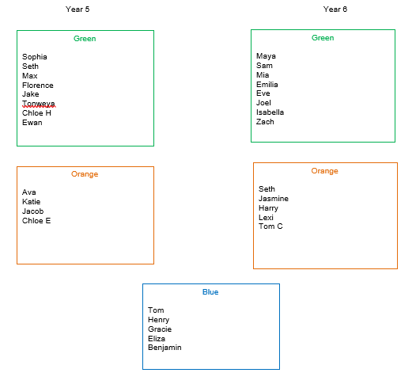
Spelling groups
08.01.21

Slide 2
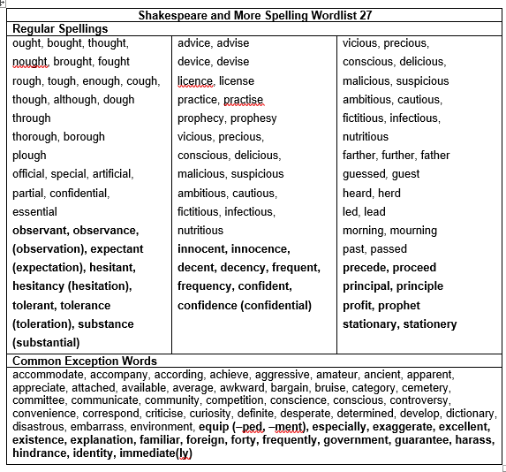
Year 5

Slide 3
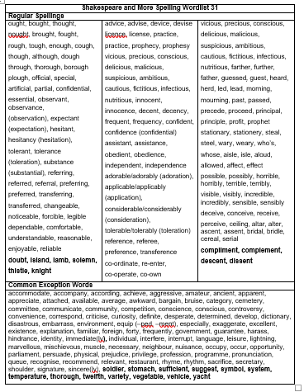
Year 6

Slide 4
08.01.21
Year 5- To be able to spell words ending in -ant, -ance, -ancy, -ent, -ence and -ency.
Year 6- To be able to spell words that include silent letters.

Slide 5
Year 5
How many words can you think of that end in -ant, -ance or -ancy?

Slide 6
Year 5
How many words can you think of that end in -ent, -ence or -ency?

Slide 7
Year 5- To be able to spell words ending in -​ant, -ance, -ancy, -ent, -ence and -ency.
You can use related words to help you to ​decide if it's an -ant, -ance or -ancy ending. You can use the root words, or words ending in ​-ation to help (eg. observation- observant.)
Use -ent, -ence and -ency after soft c, soft g and qu.
There are many words, however, where the above rules don't help. They just have to be learned.

Slide 8
Spelling focus: To be able to spell words ending in -ant, -ance, -ancy, -ent, ence and -ency.
Spelling words:
observant
tolerance
hesitancy
innocent
confidence
Your test will be on 15.01.21
on
Teams

Slide 9
Year 6- To be able to spell words that include silent letters.
These are letters whose presence cannot be predicted from the pronunciation of the word.
Some letters which are no longer sounded used to be sounded hundreds of years ago: eg in knight there was a k sound before the n.

Slide 10
Spelling focus: To be able to spell words that include silent letters.
Your test will be on 15.01.21
on
Teams
Spelling words:
doubt
island
lamb
solemn
thistle

Slide 11
Blue group- High frequency words.
Spelling words:
like
see
their
saw
his
some
looked
people
Your test will be ​on 15.01.21
on
Teams

Slide 12
Year 5 & 6
Blue:
You will be tested on the 8 spellings you're given.
Green:
You will be tested on the 5 spellings you're given plus 5 more. I will choose those 5 from the spelling sheet you have.
Orange:
You will be tested on the 5 spellings you're given plus 5 more. The 5 extra spellings may or may not be chosen from the spelling sheet you have.

Slide 13
Spelling task- 08.01.21
This week I would like you to write 5
sentences for the words you have been given to learn. Each sentence must include one of
the words.
You must use the words in the correct context, so you will need to know what they mean.
Please can you write this in your red spelling
book. You need to underline the 5 spellings I gave you.

