Slide 2
Analysing an Imaginary Setting Description
Read this imaginary setting description before beginning to plan your own.
What is your favourite thing in this description?
The city inside the great white walls burst with colour and light. Flowers of all kinds decorated the walls like a tapestry; marble pillars supported cool, shaded balconies and clear, crystalline pools filled stone basins. Mist from a nearby water feature speckled Cole’s skin and he sighed as the thick layer of dust covering his body was swept away by a gentle breeze. Above everything towered the monumental palace with its marble turrets and, looking up, Cole saw soft, white clouds which seemed to vanish at the boundary wall as though trapped in this little oasis. It was, in every way, the complete opposite of the oppressive, stifling heat outside the palace walls.
What is the atmosphere like in this place?
How has the author made the reader feel this way about the place?

Slide 3
Analysing an Imaginary Setting Description
Read this imaginary setting description before beginning to plan your own.
The setting is a beautiful and pleasant one. The author describes typically attractive features of the setting.
It is also a very grand place. The author describes impressive objects and buildings.
The city inside the great white walls burst with colour and light. Flowers of all kinds decorated the walls like a tapestry; marble pillars supported cool, shaded balconies and clear, crystalline pools filled stone basins. Mist from a nearby water feature speckled Cole’s skin and he sighed as the thick layer of dust covering his body was swept away by a gentle breeze. Above everything towered the monumental palace with its marble turrets and, looking up, Cole saw soft, white clouds which seemed to vanish at the boundary wall as though trapped in this little oasis. It was, in every way, the complete opposite of the oppressive, stifling heat outside the palace walls.

Slide 4
Analysing an Imaginary Setting Description
Read this imaginary setting description before beginning to plan your own.
The author has used figurative language to help the reader to feel the same way as Cole does.
Figurative language conjures up images and sounds in the reader’s mind.
Can you see any examples of figurative language here?
The city inside the great white walls burst with colour and light. Flowers of all kinds decorated the walls like a tapestry; marble pillars supported cool, shaded balconies and clear, crystalline pools filled stone basins. Mist from a nearby water feature speckled Cole’s skin and he sighed as the thick layer of dust covering his body was swept away by a gentle breeze. Above everything towered the monumental palace with its marble turrets and, looking up, Cole saw soft, white clouds which seemed to vanish at the boundary wall as though trapped in this little oasis. It was, in every way, the complete opposite of the oppressive, stifling heat outside the palace walls.

Slide 5
Analysing an Imaginary Setting Description
Read this imaginary setting description before beginning to plan your own.
This is a metaphor. The author claims that the city is ‘bursting’, which the reader knows isn’t true. ‘Burst’ conjures up the image of the lights and colours appearing in Cole’s vision quickly and all at once.
The city inside the great white walls burst with colour and light. Flowers of all kinds decorated the walls like a tapestry; marble pillars supported cool, shaded balconies and clear, crystalline pools filled stone basins. Mist from a nearby water feature speckled Cole’s skin and he sighed as the thick layer of dust covering his body was swept away by a gentle breeze. Above everything towered the monumental palace with its marble turrets and, looking up, Cole saw soft, white clouds which seemed to vanish at the boundary wall as though trapped in this little oasis. It was, in every way, the complete opposite of the oppressive, stifling heat outside the palace walls.

Slide 6
Analysing an Imaginary Setting Description
Read this imaginary setting description before beginning to plan your own.
This is a simile.
Similes compare the setting to something else, to help the reader to visualise it. The author compares the flowers on the walls to a ‘tapestry’, suggesting that there are lots of flowers packed tightly together with no spaces in between, and very beautiful so that it looks like they were designed in a pattern.
The city inside the great white walls burst with colour and light. Flowers of all kinds decorated the walls like a tapestry; marble pillars supported cool, shaded balconies and clear, crystalline pools filled stone basins. Mist from a nearby water feature speckled Cole’s skin and he sighed as the thick layer of dust covering his body was swept away by a gentle breeze. Above everything towered the monumental palace with its marble turrets and, looking up, Cole saw soft, white clouds which seemed to vanish at the boundary wall as though trapped in this little oasis. It was, in every way, the complete opposite of the oppressive, stifling heat outside the palace walls.

Slide 7
Analysing an Imaginary Setting Description
Read this imaginary setting description before beginning to plan your own.
Sometimes, authors will try to create sounds to support their setting descriptions. Here, the author has put three words beginning with ‘c’ close together, so that the reader repeats a clean, refreshing ‘c’ sound in their mind. This is called alliteration. Can you think of any more ‘c’ words that might describe this setting?
The city inside the great white walls burst with colour and light. Flowers of all kinds decorated the walls like a tapestry; marble pillars supported cool, shaded balconies and clear, crystalline pools filled stone basins. Mist from a nearby water feature speckled Cole’s skin and he sighed as the thick layer of dust covering his body was swept away by a gentle breeze. Above everything towered the monumental palace with its marble turrets and, looking up, Cole saw soft, white clouds which seemed to vanish at the boundary wall as though trapped in this little oasis. It was, in every way, the complete opposite of the oppressive, stifling heat outside the palace walls.

Slide 8
Analysing an Imaginary Setting Description
Read this imaginary setting description before beginning to plan your own.
calm
clad classical classy
clean
cloudy
colourful comfy
covered
cozy
crisp
The city inside the great white walls burst with colour and light. Flowers of all kinds decorated the walls like a tapestry; marble pillars supported cool, shaded balconies and clear, crystalline pools filled stone basins. Mist from a nearby water feature speckled Cole’s skin and he sighed as the thick layer of dust covering his body was swept away by a gentle breeze. Above everything towered the monumental palace with its marble turrets and, looking up, Cole saw soft, white clouds which seemed to vanish at the boundary wall as though trapped in this little oasis. It was, in every way, the complete opposite of the oppressive, stifling heat outside the palace walls.

Slide 9
Analysing an Imaginary Setting Description
Read this imaginary setting description before beginning to plan your own.
The author has also put two words with an ‘oo’ sound close together. Can you make an ‘oo’ sound that sounds like you are relaxed and happy?
This is called assonance. The author has made the reader hear the sound ‘oo’ twice to help them to feel the relaxed atmosphere of the setting.
The city inside the great white walls burst with colour and light. Flowers of all kinds decorated the walls like a tapestry; marble pillars supported cool, shaded balconies and clear, crystalline pools filled stone basins. Mist from a nearby water feature speckled Cole’s skin and he sighed as the thick layer of dust covering his body was swept away by a gentle breeze. Above everything towered the monumental palace with its marble turrets and, looking up, Cole saw soft, white clouds which seemed to vanish at the boundary wall as though trapped in this little oasis. It was, in every way, the complete opposite of the oppressive, stifling heat outside the palace walls.

Slide 10
Analysing an Imaginary Setting Description
Read this imaginary setting description before beginning to plan your own.
Here, the author describes how the mist feels on Cole’s skin.
It is important to include more of the five senses in your description than just what the character can see. However, there is no need to describe every sensation if it does not add to the overall effect of the description.
The city inside the great white walls burst with colour and light. Flowers of all kinds decorated the walls like a tapestry; marble pillars supported cool, shaded balconies and clear, crystalline pools filled stone basins. Mist from a nearby water feature speckled Cole’s skin and he sighed as the thick layer of dust covering his body was swept away by a gentle breeze. Above everything towered the monumental palace with its marble turrets and, looking up, Cole saw soft, white clouds which seemed to vanish at the boundary wall as though trapped in this little oasis. It was, in every way, the complete opposite of the oppressive, stifling heat outside the palace walls.

Slide 11
Analysing an Imaginary Setting Description
Read this imaginary setting description before beginning to plan your own.
The author also describes how Cole reacts to the setting. This helps the reader to feel as though they are experiencing the atmosphere with the character, and gives them clues about how the character is feeling.
How do you think Cole is feeling in the setting?
The city inside the great white walls burst with colour and light. Flowers of all kinds decorated the walls like a tapestry; marble pillars supported cool, shaded balconies and clear, crystalline pools filled stone basins. Mist from a nearby water feature speckled Cole’s skin and he sighed as the thick layer of dust covering his body was swept away by a gentle breeze. Above everything towered the monumental palace with its marble turrets and, looking up, Cole saw soft, white clouds which seemed to vanish at the boundary wall as though trapped in this little oasis. It was, in every way, the complete opposite of the oppressive, stifling heat outside the palace walls.

Slide 12
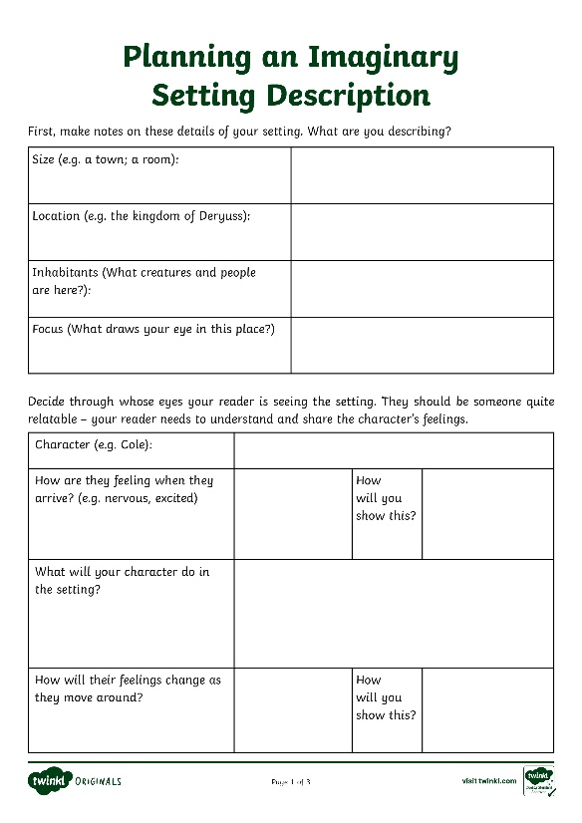
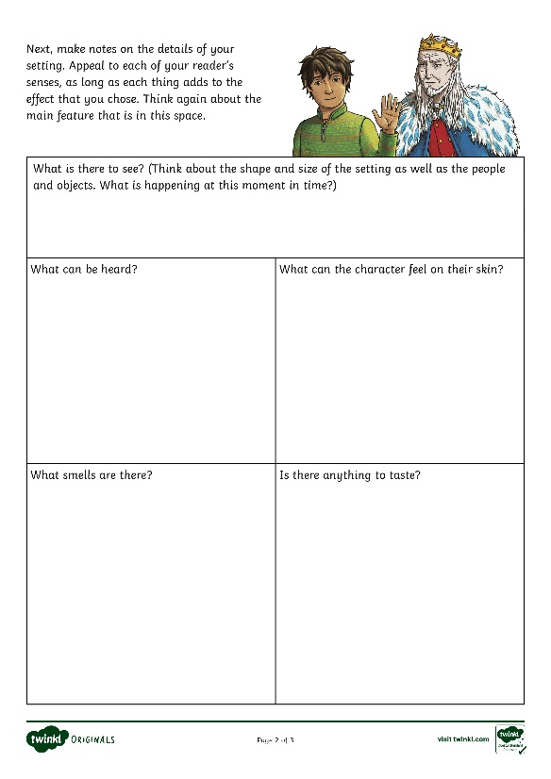
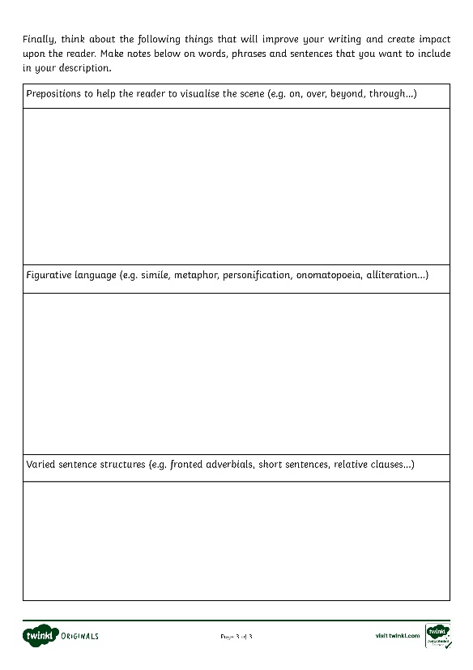
Planning Your Own Imaginary Setting Description
Use the Planning an Imaginary Setting Description Activity Sheet and PowerPoint to help you to create your own description.

