Slide 1
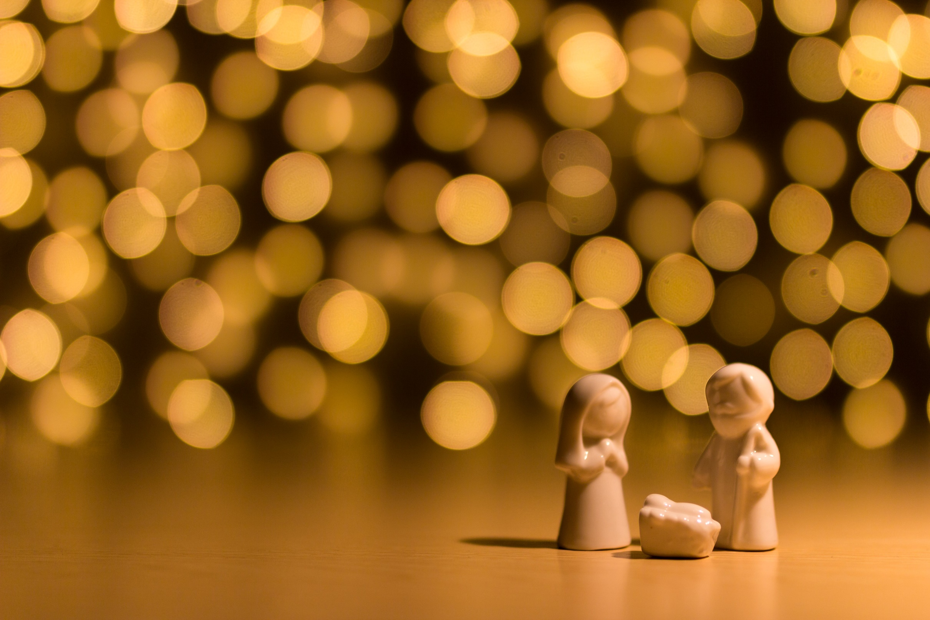
The Rhythm of Life Advent Journey
Celebrating

Slide 2
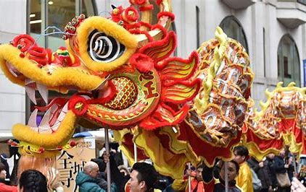
They are all celebrating the New Year.
Advent is the start of a new year for the Church. It is a time to look back over the seasons that have passed and look forward to the birth of Jesus at Christmas.
Do you know what these
pictures have in common?

Slide 3
We are going to listen to a song called Celebration. It is being sung by children from all over the world who want to change things for the better.
This has been a very different year for all of us.
As you listen, what are the things you have still celebrated this year and what are you looking forward to…?

Slide 4
What did you think of?
What can we celebrate from the year that has gone?
What are we hoping to celebrate in the year to come?
N
O
W

Slide 5
A thought to take away…
Celebrations don’t have to be big events or parties.
Sometimes they’re a time to take pride in a job well done, achieving something you have struggled with or giving something new a try.
Sometimes we need to remember to celebrate the little things too. The things that we can often take for granted, but make our lives better – a friend, a smile, the gift of love.

Slide 6
Celebration 1
Today’s Challenge
If you would like to have a go at today’s challenge, why don’t you:
Draw two candles. On one, write or draw something good from this year and on the other, something you are looking forward to. The candles remind us that even when things seem dark, a light can still shine. You might want to ask at home and see if you can light some candles too and share the things you chose.
or
Ask someone at home if you can bake an ‘Advent cake’. As you eat it together with some family or friends, talk about all things you are looking forward to at Christmas and for the new year.

Slide 7
If you would like to, you can join in saying these prayers.
A Prayer for the Day
The Rhythm of Life Prayer
Heavenly Father,
As we look back over this year, help us to celebrate the things that have still been good.
As we look forward, help us to remember the small things that bring joy to our lives,
each and every day.
Amen
Loving God,
Help us to learn from you
the habit of celebrating,
so that the rhythm of our lives can match
the rhythm of your heart of love.
Amen

Slide 8
This resource was produced by the Diocese of Leeds Education Team.
For more information about this or future resources,
please contact your named adviser:
simone.bennett@leeds.anglican.org
simon.sloan@leeds.anglican.org
darren.dudman@leeds.anglican.org
janet.tringham@leeds.anglican.org
lee.talbot@leeds.anglican.org
rupert.madeley@leeds.anglican.org

