Slide 1
LO: To learn about speech marks. To write a dialogue for the characters

Slide 2
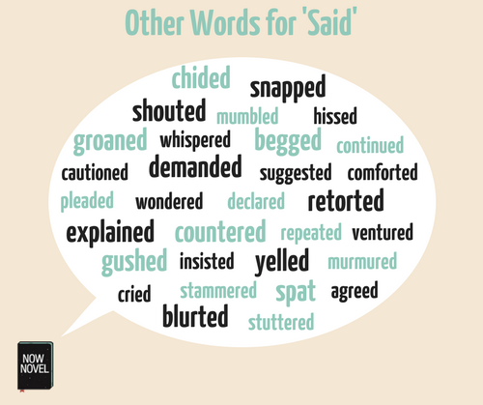
What words can we use instead of ‘said’?
Notes:
Go through the words – What image do they get when they hear these words…What sort of story will it be about? Which story genre will it be? Then read the story until pg 12.

Slide 3
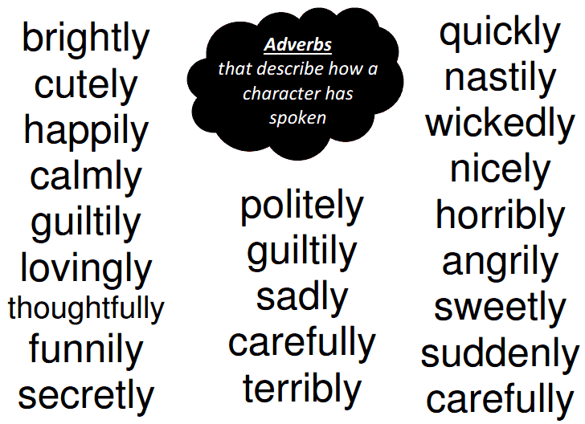
What words can we use instead of ‘said’?
How do characters speak?
Notes:
Go through the words – What image do they get when they hear these words…What sort of story will it be about? Which story genre will it be? Then read the story until pg 12.

Slide 4
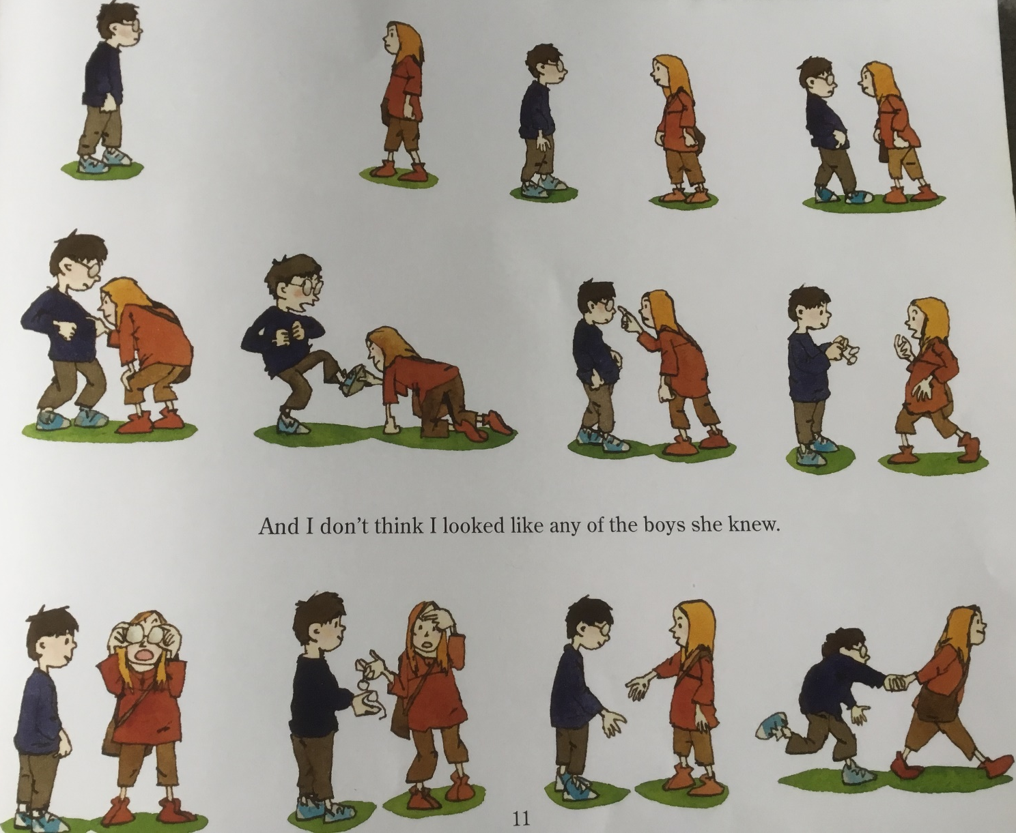
Hello!
That is a very strange creature!
Hi, I am Om!
You’re where?
Who are you?
What are the characters saying?
It’s my jumper.
Stop! I’m going to fall down!
What is this?
Ow! Stop poking my eye!
Here you go! Try it on.
How odd? Very similar!
This is so weird! My head hurts and its going round and round!
No? Didn’t like it?
Hello! Come on!
We are going to write a dialogue to demonstrate what the characters are saying.
Whoa! Whoa! Everything is huge!
Aww…stop dragging me!

Slide 5
Notes:
When in slideshow format, click on the picture – it will take you to a video.

Slide 6
Notes:
This is on my working wall – a reminder of the punctuation needed for using speech marks.

Slide 7
Notes:
Success criteria for writing dialogue with speech marks

Slide 8
The young boy spoke softly, “Hello!”
The girl silently stared at him and thought, “That is a very strange creature’.
Introducing himself, the lost boy whispered, “Hi, I’m Om”.
But she retorted loudly, “You’re where?”.
Notes:
Modelled speech writing. You can add more.

Slide 9
LO: Write a dialogue for the character’s speech
SC:
Speech marks at the start and end of what is being spoken (What is in the speech bubble)
Capital letter at the start of the speech
Punctuation inside the speech marks
New speaker, new line
Don’t forget those commas – before the first OR the last speech mark
Notes:
This goes in their books.

