Slide 2
Aim
I can add, edit and calculate data.
Success Criteria
I can use formulas to calculate totals and averages.
I can sort data by different criteria.
I can add extra data, including inserting rows or columns.
I can edit existing data and be aware of the results.

Slide 3
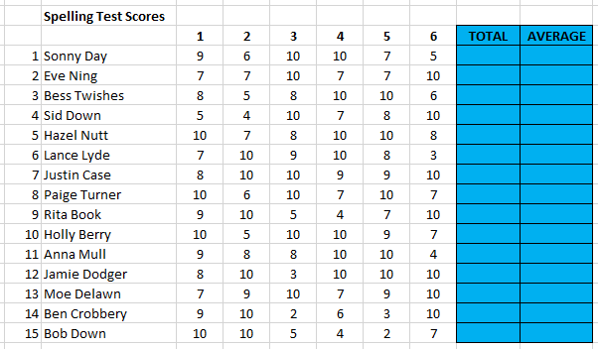
Totals and Averages
This spreadsheet has been used to record a list of spelling test scores.
How could we calculate the totals and averages for each row of data?

Slide 4
Totals and Averages
How to use the AVERAGE function.
Average?
First, click in the cell that you want the average to appear.
…or choose from the AutoSum drop-down menu
Enter or highlight the first and last number in the row of data of which you want to find the average.
Either click on the Insert Function button and choose ‘AVERAGE’…

Slide 5
Calculate and Sort
First select your table of data, including column headings.
In the drop-down menu, select ‘Custom Sort’.
Can anyone remember how to sort the data?
Click on Sort & Filter.
Choose how to sort your data and the Order.

Slide 6
Adding Data
What if we needed to add extra pupils to the list?
What if we needed to add an extra week of scores?
We can type extra rows at the bottom.
We can also insert rows or columns in a particular place.

Slide 7
Editing Data
What if someone’s scores were wrong?
In a spreadsheet, they can be edited and the formulas will automatically recalculate the correct totals and averages.
How is this different to if we were using pen and paper with a calculator?
Will we need to re-sort data after it has been recalculated?
What will be the effect if this score was wrong and needed to be changed?

Slide 8
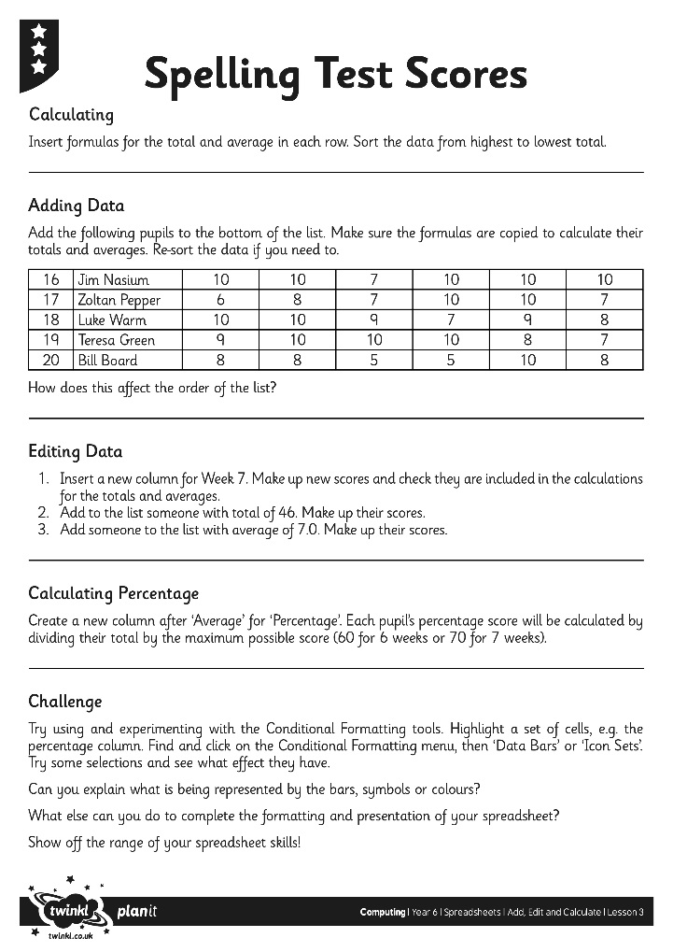
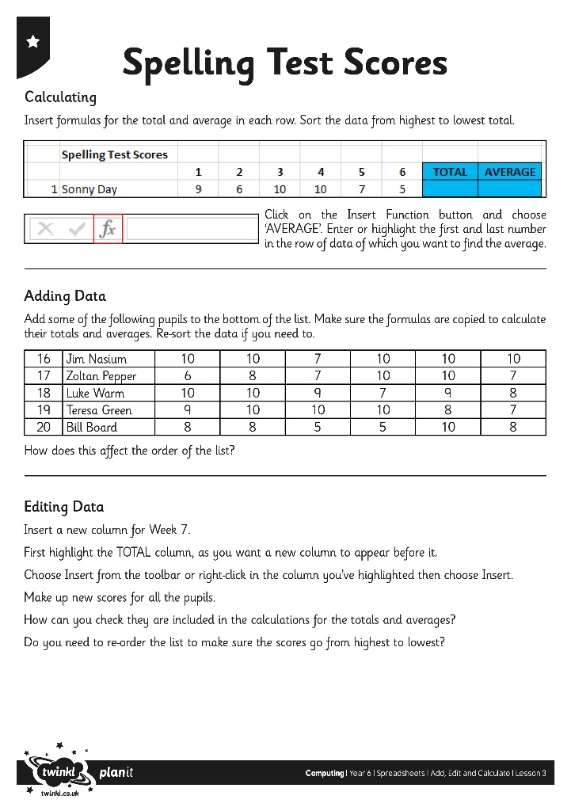
Find the Formulas
Using the Spelling Test Scores Activity Sheet, can you add and edit the data as instructed?

Slide 9
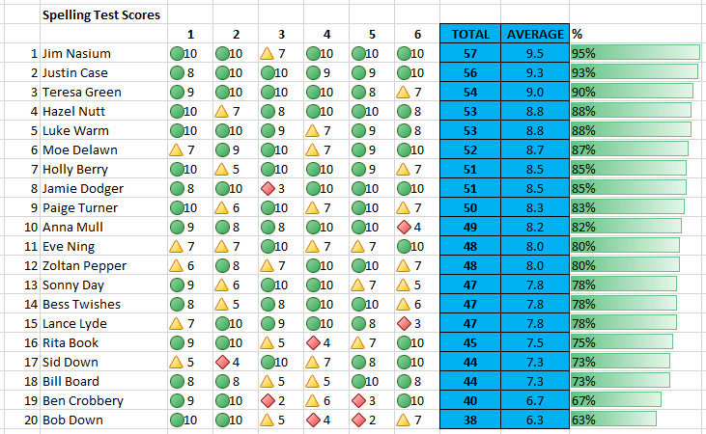
Find the Formulas
Challenge: After saving your work, try experimenting with the ‘Conditional Formatting’ tools.
Highlight a set of cells first, e.g. the % column.
Click on the Conditional Formatting menu, then ‘Data Bars’ or ‘Icon Sets’.
Try some selections and see what effect they have.
Can you explain what is being represented?

Slide 10
Plenary
Did anyone encounter any problems? How were they solved? Can anyone demonstrate any new skills?

