Slide 1
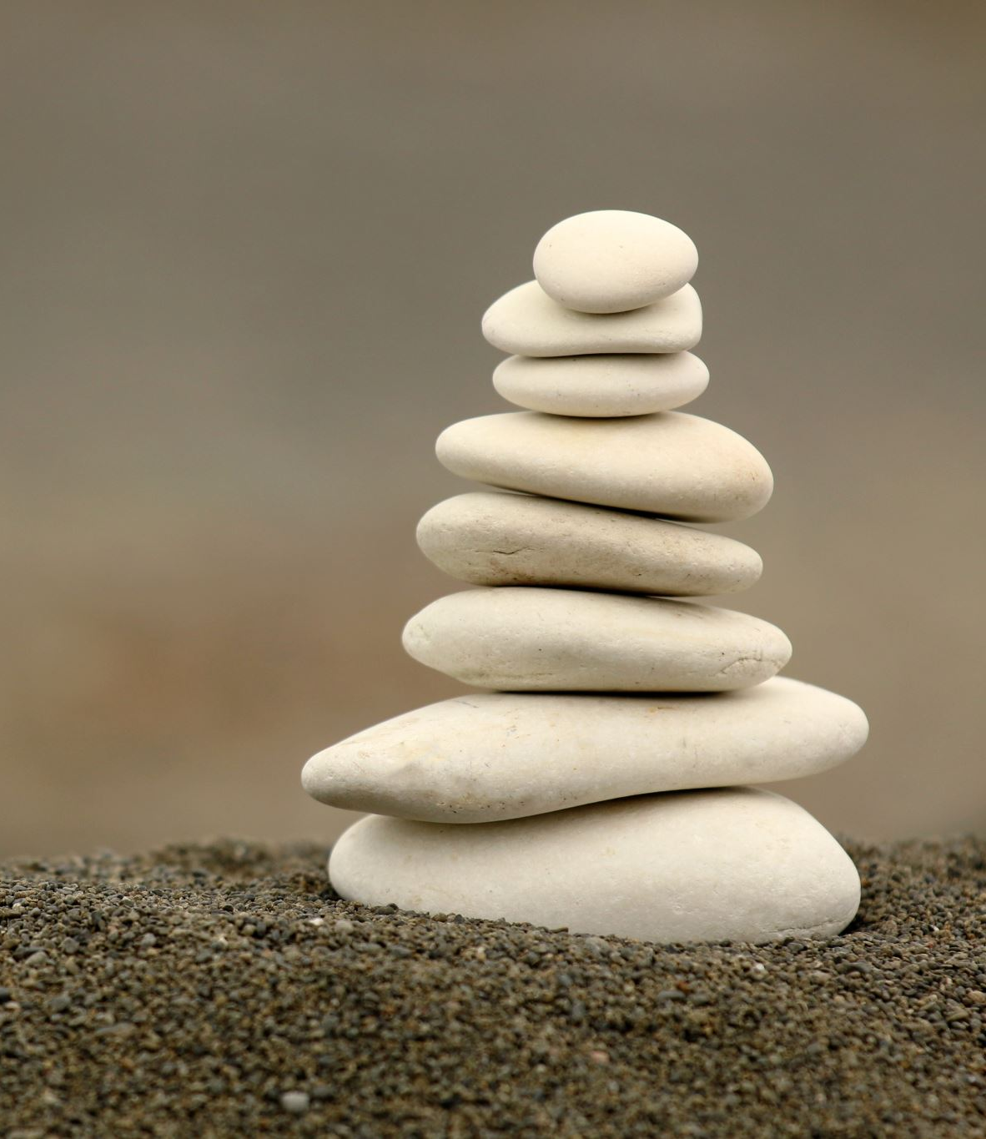
Collective Worship
Tuesday 12th January

Slide 2
Challenge
Make yourself a set of no more than 4 stepping- stones. You and a sibling, or mum and dad, must use the stepping-stones to both cross the room/garden without touching the floor. Only one person can step on the stones at the same time. You won’t have enough stepping-stones to lay out to cross in one go so will have to work as a team. Time yourself as you do this task.

Slide 3
How did you get on?
Repeat the activity again. Now you have done it once you will have learnt something about the best way to do this. The neurons in your brain will have created pathways which will help you to remember and the more times you practice then the quicker you will get at completing the task.

Slide 4
Perseverance

Slide 5
Let us pray…
Dear God,
Thank you for our teachers and parents who are working hard to help us learn both at home and at school.
Amen

Slide 6
Go in faith, hope and love to believe, learn and flourish.

