Slide 1
LI: I can find patterns in the way the size of shadows change.

Slide 2
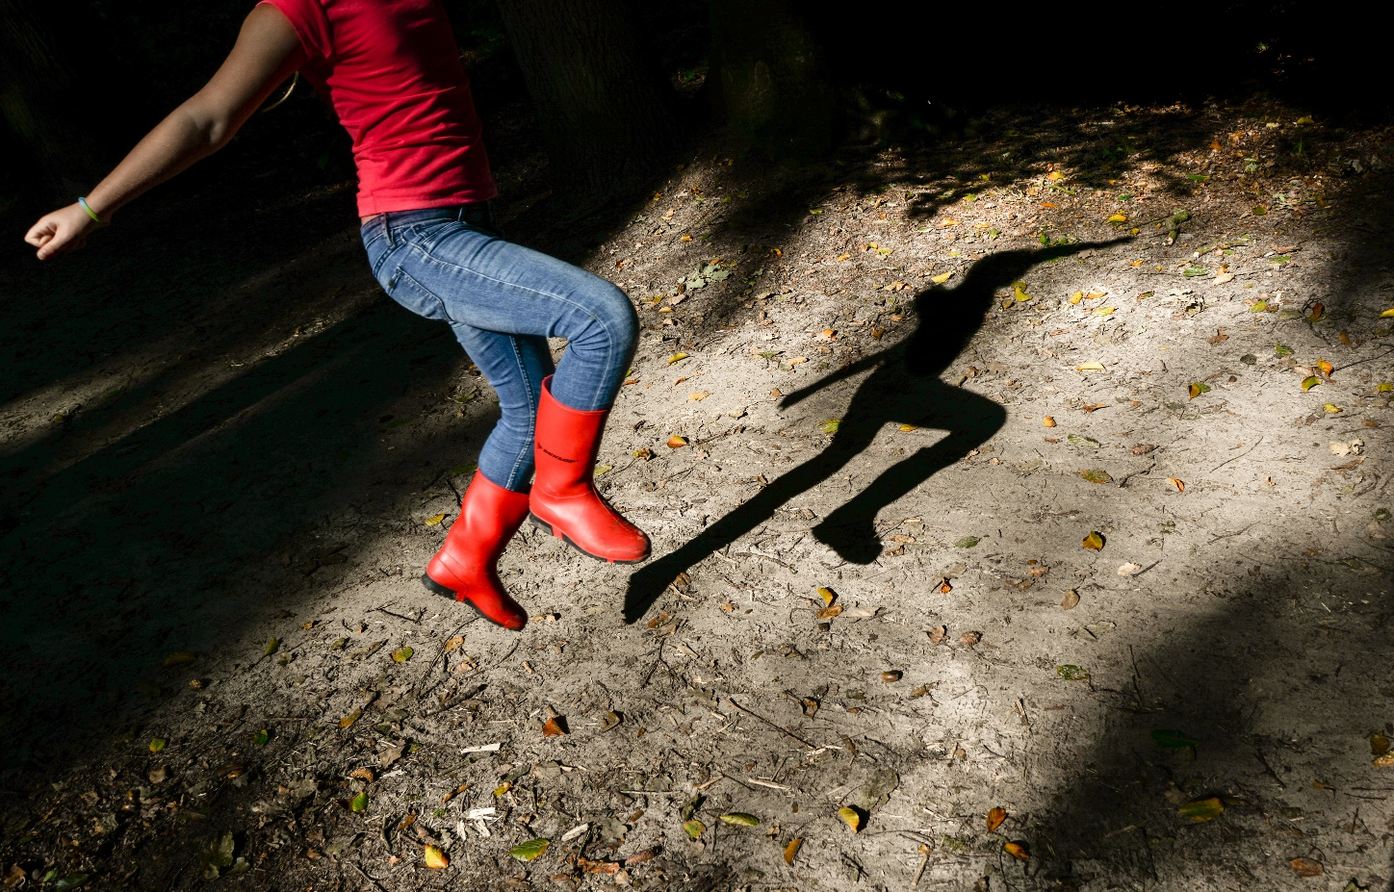
Recap- What Is a Shadow?
A shadow is formed when an object does not allow the light to pass through it.
Recap- What does Opaque mean?

Slide 3
How Are Shadows Made?
Shadows are made when there is an object blocking the light from hitting the surface.
The object needs to be a solid object. If it is clear then the sun will pass through it, whereas a solid object will block it.
This means that the shadow will always
be on the opposite side of an object to the
sun or light.

Slide 4
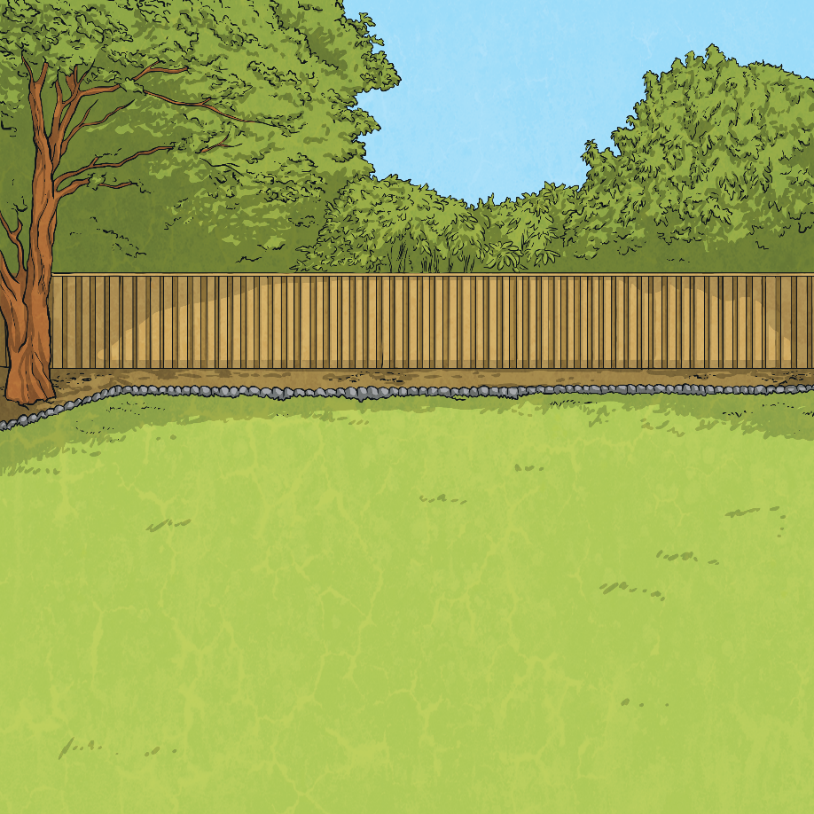
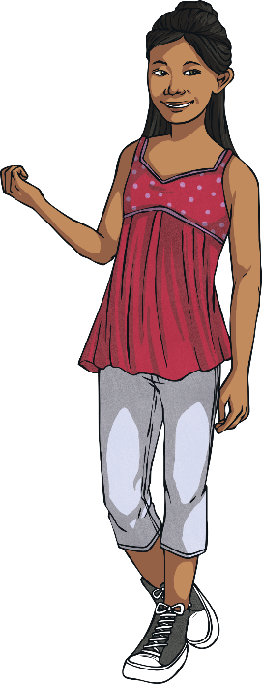
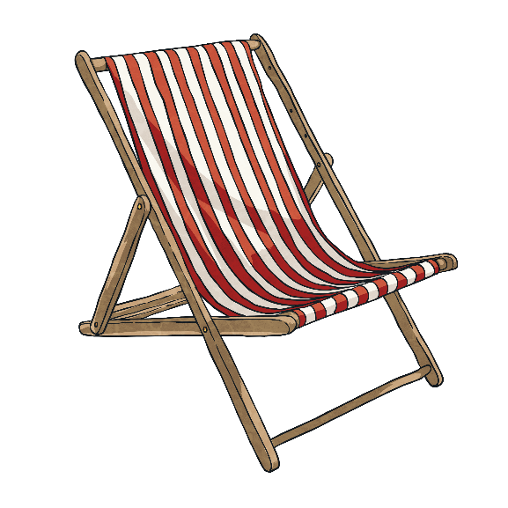
A Sunny Day
It was a lovely sunny Saturday. Having done all her homework and eaten her lunch, Eva decided to sit out and enjoy the sunshine. Having put on SPF50 sun cream, Eva put her deckchair in the sunniest part of the garden, away from the shadows of the oak trees.

Slide 5
Shadows
Eva had a relaxing time lying on her deck chair and reading her book. Gradually she nodded off to sleep. Suddenly, she woke up feeling a bit chilly. When Eva had fallen asleep, she was in bright sunshine. Now she was in the shadow of the oak trees. Eva was confused. She hadn’t moved, so why now was she in the shadow?

Slide 6
What Direction Does Light Travel?
Light travels in straight lines.

Slide 7
Which Direction Is the Sun?
Notes:
Click once to reveal the sun options, click again for answer to be revealed

Slide 8
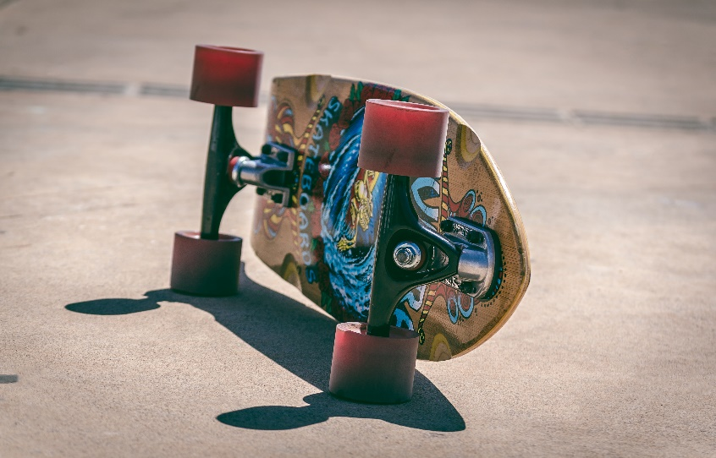
Which Direction Is the Sun?

Slide 9
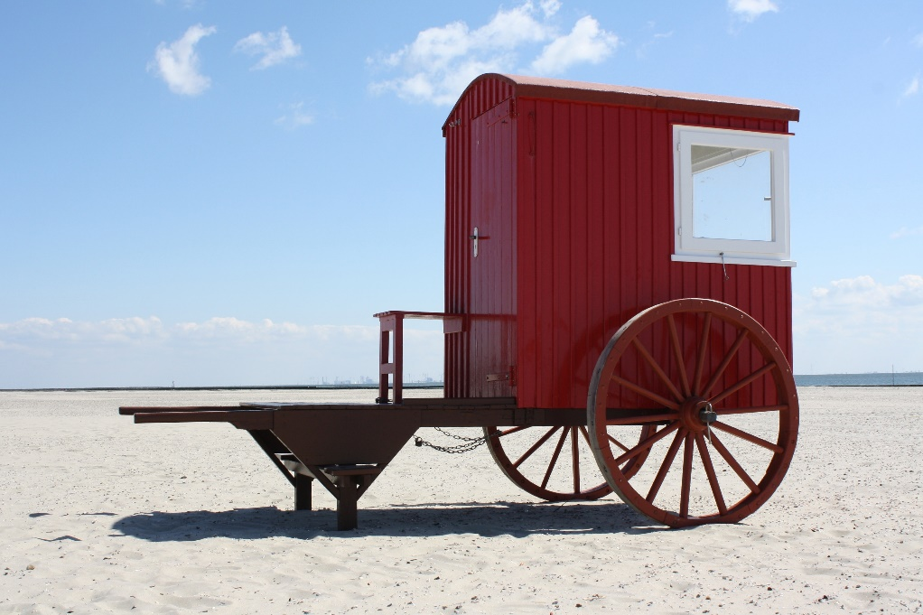
Which Direction Is the Sun?

Slide 10
Explore:
Choose one object from around your house and see if you can create shadows in different directions and different sizes.
Record your findings! (Including your light source.)
What is affecting the shadow?
Talk about why you think this is possible or not possible

Slide 11
Changing Shadows
Look at the shadow the ball makes.
What do you think will happen if the ball is moved closer to the torch? What will happen if the ball is moved further away from the torch?
Talk About it!

Slide 12
Changing Shadows
Look at the shadow the ball makes.
The closer to the light source an object is, the bigger the shadow will be. This is because the object blocks more of the light.
The further away from the light source an object is, the smaller the shadow will be. This is because the object blocks less of the light.

Slide 13
Changing Shadows
When the light source moves, the shadow will change. When the light source is directly above the object, the shadow will be directly underneath. When the light source is to one side of the object, the shadow will appear on the opposite side. The shadow will also be longer.

Slide 14
Investigate
I can investigate how moving a light source changes the size of an objects shadow
What are we changing?
What do we need to keep the same?
What are we measuring?
Have a look at the PDF on the website for more information on the experiment

Slide 15
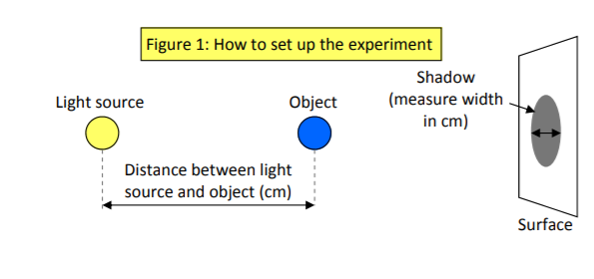
Set up your experiment...

Slide 16
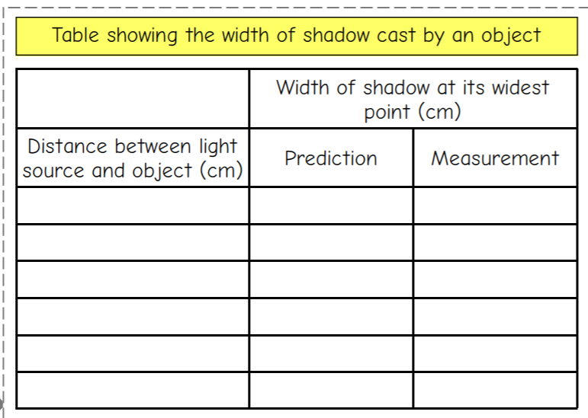
Record your findings
5
7
20

Slide 17
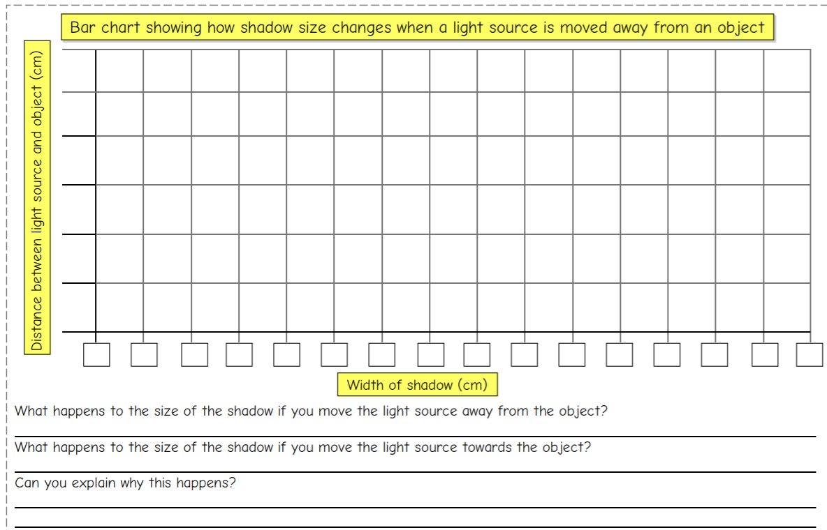
Create a graph

Slide 18
Complete the quiz on the website.
How many questions did you get right?

