Slide 2
How do Muslims Pray?
Learning Objective:
To know the facts about prayer in Islam
Say hello to the person next to you
Does it feel different to do something with your speech, action and mind or intention
2. Now stand up, shake their hand and say hello
3. Now do it again, but really mean it this time
(you could even smile or make eye contact!)

Slide 3
What is Salah?
Salah is the Arabic word for prayer. Salah involves both words and actions. This helps to focus the body and mind on Allah during prayers.
Copy this definition
Now watch this explanation and demonstration of prayer and answer the questions.

Slide 4
When do Muslims pray?
God ordered Muslims to pray at five set times of day:
1. Dawn, before sunrise
2. Midday
3. The late part of the afternoon
4. Just after sunset
5. between sunset and midnight
All Muslims try to do this. Muslim children as young as seven are encouraged to pray.

Slide 5
Activity
Make a schedule of your day and work out how you would need to change it if you had to make time for Salah prayers.
Time | Activity
5.30am 7am | Morning prayers Get up, have breakfast, get dressed
7.40am | Leave for school
8.20am | Arrive at school
8.45am | School starts
Add in the changes in a different colour.
Eg. 5.30am morning prayers

Slide 6
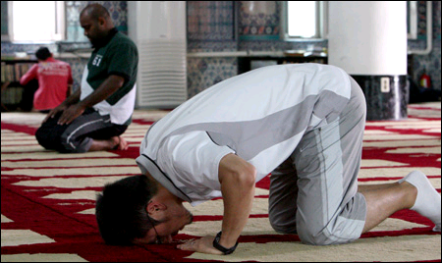
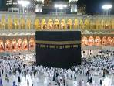
All Muslims face the Ka’bah in Makkah when they pray.
Many prayer mats have a compass on it showing the direction of Makkah.
Which way would we face?
http://www.al-habib.info/qibla-pointer/

Slide 7
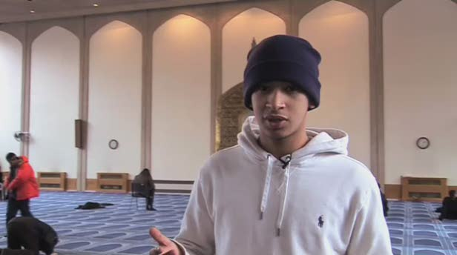
How does performing salah show commitment?
Watch the second clip.

