Slide 2
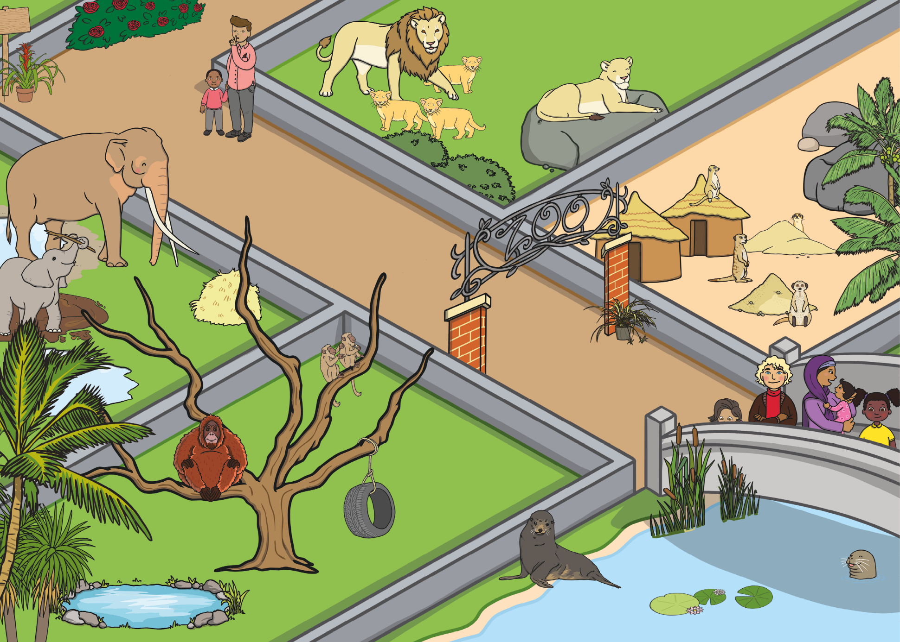

Slide 3
back to the picture
next

Slide 4
back to the picture
next

Slide 5
back to the picture
next

Slide 6
back to the picture
next

Slide 7
back to the picture
next

Slide 8
back to the picture
finish

