Slide 1
Nidderdale High School

Slide 2
A Student Guide to...
Subjects, Teachers and lessons

Slide 3
Subjects
Subjects available at Nidderdale
Art
DT
RE
PE
Biology
Chemistry
Physics
Maths
English
French
Food Technology
Textiles
Drama
Geography
History
German(From year 8)
ICT
PSCHE
Photography (at GCSE)
Music
At Nidderdale there are a range of fun and interesting subjects
Some of these will be new subjects for you
Others that you may have studied in primary school are explored more deeply in KS3
Top Tip!
Keep an open mind when you start new subjects as when you learn more, they often become more interesting!
Year 7 is a great time to work out your strengths and find out what you enjoy most!

Slide 4
Teachers and Lessons
As Nidd is a small school you will get to know the teachers in no time which makes learning easier as they will get to know your strengths and weaknesses
The teachers are friendly and put lots of effort into making the lessons fun
If you are struggling with anything you can go and see your teacher at lunch or break and they will be happy to help!
The 2 week timetable makes it hard to be bored and enables you to have a structure which will become easy to remember
One worry I had before coming to Nidd was that I wouldn’t have time to get to my next lesson but as it is a small school it is really hard to be late!

Slide 5
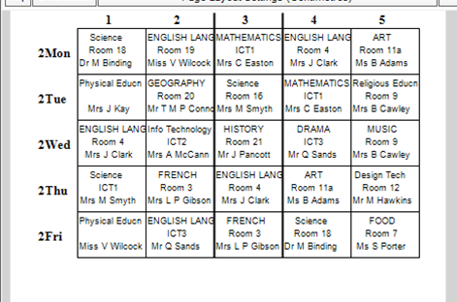
Your Timetable
A Typical day
Time | Lesson
8:50-9:10 | Form
9:10-10:10 | Period 1
10:10-11:10 | Period 2
11:10-11:30 | Break
11:30-12:30 | Period 3
12:30-1:15 | Lunch
1:15-2:15 | Period 4
2:15-3:15 | Period 5
When you start in September you will be given your timetable which you will follow for the whole year
The timetable is a two-week timetable and you will have 5 lessons or "periods" a day
Each lesson is an hour long and different teachers use different and interesting ways to teach you such as games and quizzes.
Week 2 of a year 7 timetable

Slide 6
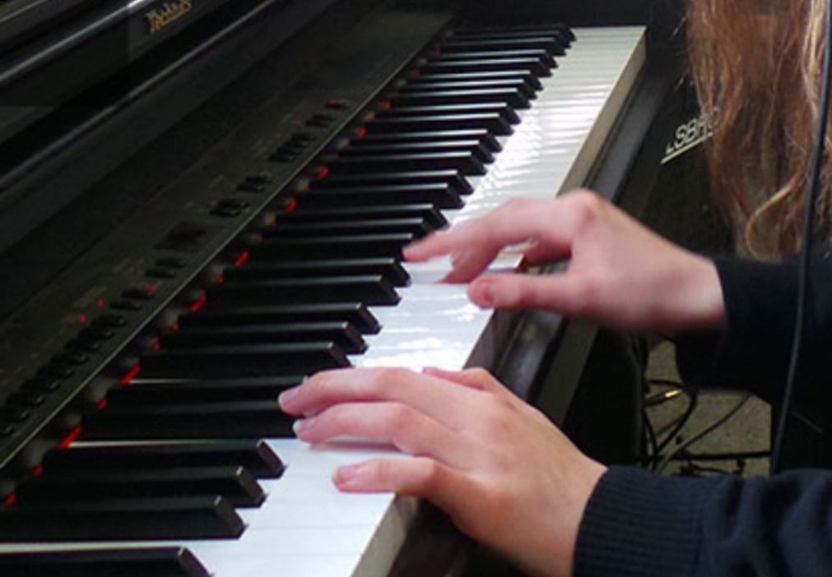
Breaktimes
You will have two breaks during the school day: morning break (11:10 to 11:30) and lunchtime (12:30 to 1:15). This may seem scary but there are loads of new exciting things to do and places to go!
Lunchtime is a great chance to join some clubs: there is a huge range of sports to start (from gymnastics to dodgeball, boxercise to table tennis and, of course, football) but there are also lots of subject specific clubs (to name a few- ICT, DT, Science, Drama) and also a choir, sign language club, eco schools and much more.

Slide 7
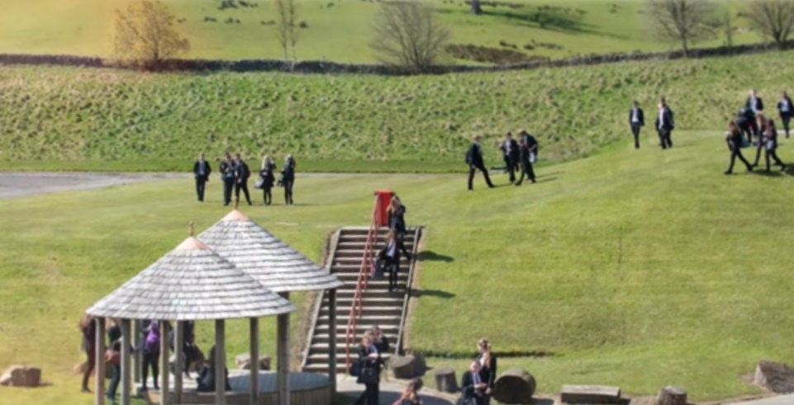
Places and things to do
Most year 7s eat in the lunch hall but you don’t have to stay in the hall for the whole of lunch (or break), there are lots of other places to go:
The playground where there are benches and huts to sit in
The MUGA where people usually play football and other games
In sunny weather, the field
The pastoral garden is a nice quiet space
The sports hall is often available for playing sports
Going to a lunchtime club
The library has lots of board games and books
Homework club is open most days of the week where you can access computers and also buy any stationary (at a very low price!).

Slide 8
Food
Starting high school is extra exciting when it comes to food! Our canteen offers a wide choice of tasty snacks and meals at break and lunch (there is even a breakfast club in the morning). Here are some of the things to look forward to:
Multiple hot and cold choices (including a set meal deal every day)
Bacon and sausage sandwiches at break
Pizza day on Thursdays and Curry day on Fridays
A huge range of snacks and drinks
Vegetarian options
Take away
Food recommendations from some year 11s!!
“My favourite things to eat at school were the hot baguettes, curries on fridays and having the occasional bacon sandwich at break! I’ll really miss the beef baguettes”
“Everyone loves grabbing a bag of popcorn at break, they’re so popular for a reason.”
“School traybakes are so good, I love the flapjacks and chocolate crispies”
For the first two weeks you can go to lunch 15 minutes earlier then the rest of the school and after that you are allowed in the hall at 12:45 to stop the hall from getting too busy.

Slide 9
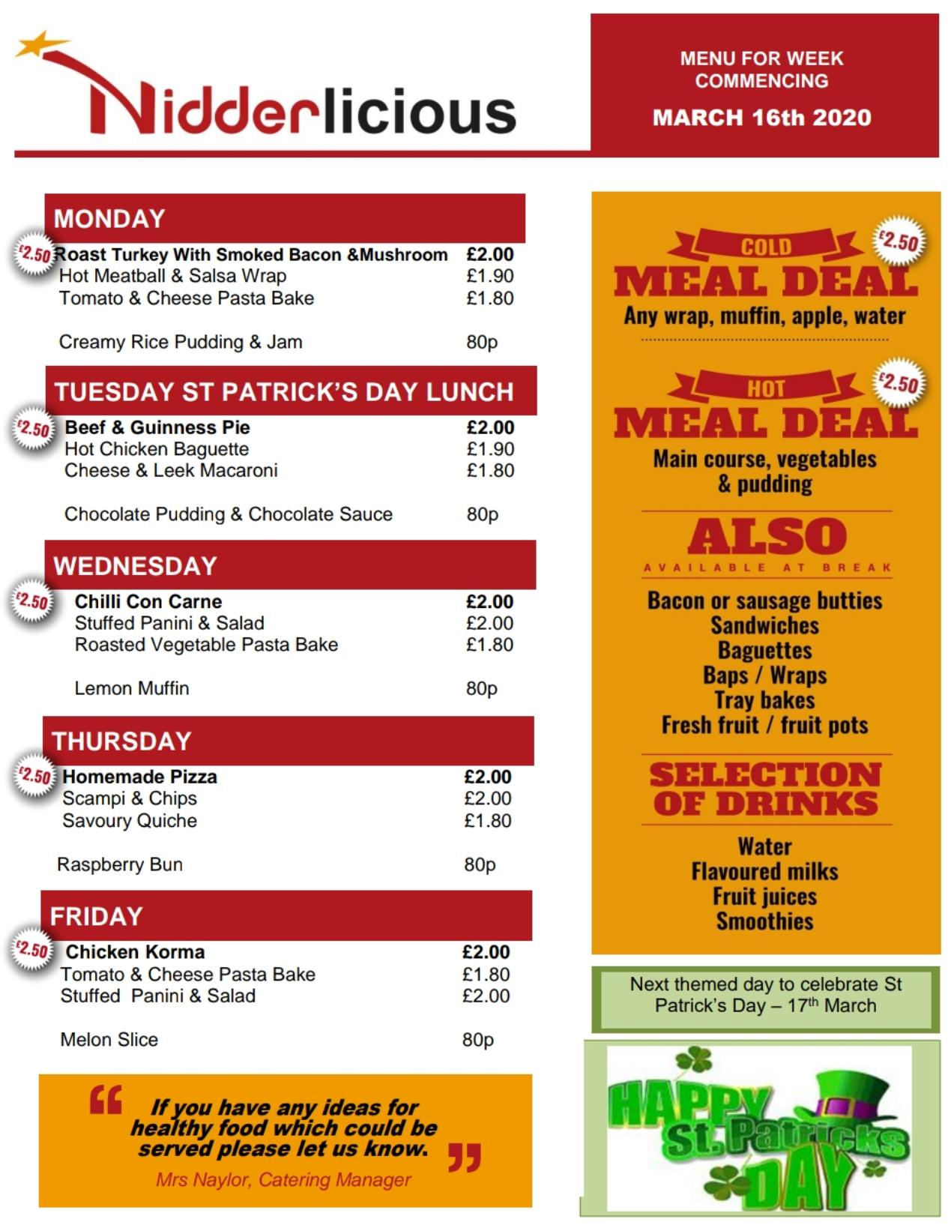
A sample weekly menu from this March
We have a cashless catering system which means you dont need to bring any money into school, all you need is a thumb! You’re fingerprint gets scanned and your food is paid for- it really is as easy as that!

Slide 10
A Student Guide to…
Student Leadership

Slide 11
If you decide to join the student leadership team,
You will be able to help organise charity events such as bake sales and sport matches.
You also have the chance to become a mentor for a younger student or even someone in your own year who may be struggling with adjusting to high school
As a bonus you also get your own Student Leader tie and badge

Slide 12
Roles
In the team there are various committees you could join, for example:
Catering committee which looks at the school menu to see if there's any way we could change it
Eco school committee which works to make our school more eco friendly
Other roles you could volunteer for are chair of the meetings which makes sure all the Senior Student gatherings run smoothly and secretary which types up the meeting discussions

Slide 13
A Student Guide to...
Languages

Slide 14
Every student at Nidd gets a chance to develop new and exciting skills. Most students at Nidd will learn at least one foreign language during their time at high school. At Nidd every year seven student will study French with either Miss Gibson or Miss Overend. These lessons often include fun games and songs to help everyone learn the basics of French. You don’t need to worry if you didn’t learn French at primary because the teachers will support every student to make sure everyone has the same level of understanding before starting any more difficult topics. If you don’t enjoy French then you can always try German in year eight. Most students won't have ever learnt German before so it's an exciting new opportunity for all. Most students will go on to do either French or German at GCSE, however if you enjoy learning both then you can choose to carry both languages on. The language teachers at Nidd are very supportive and passionate about their subjects and will be happy to help anyone if they are ever struggling. If you want extra support with a language then you can speak to them and they will do their best to support you, sometimes with extra lessons or with extra activities designed to help you.
There is also a sign language club once a week at lunch time which is open to students from all year groups. This is a great opportunity to learn something new and to make new friends.
'I enjoyed learning German because we played lots of fun games and we held our own German festivals which helped us learn about German culture.'
'I loved learning French because the lessons are very interactive which helped me to learn quickly. I also loved playing fun games with my classmates because they helped me develop new friendships. Also the teachers were very friendly and always supported me'

Slide 15
A Student Guide to ...
Extra curricular Activities

Slide 16
Activities
At Nidd there are lots of different activities available for you to try on at lunchtime or after school.
For example on a lunchtime you can go to the sports hall and do a variety of different sports games such as football ,netball and boxing. Some of these sports are is also available after school.
For those who don't particularly want to do sport activity there's sign language club, choir and drama club.
If you decide to join the choir, you will also have the chance to perform in one of the showcases through the year which are a lot of fun and if you're in a drama club you can put on a performance
There is no limit to who can be in the showcases and you can show any of your talents.

