Slide 1
Monday 18th January

Slide 2
Phonics - Phase 3
Can you remember the phonemes that we have learned?
See how quickly you can move through the slides saying each phoneme out loud.

Slide 3
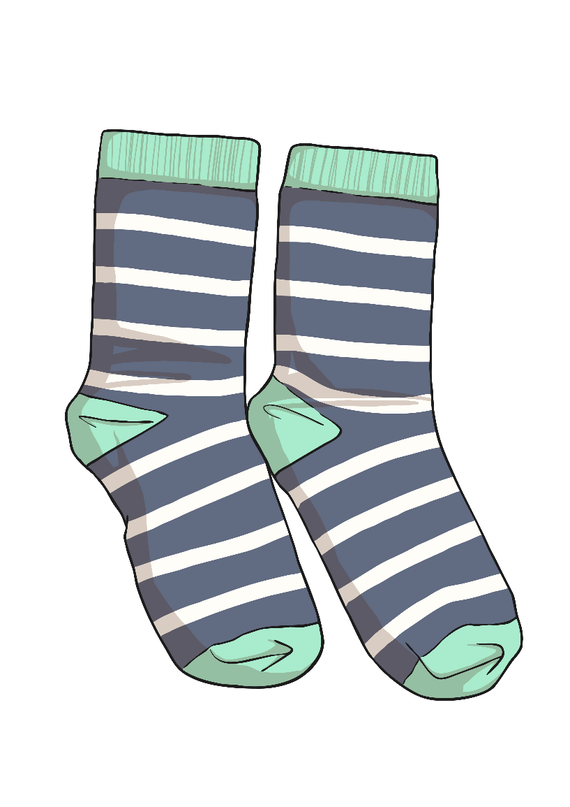
s

Slide 4
t

Slide 5
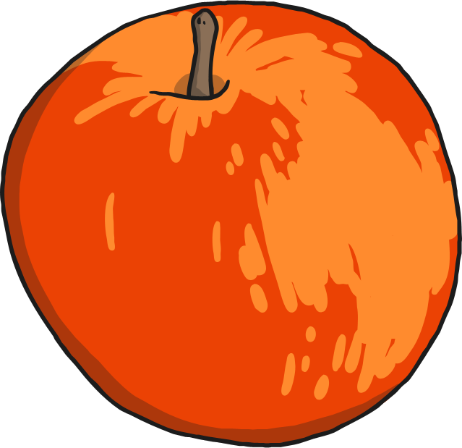
a

Slide 6
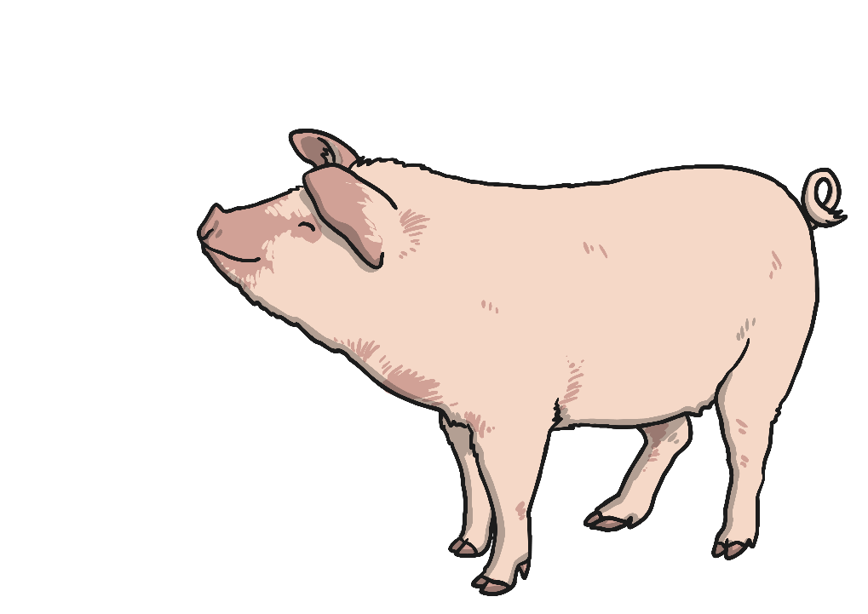
p

Slide 7
i

Slide 8
n

Slide 9
m

Slide 10
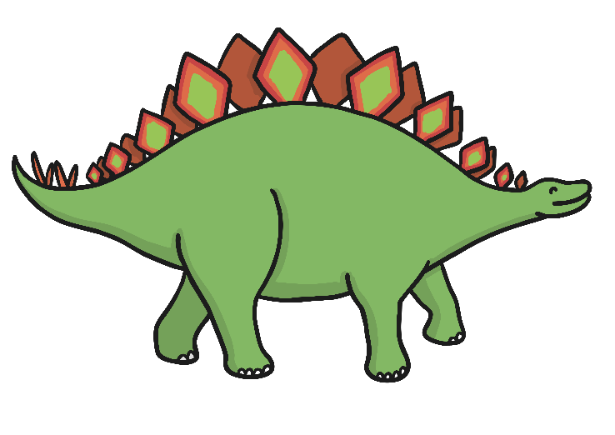
d

Slide 11
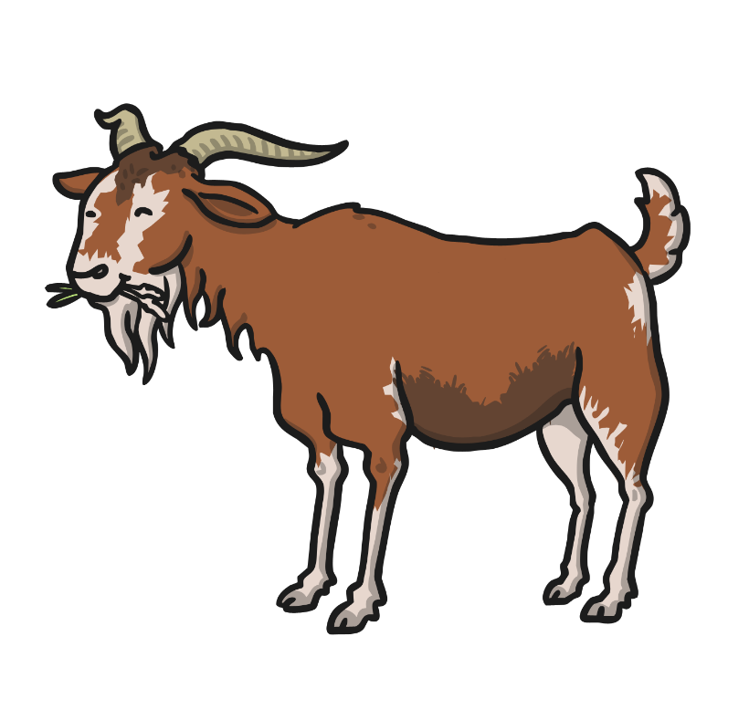
g

Slide 12
o

Slide 13
c

Slide 14
k

Slide 15
ck

Slide 16
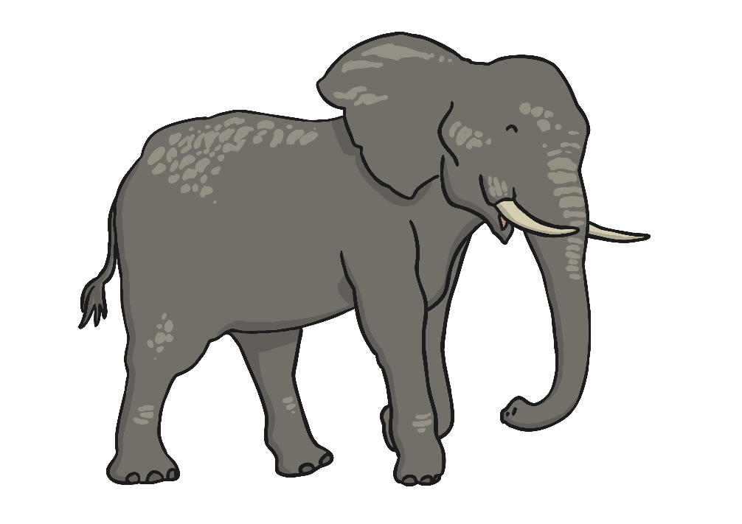
e

Slide 17
u

Slide 18
r

Slide 19
h

Slide 20
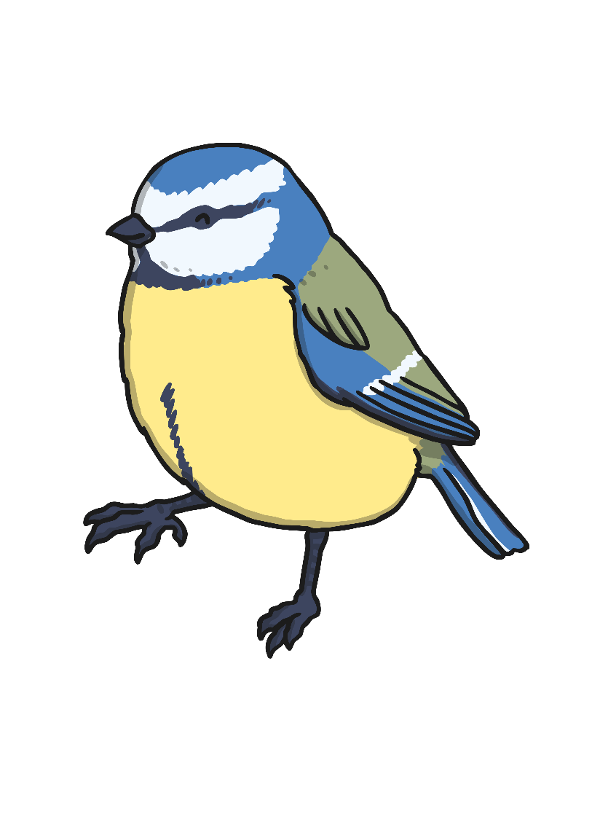
b

Slide 21
f

Slide 22
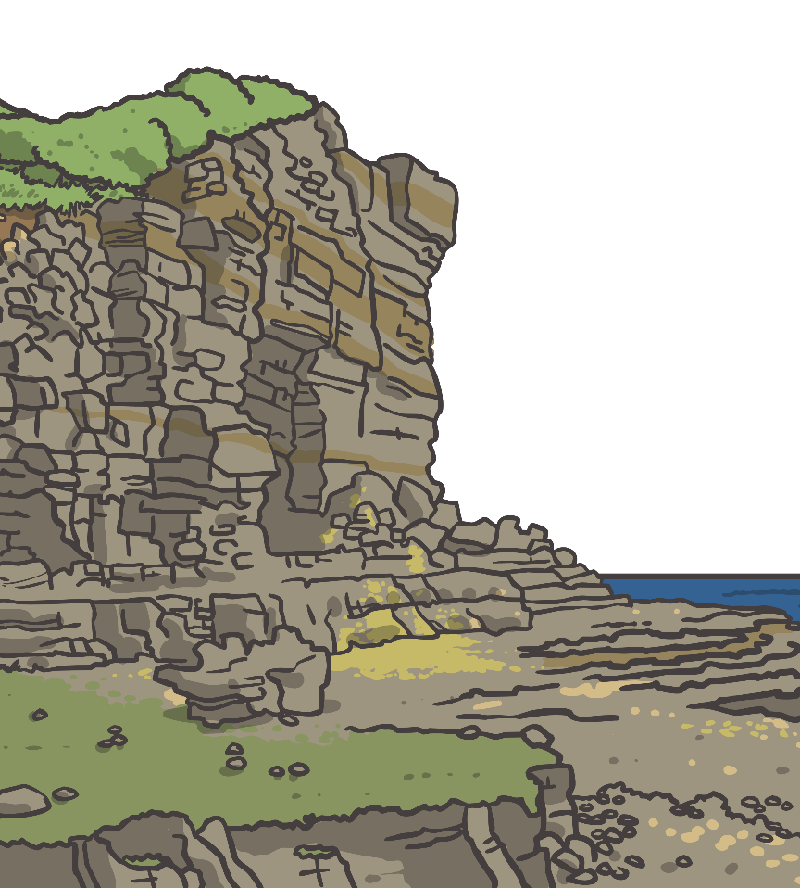
ff

Slide 23
l

Slide 24
ll

Slide 25
ss

Slide 26
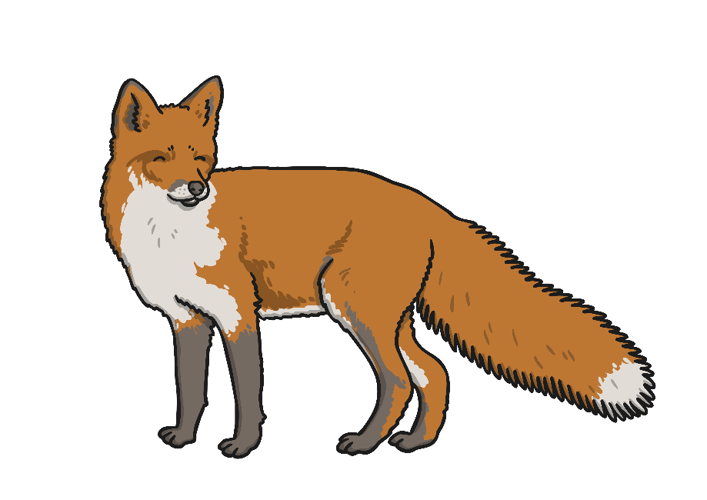
x

Slide 27
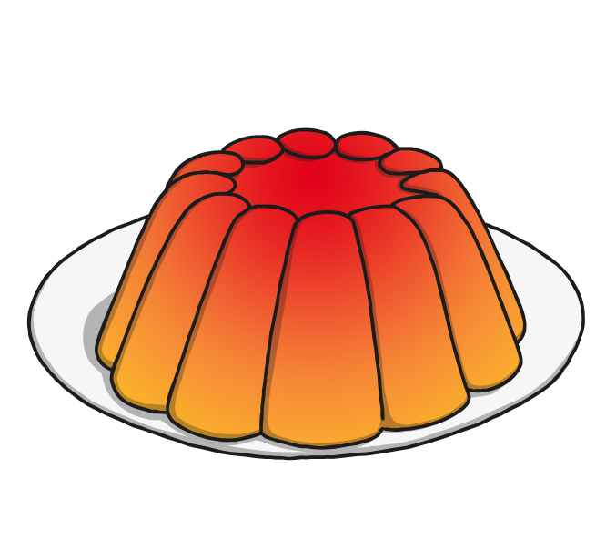
j

Slide 28
v

Slide 29
w

Slide 30
y

Slide 31
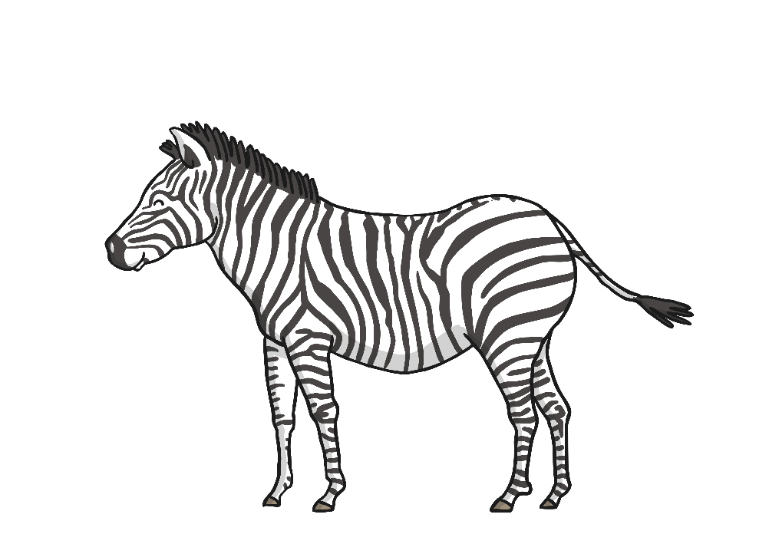
z

Slide 32
zz

Slide 33
Our phoneme today is…
quack
qu
queen
quiz
quick
Can you say these words with our phoneme in? See if you can sound out the words then blend to read

Slide 34
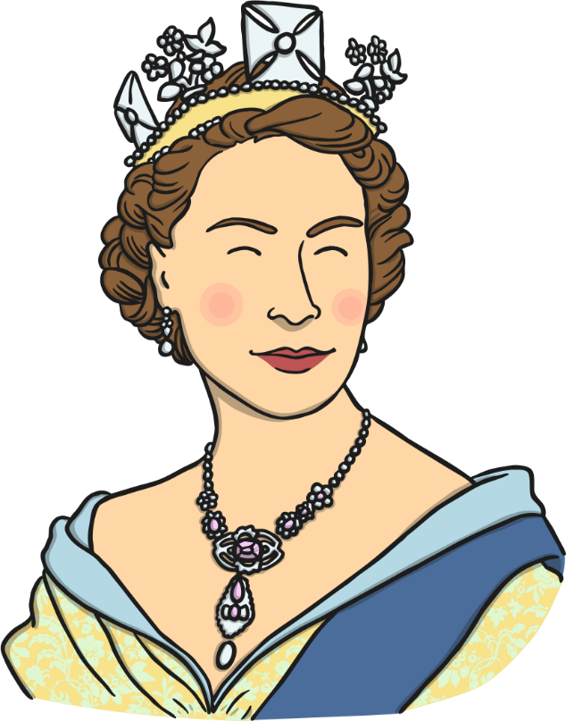
qu

Slide 35
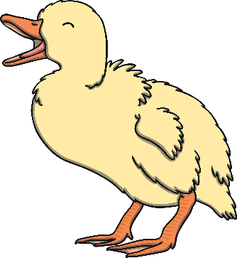
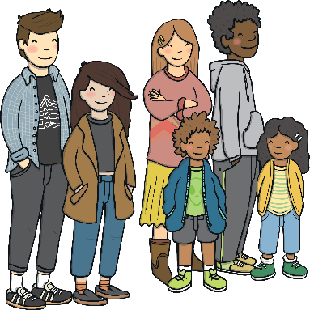
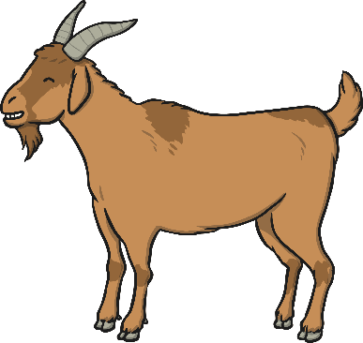
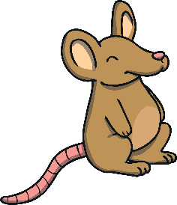
Click the pictures that contain ‘qu’ to move them into the middle.
qu
quack
x
=
x
squeak

Slide 36
Our phoneme today is not always found at the start of a word…
queen quilt quack
squeak squeeze equal

