Slide 1
Science
Animals Including Humans
Lesson 1
Year One
Science | Year 3 | Animals Including Humans | Types of Nutrition | Lesson 1

Slide 3
Aim
I can explain how living things obtain food.
I can state the different food types that animals, humans especially, eat.
Success Criteria
I can explain how plants obtain food.
I can explain how animals, including humans, obtain food.
I can demonstrate I understand the difference between how plants and animals obtain food.
I can identify foods in different food groups

Slide 4
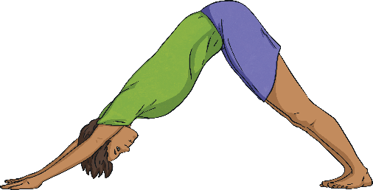
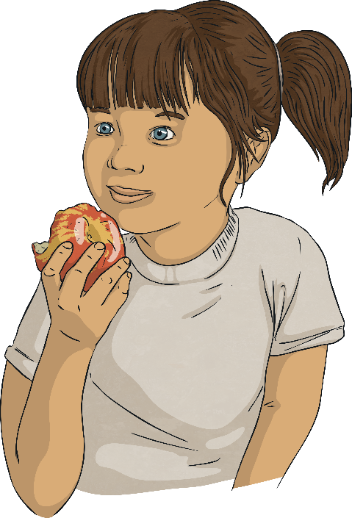
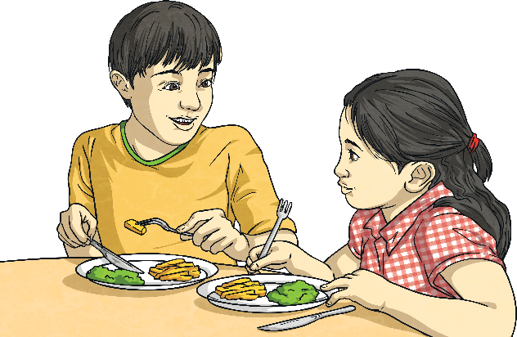
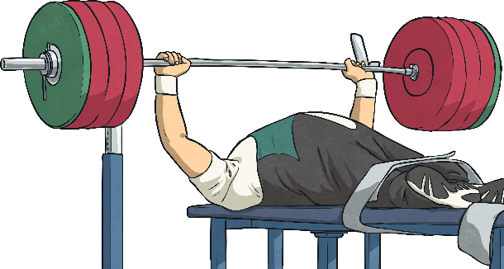
Living Things and Food
Why do living things need food?
To grow
To be strong
To be healthy

Slide 5
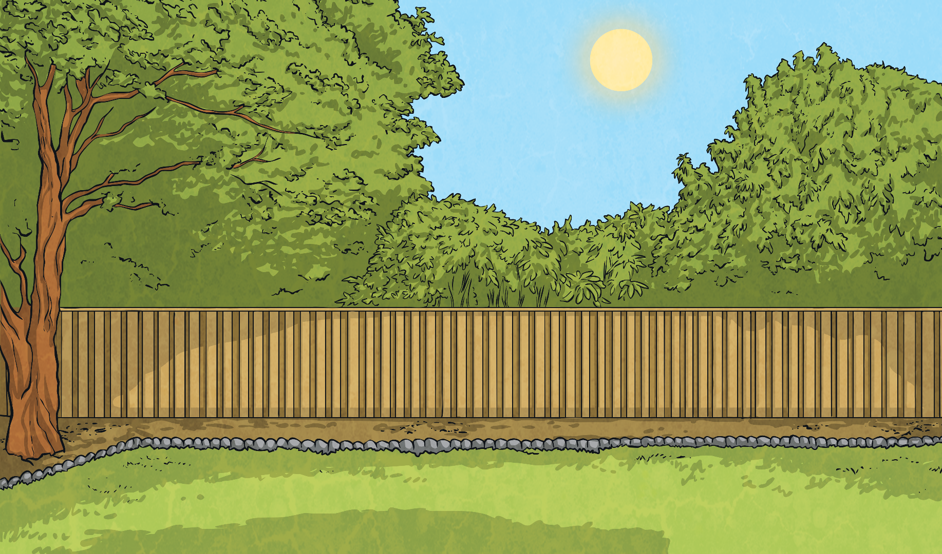
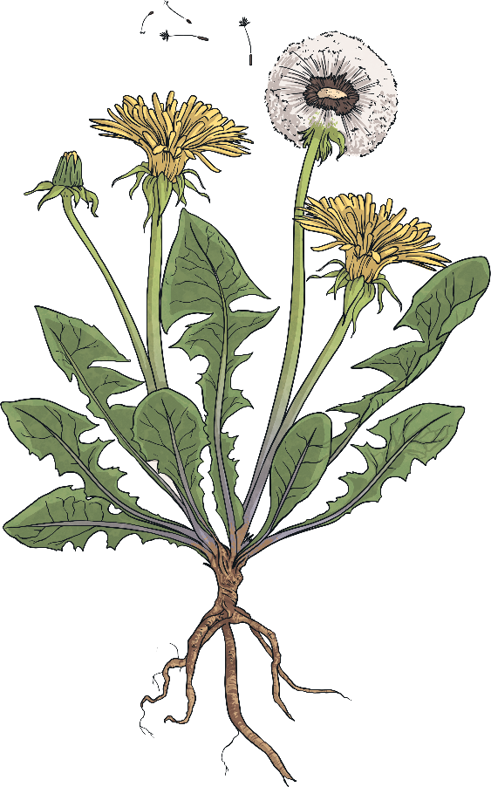
Photosynthesis
sunlight
How do plants obtain food?
Plants make their own food! This process is called photosynthesis.
They use water, sunlight and carbon dioxide (a gas in the air) to produce food in their leaves.
carbon dioxide
water

Slide 6
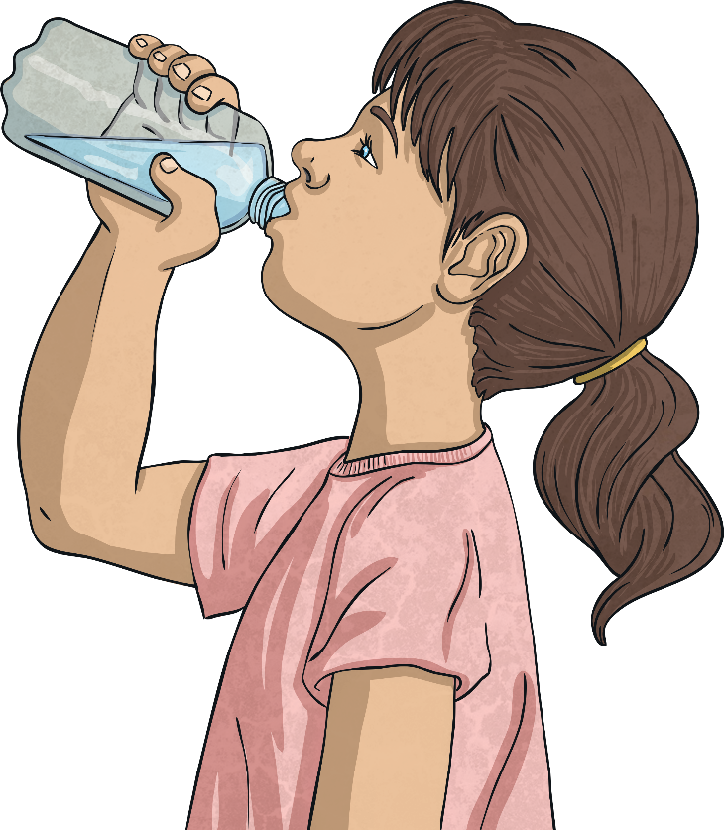
Animals and Photosynthesis
water
sunlight
What would happen to animals if they tried to obtain food in the same way as plants?
carbon dioxide

Slide 7
Key Question Number 1
What is the difference between how a plant and an animal obtain food?
Please record your answer in your exercise book. Ask an adult to check your answer, or send these answers to Mrs Lewis to check. (There is one more later on!)

Slide 8
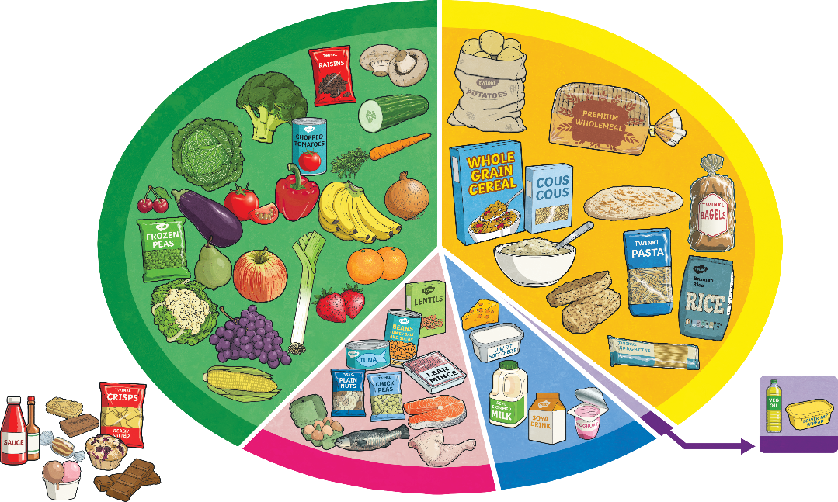
Human Food
What kind of foods do humans need?
Food is commonly divided into five food groups.
How many of the food groups can you remember?
Look carefully at the information and see if you can remember the names.

Slide 9
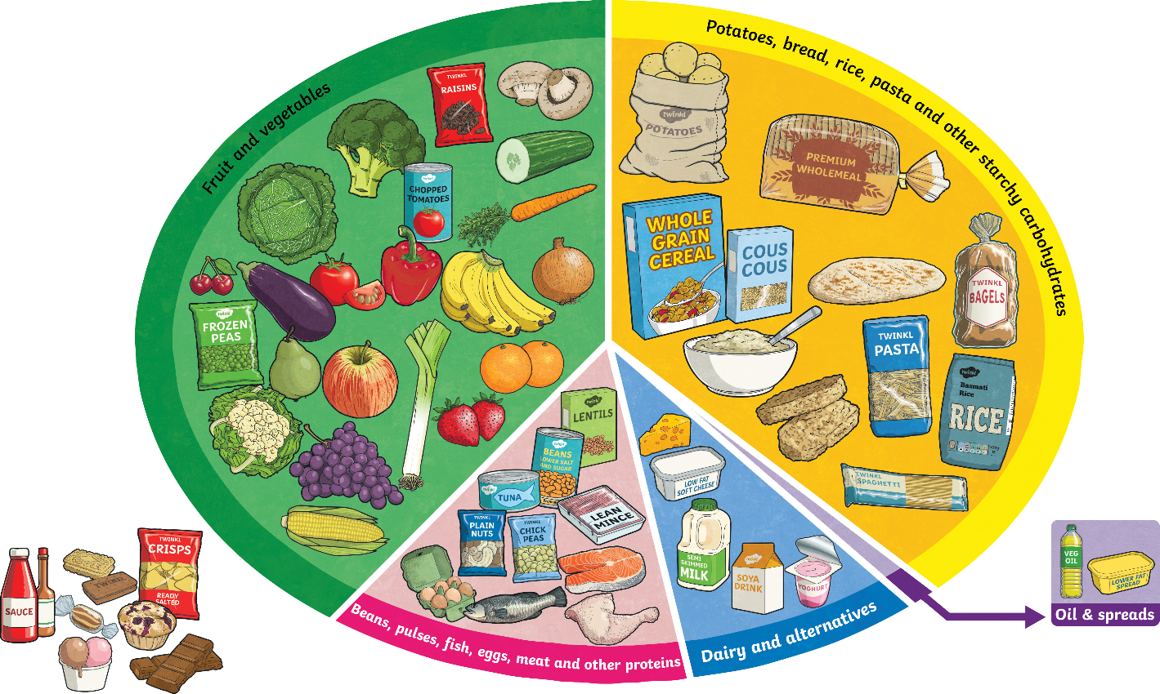
Human Food
What kind of foods do humans need?
Fruit and vegetables
Aim to eat 5 a day! Dried, frozen and tinned fruits and vegetables count as well as fruit juices. Important as sources of vitamins and minerals which reduce your risk of disease and keep you healthy. Limit fruit juice and/or smoothies to 150ml a day.
Potatoes, bread, rice, pasta and other starchy carbohydrates
These are important for giving us energy.
Oil and spreads
Choose unsaturated oils and use in small amounts.
Dairy and alternatives
These are important for strong teeth and bones.
Beans, pulses, fish, eggs, meat and other proteins
These are very important for helping us grow and build muscles. Try to eat 2 portions of fish a week and try to reduce intake of red and processed meat.
Are there any groups you were confused by? Which ones? Why?
Why do you think foods that are high in sugar and/or fat are not a food group?
How many did you get correct?
Well done!

Slide 10
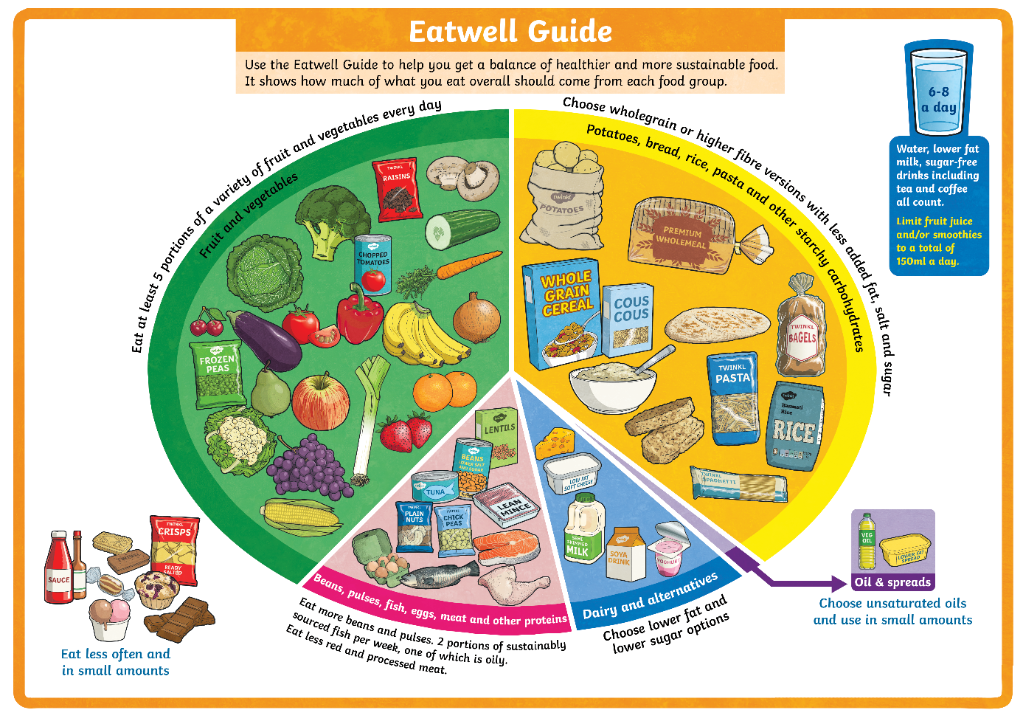
Food Groups
The Eatwell Guide helps us to make decisions about how to make sure we eat the right balance of nutrients in our diets.
Notice that drinking plenty of water is also very important to keep us healthy.
The food groups are shown on the Eatwell Guide.

Slide 11
Key Question number 2
What are the different food groups humans need to eat from?
Again record your answer in your exercise book and ask an adult to check it, or send these answers to Mrs Lewis to check.

Slide 12
Types of Nutrients
Nutrients are substances that animals need to stay alive and stay healthy. These nutrients are found in the foods we eat.
There are seven nutrients.
Foods are a mix of different nutrients, so some foods may contain a lot of fibre, but it will also contain other nutrients such as vitamins, minerals and water.

Slide 13
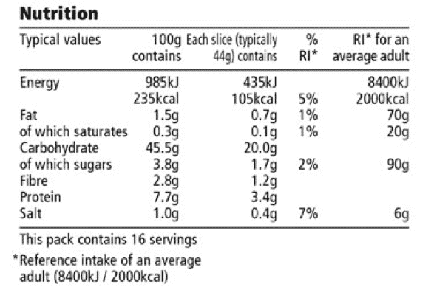
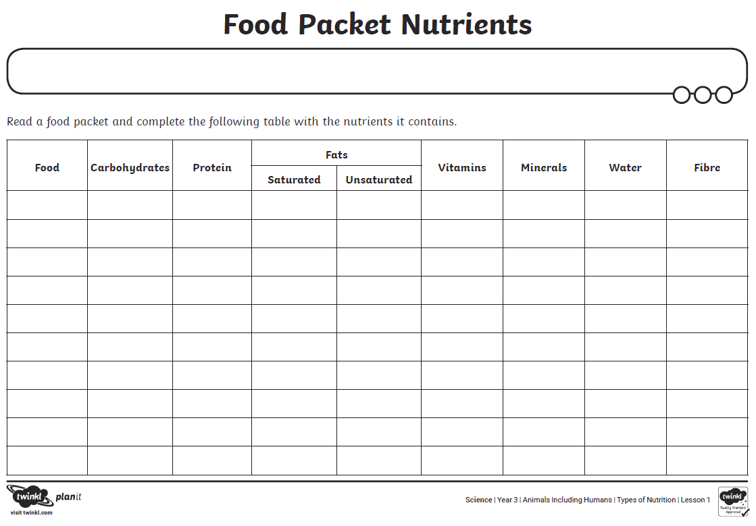
Types of Nutrients
Foods sold in shops have labels that show what nutrients the food contain.
Your task is to take a closer look at some nutrition labels on food in your homes! Choose a wide variety of food and record what you find.

