Slide 1
The Rhythm of Life Advent Journey
Reflecting

Slide 2
Have a think about this verse from the Bible …
‘As water reflects the face,
so one’s life reflects the heart.’
Proverbs 27:19
Can you think of ways in which the things you do every day on the outside, reflect who you are on the inside?

Slide 3
Here is a short video for you to watch.
As you watch, think about how the things we say can have a big impact on how we feel and how we make other people feel.
Is this just about a reflection in the mirror, or is there another type of reflection happening in this video?

Slide 4
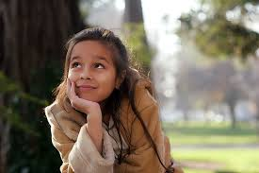
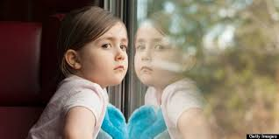
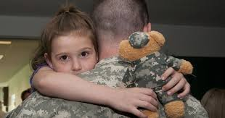
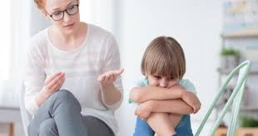
Reflecting can be a kind of thinking. It’s when we take some time to stop and think about things. Sometimes we might think about ourselves, sometimes about other people and sometimes we might even daydream!
How can reflecting on something help us?
What might the children in these photographs be reflecting on?

Slide 5
A thought to take away…
The dictionary says that the word ‘reflection’ can have lots of different meanings. Sometimes it can mean a reflection in a mirror or shiny surface. Sometimes reflection means thinking deeply and carefully about something that matters to you.
Was the child in the video just looking in the mirror?
Do you remember the bible quote we began with? It asks us to think about how our actions and the things we say can reflect the kind of person we are on the inside.
How do your actions and the things you say reflect your kindness and care towards others?

Slide 6
Today’s Challenge
If you would like to join in with today’s challenge,
why don’t you:
Take some time to quietly think about something that matters to you. You could even take a little bit of time to daydream!
or
Pretend you are looking at yourself in a mirror, like the girl in the video. What would you say to yourself and what would your reflection say back to you?

Slide 7
If you would like to, you can join in saying these prayers.
A Prayer for the Day
The Rhythm of Life Prayer
Dear God,
As I take time to reflect today
Let me think about my actions,
Let me think about my words,
Let me think about other people,
Let me think about the world around me
So that everything I do reflects goodness back into the world.
Amen
Loving God,
Help us to learn from you
the habit of reflecting,
so that the rhythm of our lives can match
the rhythm of your heart of love.
Amen

Slide 8
This resource was produced by the Diocese of Leeds Education Team.
For more information about this or future resources,
please contact your named adviser:
simone.bennett@leeds.anglican.org
simon.sloan@leeds.anglican.org
darren.dudman@leeds.anglican.org
janet.tringham@leeds.anglican.org
lee.talbot@leeds.anglican.org
rupert.madeley@leeds.anglican.org

