Slide 1
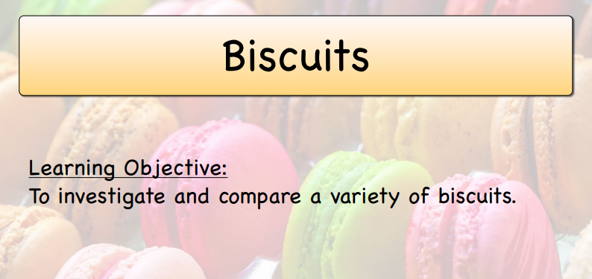

Slide 2
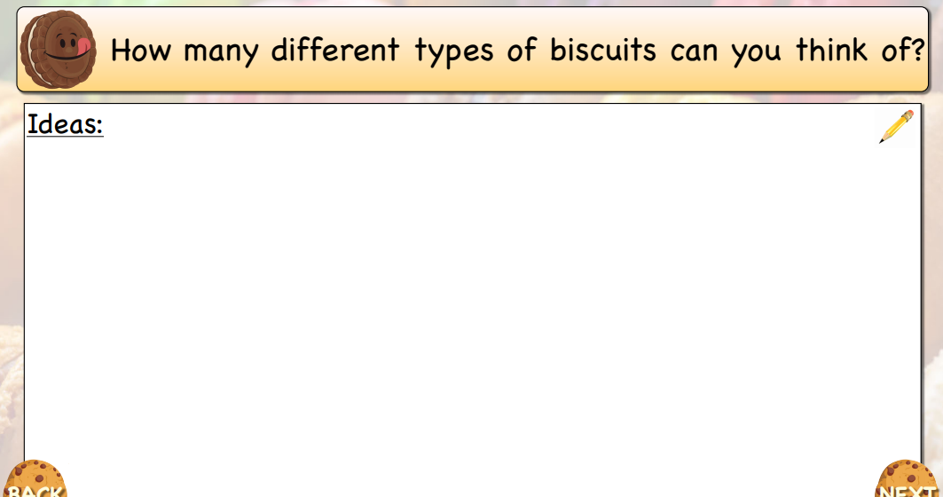

Slide 3
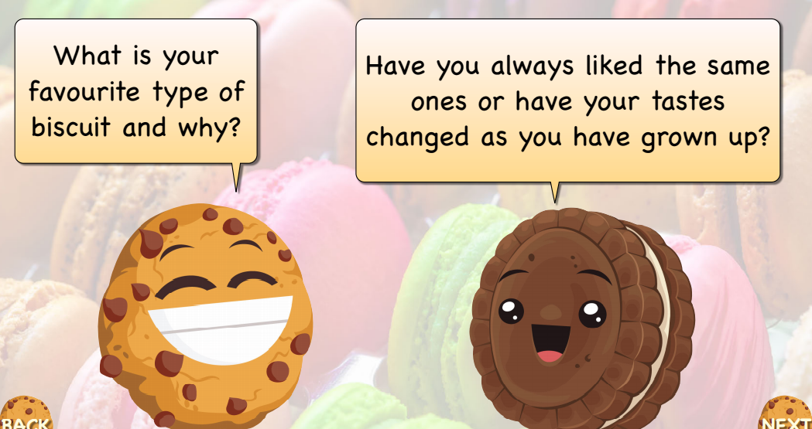

Slide 5
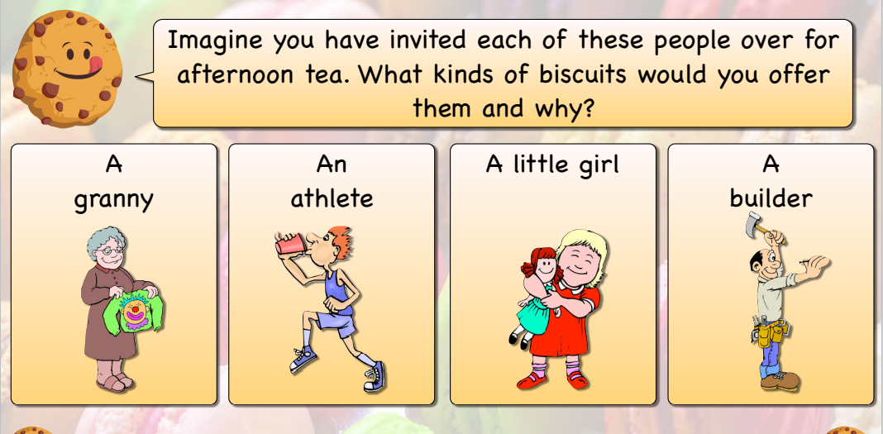

Slide 7
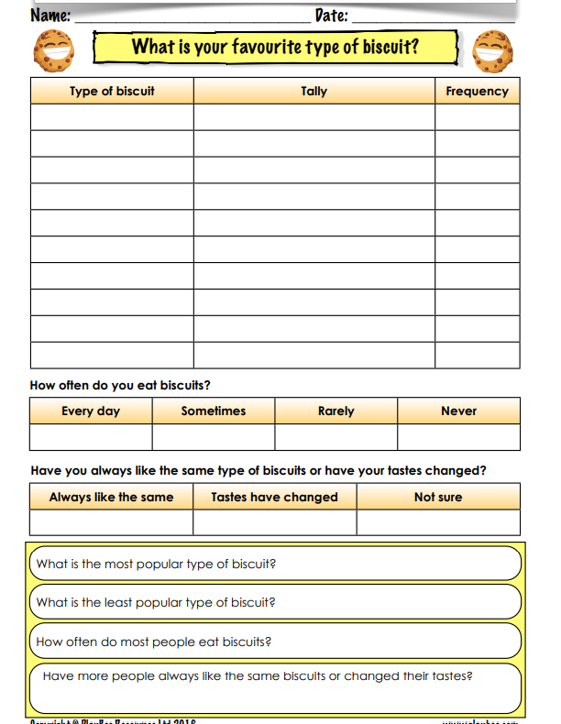
I would like you to fill this sheet in.
You will need to ask other people about their favourite biscuits.
Then you need to answer the questions at the bottom.

Slide 8
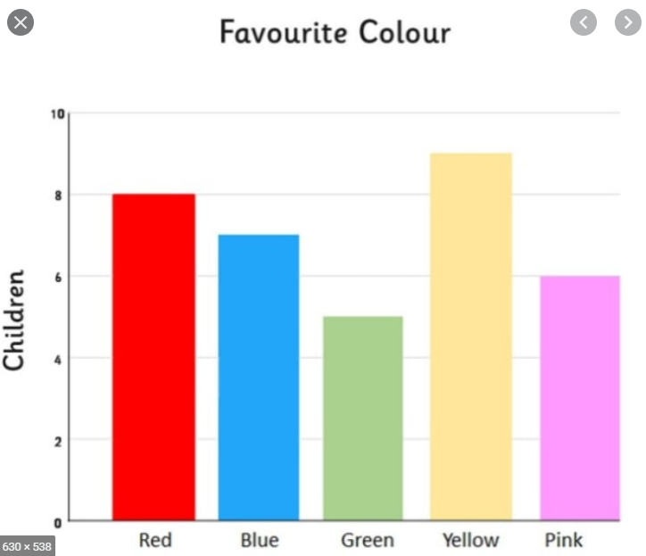
Challenge
To create a bar graph to show some of your results. You could choose the most popular biscuit types to display in your bar graph.
This is an example bar chart

Slide 9
Questions to think about:
What kind of biscuit was the most popular?
Which kind of biscuit was least popular? Did you notice a difference between the preferences of young people and older people?

