Slide 1
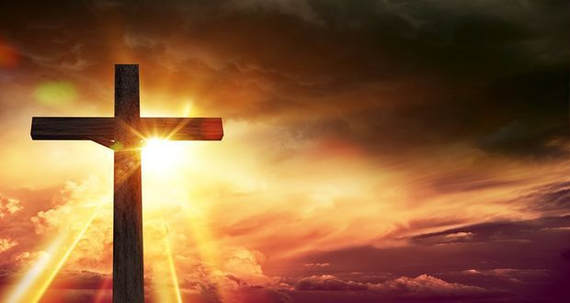
Was Jesus the Messiah?
Lesson 4

Slide 2
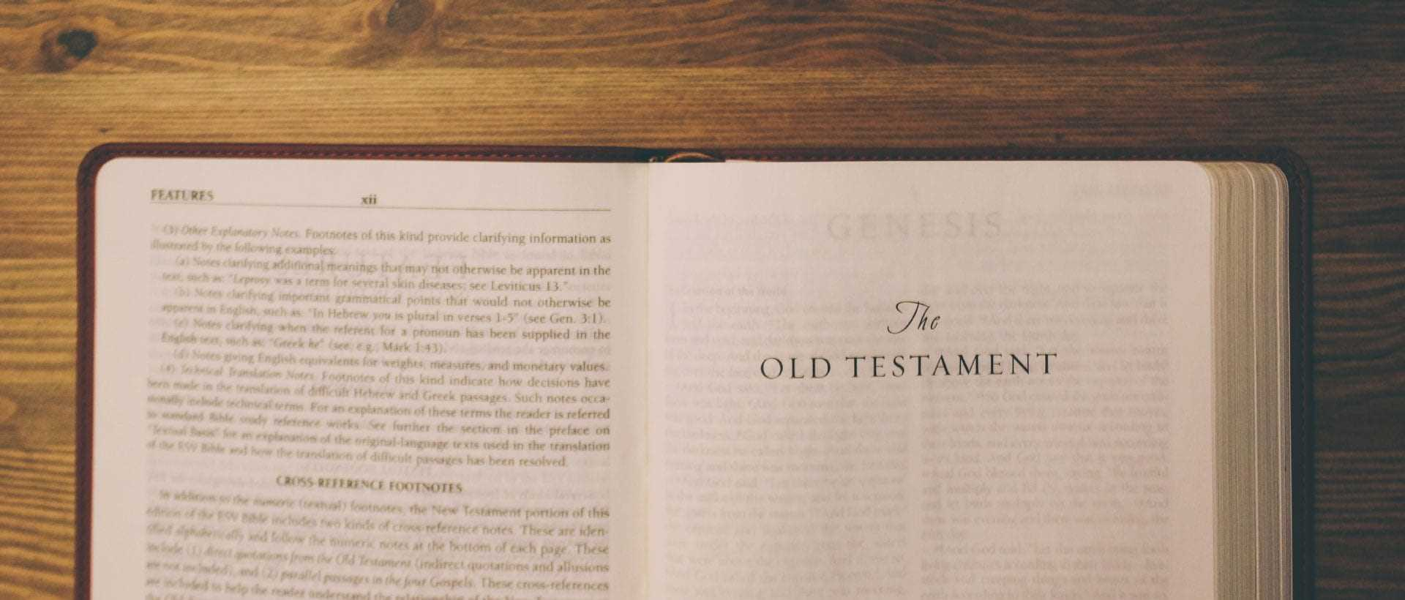
LI: To comment on how the idea that Jesus is the Messiah makes sense in the wider story of the Bible.
LI: To weigh up how far the idea that Jesus is the Messiah is important in the world today, and if it is true, what difference that might make in people's lives.

Slide 3
Think about what we've done in this unit so far...
Who believed that Jesus was the Messiah?
Who didn't?
What do you think?
What reasons are there to believe that Jesus was the Messiah?

Slide 4
Let's remind ourselves of the big story in the Bible.
What came first in the Bible?
Can you remember which book comes first?
Read the next slide to remind you of the story of the Bible.

Slide 5
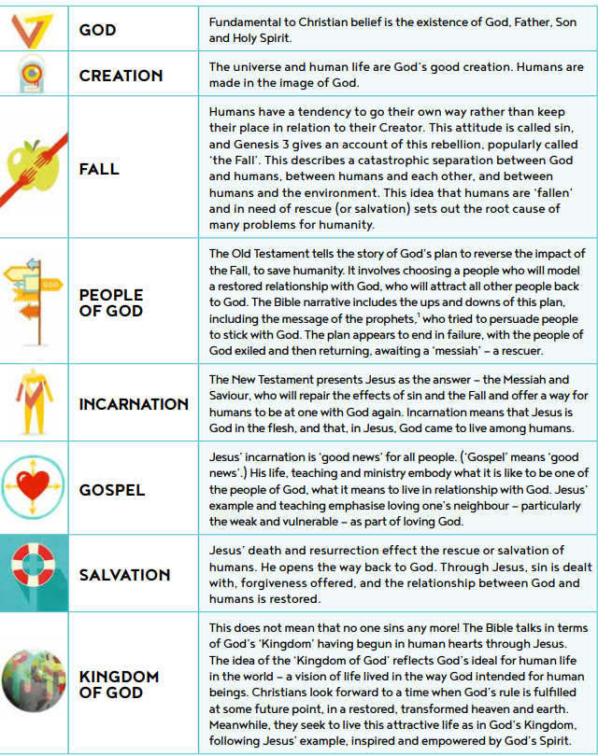

Slide 6
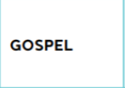
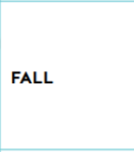
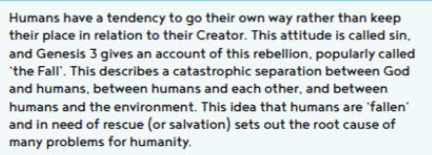
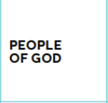
Can you join the definition to the correct theological term?

Slide 7
Not everyone thinks Jesus is the Saviour from God, but why might people think that the world needs one?

Slide 8
Imagine that there is a God: if this God sent a new messenger to Earth in the twenty-first century, what would the messenger say?
It would need to be a message for all people, not just those who believe in God!

Slide 10
Think about...

Slide 11
Choose 6 to 8 of these prompts to write a paragraph to explain what you think...

Slide 12
So the question we have been looking at throughout this unit is:
Was Jesus the Messiah?
I would like you to add your final answer to that question under the paragraph you have just finished.

