Slide 1
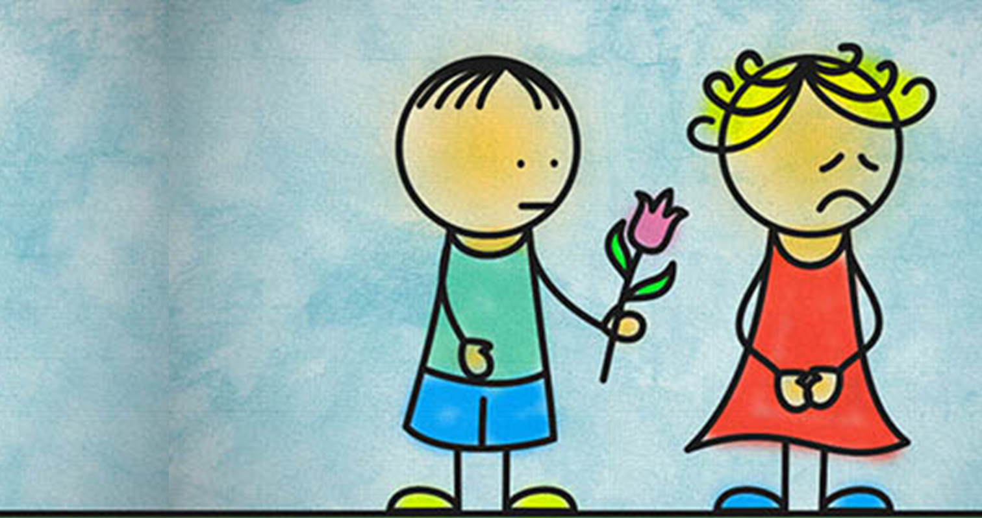
How does Jesus expect us to act with forgiveness?
Forgiveness
Collective Worship.

Slide 2
In Matthew's gospel Jesus is talking to the crowd when he says:
For if you forgive others the wrongs you have done, your heavenly Father will also forgive you; but if you do not forgive others, then your Father will not forgive the wrongs that you have done.
Matthew 6:14-15

Slide 3
Think about the last time you did something unkind to someone else, it may have been in school or it may be at home.
Why did you do it?
Was the other person really sad?
Were you sorry afterwards about it and wished you could change it?
Lord Jesus, help us this day to forgive those hurts we keep locked up inside us so that we can start again with gladness. Amen
Notes:
You may want some quiet music for the back ground to this.
If you’re in the classroom you may want to give each child a pebble so they can put their action onto it and then put it into a central basket as they give it to God.
Allow the children plenty of time to think about their forgiveness using the prompts.

