Slide 1
Thursday 6th January

Slide 2
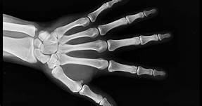
Phonics - Phase 3
Look at the pictures…
Say the words aloud, Can you guess what our phoneme of the day is?

Slide 3
Our phoneme today is…
X
Can you make the shape of the phoneme with your bodies?

Slide 4
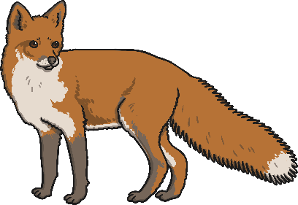
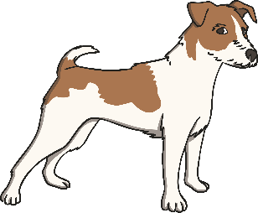
Click the pictures that begin with ‘x’ to move them into the middle.
x

Slide 5
Have a go at writing these words:

