Slide 1
The Rhythm of Life Advent Journey
Resting
Advent – Day 1

Slide 2
How often do you stop and do nothing?
How often do you stay still and silent?
Sit comfortably and watch this next video or close your eyes and listen to the sounds.

Slide 4
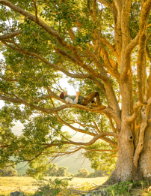
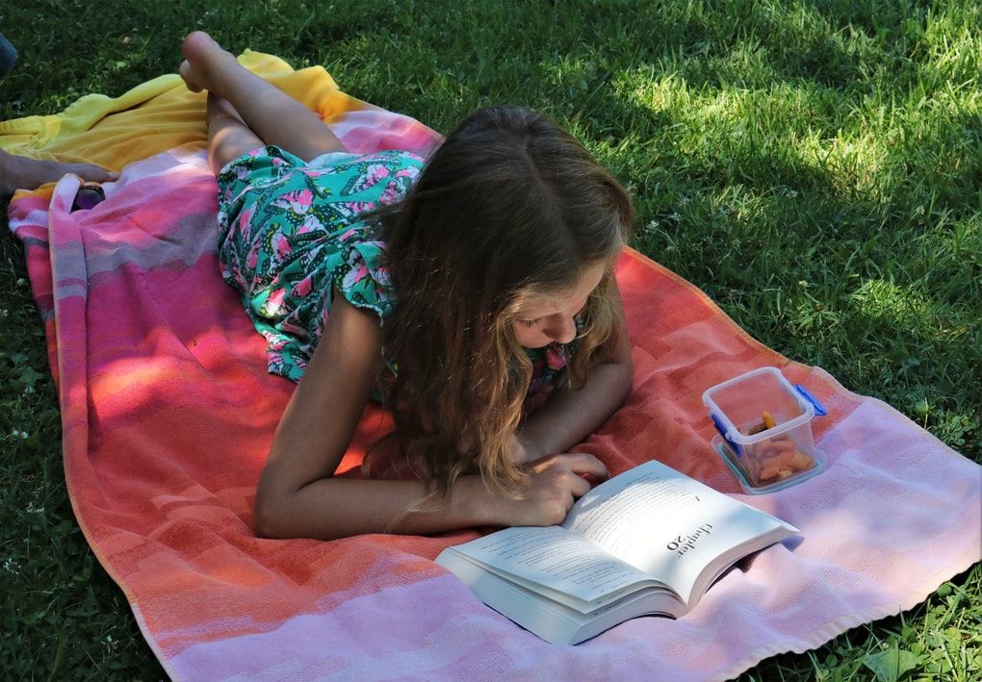
How did that make you feel?
Was it easy being still and calm for two minutes?
Where would you go to rest if you could?
Do you think that resting is important?
Is being still and quiet the only way to rest?

Slide 5
A thought to take away…
If we read about the life of Jesus, we see the many amazing things he did. But the Bible also tells us that Jesus needed time to be alone. Jesus knew it was important to get away from the crowds, to be by himself and with God. That is one way he took care of himself.
Whether you are reading a book, going for a walk, or just lying on your bed and staring at the ceiling, if you are resting, you are taking care of yourself.

Slide 6
Today’s Challenge
If you would like to join in with today’s challenge, why don’t you:
Find a time and a place in your day where you can safely stop and rest. For two minutes stay still, quiet and listen carefully.
or
Use instruments to compose some restful sounds. You might want to share your creation with someone.

Slide 7
If you would like to, you can join in saying these prayers.
A Prayer for the Day
The Rhythm of Life Prayer
Father God,
you made us and know us.
Help us to rest and enjoy
as you rested and enjoyed your creation.
Give us a time to rest
so we can be refreshed.
Amen
Loving God,
Help us to learn from you
the habit of resting,
so that the rhythm of our lives can match
the rhythm of your heart of love.
Amen

Slide 8
This resource was produced by the Diocese of Leeds Education Team.
For more information about this or future resources,
please contact your school’s named adviser:
simone.bennett@leeds.anglican.org
simon.sloan@leeds.anglican.org
darren.dudman@leeds.anglican.org
janet.tringham@leeds.anglican.org
lee.talbot@leeds.anglican.org
rupert.madeley@leeds.anglican.org

