Slide 2
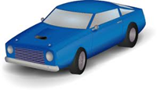
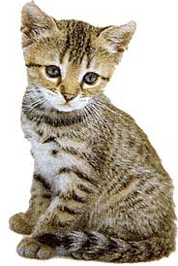
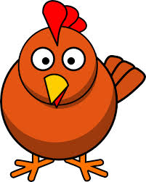
car
star
cat
chicken

Slide 3
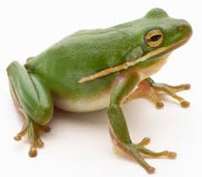
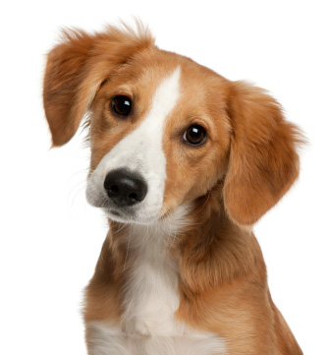
frog
crayons
dog
tree

Slide 4
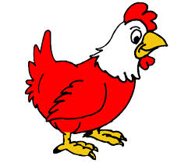
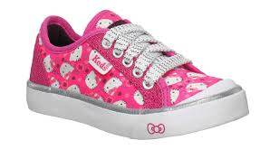
pen
shoe
hen
apple

Slide 5
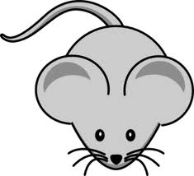
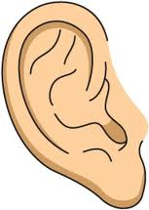
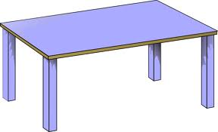
mouse
table
ear
house

Slide 6
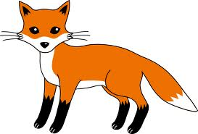
box
mum
fox
book

Slide 7
Try again

Slide 8
Try again

Slide 9
Try again

Slide 10
Try again

Slide 11
Try again

Slide 12
Next

Slide 13
Next

Slide 14
Next

Slide 15
Next

Slide 16
Well done
Class 1

