Slide 1
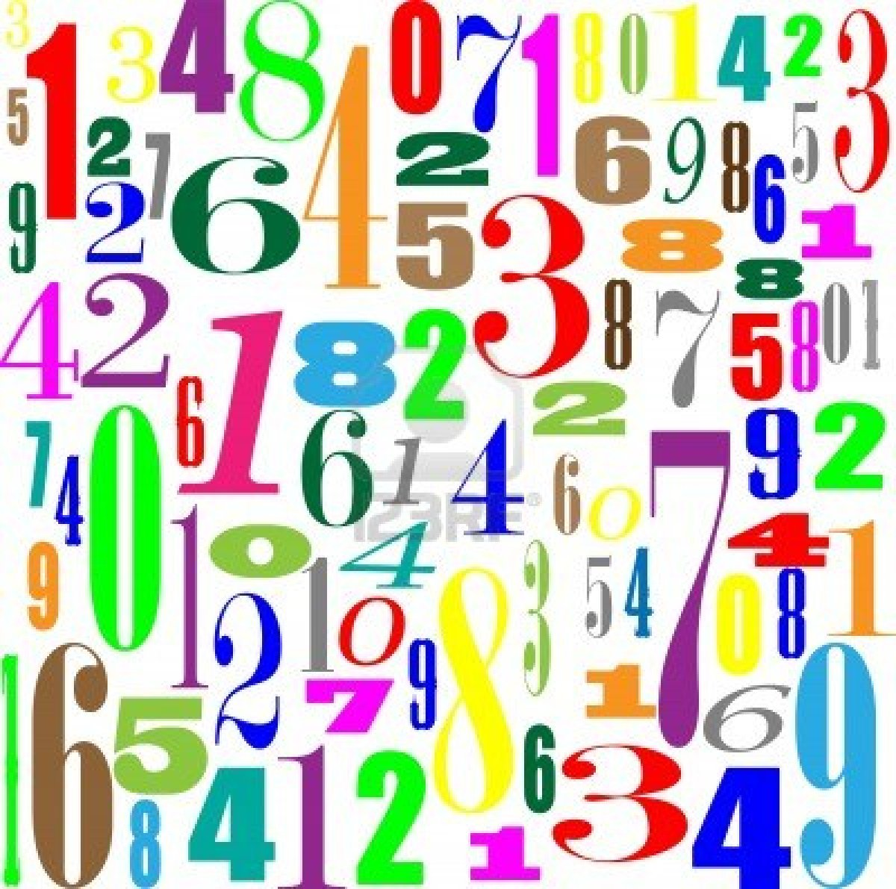
LI: To compare volume.
LI: To calculate volume.

Slide 2
Let's recap what we know about volume...
What does it measure?
What unit of measurement do we use?

Slide 3
What does it measure?
It measures the amount of space a 3D shape takes up. It's what can fit into it. It can also be called capacity.
What unit of measurement do we use?
In mm3 cm3 or m3
The 3 stands for cubed.

Slide 4
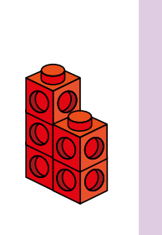
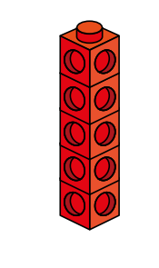
This is the reason the unit of measure is cubed (example, cm3).
= 1cm3
Volume = 5cm3
Volume = 5cm3

Slide 5
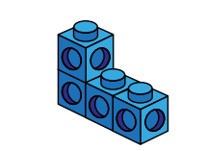
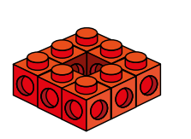
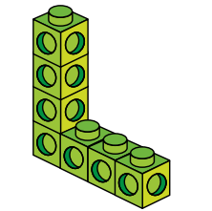
What are the volume of these shapes?
Remember, you might not be able to see all the cubes!

Slide 6
Volume = 4cm3
Volume = 7cm3
Volume = 8cm3

Slide 7
Year 5 children, you can start your activity sheet now. Year 6 children, you need to go through the rest of the slides.

Slide 8
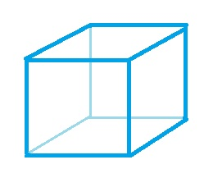
6cm
5cm
4cm
Can you find the ​volume of this cuboid?

Slide 9
Volume = length x width x height
Volume = 5 x 4 x 6 = 120cm3
6cm
Does it matter which way round we do the calculation?
5cm
4cm

Slide 10
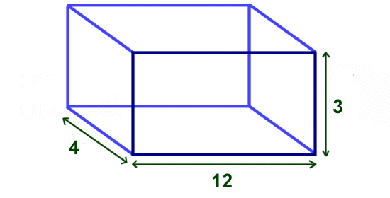
Can you find the volume of this cuboid?

Slide 11
Volume = length x width x height
Volume = 4 x 12 x 3 = 144cm3

Slide 12
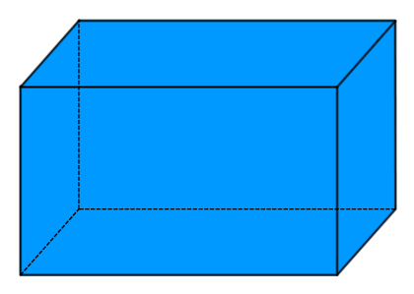
Can you find the volume of this cuboid?
6cm
5cm
10cm

Slide 13
Volume = 5 x 10 x 6 = 300cm3
6cm
5cm
10cm

