Slide 1
DT- Structures
Food packaging

Slide 2
L.O. To design my own packaging
Success Criteria
I will plan my design.
I will choose an appropriate shape net for my packaging.
I will be able to decorate my net, by adding colours, shapes and text.
I will save or print my net.
I will evaluate my own work.

Slide 3
Design
The first thing I want you to do is plan your packaging. I have attached a planning sheet to the website. Either print this off and fill in or record your answers on your own paper.
To help with your design look at packaging you have in your house.
These are the shapes you can choose from

Slide 4
Purple Mash
Login to Purple Mash and you should have a 2Do using 2Design and Make - Food packaging.
Open the 2Do
Use the arrows to get to these shapes and choose one for your packaging, please don’t use the others.
Then press ok.

Slide 5
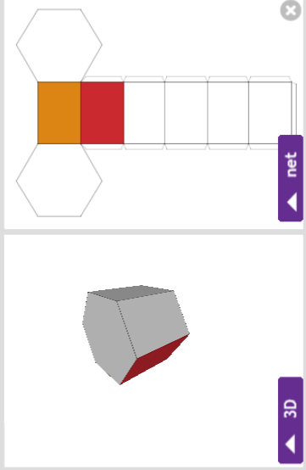
Get creative
Now is the time to show your off your artistic skills.
Experiment with adding colour, click on the section of the net you want. To do this click on the purple net button and this will move
into the middle of the screen.

Slide 6
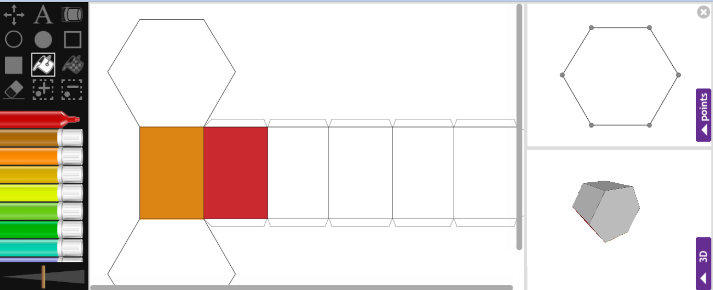
Get creative
Then choose the colour pen you want and press one of the paint tins. Then select the area of the net you want to colour in.
You can add shapes, choose your colour and press the shape you want. Then drag and drop the shape where you want it to go

Slide 7
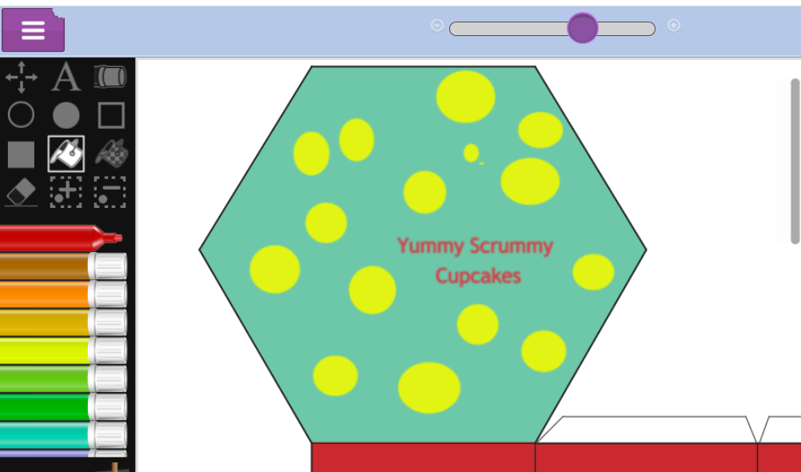
Have a closer look
To get a closer view of one of the sides of your net, slide the purple button along the bar at the top and then move the page up and down, left and right until you can see the part you need.

Slide 8
Add the information
You must add a label so I know what your food is.
Try to think of a catchy name.
To add text press the ‘A’ button
You can move the text and rotate it in different directions.
What other information do we find on food packaging?

Slide 9
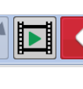
Other tools
Rubber, if you want to erase anything.
Pen to add drawings, remember to choose your colour first.
Make the lines thicker or thinner.
For more help, there are videos to watch
(top right corner).

Slide 10
Save your work!!!
Everyone must save their work. Click on the 3 lines, press save
Scroll down to Class 3 and click on the food packaging folder.
You should name your file with your name.
If you have a printer, you could print off your packaging and then make your net. But don’t worry if you don’t we can do this when we are back at school.
If you want to explore the other nets you can search 2Design and Make and have a go.

Slide 11
Evaluation
Now you have finished your work I want you to answer these questions. Record your answers with your planning work.
What went well?
What was tricky?
Is there anything you would change if you were to do this again?

