Slide 1
Computing
Spreadsheets
Year One
Computing | Year 6 | Spreadsheets | Number Operations | Lesson 1

Slide 3
Aim
I can enter data and formulas into a spreadsheet.
Success Criteria
I can identify cells using rows and columns.
I can type text and numbers into cells.
I can use the SUM function to add numbers together.
I can use the SUM function to perform further calculations.

Slide 4
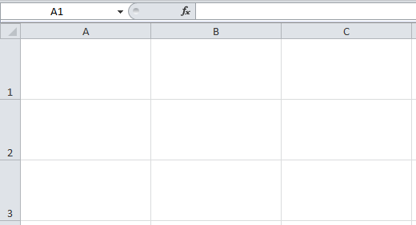
Introducing Spreadsheets
What do you know about spreadsheets already?
Does anyone know what they are used for?
What can they do?
Discuss with a partner and be ready to feed back any ideas.

Slide 5
Cell References
Everything in a spreadsheet goes into a cell (like a box in a grid).
Each cell is named by the row and column in which it is located.
See the Cells and Data Spreadsheet as an example.

Slide 6
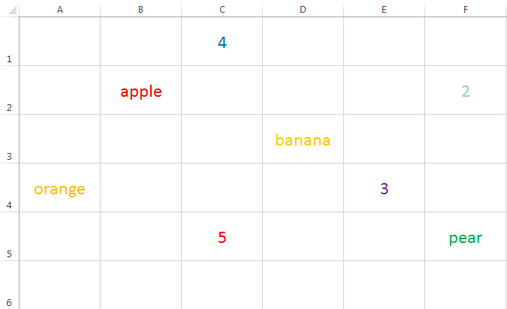
Cell References

Slide 7
Formatting Cells
Cells can be formatted to look clearer or more interesting, similar to word processing or desk top publishing.
Watch then practise how to change cell colours and borders, font size, style, colour and alignment, row height, column width.
You can also select an entire row, column or the entire sheet and then adjust or format multiple rows or columns at the same time.
Explore the formatting features so you can present your work attractively, if you have time after each future activity.

Slide 8
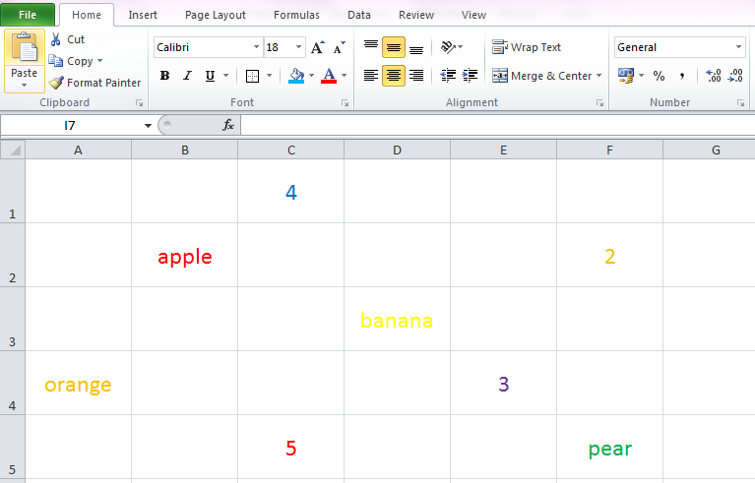
Formatting Cells
Font Style
Borders
Font Size
Cell Colour
Font Colour
Click and drag between rows or columns to adjust height or width.
Click on a row or column heading to highlight entire row or column.
Note: The exact look may change in different versions of the software.

Slide 9
Calculations
One advantage of spreadsheets is the ability to do calculations quickly, like a calculator.
Next we are going to look at the Number Operations Spreadsheet.
As well as typing text and numbers into a cell, we can instruct the computer to add the contents of two cells automatically.
This is done using the SUM function.
Click in the cell that you want the calculation to appear. Then click on Sum in the AutoSum menu.

Slide 10
Calculations
The function appears in the formula bar here.
In this case:
=SUM(B5+B6)
A formula is always shown by using the ‘=‘ sign first, followed by ‘SUM’
The calculation then goes inside the brackets

Slide 11
Calculations
What if we changed the contents of the cells now?
Next, we are going to enter calculations for Subtract, Multiply and Divide.
To multiply we use the ‘*’ symbol, e.g.
Click in the cell that you want the calculation to appear. Then click on Sum in the AutoSum menu.
Numbers: 3 * 4 = 12
Cells: B5 * C5
To divide, we use the ‘/’ symbol, e.g.
Numbers: 12 / 4 = 3
Cells: B5 / C5

Slide 12
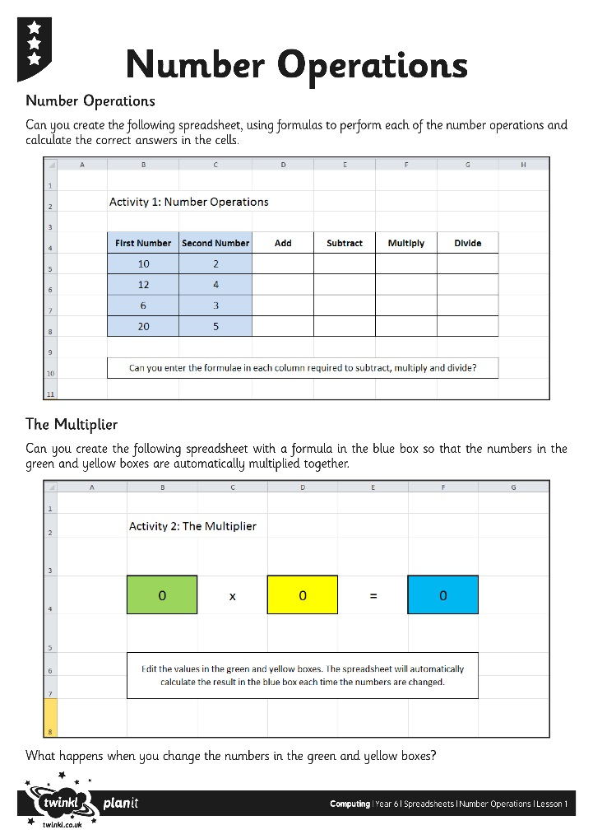
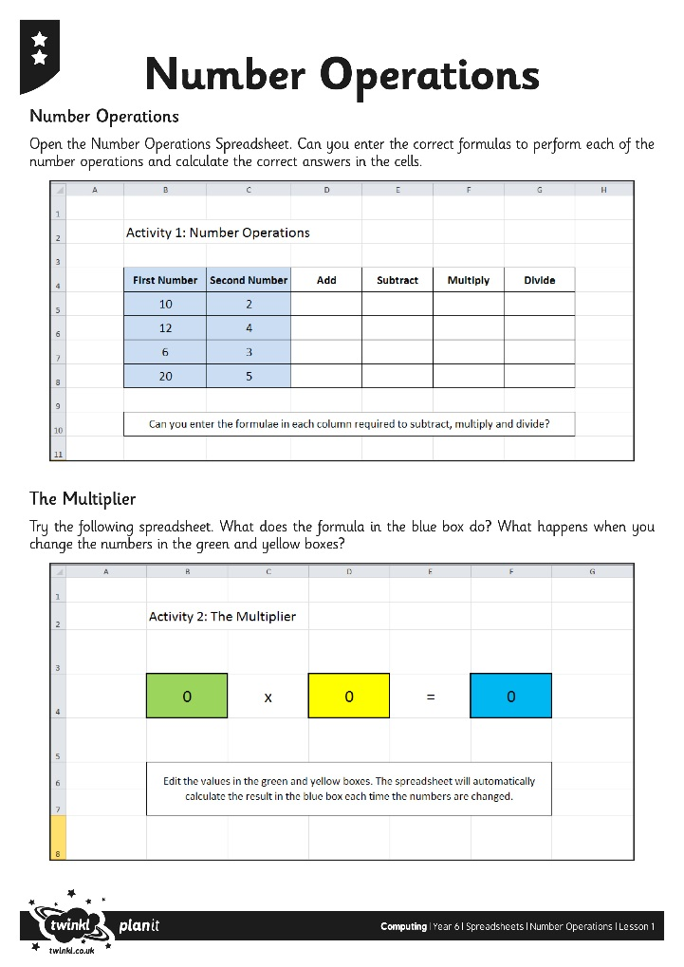
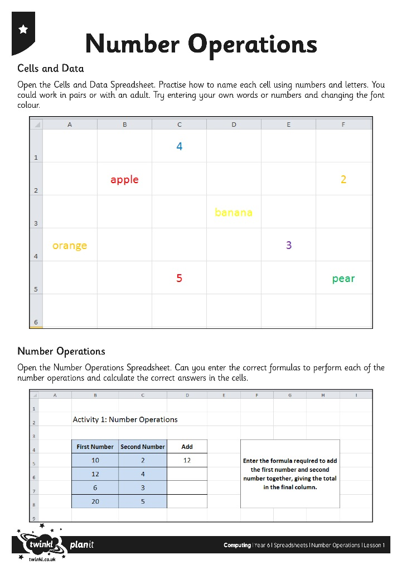
Try It Yourself
Use the Spreadsheets and Activity Sheets to try entering and formatting data, then using calculations for the Number Operations.

