Slide 1
Introduction
This PowerPoint focuses on comparing amounts of objects up to five.
Children will be encouraged to think about how the objects have been sorted and then compare the amounts in the two groups. They will be supported in making comparisons by using the mathematical language of more, most, few and fewest.
The two sets of objects will be displayed in a five-frame, supporting the children with their 1:1 correspondence and direct comparison. There is also the option to click for questions, encouraging discussion about the different amounts. Children can then agree on their answers and reasoning before moving on to the next side.
Towards the end of the PowerPoint, children are supported in making comparisons between a smaller amount of large objects and a larger amount of smaller objects. This will help children to recognise the difference between size and quantity.

Slide 3
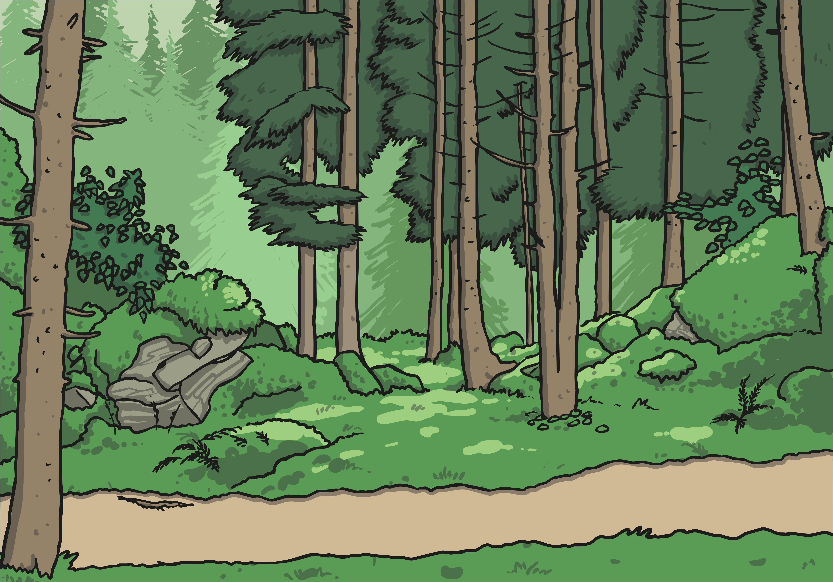
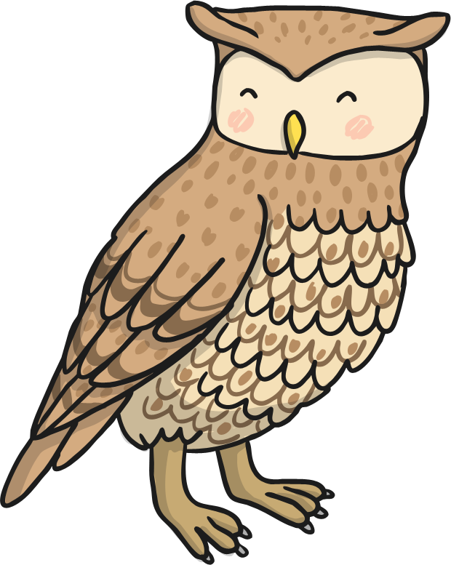
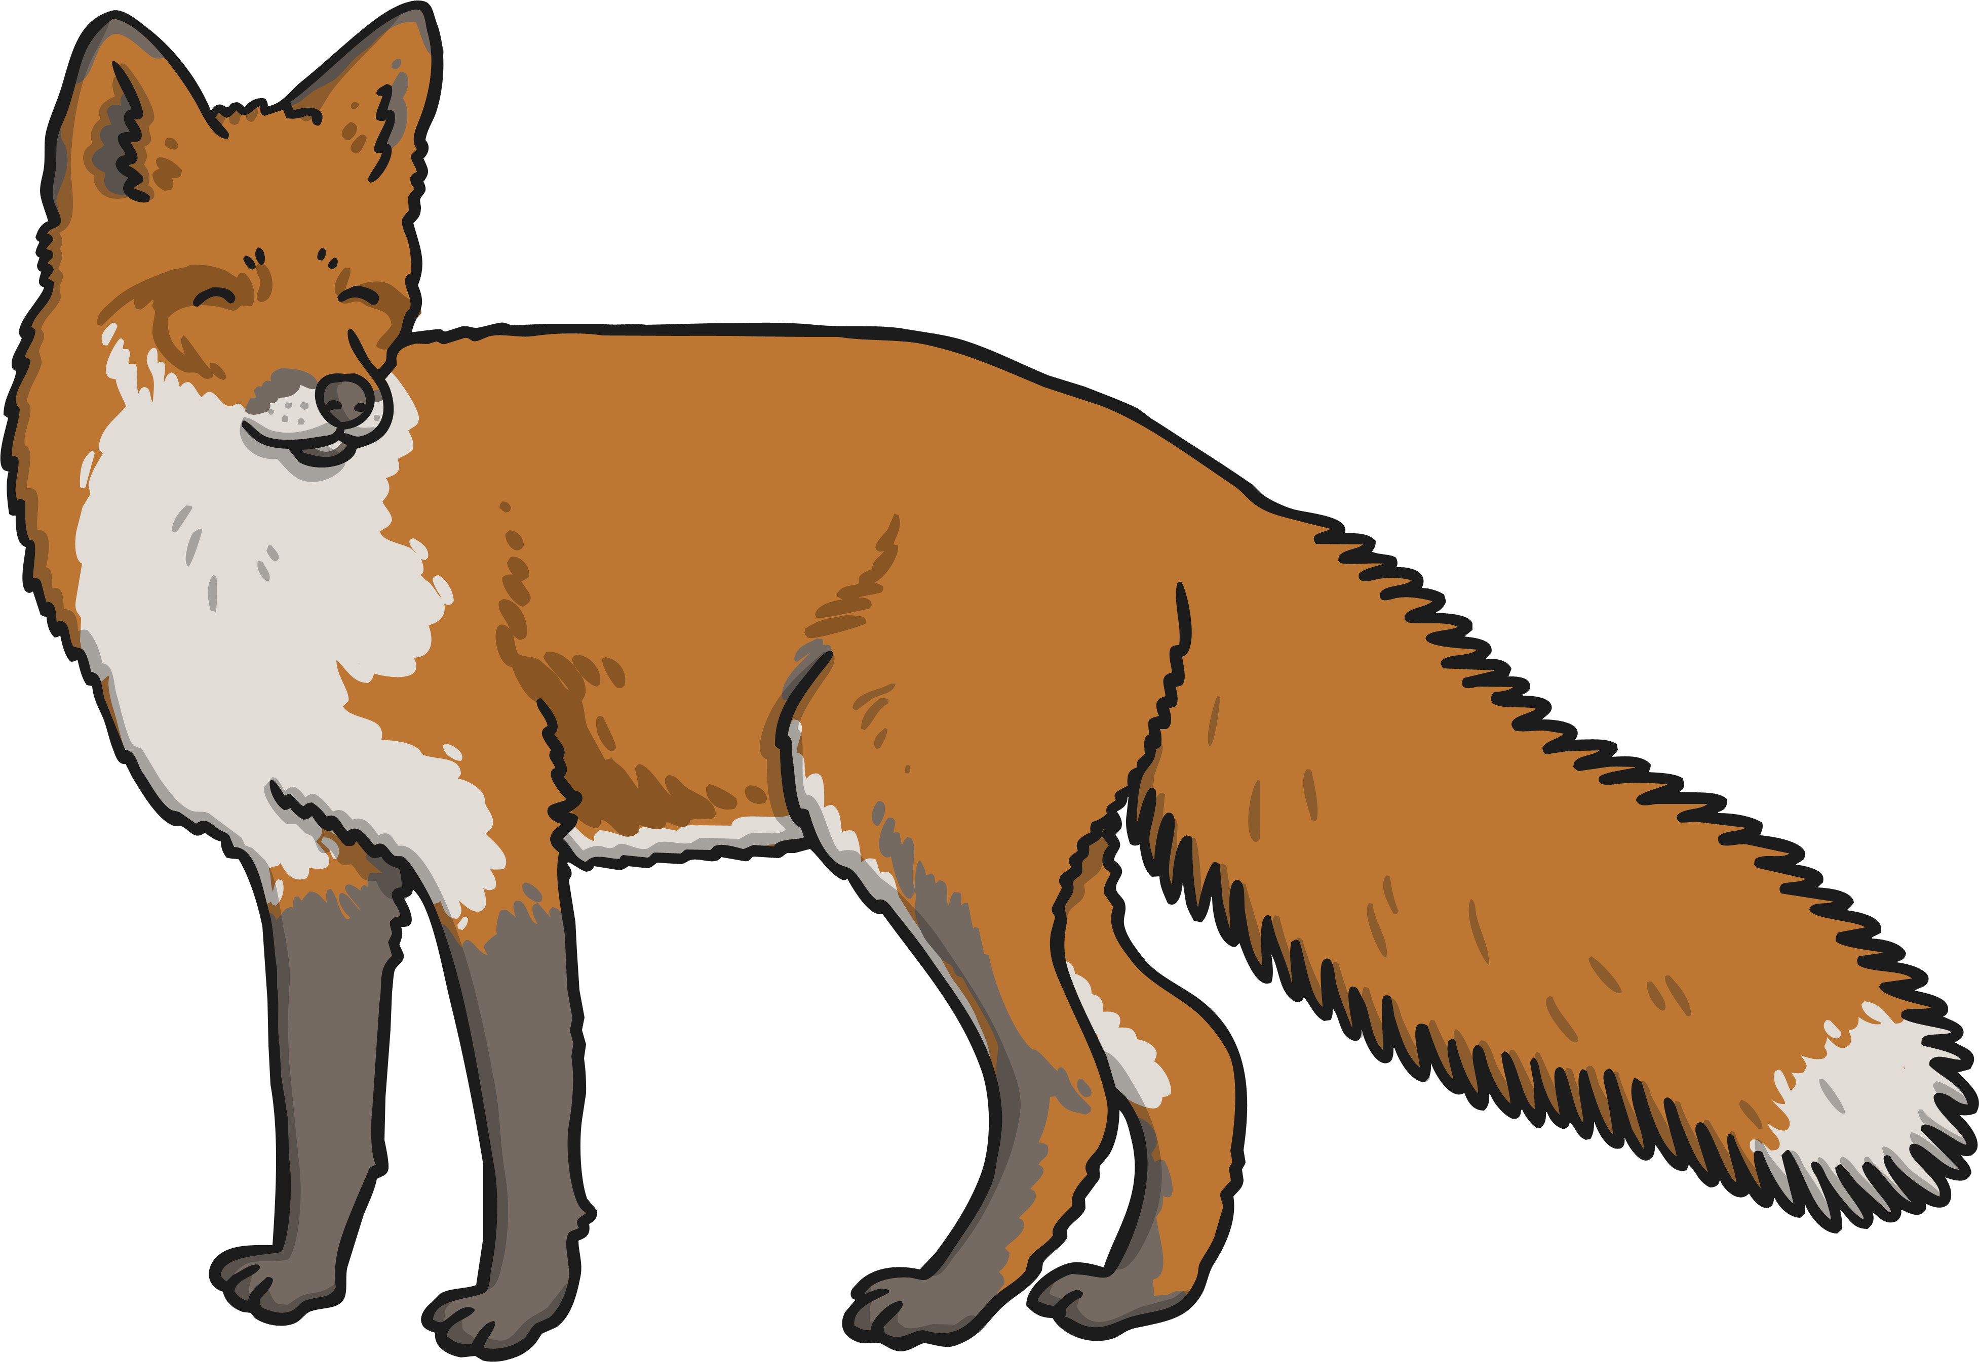
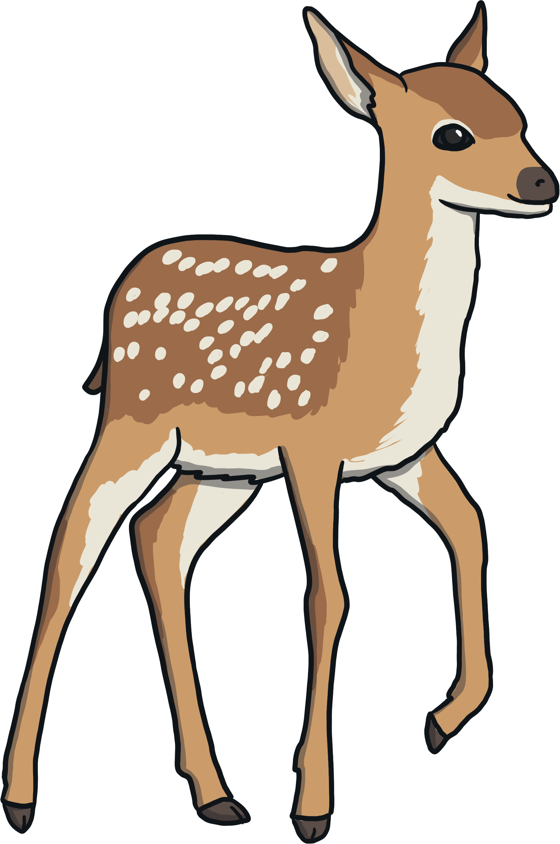
Which are there more of, owls or foxes?
How do you know?
Click for a question.

Slide 4
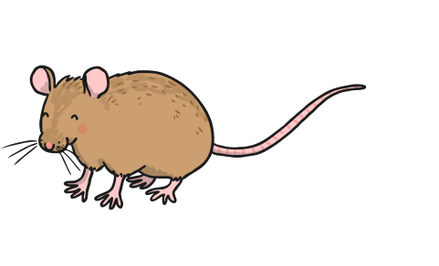
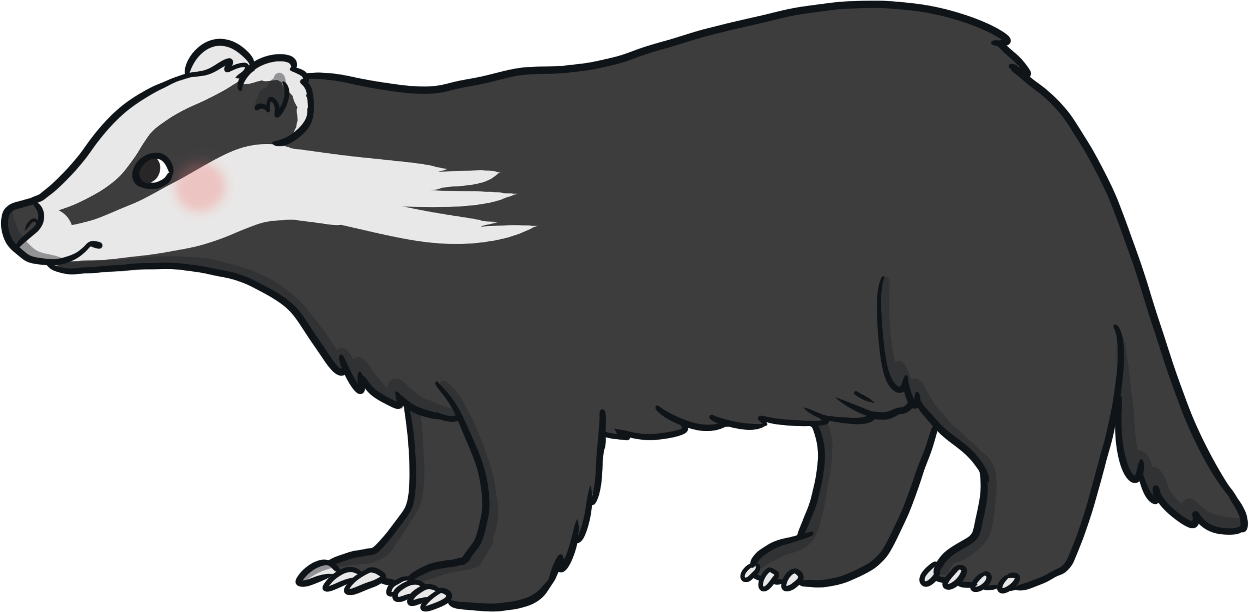
Are there fewer mice or fewer badgers?
How can you be sure?
Click for a question.

Slide 5
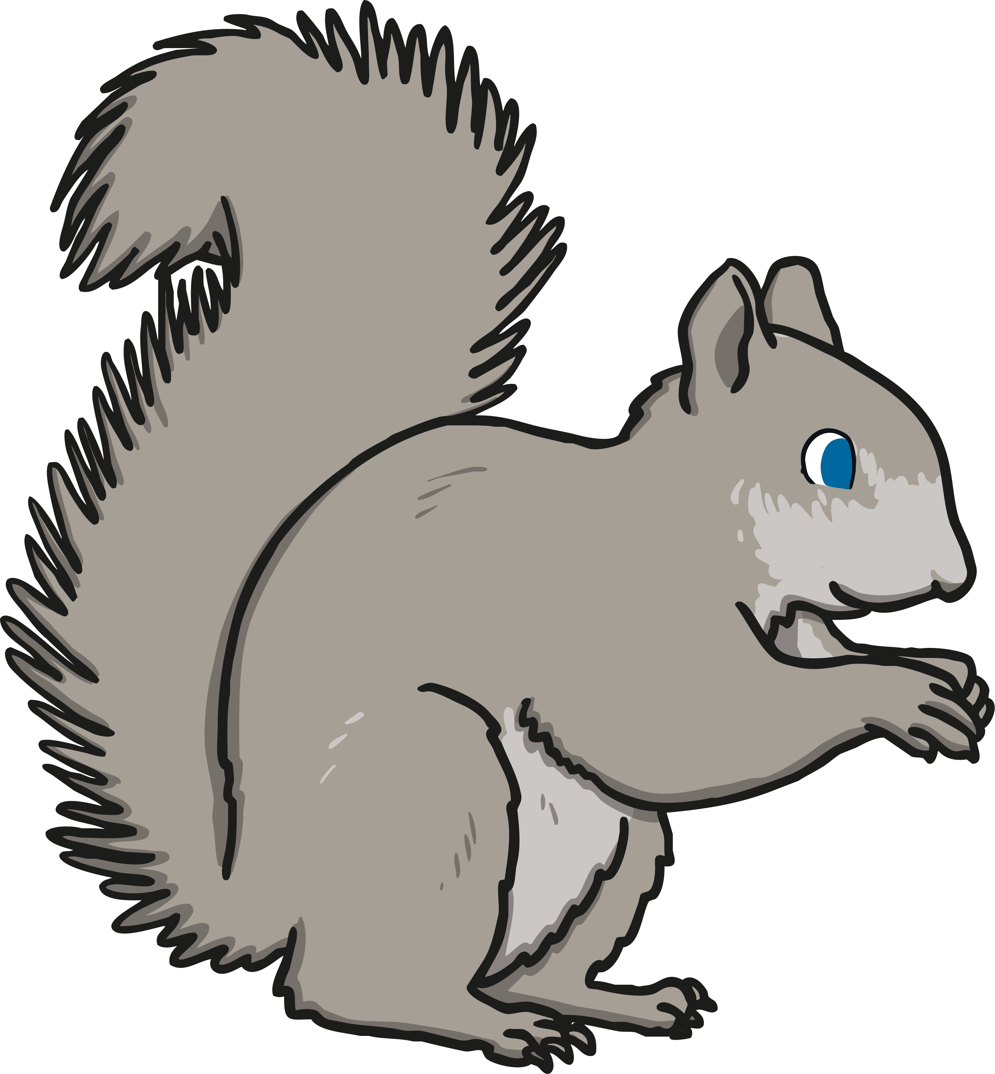
How many deer are there?
How many squirrels are there?
Which group of animals has the fewest amount?
Click for a question.

Slide 6
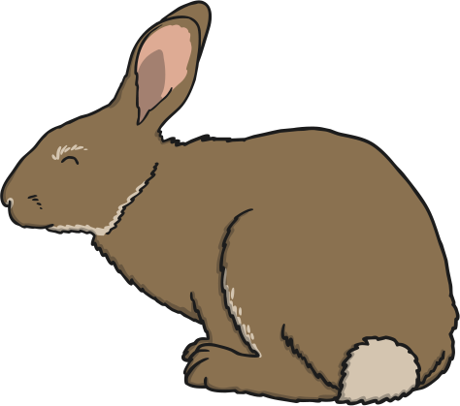
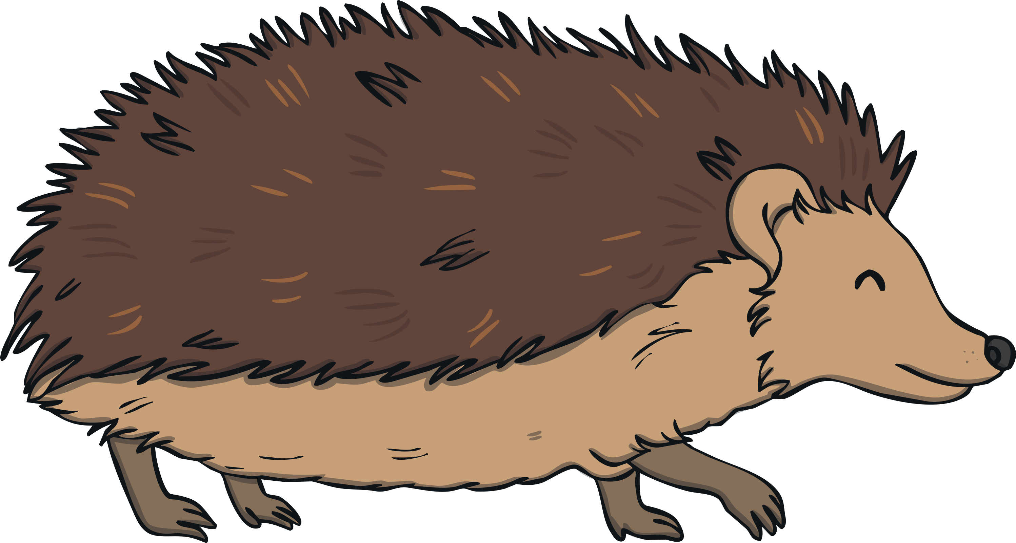
Which animal is there more of?
Which animal is there fewer of?
Click for a question.

Slide 7
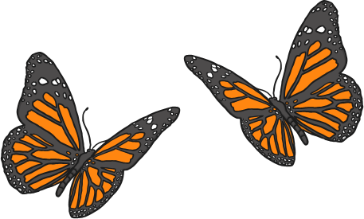
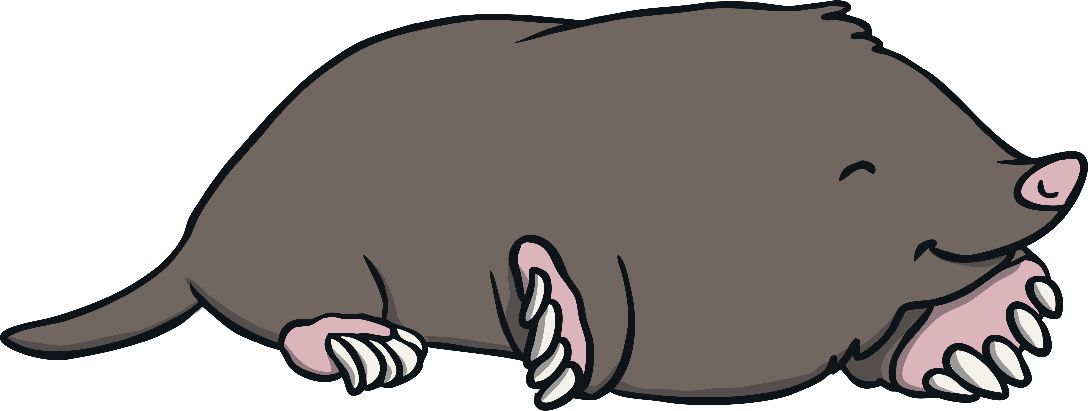
Does one group have more?
Does one group have fewer?
How can we describe the groups?
Click for a question.

Slide 8
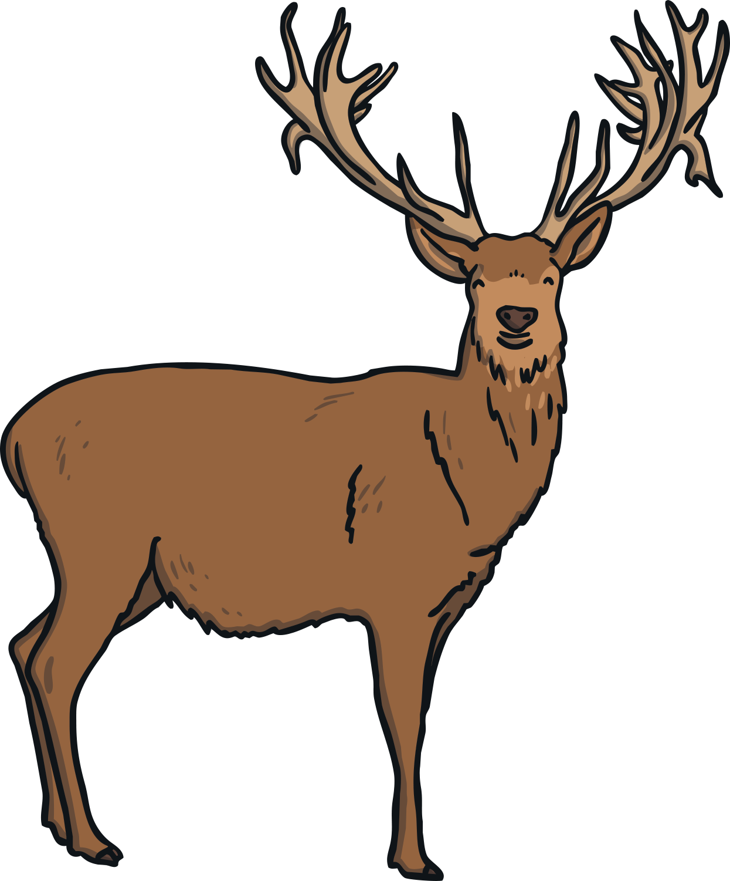
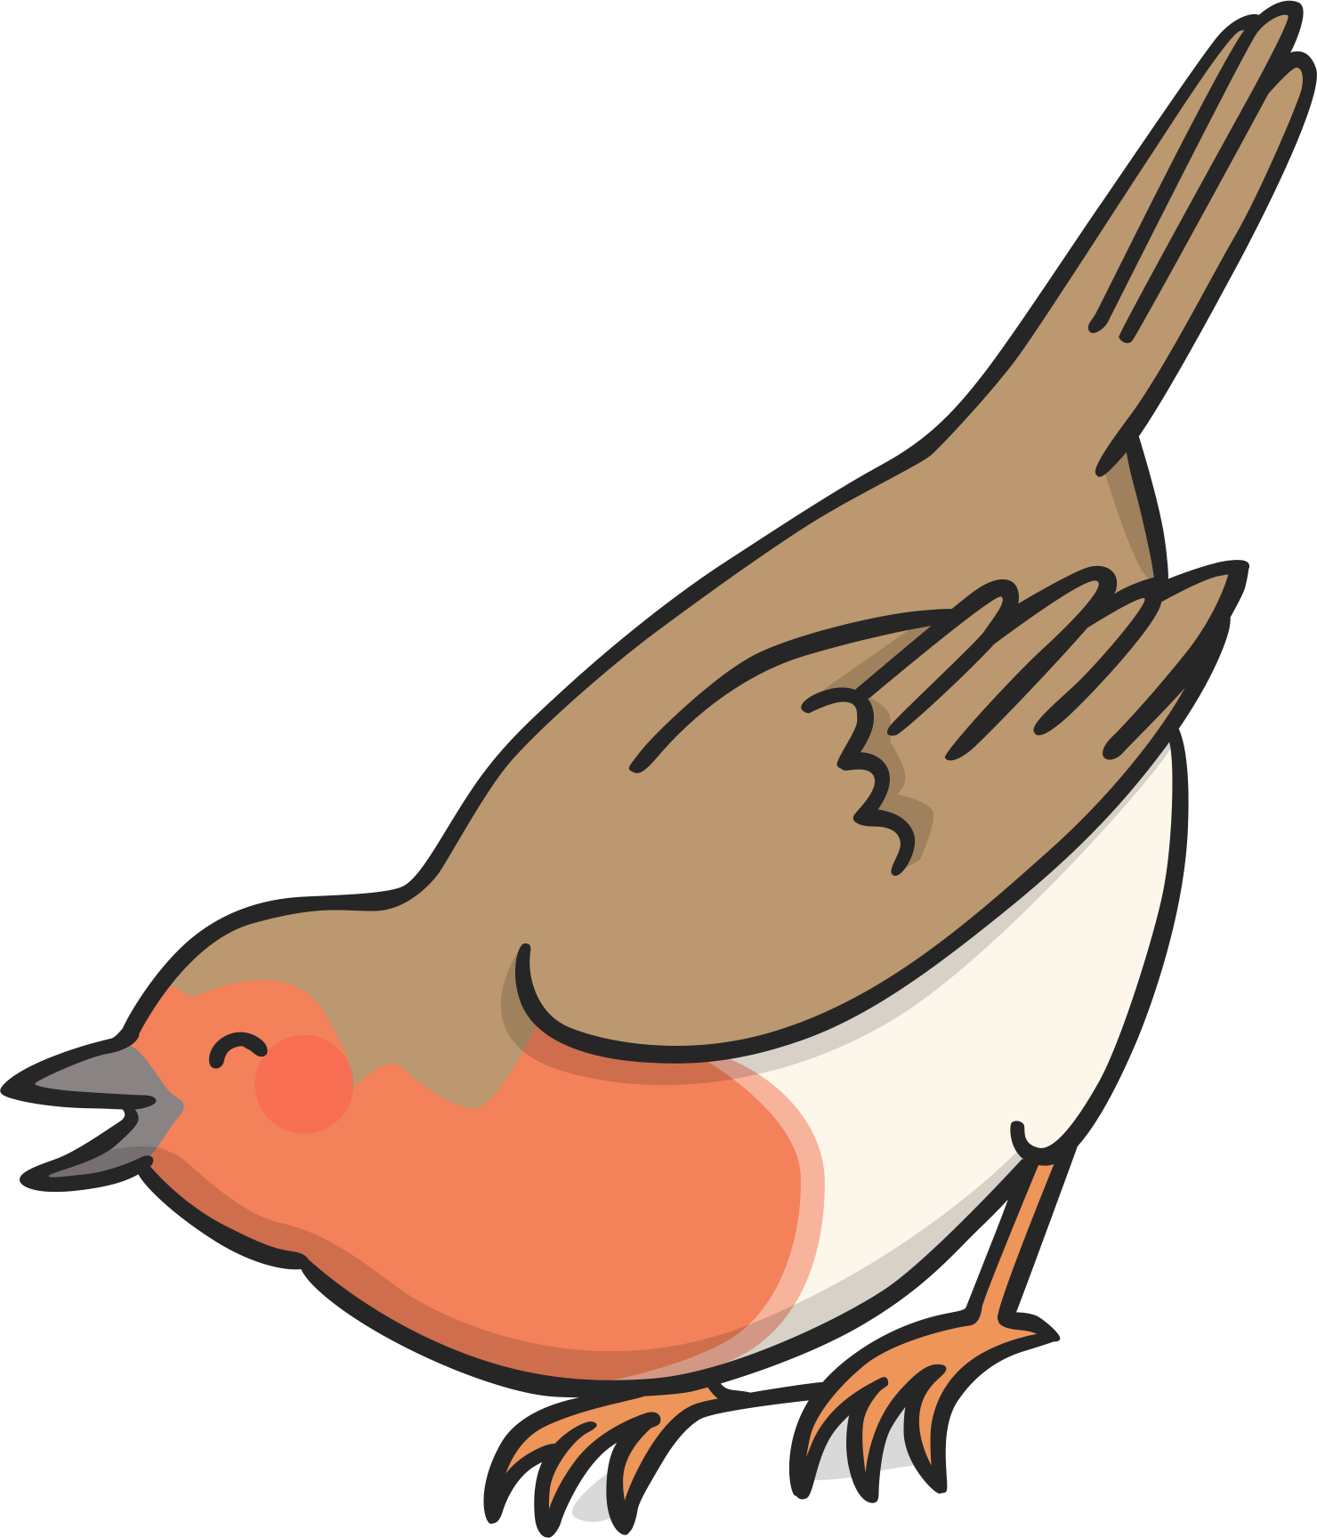
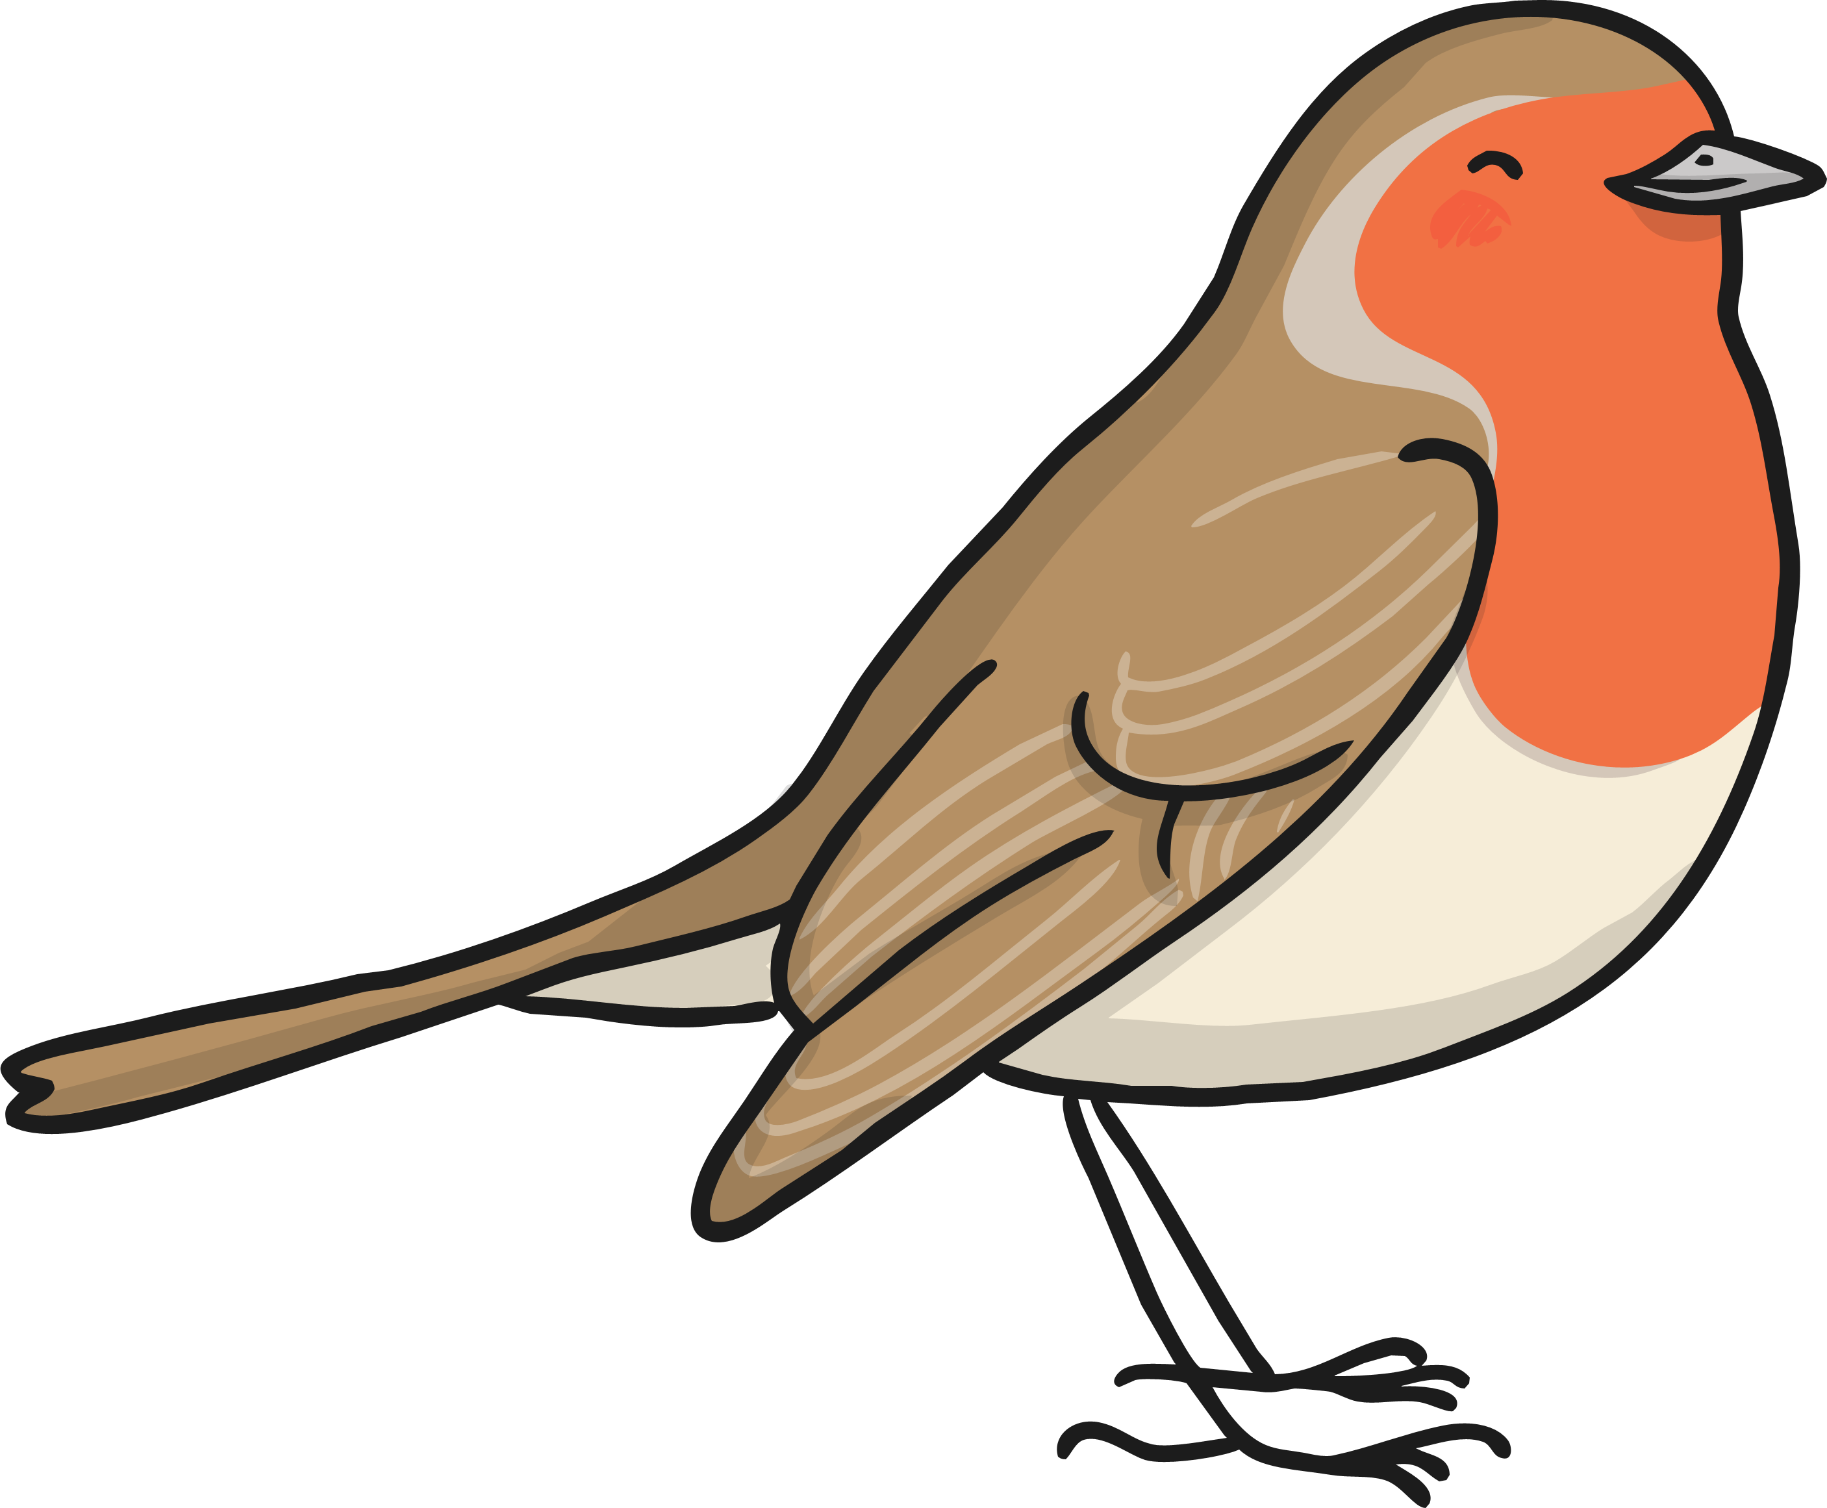
Which animal do you think there is more of?
How can we check?
Click for a question.

