Slide 1
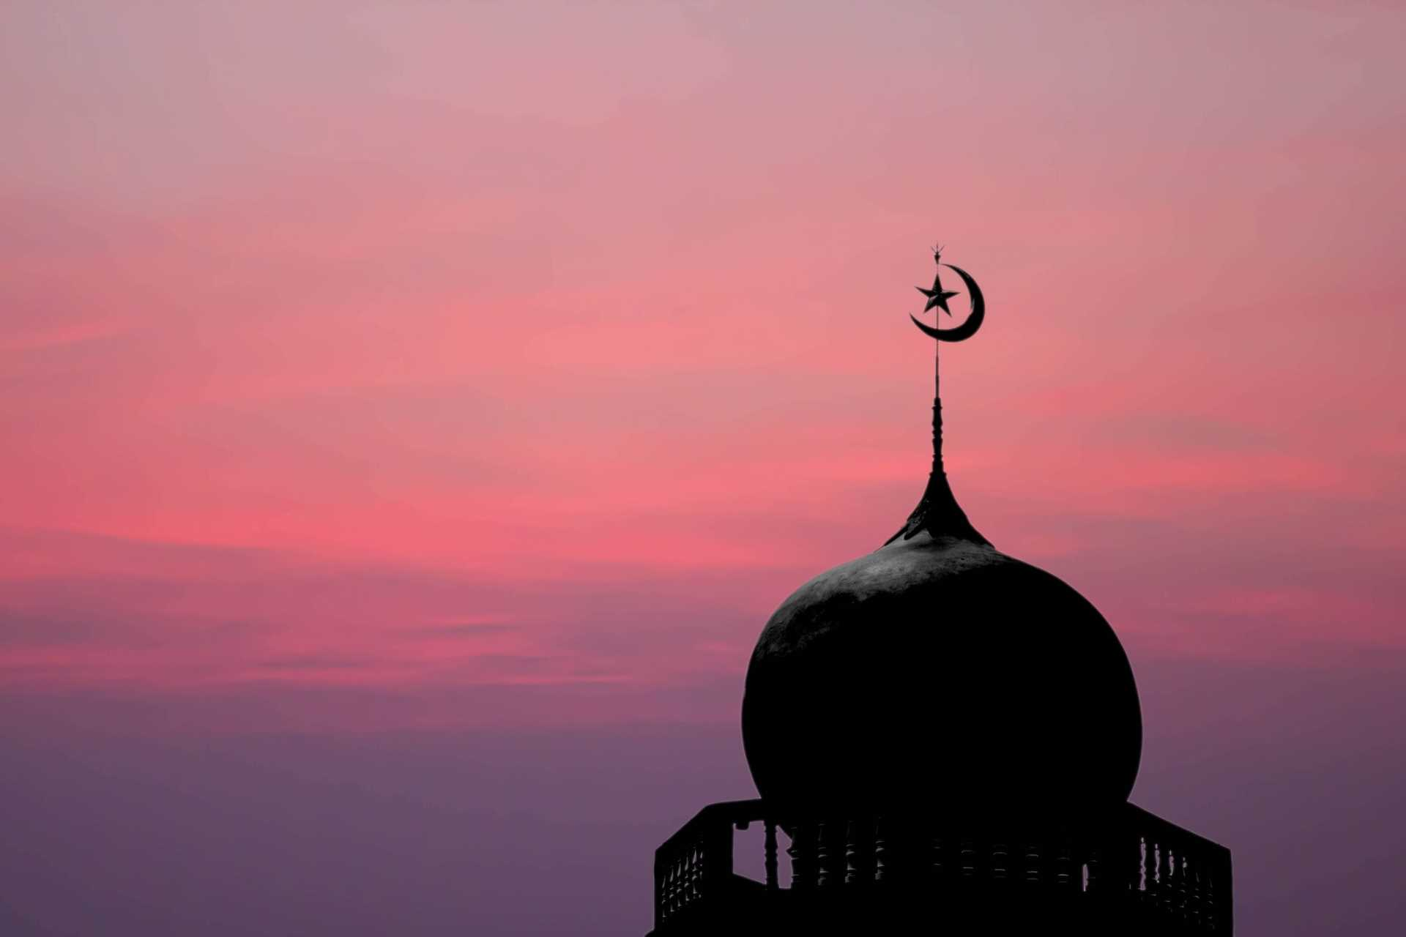
What does it mean to be a Muslim in Britain today?

Slide 2
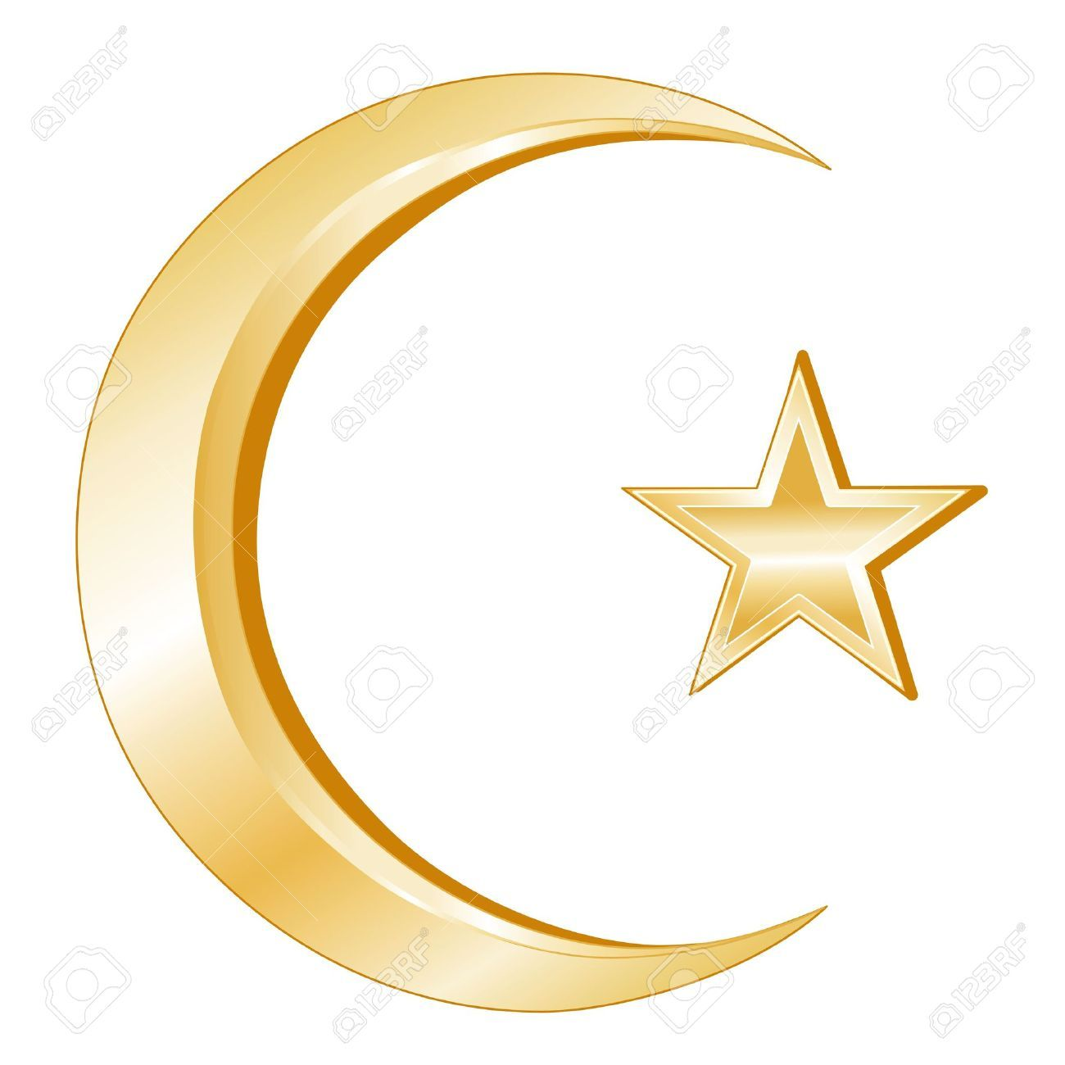
LI: To describe the key belief of Muslims and explain how it affects their life.

Slide 3
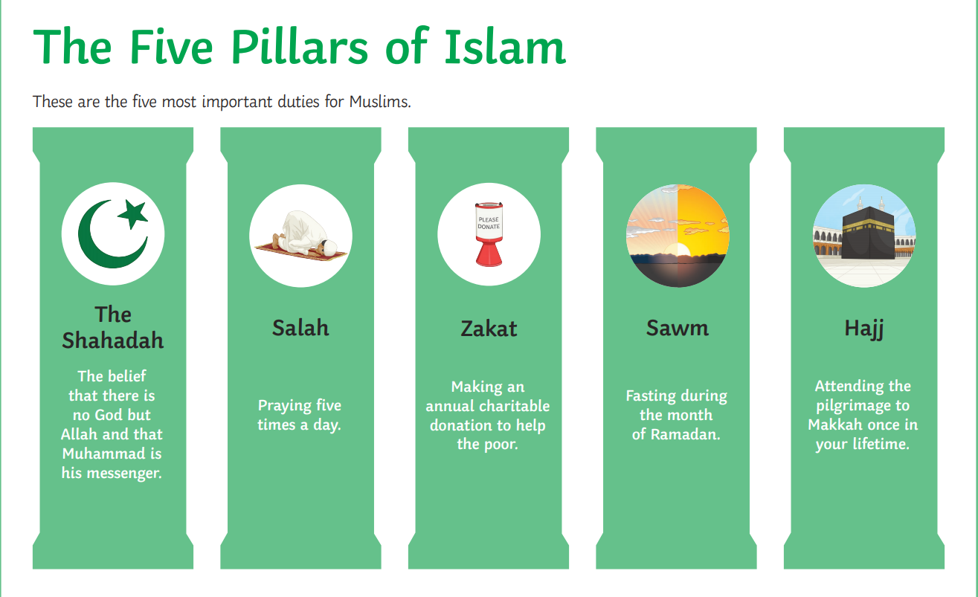
Let's recap what the 5 pillars of Islam are ...

Slide 4
There are two ways that the words of the Shahadah are used.
-It is used as call to prayer from a Mosque.
-The words of the Shahadah are the first words that a Muslim baby hears when he/she is born. The father whispers the words into the ear of the baby.

Slide 5
The Shahadah
This is one of the most important beliefs in Islam.
The Shahadah says
'I witness that there is no other God but Allah, and Muhammad is the prophet of Allah.'

Slide 6
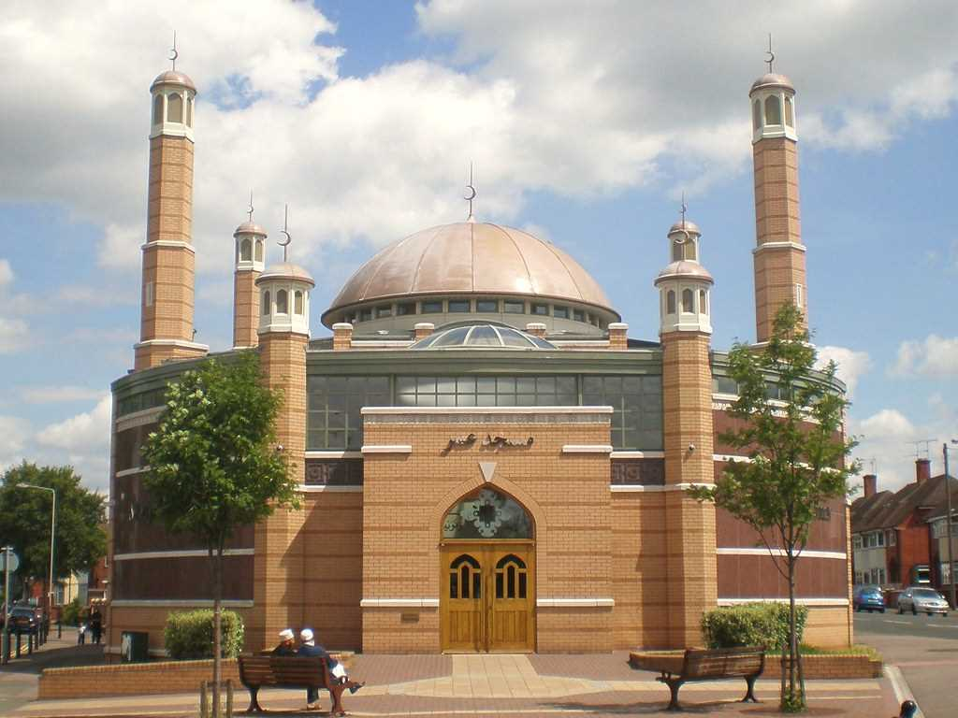
What belief or value is so important to you, that you would shout it from the top of a tall building?
I would like you to write a sentence that you would have liked your parents to whisper into your ear when you were born. Think about why you have chosen these words?

Slide 7
We are going to find out about Bilal now. Bilal was the first Muezzin. A Muezzin is a man who calls Muslims to prayer from the Mosque.
Bilal stood on top of the Ka’aba in Mecca. It had been a difficult and dangerous thing to do, but he had a far more important task to complete. He filled his lungs with as much air as he could, then used his deep and powerful voice to call faithful Muslims to prayer.
Allah is the greatest.
I bear witness that there is no god but Allah.
I bear witness that Muhammad is Allah’s messenger.
Come to prayer. Come to salvation.
There is no God but Allah
Even Bilal could not believe how his life had changed to bring him to this point.
Bilal was born in Arabia, but he was a slave. His parents had been black Africans who had also lived as slaves, so their son had to be a slave too. When he was old enough, he was taken to the market place and sold to a new master.
Umaya owned Bilal. He was a merchant, who made a good living from selling idols in Mecca. He had a number of slaves, and treated them badly, for slaves were cheap, and Umaya had plenty of money. When the merchant heard Muhammad teaching about one god, Allah, he was angry. He might lose money. But when he heard Muhammad say that all people were equal, like the teeth in a comb, he was furious. No slave was equal to him.

Slide 8
The merchant decided to test Muhammad’s teachings. He ordered Bilal to strike one of the Prophet’s companions, firmly believing that a slave would not disobey his master. But Bilal had listened to Muhammad too, and he thought the Prophet was right. He dropped the whip Umaya had given him, and refused to do as he was told.
Immediately the merchant had Bilal thrown in prison, and his execution was ordered. During the long, dark night, Bilal thought more and more about Muhammad’s words, and became more and more convinced that they were right.
In the bright light of day, Bilal was staked to the ground and beaten. Then heavy rocks were piled on him, to crush his body. All that could be heard by those who went near was Bilal’s deep, strong voice saying “One God, One God.”
It happened that Abu Bakr, a great friend of the Prophet was passing and heard Bilal. Moved by his voice, and his cry of “One God, One God,” Abu Bakr haggled with Umaya until he was able to buy Bilal and set him free.
As a free man, Bilal became a close and dear friend to both Abu Bakr and Muhammad. He helped to build the first mosque in Medina. When the time came bilal.doc that the Muslim’s were searching for a way to call the faithful to prayer, Bilal came into his own. The believers decided they did not want a flag, or a bell, or a rattle, or a drum, or a trumpet, but a beautiful human voice.
Abu Bakr became excited. “Then there is only one voice we could use for our first call to prayer,” he said, and explained how he had found Bilal and set him free. And so it was that Bilal became the first muezzin, the first to call people to prayer in Medina. And when the Muslims returned to Mecca, he was the first to call from the top of the Ka’aba. Today the call to prayer is still as it was in Bilal’s time, just a beautiful human voice calling people to worship.

Slide 9
What do you think mattered most to Bilal?
Was it his work, his own comfort, using the gifts God gave him, being loyal to his friends, serving Allah, escaping from slavery, preserving his own life, praying, following the prophet, obeying his master, fashionable clothes, helping other people?
On the next slide you will see a circle diagram. I would like you to place all of the above statements in one of the circles.
You can't put more than 3 statements in each circle.

Slide 10
Doesn't matter
Matters a bit
Matters quite a lot
Matters very much
Matters
most

Slide 11
Watch this video about Muhammad - click on the link below...
(or you might have to copy and paste the link into your internet browser.)
https://www.bbc.co.uk/bitesize/clips/z9b9jxs

Slide 12
Now we are going to read the story of Muhammad and the black stone.
Whilst reading it, think about what it teaches us about the character and qualities of Muhammad.
The story is on the next slide.

Slide 13
This is the story of Muhammad and the placing of the Black Stone.
The Prophet Muhammad was a wise man, even before he received the revelations of the Qur'an from Allah. When the Prophet Muhammad was a young man, about thirty-five years old, the people of his home town, Makkah, decided to rebuild the sacred masjid of Makkah, the Ka'bah. ​Since there were many big families at Makkah, they worked separately, family by family, until the walls were high enough for the black stone to be built again into its corner.
Then a violent argument broke out among them; for each family wanted the honour of putting the black stone into its place. The disagreement lasted for four or five days and anger had increased to the point that they were ready to fight with arms, when the oldest man present suggested a solution. He called, "O men of Quraish! Take as a judge between you, the first man who shall enter in through the gate of this Sacred Mosque.“ They agreed to follow the advice of the old man; and for their good luck, the first man to enter the Mosque was Muhammad, who had just returned to Makkah after a brief absence for a few days. The sight of him produced an immediate and pleasant feeling that here was the right person for the task, and his arrival was greeted by words of satisfaction. ​"This is al-Amin," said some. "We accept his judgement," said others, "It is Muhammad.“ ​Muhammad asked, "What is this all about?“ When they explained the matter to hm, he took off his cloak, and spread it on the ground. Then, picking up the Black Stone, Muhammad laid it in the middle of the cloak. "Let the leader of each family take hold of the border of the cloak," he said, "then lift it up, all of you together.“ When they had raised it to the right height, Muhammad took the stone and placed it in the corner with his own hands, and the building above the Black Stone was continued and completed peacefully and quietly.

Slide 14
What does this story tell us about Muhammad?
I would like you to create a cartoon strip to re-tell the story of the black stone.
You should include pictures with captions.
The format is on the next slide for you to see.

Slide 15
