Slide 1
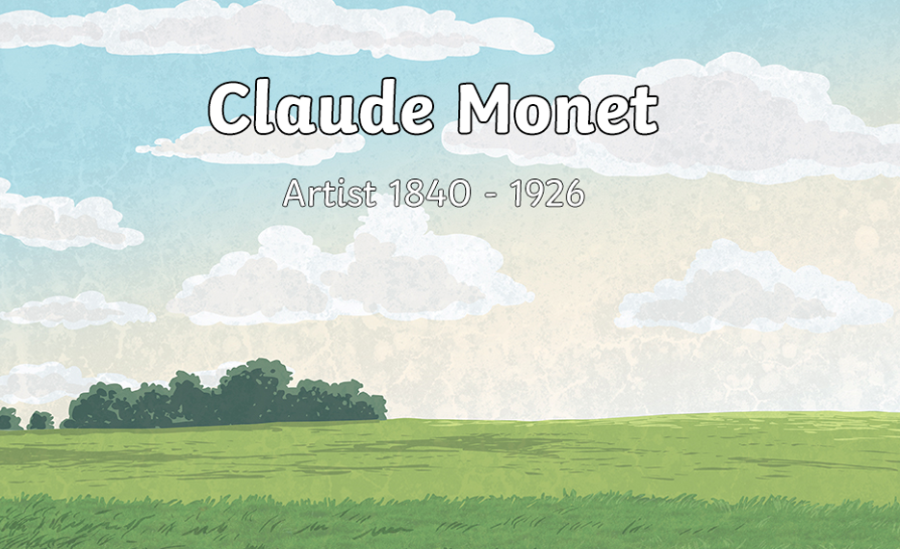

Slide 2
What do we know about Claude Monet already?
What do we know about the painting Impression, Sunrise?
What was this the start of?
Why is Monet so famous?

Slide 3
Watch this video about Monet and his painting style.
https://video.link/w/0PfHb
You will need to copy this link into the internet.

Slide 4
Look at the video at around 3 mins 10 seconds.
How did the painter achieve an impression of the scene he saw?
Look at the video at around 3 mins 50 seconds.
Note the cross-hatch patterns and how the painter uses a range of different brush strokes as well a rag to blur and blend.

Slide 5
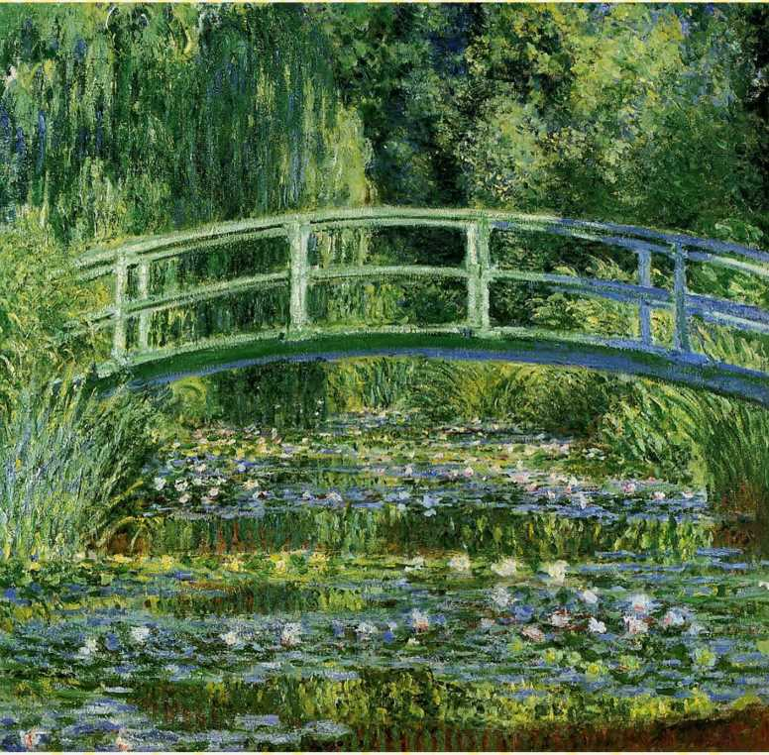
This is the painting 'Water lilies'.
This is one of Monet's most famous paintings.

Slide 6
Today, I would like you to go outside and do some painting - just like Monet did.
Ideally, you will need: paper, a clipboard or book to lean on, paint, water, a pallet or plate to mix on, paint brushes.
Obviously if you don't have these resources at home, that is absolutely fine. Just use whatever you can find.
You will need to find somewhere comfy to sit, and ideally with a good view to look at (again, I planned to do this lesson at school).

Slide 7
I would like you to paint your own impressionist picture of an outdoor scene.
You could either squint or use a clear document sleeve/ plastic wallet to help you ignore the detail and paint an impression.
You could begin by sketching only the main shapes and outlines you can see through your sleeve/ plastic wallet.
Think about the techniques you saw in the film.
As you're painting remember to think about light and shadow and cross-hatching strokes of colour as Monet did.
Think about the affect of light on the colours. Can you create lighter and darker patches of the same colour?

Slide 8
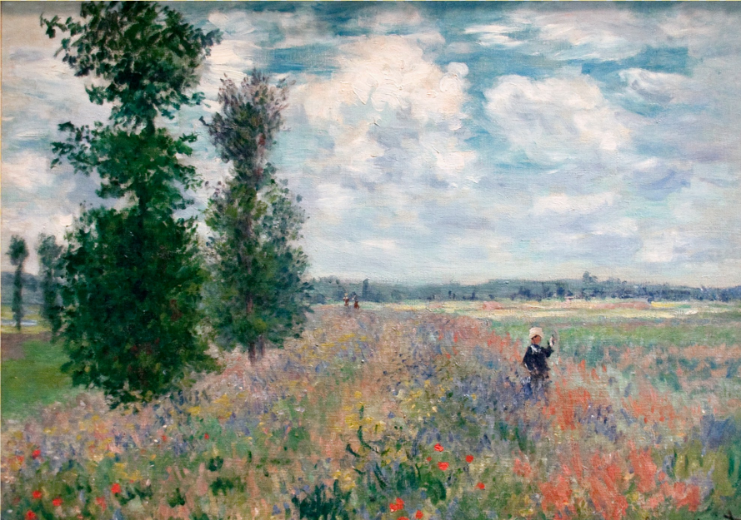
When you have completed your painting, think about:
Have you managed to create an “Impression” of the scene?
Does standing back make a difference? Why? Why not?
Did the painting technique help with this?
How did you find using the document sleeve/ plastic wallet to blur the hard edges?
Has your painting captured the light and colour of the scene successfully?

