Slide 1
Find the number…

Slide 2
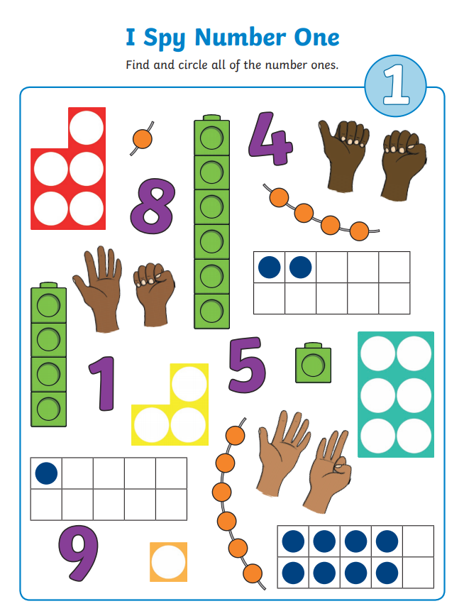

Slide 3
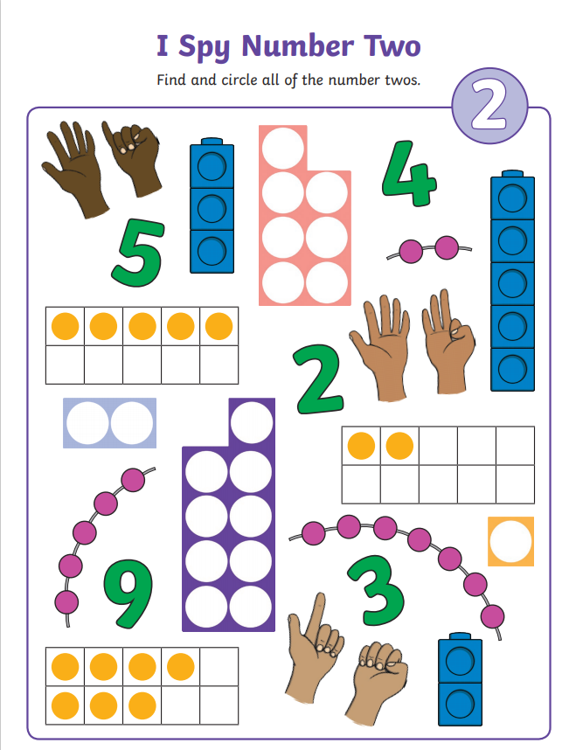

Slide 4
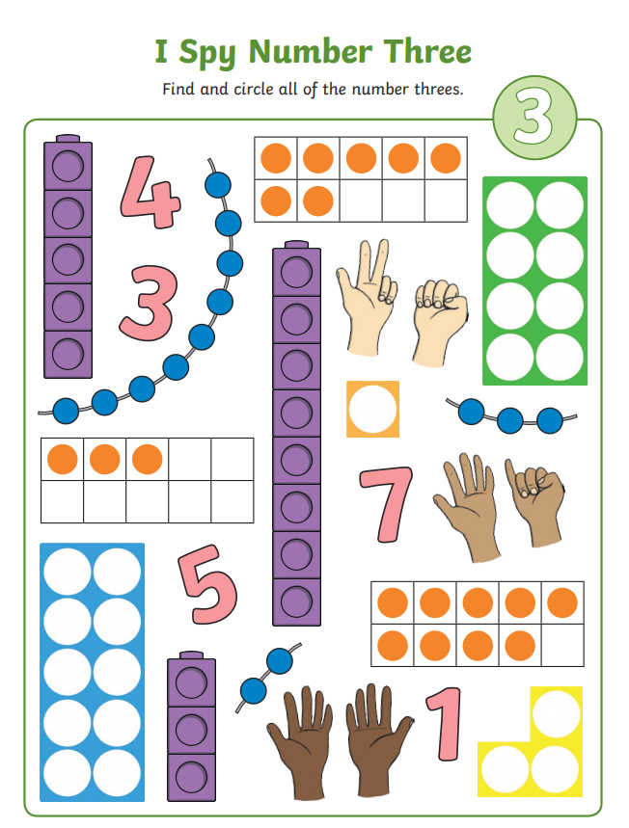

Slide 5
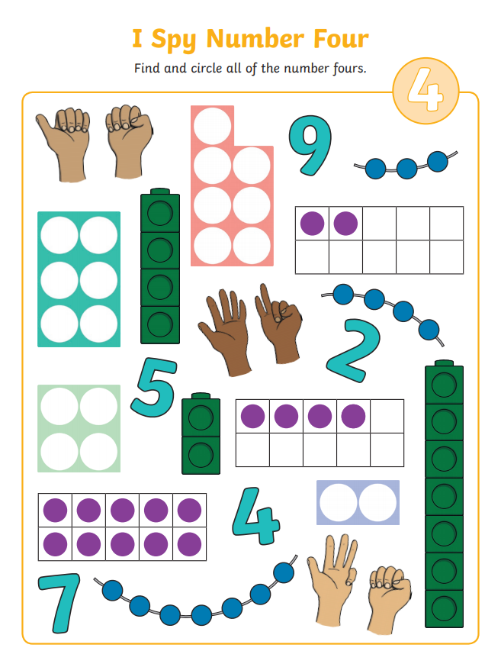

Slide 6
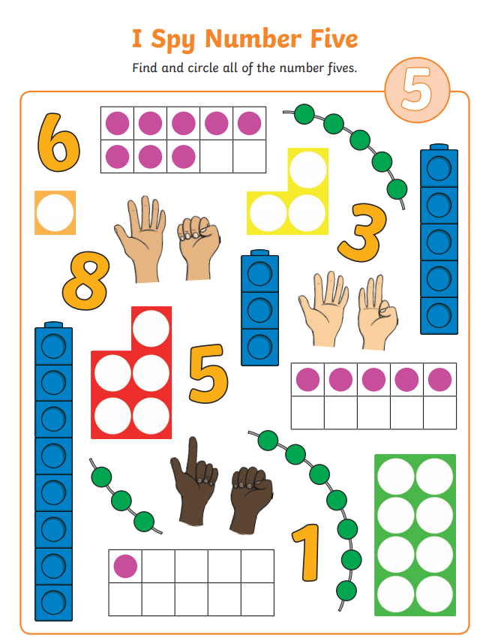

Slide 7
Can you recognise these numbers?

Slide 8
1

Slide 9
4

Slide 10
3

Slide 11
5

Slide 12
2

Slide 13
6

Slide 14
8

Slide 15
10

Slide 16
7

Slide 17
9

Slide 18
How many…

Slide 19
How many…

Slide 20
How many…

Slide 21
How many…

Slide 22
How many…

Slide 23
How many…

Slide 24
Which numbers are missing?
1 __ 3 4 __

Slide 25
Which numbers are missing?
__ 2 3 __ 5 6

Slide 26
Which numbers are missing?
1 2 __ 4 5 __

Slide 27
Which numbers are missing?
5 6 __ 8 __ 10

Slide 28
Which numbers are missing?
5 __ 7 8 9 __

