Slide 1
Wednesday 13th January

Slide 2
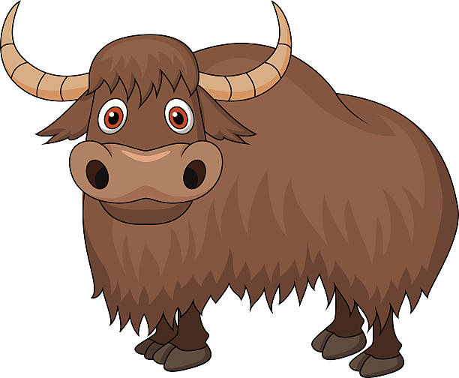
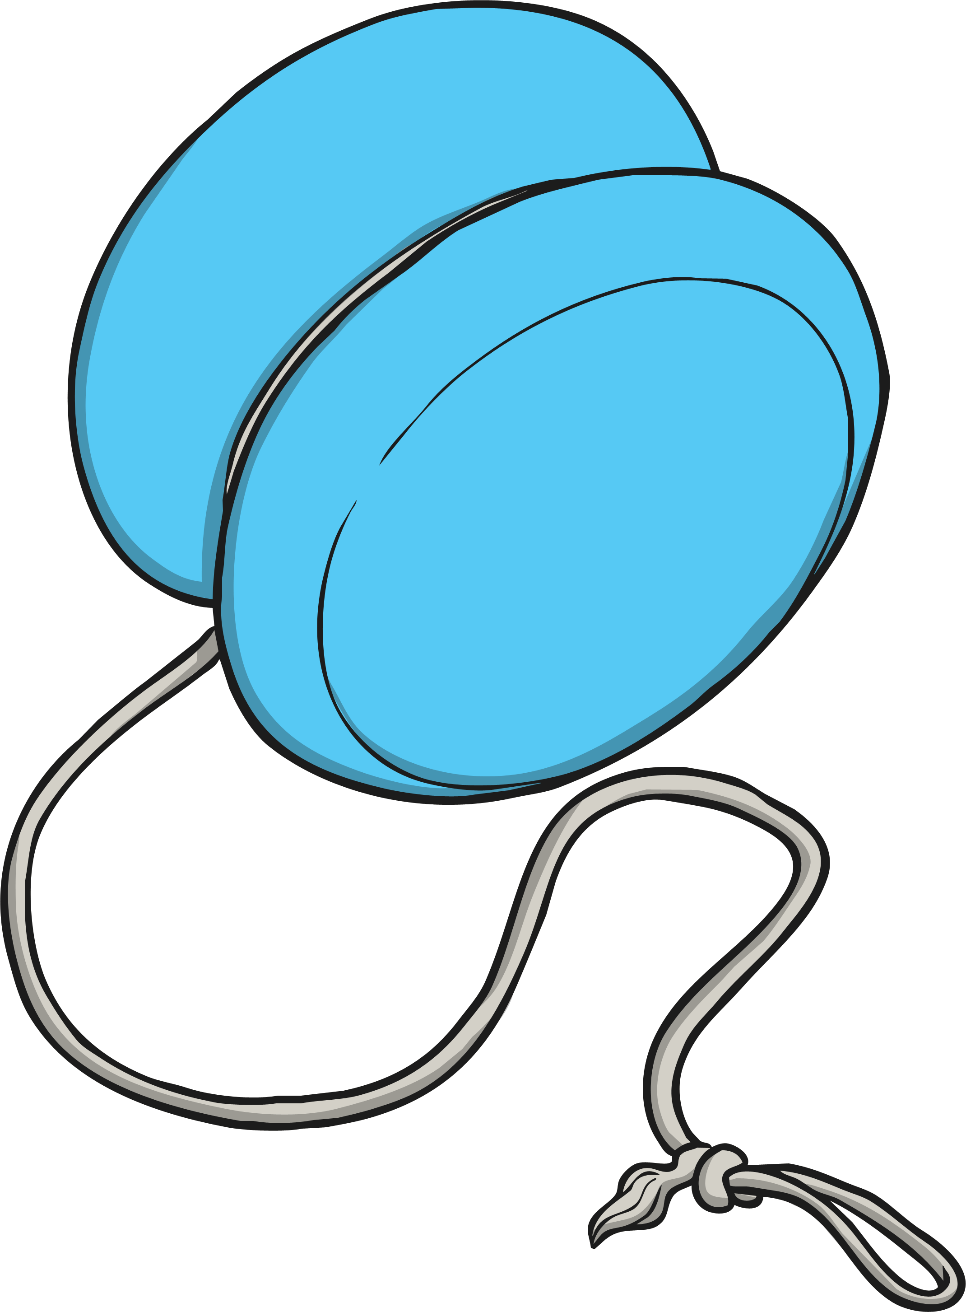
Phonics - Phase 3
Can you guess what our phoneme is today?

Slide 3
Our phoneme today is…
yes
yak
y
yellow
yell
Can you say these words with our phoneme in? See if you can sound out the words then blend to read

Slide 4
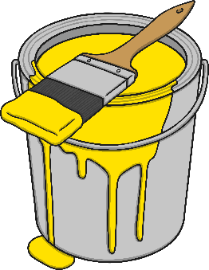
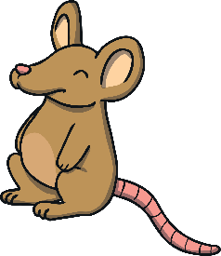
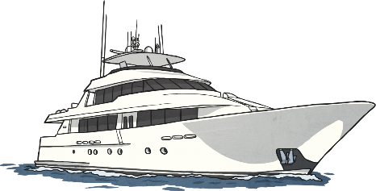
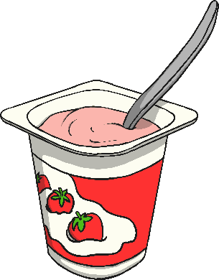
Click the pictures that begin with ‘y’ to move them into the middle.
y

Slide 5
Can you decode to read our sentences? How many ‘y’ graphemes can you see? Yes! I can get a pet. Yum! It is jam. A dog can yap.
Follow this link to play Buried Treasure – read the word and decide if it is a real word or a monster word. You can select the phoneme we have been looking at today or use previous phonemes to consolidate.

