Slide 2
Aim
I can design my own spreadsheet for a specific purpose.
Success Criteria
I can plan the requirements for a new spreadsheet.
I can make decisions on formatting to improve the appearance.
I can think of original ideas for using a spreadsheet.
I can create a range of suitable formulas for a purpose.

Slide 3
Quick Reminder Quiz
Can you remember what you have been taught so far about how to use spreadsheets?
Who can answer these quick reminder questions:
How do you sort a list of values from largest to smallest?
How do you change the font style for the entire spreadsheet?
How do you add a set of numbers together?
How do you insert an extra row into your spreadsheet?
How do you adjust the width of multiple columns?

Slide 4
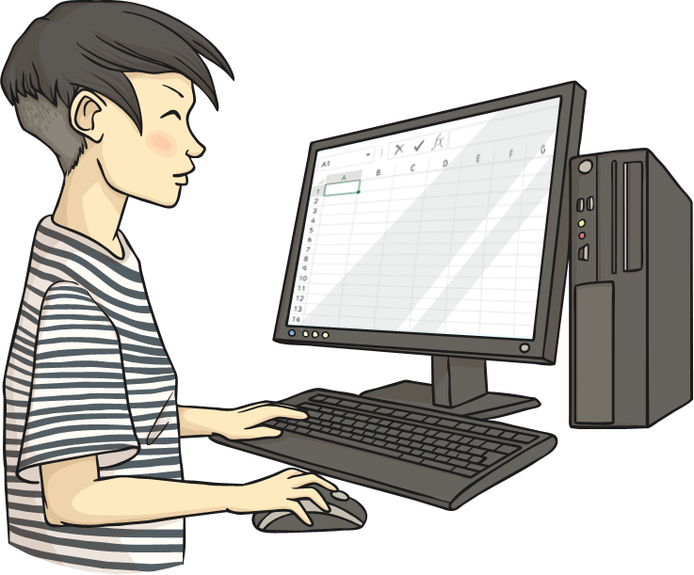
Design Your Own
In this lesson, you will get the chance to design your own spreadsheet for a specific purpose.
You could create your own version of a spreadsheet from a previous lesson or use your own original idea.
You may be asked to complete one of the previous lesson spreadsheet tasks first, if you did not finish.

Slide 5
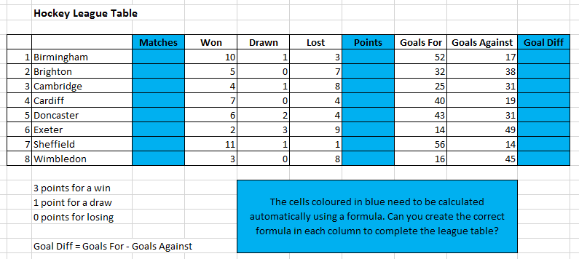
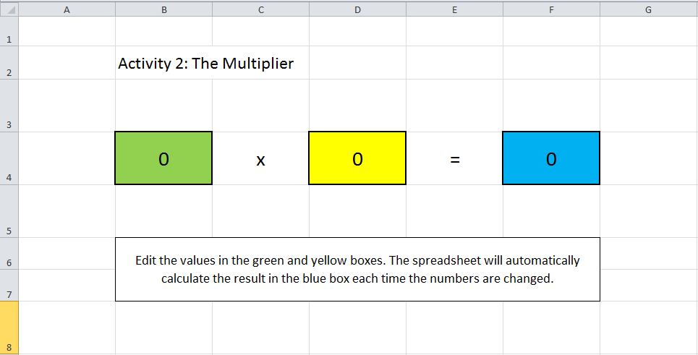
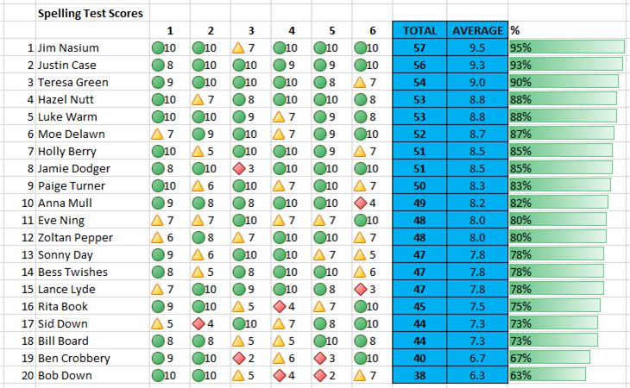
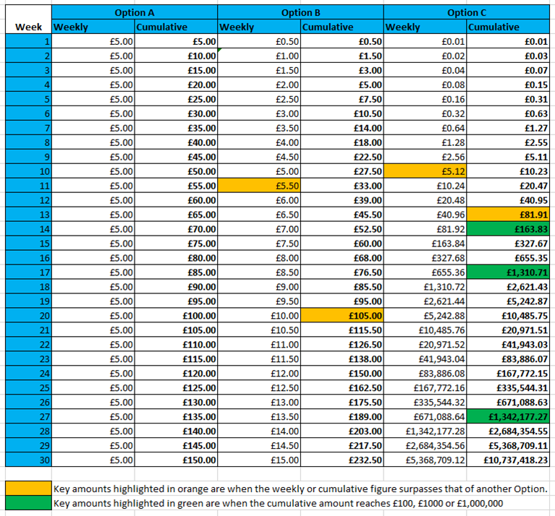
Example Spreadsheets
Which cells have been merged together here?
Can you remember what these spreadsheets were for?

Slide 6
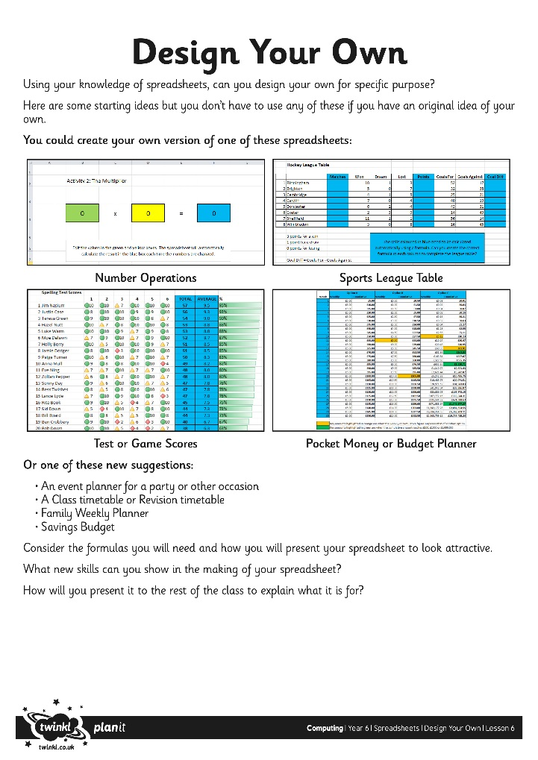
Create Your Spreadsheet
Listen to this one first.
When you are ready to begin, you may like to jot down some notes first on paper or a whiteboard to decide what your spreadsheet will be for.
Next, open a new blank spreadsheet and start creating.
Consider the text labels, numbers and formulas required.
Make sure you think about your layout and present your design attractively (format font, colour, alignment, background, borders)
Listen to this one second.

Slide 7
Plenary
What is your spreadsheet used for?
Explain what it is designed for and what formulas were required.
What are the advantages of using a spreadsheet for your purpose rather than pen and paper?

