Slide 3
Which arrow shows
the length?
2) Which arrow shows
the height?
3) How long is the pencil?
4) How tall is the flower?
a
b
b
a

Slide 4
Which arrow shows
the length?
2) Which arrow shows
the height?
3) How long is the pencil?
4) How tall is the flower?
a
b
b
a
4 cubes
5 cubes

Slide 6
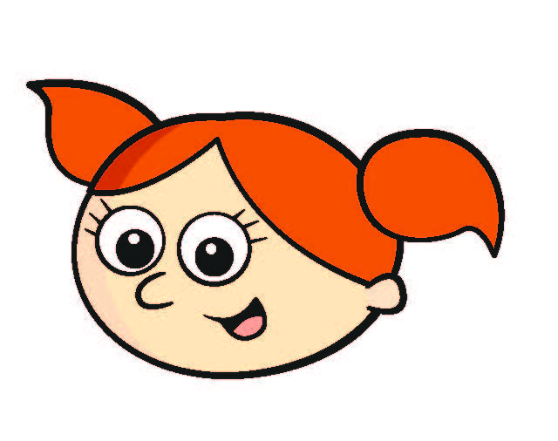
The height is 9 cubes.
No, it’s
4 cubes.

Slide 7
We can measure length and height in centimetres using a ruler.

Slide 8
How long is the pencil?
The start is lined up with cm.
0
The end is lined up with cm.
8
The pencil is cm long.
8
Have a think

Slide 9
How long is the line?
The line is exactly 6 cm long.
Do you agree with Tiny?
No.
Have a think
Tiny has not lined up with 0 cm.

Slide 10
How tall is the tower of cubes?
The start is lined up with cm.
0
The end is lined up with cm.
5
The tower is cm tall.
5
Have a think

Slide 11
What is the length of each line?
A
7 cm
B
10 cm
Which line is longer?
10 $>$ 7
Have a think
Line B

Slide 12
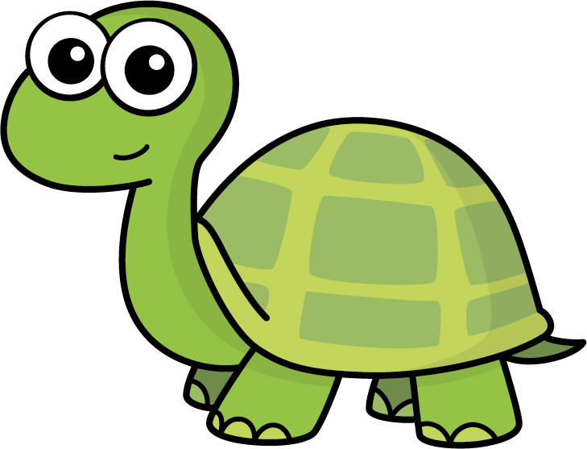
A
7 cm
B
10 cm
My line is longer than A but shorter than B
How long could Tiny’s line be?
8 cm
Have a think
or 9 cm

Slide 13
How long is the line?
The line is 5 cm long to the
nearest centimetre.

Slide 14
How long is the line?
The line is cm long to the
nearest centimetre.
10
Have a think

Slide 15
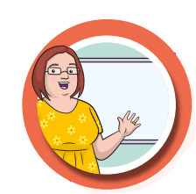
Measure the lengths of two objects in your classroom using a ruler.
The is cm long to the
nearest centimetre.
Which object is shorter?
Which object is longer?

