Slide 1
Friday 7th January

Slide 2
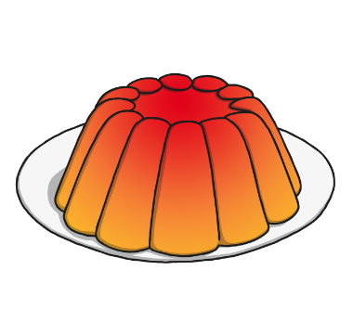
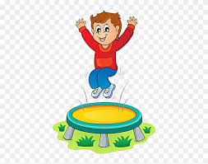
Phonics - Phase 3
Look at the pictures…
jelly jump jug
Look at the labels for these pictures, can you say the words aloud?

Slide 3
Our phoneme today is…
j
Can you use your magic finger to write the letter in the air or on someone’s back?

Slide 4
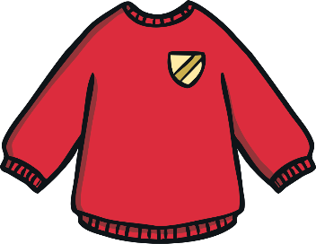
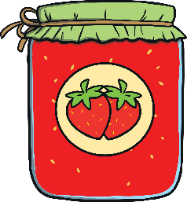
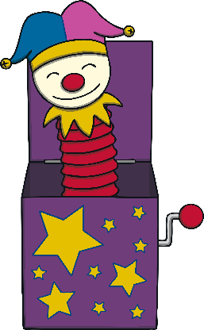
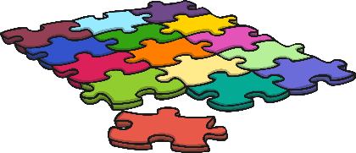
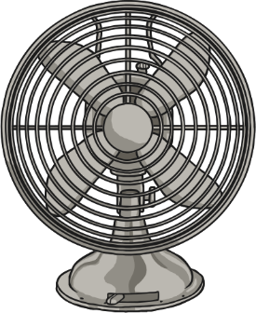
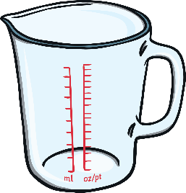
Click the pictures that begin with ‘j’ to move them into the middle.
j

Slide 5
Have a go at writing these words:

