Slide 2
Select a Game
Find the Blue Clothes
Find the Red Clothes
Find the Yellow Clothes
Find the Green Clothes
Find the Orange Clothes
Find the Purple Clothes
Find the Stripy Clothes
Find the Spotty Clothes
Find the Zigzag Clothes

Slide 3
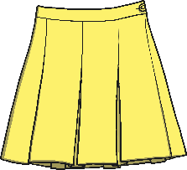
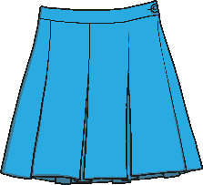
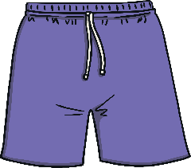
Find the Blue Clothes
Select Another Game

Slide 4
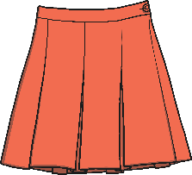
Find the Red Clothes
Select Another Game

Slide 5
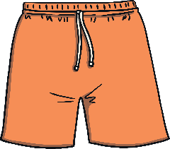
Find the Yellow Clothes
Select Another Game

Slide 6
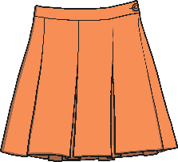
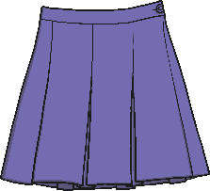
Find the Green Clothes
Select Another Game

Slide 7
Find the Orange Clothes
Select Another Game

Slide 8
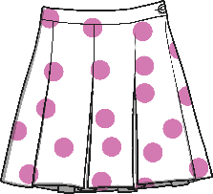
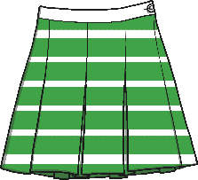
Find the Purple Clothes
Select Another Game

Slide 9
Find the Stripy Clothes
Select Another Game

Slide 10
Find the Spotty Clothes
Select Another Game

Slide 11
Find the Zigzag Clothes
Select Another Game

