Slide 1
Monday 25th January

Slide 2
Phonics - Phase 3
Can you remember the phonemes that we have learned?
See how quickly you can move through the slides saying each phoneme out loud.

Slide 3
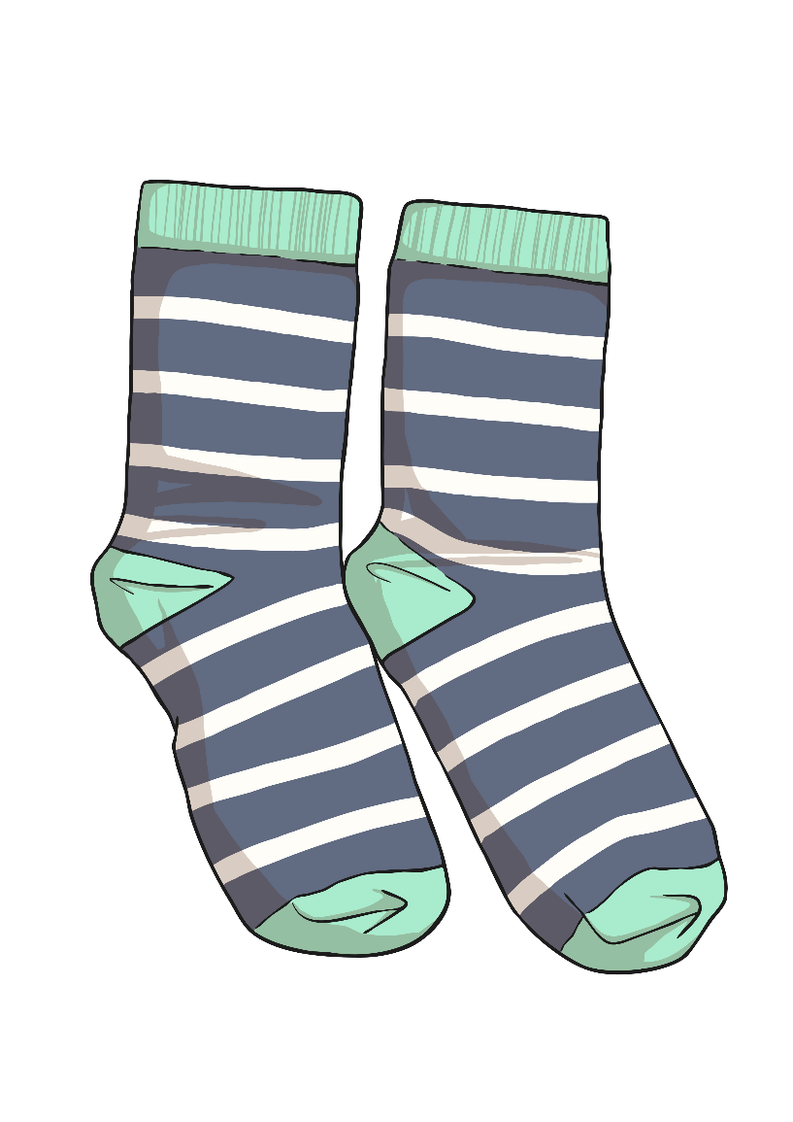
s

Slide 4
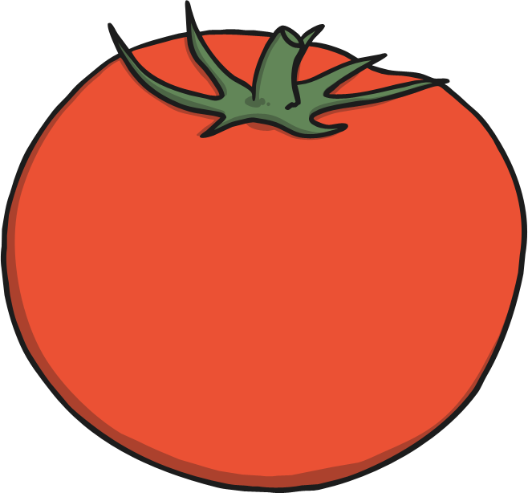
t

Slide 5
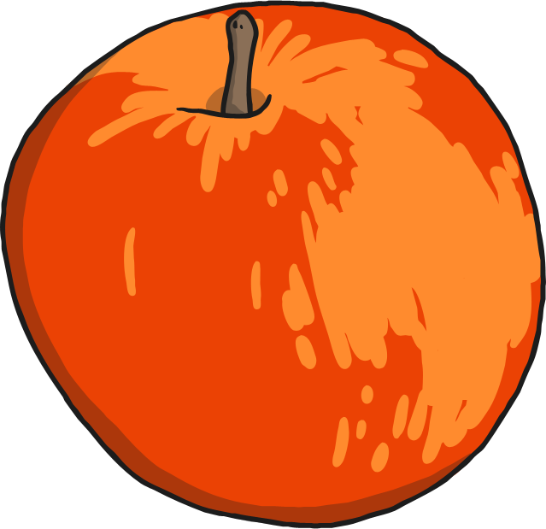
a

Slide 6
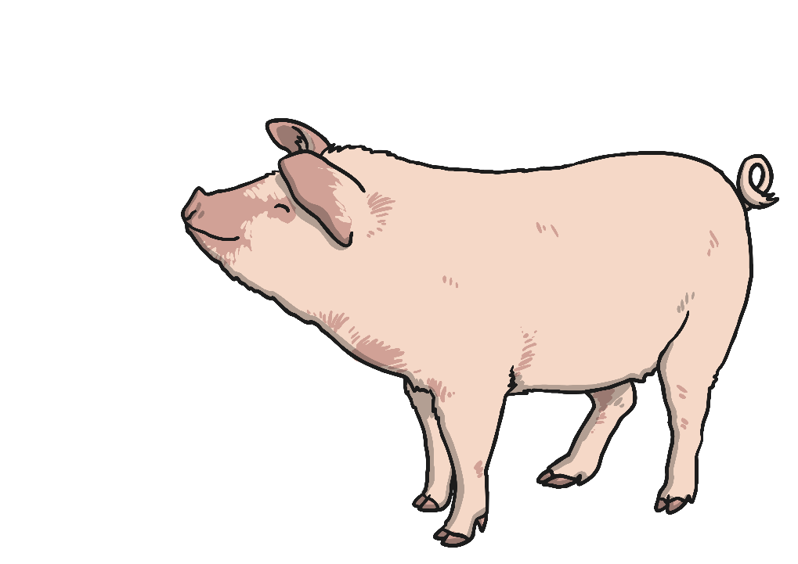
p

Slide 7
i

Slide 8
n

Slide 9
m

Slide 10
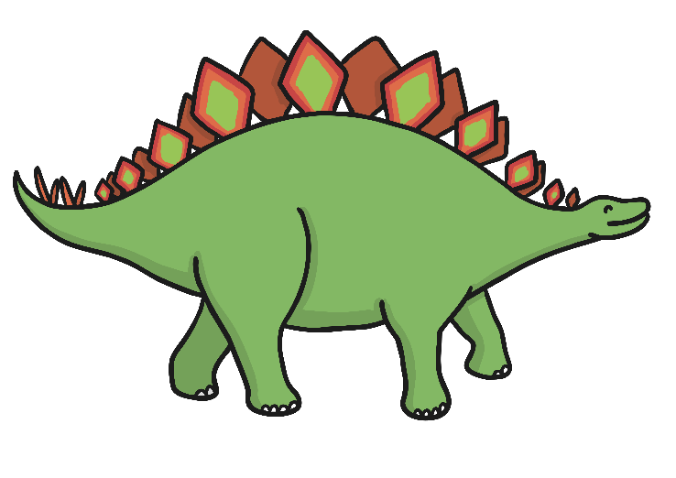
d

Slide 11
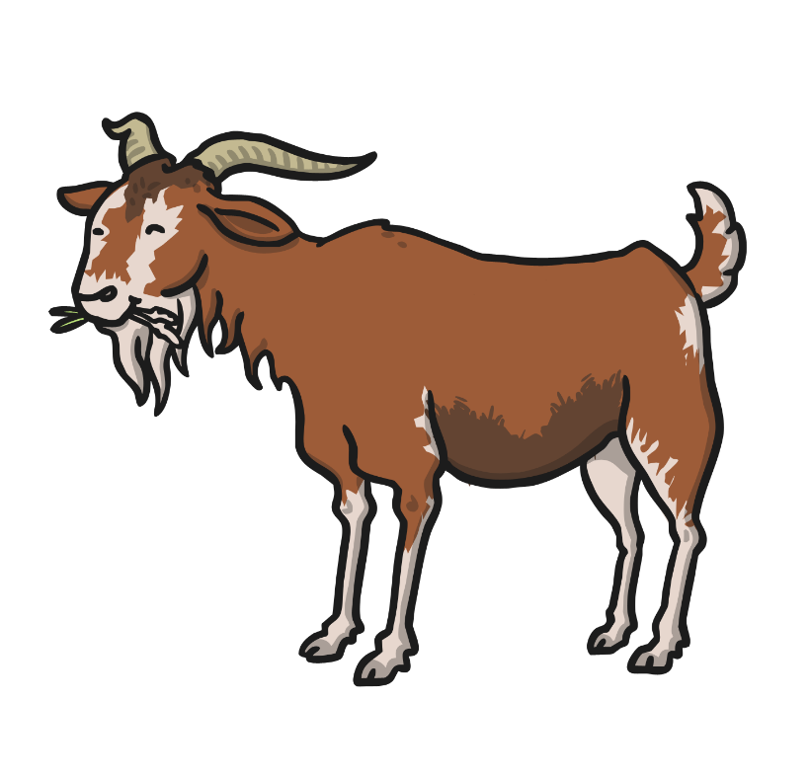
g

Slide 12
o

Slide 13
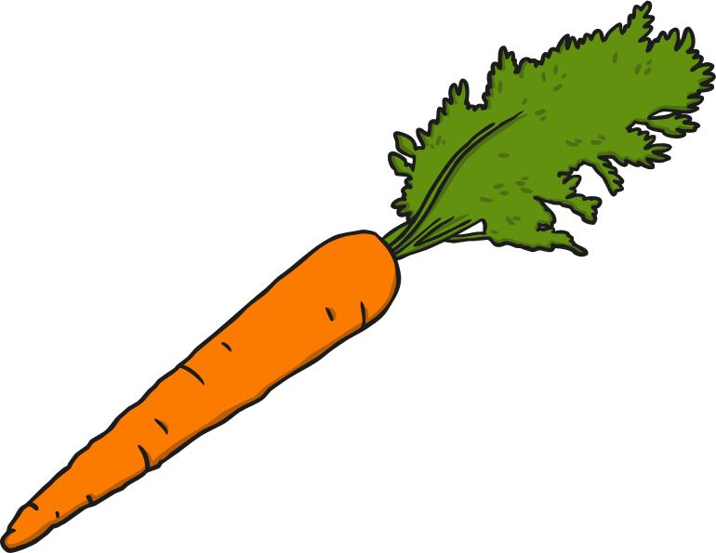
c

Slide 14
k

Slide 15
ck

Slide 16
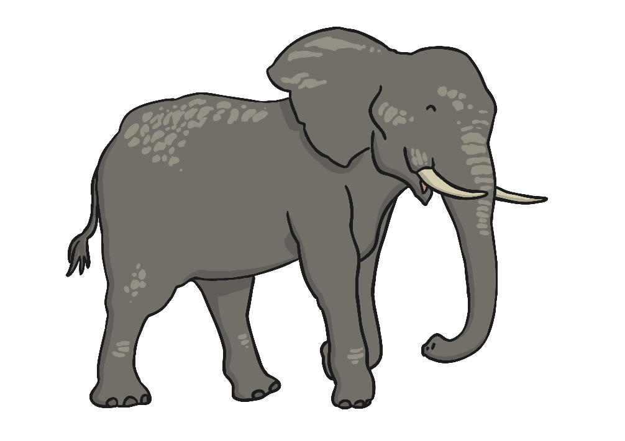
e

Slide 17
u

Slide 18
r

Slide 19
h

Slide 20
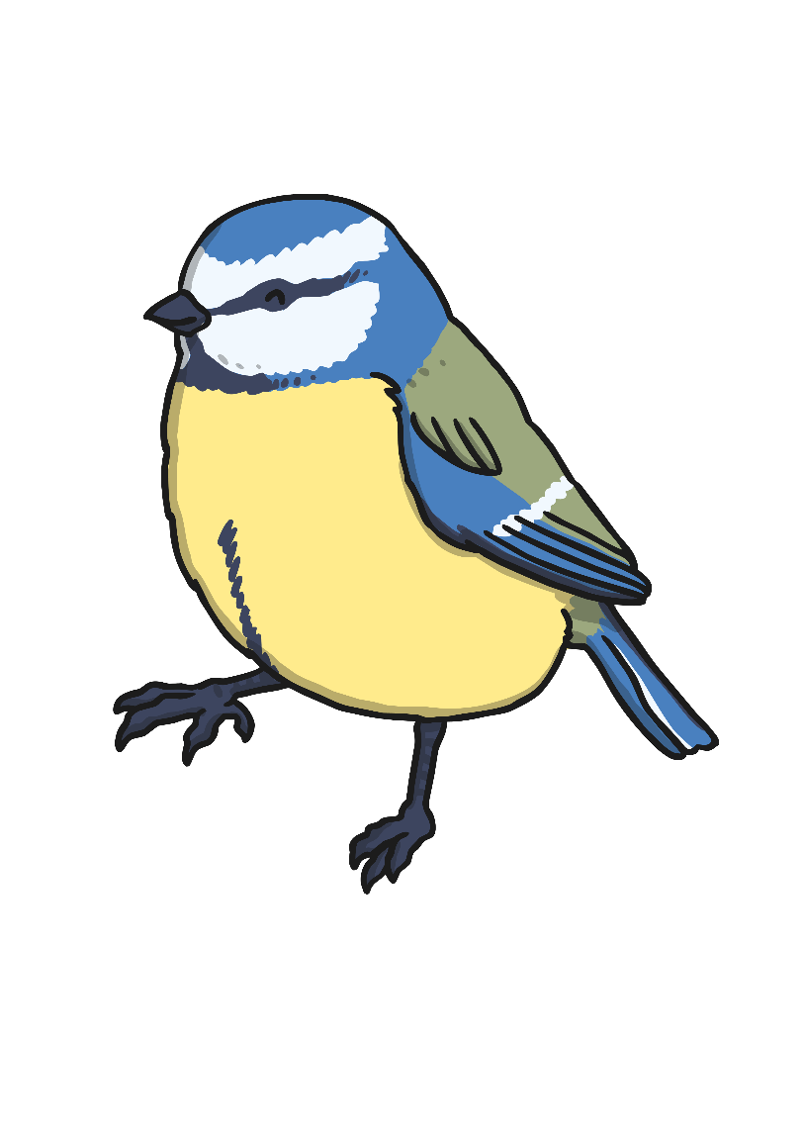
b

Slide 21
f

Slide 22
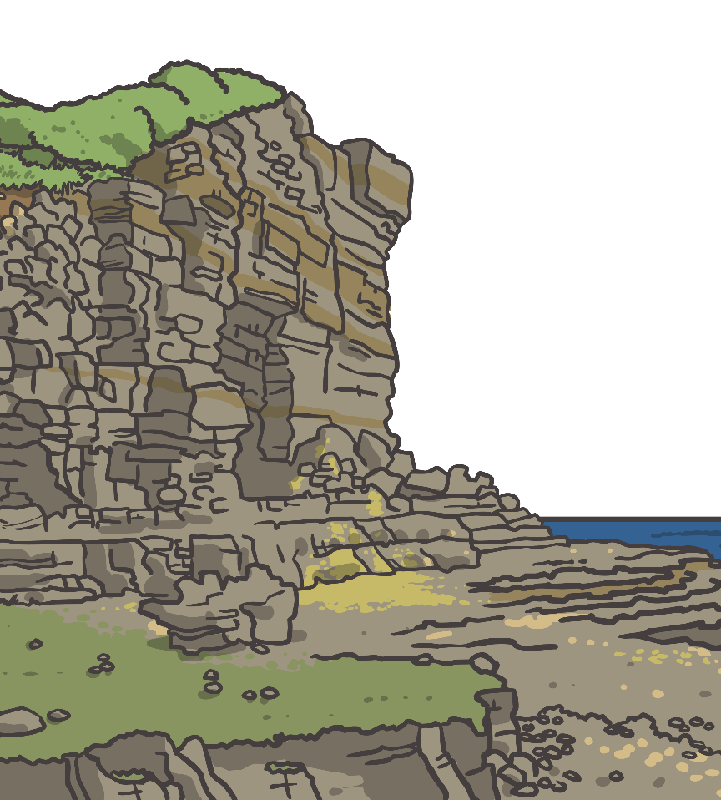
ff

Slide 23
l

Slide 24
ll

Slide 25
ss

Slide 26
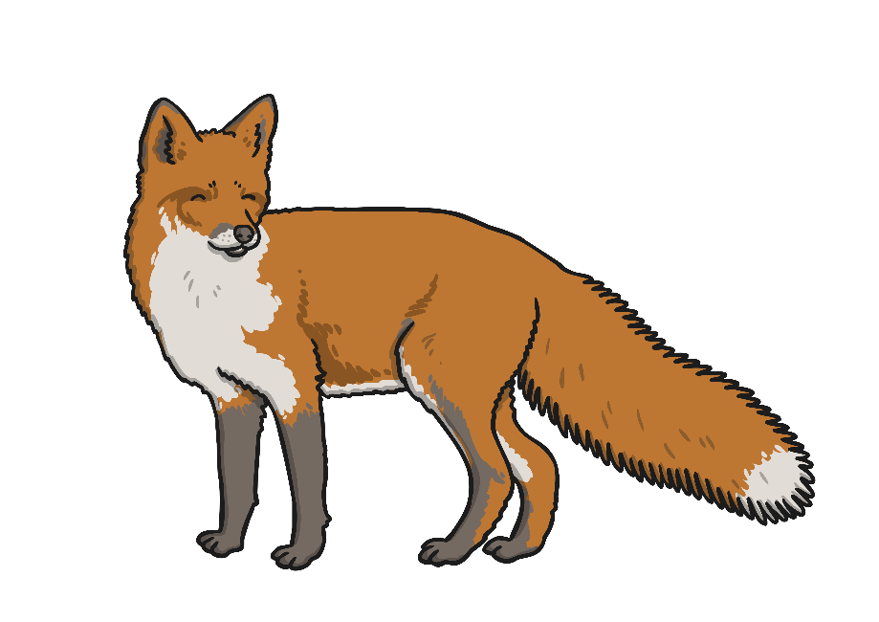
x

Slide 27
j

Slide 28
v

Slide 29
w

Slide 30
y

Slide 31
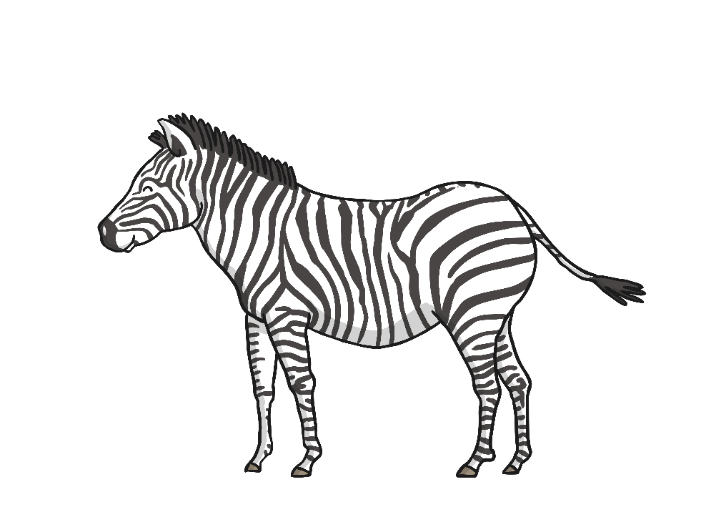
z

Slide 32
zz

Slide 33
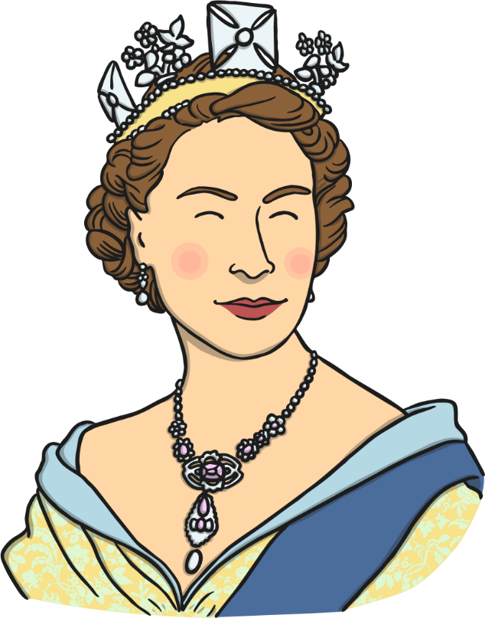
qu

Slide 34
sh

Slide 35
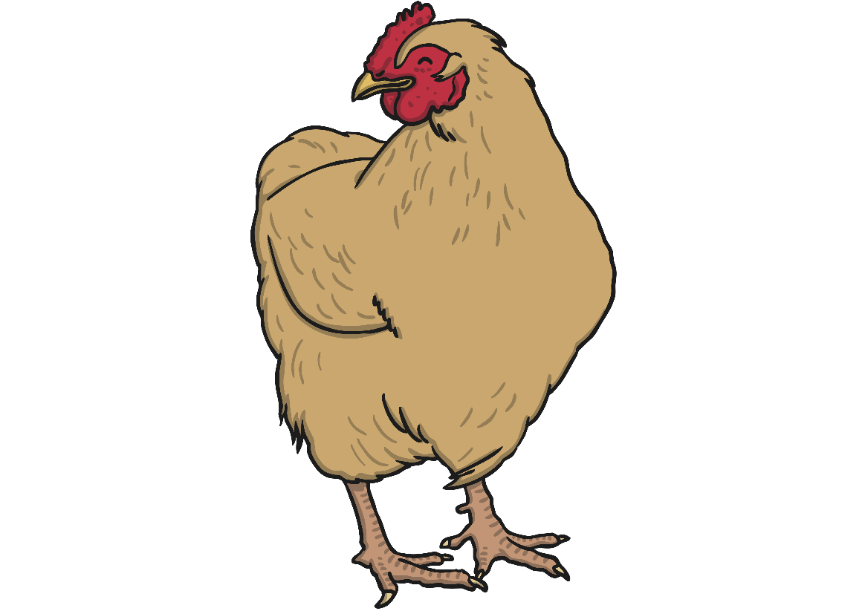
ch

Slide 36
th

Slide 37
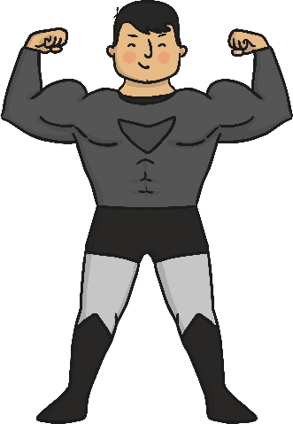
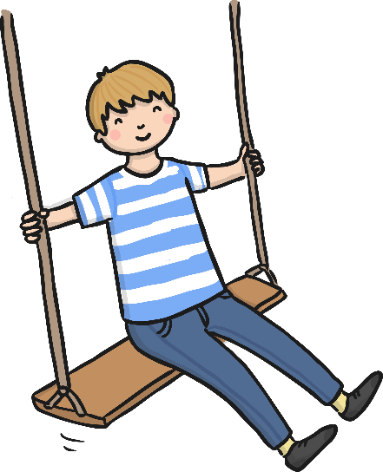
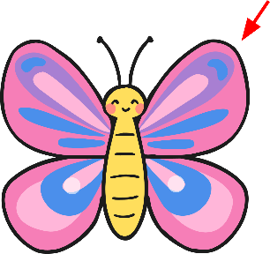
Phonics - Phase 3
Can you guess what our phoneme is today?

Slide 38
Our phoneme today is…
Can you read the ‘ng’ words?
song
ring
ng
long
hang

Slide 39
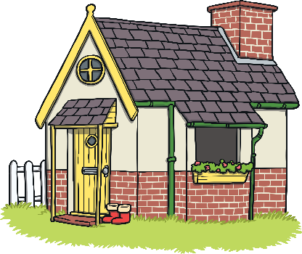
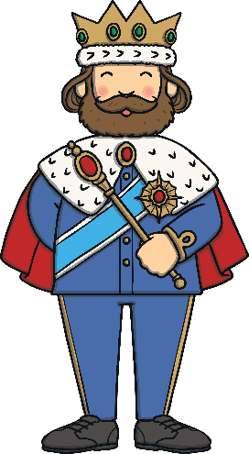
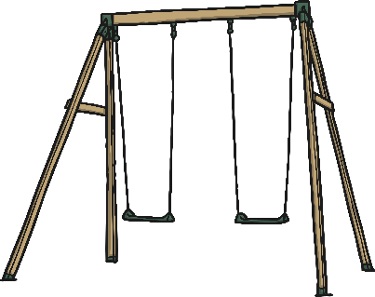
Click the pictures that contain ‘ng’ to move them into the middle.
ng
x
x

Slide 40
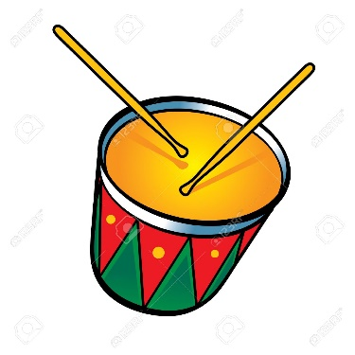
wing
king
rang
song
bang

