Slide 1
Learning together with Teams
Federation of Grewelthorpe and Fountains C of E Primary School

Slide 2
What does my child need to sign into their Microsoft 365 account?
Students and educators at eligible institutions can sign up for Microsoft 365 Education for free. Students can log into their school accounts at mail365, where they’ll have access to Microsoft Teams. They can also download the Teams App.

Slide 3
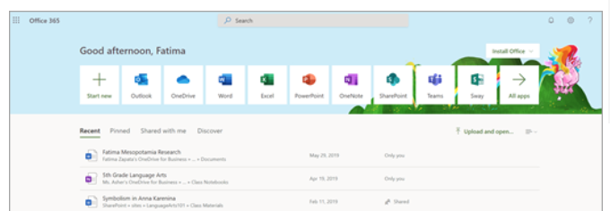
Quick start guide
1. Open mail365 and sign in with your school email and password which can be found in your child’s home learning book..

Slide 4
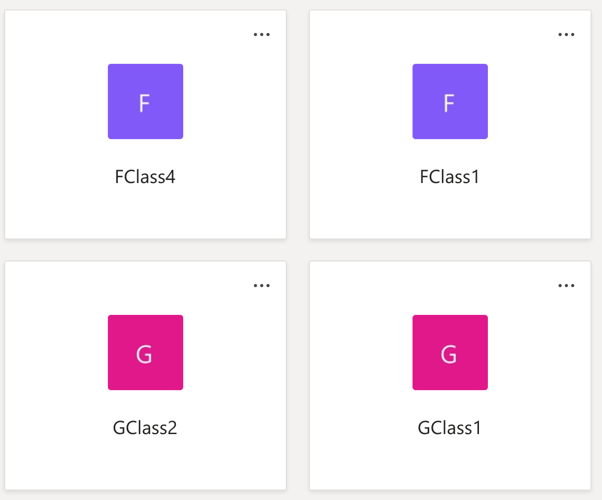
2. From your mail365 homepage, click on TEAMS app to open in your browser.
3. Select your class team tile.

Slide 5
Communication
We will be using Teams to do a daily catch up with class groups. It will be an opportunity for teachers to provide some input and expectations for the day or to collect feedback from the children about the tasks they have been doing that day. You will be allocated a specific time slot so will need to be logged into Teams to join the call.

