Slide 1
o
Let’s recap yesterday’s sound. Can you remember which two letters make our new sound? Click to see if you’re right.
w

Slide 2
‘Ow’ Sentences
Robot-talk and blend these words, then match the pictures with the words.

Slide 3
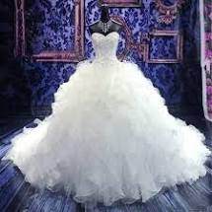
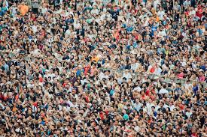
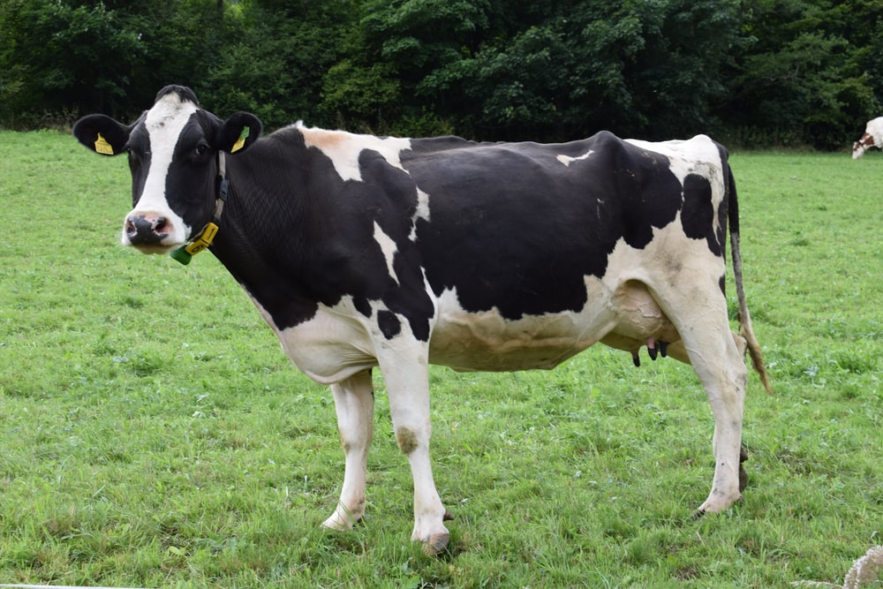
c
ow
c
ow
d
r
g
ow
n
c
ow
n
r

Slide 4
‘Ow’ Sentences
Can you read these ‘ow’ sentences?

Slide 5
g
n
ow
c
ow
i
A
n
a

Slide 6
The
clown
h
s
a
a
frown

Slide 7
c
The
f
n
go
up
l
t
i
a
nd
down
a

Slide 8
‘Ow’ Sentences
Now try these these next sentences. They include other digraphs too. Can you remember these sounds? Think of a word you know with these sounds in.
igh
th
ee

Slide 9
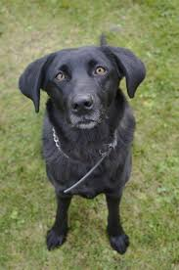
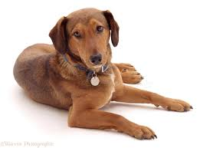
c
Which picture matches with this silly sentence?
see
a
n
I
a
brown
d
o
g

Slide 10
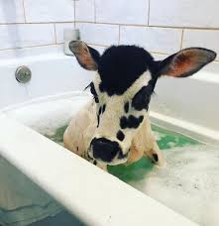
is
Which picture matches with this silly sentence?
A
cow
in
the
b
th
t
night
a
a

Slide 11
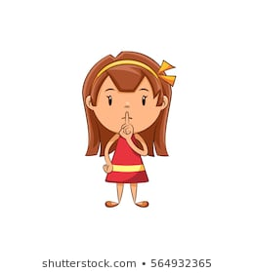
‘Ow’ Sentences
Now write your own short, silly sentence, including at least one ‘ow’ word.
Start your sentence with:
I can see a… OR A cow is…
Try not to copy your sentence – use your robot-talking to write the sounds
that you hear. Don’t forget……
Captain Capital
Suzie Finger-space
Freddie Full-stop

